Slide 1
Aggie Blue Parking
Group 9 - Spencer Hanson, Sarah Jones, Andrew Jouffray, & Kevin Thomas

Slide 2
Overview

Slide 3
Renting a spot
Space Rental (requirements definition)
3.4.1 Description:
Renters should be able to make their spot available during events that they choose so that others may reserve it.
3.4.2 Stimulus/Response Sequences:
Parking space owners may select to rent out their space for particular events on the calendar by selecting the option on the event in the calendar or in the event info.
3.4.3 Functional Requirements:
SR-1: Set up button to list rental space as available
SR-2: List spot as available in database for that date/time
SR-3: API endpoint to manage space availability
Notes:
Here is the first written record of the spot rental requirement in this project, it’s well defined and was implemented accordingly, the only difference is the Owner cannot decide which spots are available for each event, all spots are available by default.

Slide 4
Renting out a spot
FURPS: Functionality: A user can rent a desired parking spot, be charged for it and receive a confirmation code. Usability: All available parking spot and pricing must easily be viewable and selectable. Reliability: We cannot afford two users renting the same spot, the system must only allow available spots to be rented Performance: System should be very efficient, and should retrieve information from the database quickly. Supportability: All the documentation about the API should be clear and concise, the code readable. | MOSCOW: Must: Users must be able to view available parking and rent it. Must: System should debit money from user into the owner’s account. Must: System doesn’t allow users to rent the same space twice. Should: System should display a confirmation of the rental. Could: System lists the parking spots from closest to furthest. Won’t: Display a photo of the parking spot. | Audience Oriented: Business: Enables the transactions to be made on the platform. User: Allows users to rent a spot for an event easily and quickly. Functional: Retrieve available spots from a database and display them to the user along with price. Nonfunctional: System must handle multiple users renting spots at the same time, without conflict. Implementation: Get all parking spots who do not have a rental associated with them on the same date as a given event, and return them to the front end.
Notes:
You can read those out if you want but the most important part was to make sure spots could not be rented twice, this is why it appears in all of those requirement gathering methods. The system does that in two ways, first it does not display spots that are rented out on the same date as the event, even if it was for another event, secondly when renting the spot, the system again checks to make sure the spot is available and will return an error if not.

Slide 5
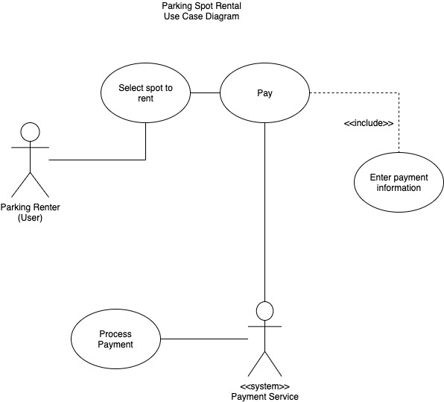
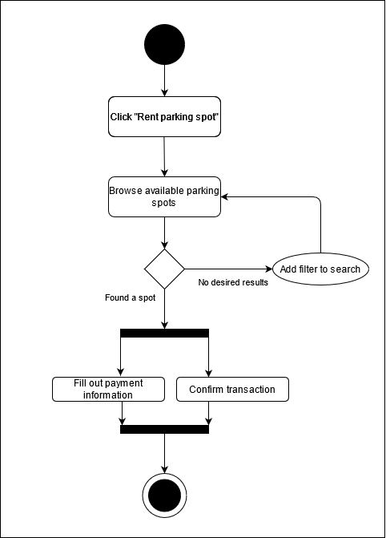
Renting a spot
Notes:
These diagrams are quite simplified but they cover all the basics of the process, they were created during milestone 1 and 2.

Slide 6
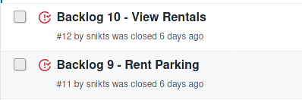
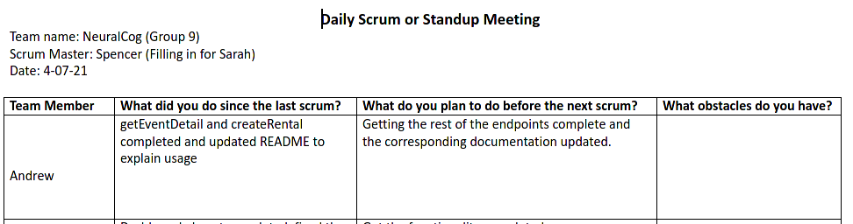
Renting a spot
Backlog related to the requirement
Notes:
Here we can see the progress tracking of the development of this requirement through the scrum meetings and the github issue backlog (not super interesting)

Slide 7
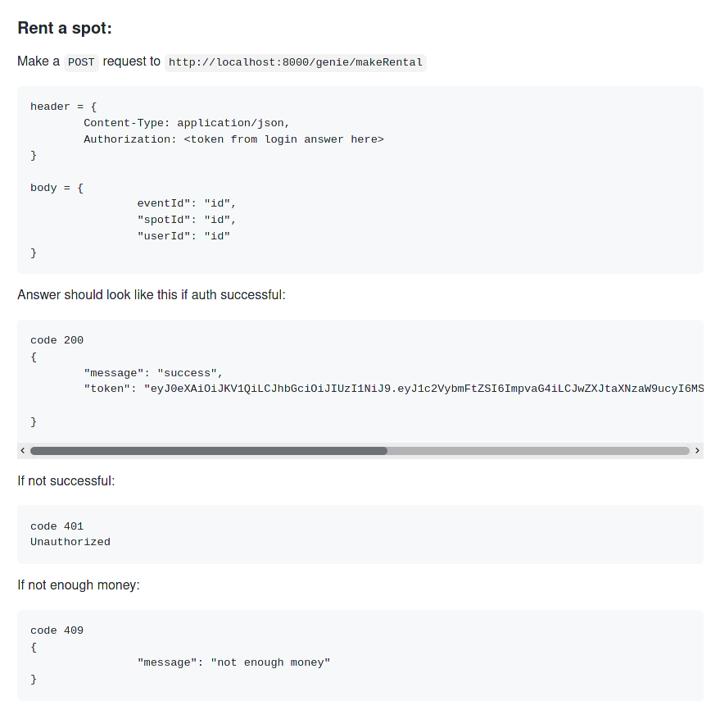
Renting a spot testing instructions and documentation
Handles:
Conflict avoidance
Transaction
Allows the same spot to be rented on different dates
Creates rental authentication code
Notes:
This is found in the readme, it is the testing instructions copied directly from Postman, we did all out backend testing through postman making sure that the endpoint was robust, we tested with non-logged in user, user with no money and a user trying to rent out a spot twice or an already rented spot.

Slide 8
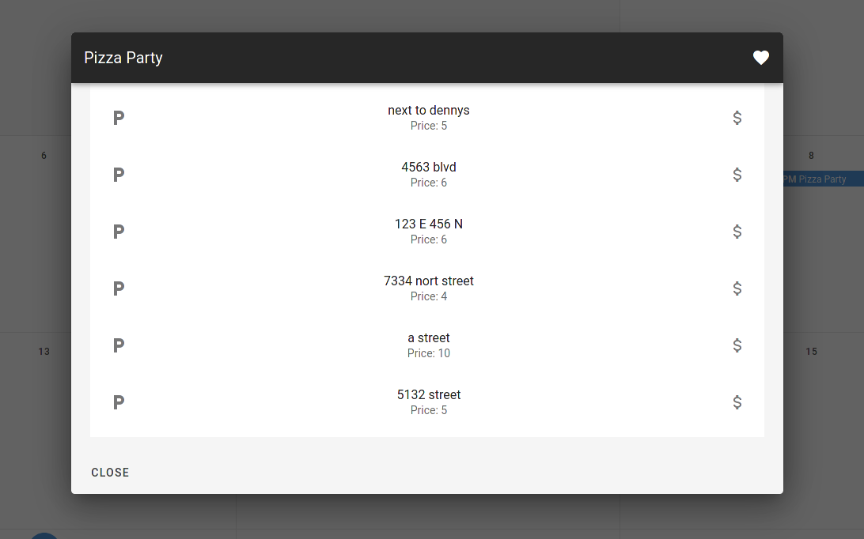
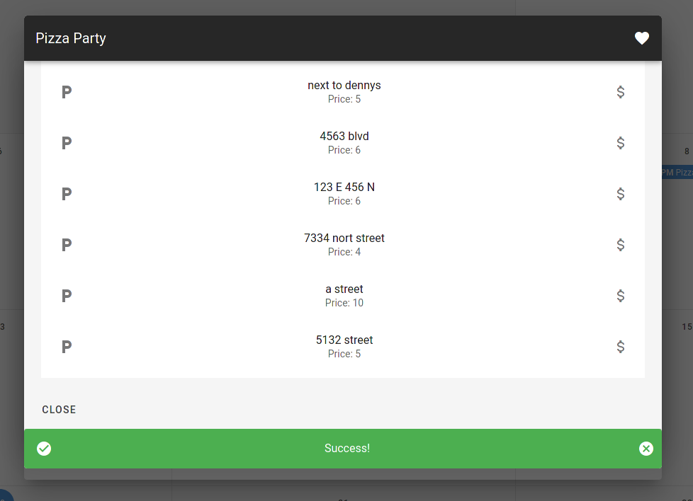
Renting a spot (screen shots)
Dynamic using interface showing confirmation of purchase to the user
Notes:
This is the clean interface developed for this requirement, it displays all the available spot for an event, it also confirms the purchase or notifies of an error if something happened.

Slide 9
Events
3.3 Event Scheduling
3.3.1 Description:
Supervisors should be able to create and notify people of events so that renters and rentees can schedule parking spaces accordingly.
3.3.2 Stimulus/Response Sequences:
When a supervisor wants to create an event, they can add it to the calendar and be presented with a form to enter in the applicable information such as date, time, location, etc.
3.3.3 Functional Requirements:
ES-1: Set up event creation form
ES-2: create event endpoint in API
ES-3: create event entries in database

Slide 10
Events Requirements Breakdown
FURPS: Functionality: Supervisor should be able to post events to database. Users should be able to view events and event details. Usability: Events should be clearly displayed and sorted by date. Event details should be easy to read. Reliability: Event viewing should be very reliable, and available 24 hours a day, 7 days a week. Performance: System should be very efficient, and should retrieve information from the database quickly. Supportability: Event fetching is easy to maintain, and code is easily tested through Postman. | MOSCOW: Must: System must allow user to see all events. Should: System should allow user to view event details when they click on the event. Could: System could allow user to be redirected to parking spots available for event. Won’t: System won’t allow event reservations. | Audience Oriented: Business: Give customer a way to list events, and manage parking for those events. User: Allow user to view events and their details. Functional: Retrieve events from database, display them, and allow them to be clicked for details. Nonfunctional: System must handle multiple users on the page, and must handle event posting while the view events page is in use. Implementation: Transfer currently scheduled events into database, list any pre-software committed parking as available for those events.
Notes:
For ease of developers and supervisors, we chose to make supervisors super users in the django database. This means they can log in through the django admin portal, which is where they create events. This allows supervisors to have a clear and separate portal that contains all the tasks they may need.
Reliability: If the page to view events and their details should go down, it should be less than an hour at a time, and less than five times total in a year. Any maintenance needed for the events page should be clearly communicated to the user before the maintenance occurs. If an error should occur when a user attempts to access the events page, it should be made clear to the user that the events page is currently down, and will be back up soon.

Slide 11
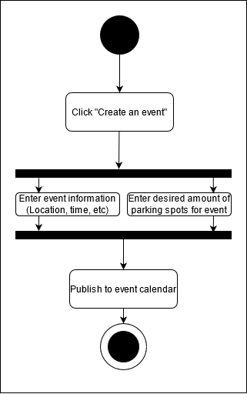
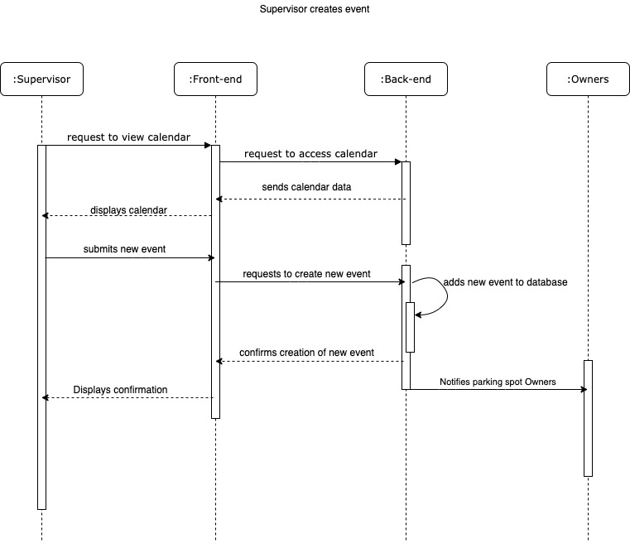
Events Modeling
Notes:
These were our initial UML diagrams. The event system evolved outside this slightly, as we did away with a developer created event posting system, and instead allowed supervisors to create events through the admin portal. However, much of this remains the same, regardless.

Slide 12
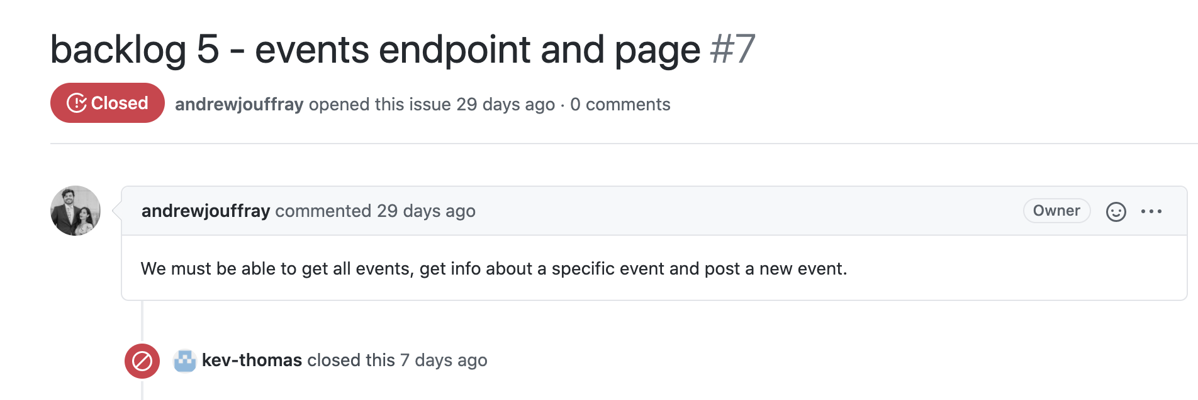
Events Backlog
Notes:
Andrew - get events endpoint, get event details endpoint
Sarah - create events endpoint (ultimately not used in favor of allowing supervisors to create events through django admin portal)
Kevin - events calendar page

Slide 13
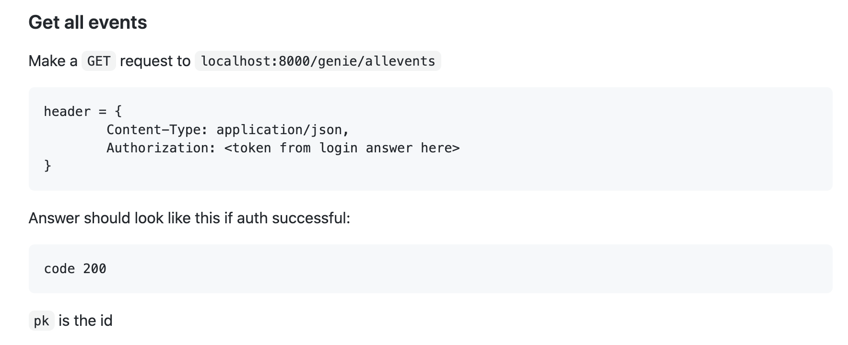
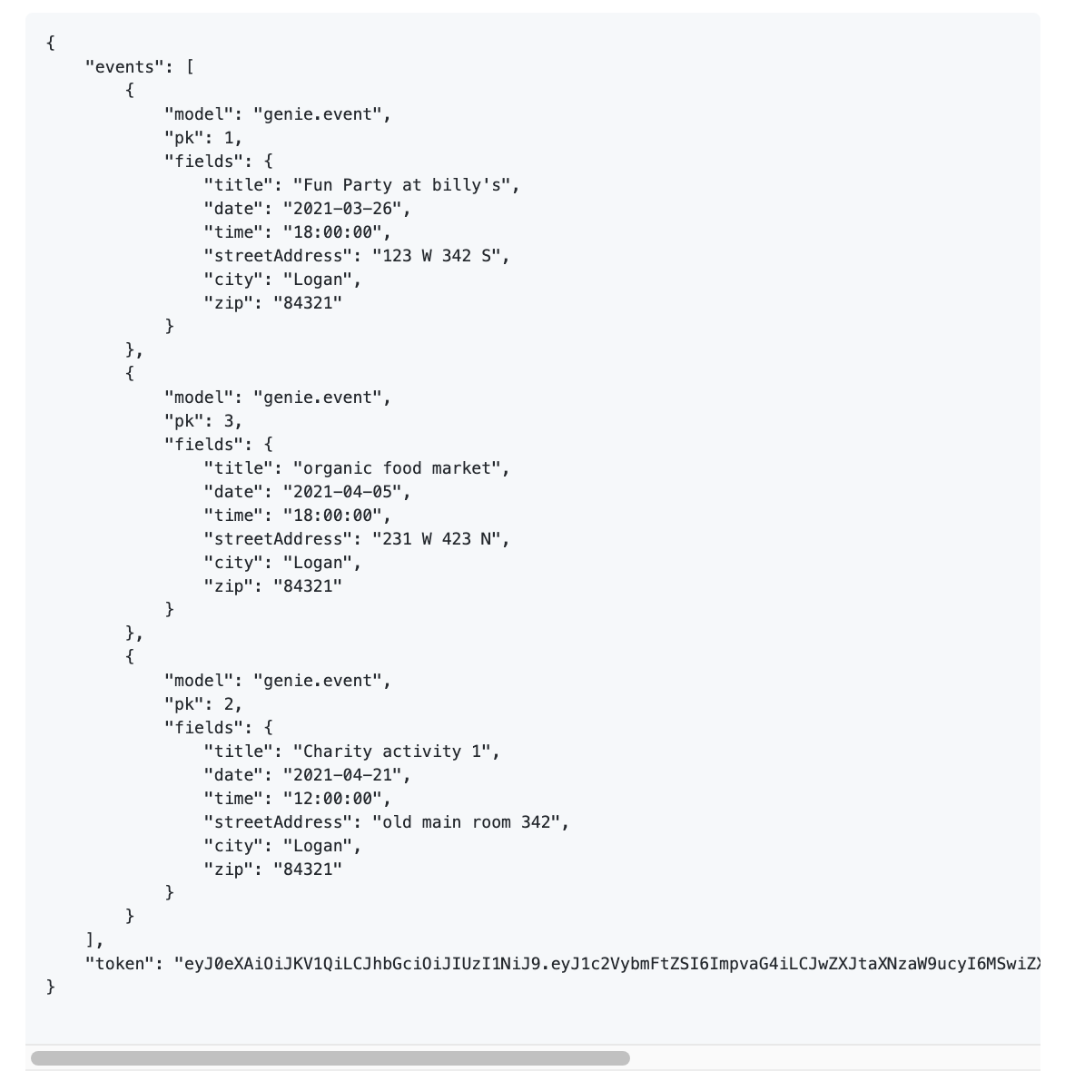
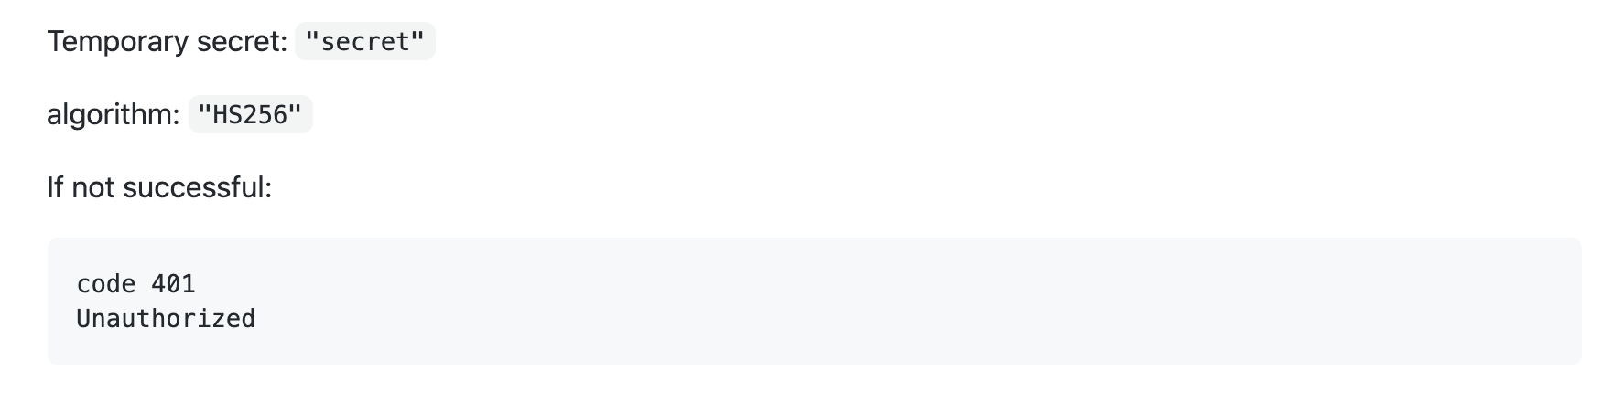
Events Testing
Notes:
Testing is done with Postman, by creating a request of this format. Will send as a JSON response with all events and details on a success. Anything else will flag as an Unauthorized response.

Slide 14
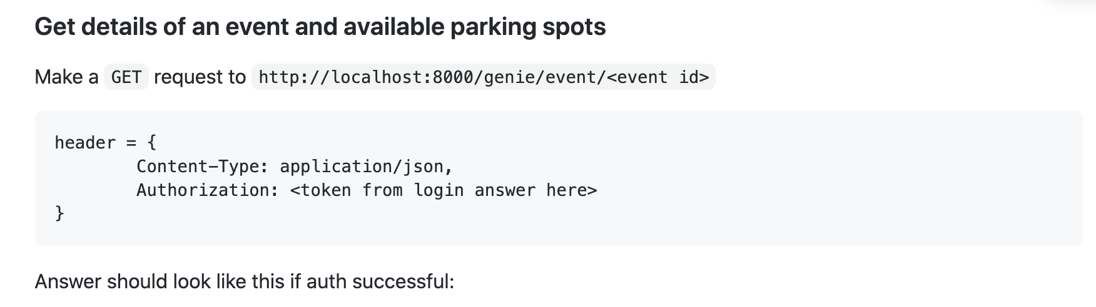
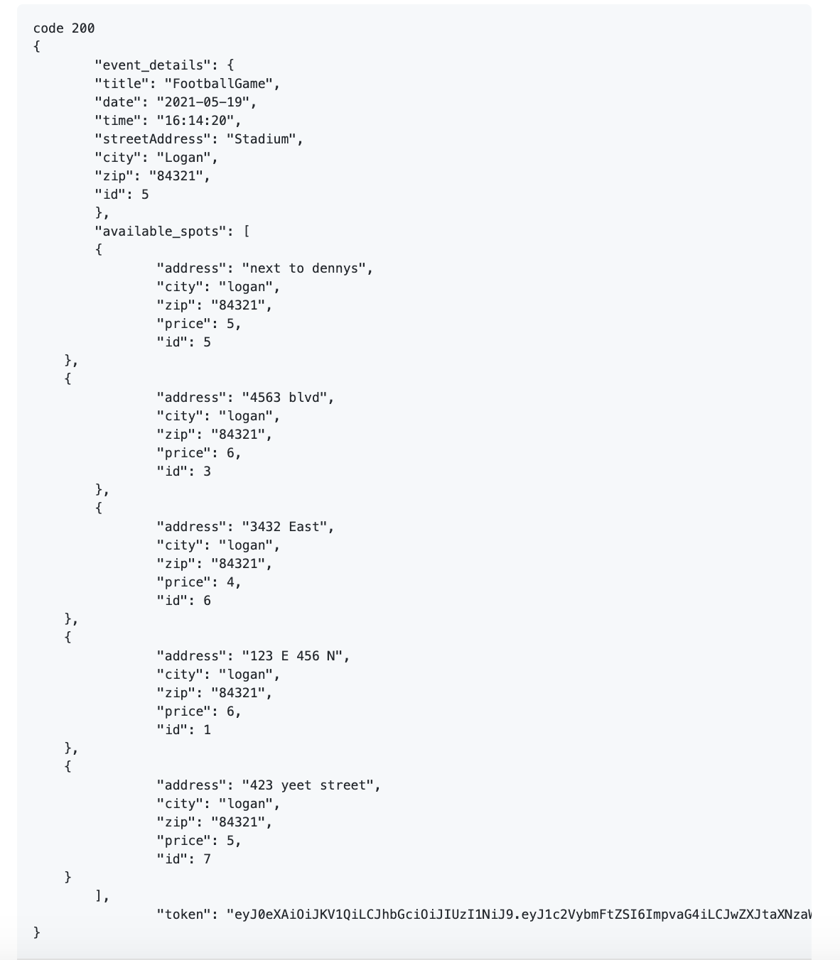
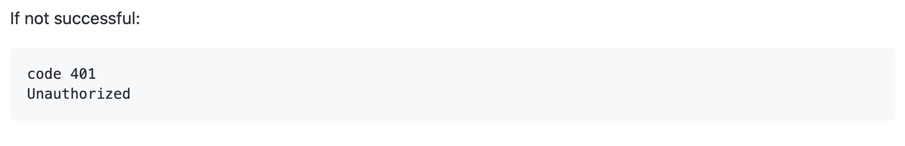
Events Testing
Notes:
Testing is done with Postman, by creating a request of this format. Will send as a JSON response with event, details, and available parking on success. Anything else will flag as an Unauthorized response.

Slide 15
User Registration and Login
FURPS: Functionality: Any person who visits the site must be a registered user to use any of the functionality Usability: A users’ account enables the action of viewing and/or renting parking spots for events Reliability: The users’ account is their main way of identifying themselves to the whole system, this must work in able for use of this system Supportability: JSON Web Tokens (JWT) is handy and able to track a users session, also giving the desired effects of only allowing registered users. | MOSCOW: Must: System must first check the user for valid login credentials. Should: System should allow any visitor to register as a renter at any time, given that they have unique credentials Could: System could give privileges to people who decide to put their own parking spots up for rental. Won’t: System won’t allow non registered users | Audience Oriented: Business: Enable customers to use the application to rent parking spots. User: Enables the user to access the functionality of the app. Functional: Backend sends an authorization token back to user to authenticate themselves in new session. Nonfunctional: The backend system must be able to correctly identify existing credentials and allow the creation of new users. Implementation: When correct credentials are passed to the backend (from frontend), send a JWT token to authenticate this user.

Slide 16
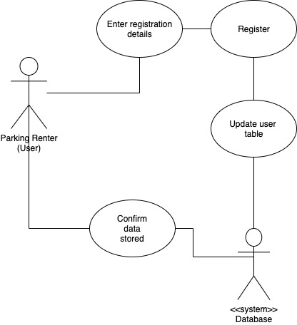
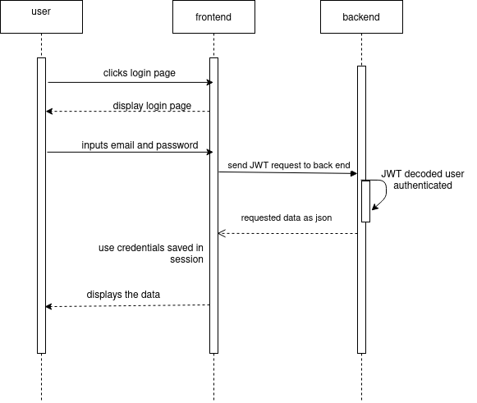
User Registration and Login

Slide 17
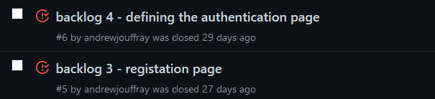
User Registration and Testing Backlog

Slide 18
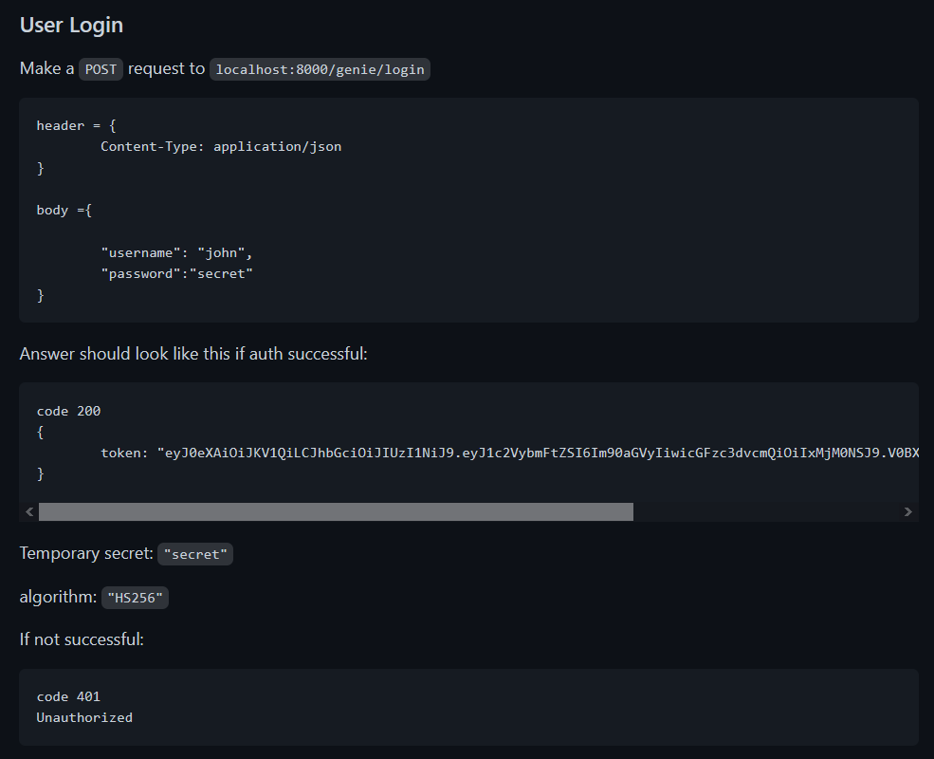
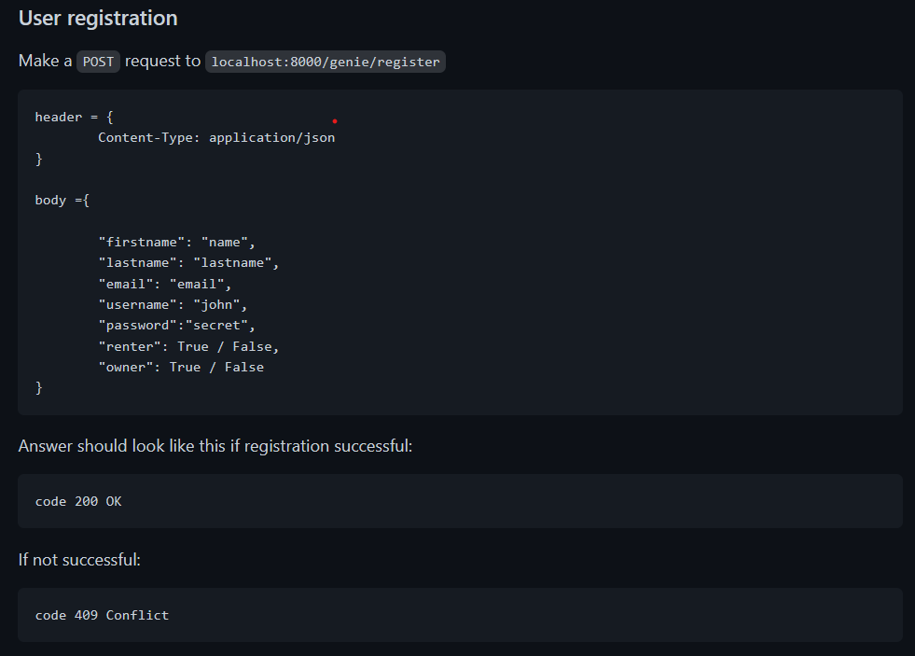
User Registration and Login Testing

Slide 19
Use Case Demos

Slide 20
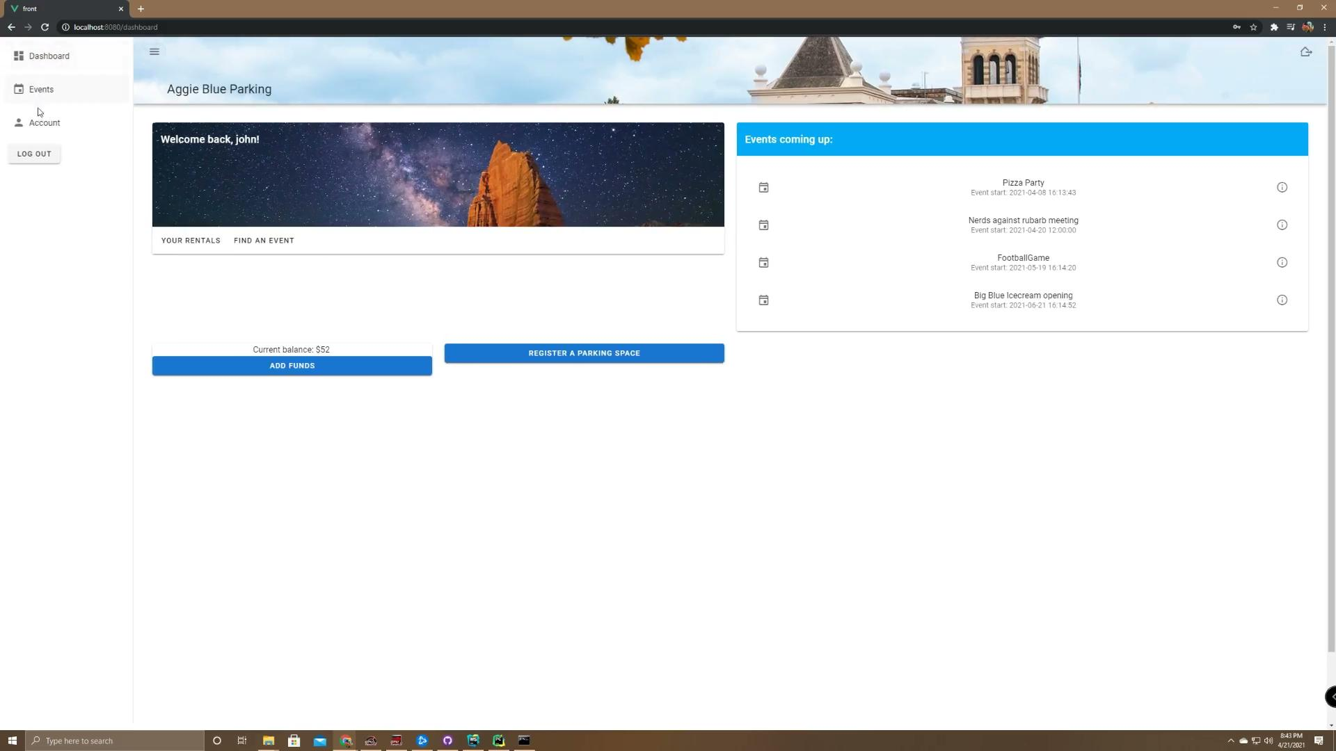
User Login

Slide 21
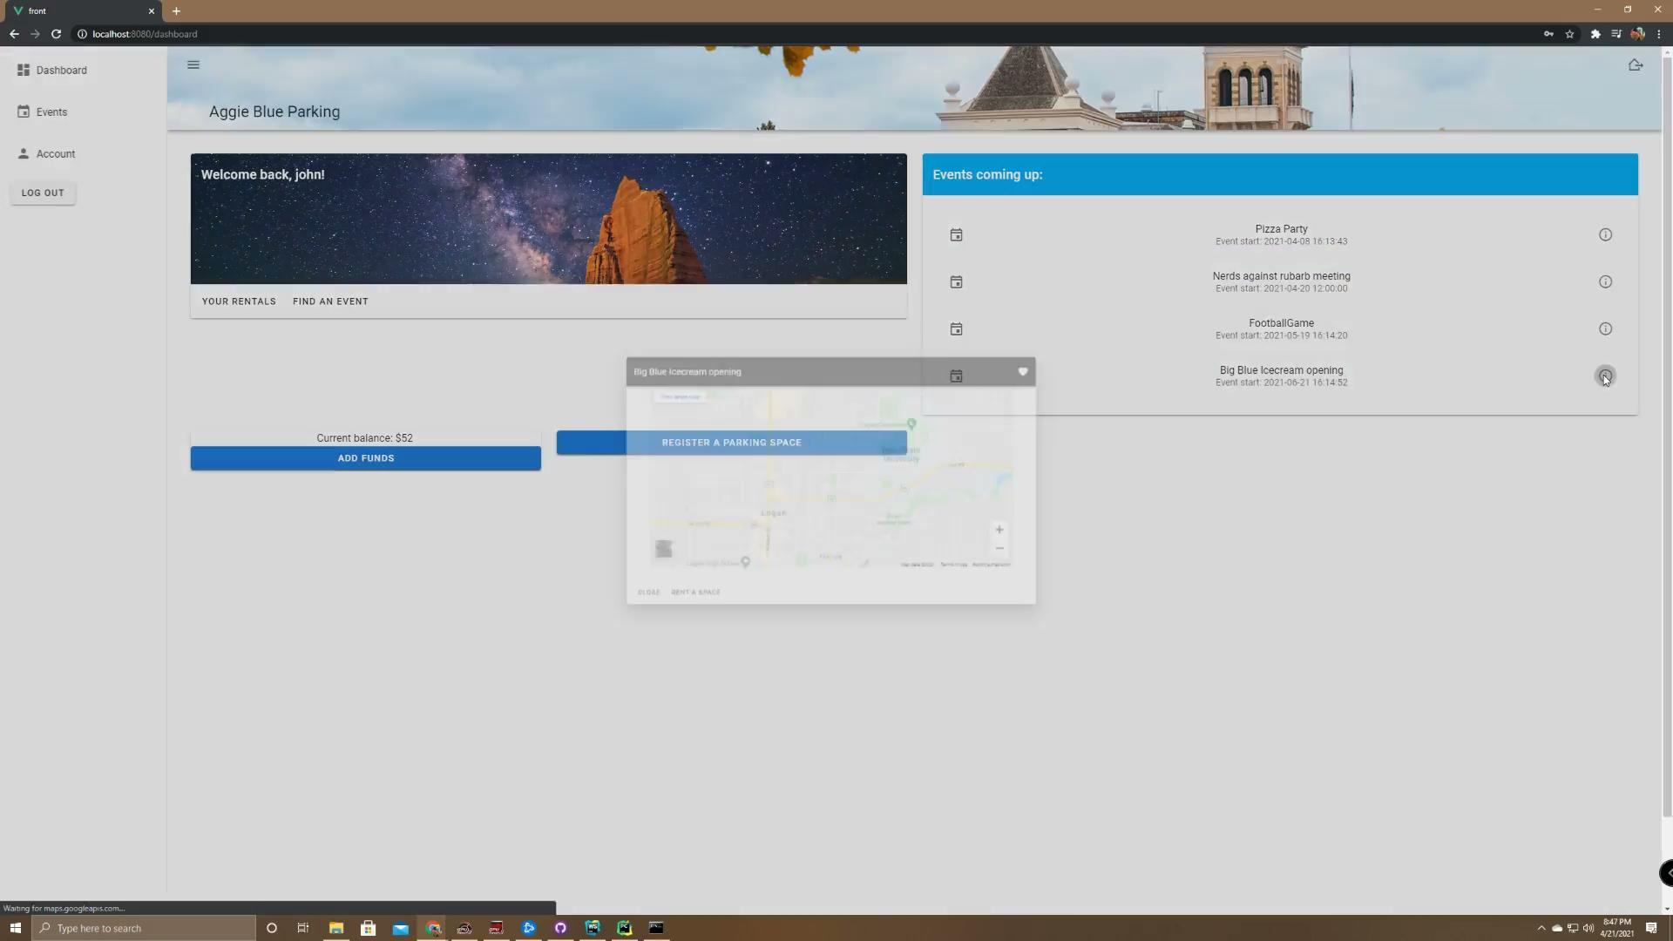
Rent a parking space for an event

Slide 22

User Registration

Slide 23
Add money to user account

Slide 24
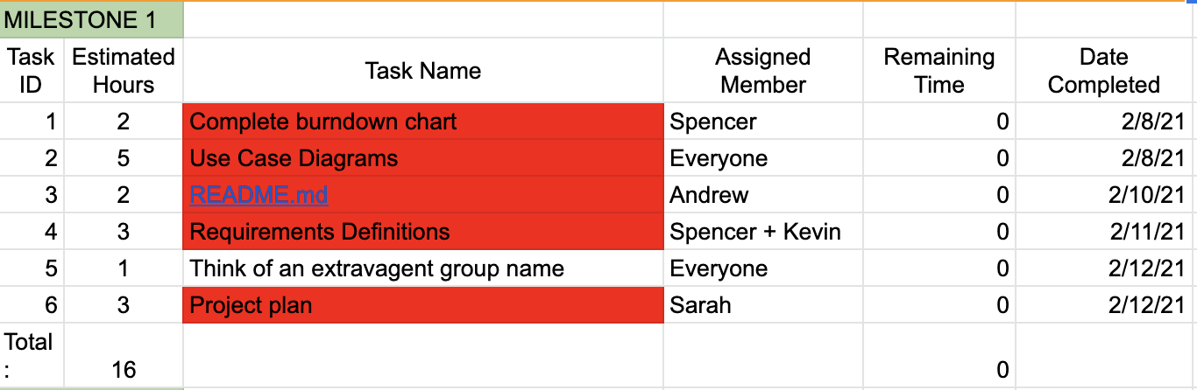
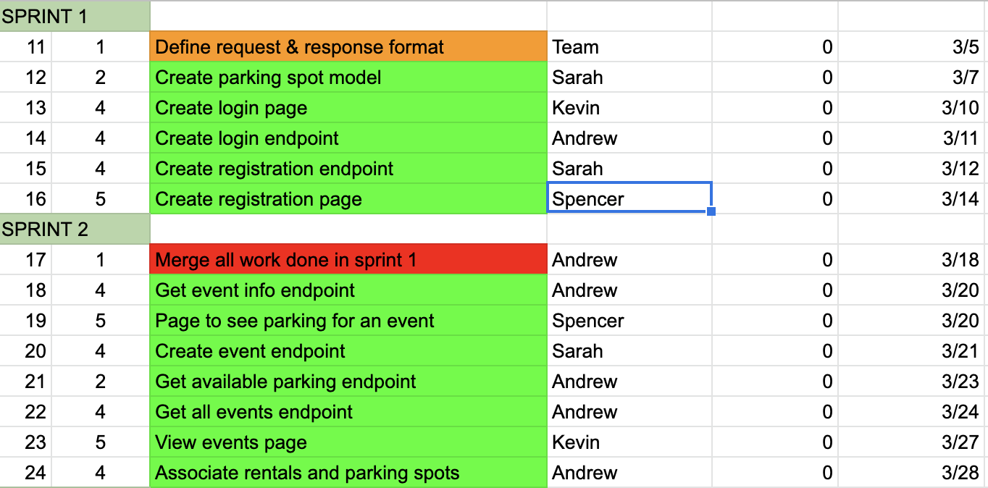
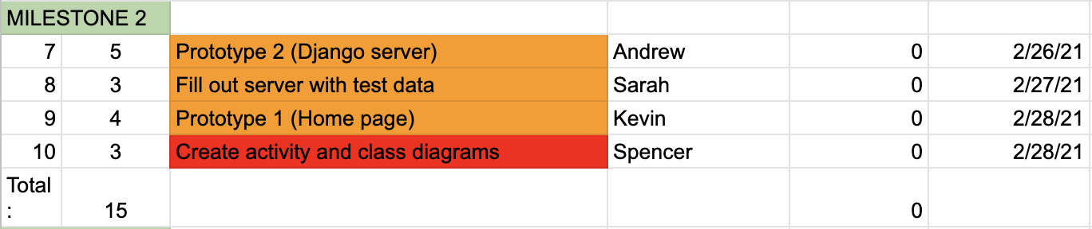
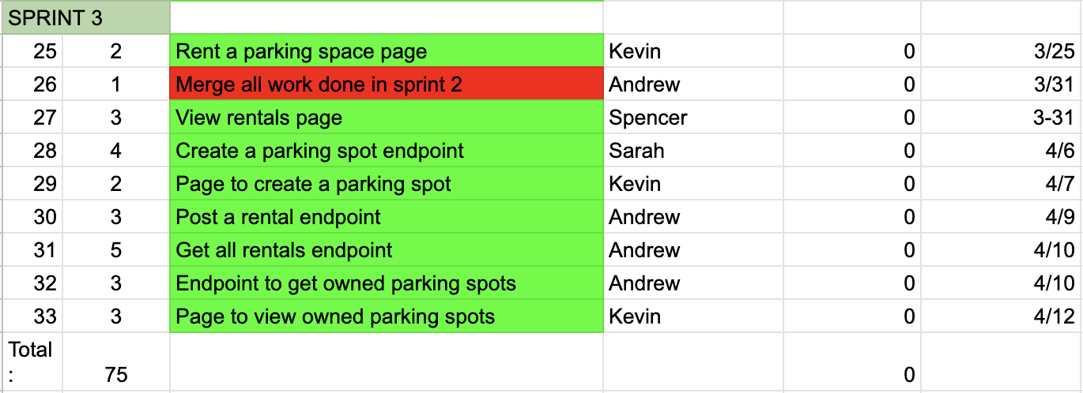
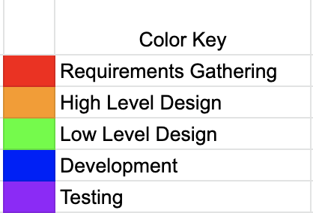
Final Burndown Chart

Slide 25
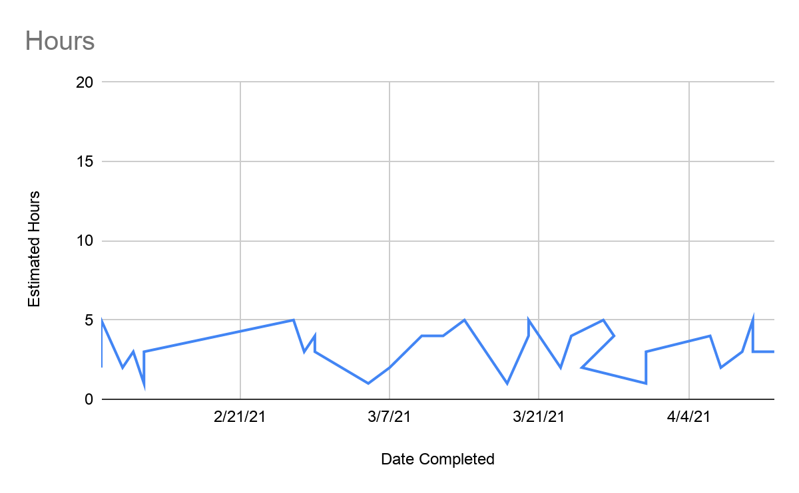
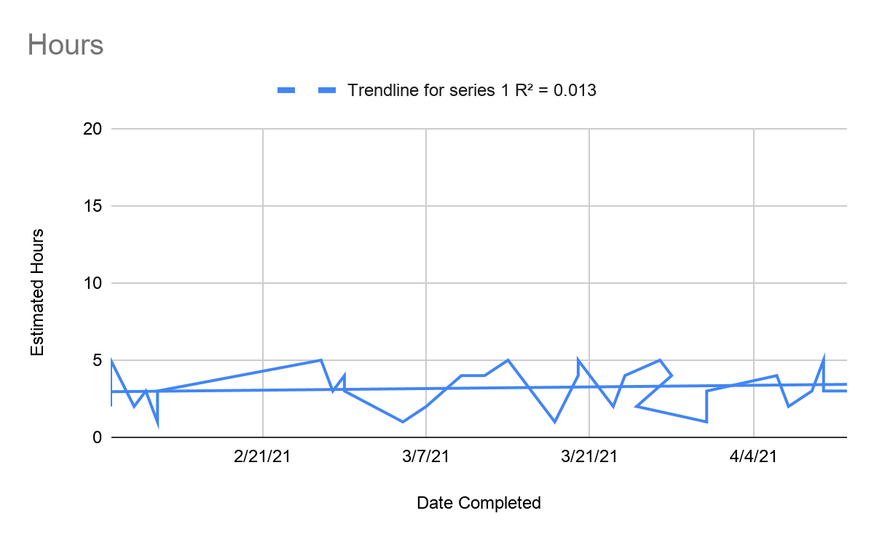
Final Burndown Chart

Slide 26
Questions?
Ferreira, V. (2018, January 25). vue-session. npm. https://www.npmjs.com/package/vue-session.
A Material Design Framework for Vue.js. Vuetify. (n.d.). https://vuetifyjs.com/en/.
Vue.js Documentation. - Vue.js. (2020, October 21). https://vuejs.org/v2/guide/.
You, E. (2021, April 18). Vue Router. Getting Started | Vue Router. https://router.vuejs.org/guide/.
Maximilian Schwarzmüller. Vuejs learning the basics. Academind.com.
https://academind.com/tutorials/vuejs-learning-the-basics/

