Slide 1

IOT Course
Final project
LunchBox
sophomore
110419009 Eric Hsu
110419008 Kevin Wang
110419027 Chun-Tzu Fang

Slide 2
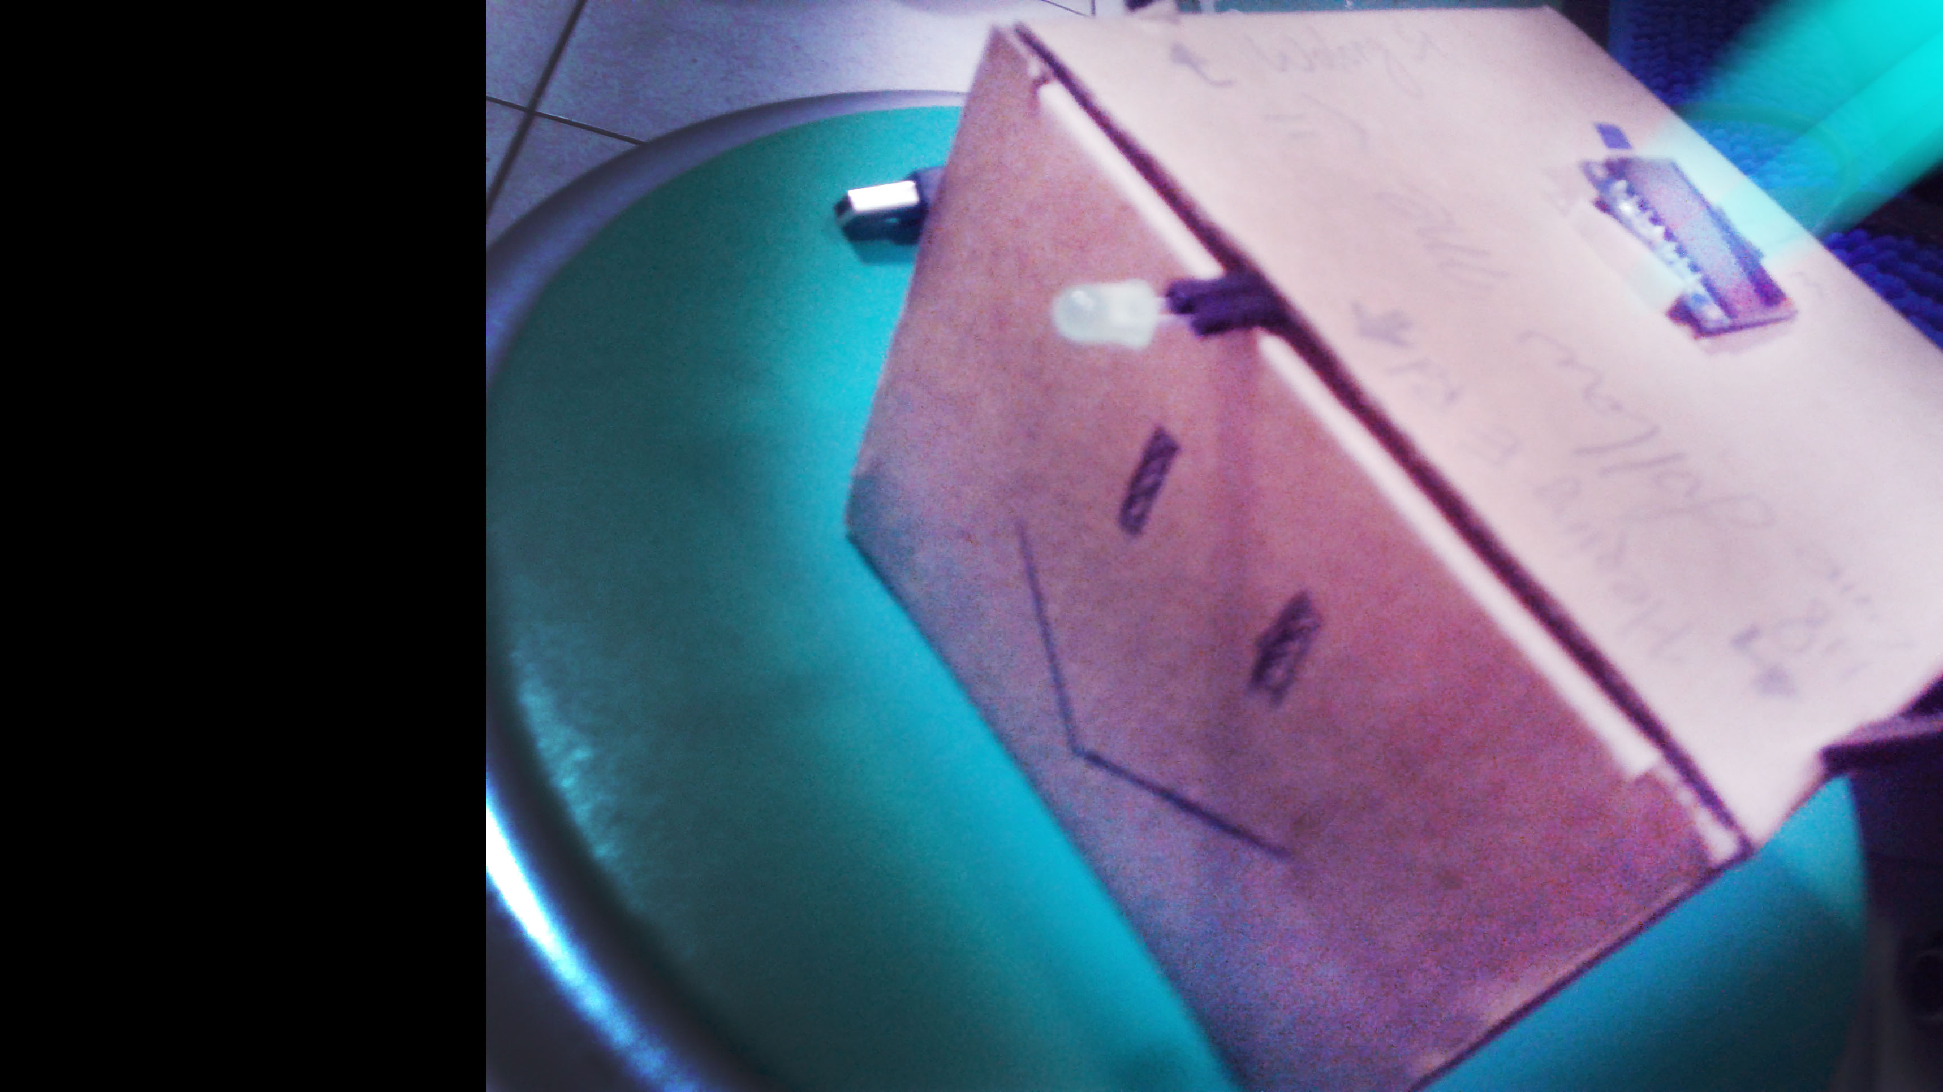
What is LunchBox?
Worried about your lunch?
If you are hesitant, TRY OUR LunchBox!
It will find the best choice for YOU!

Slide 3
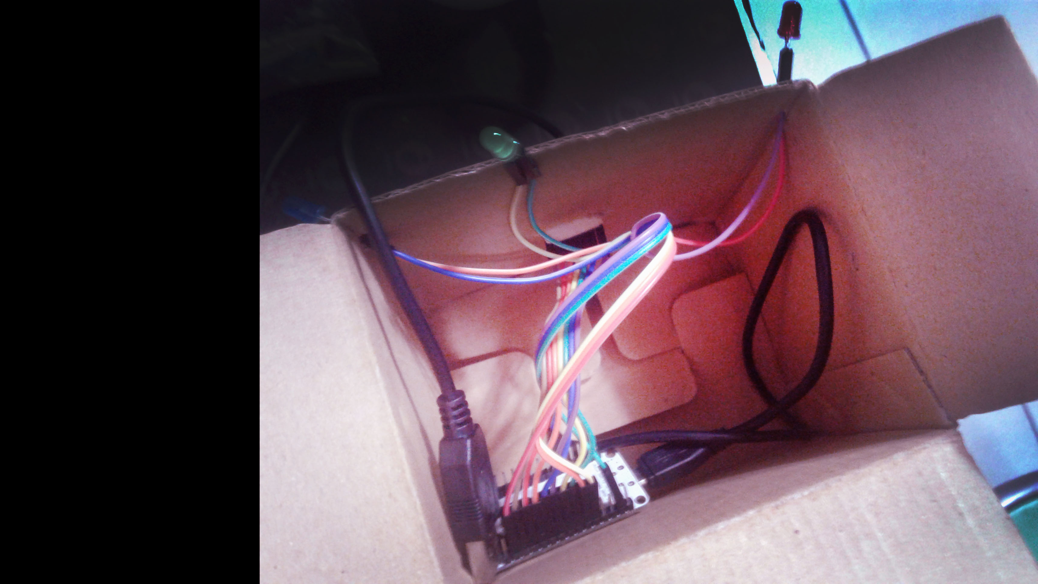
Material
NO peeking!
I’m shy~~ ;: /

Slide 4
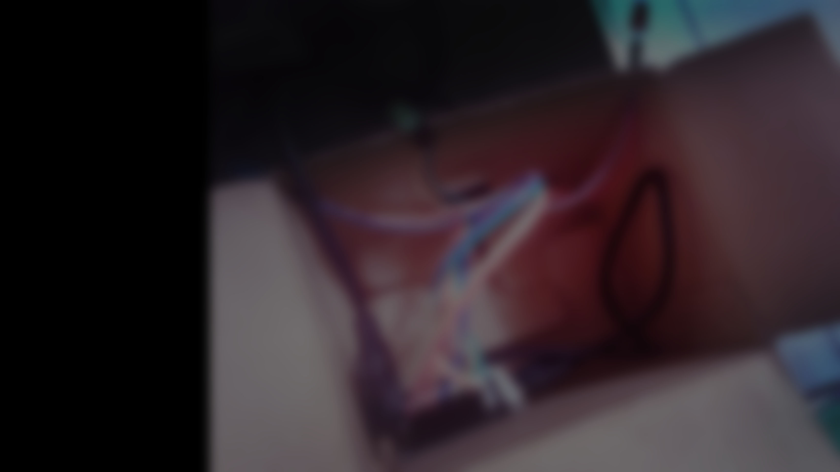
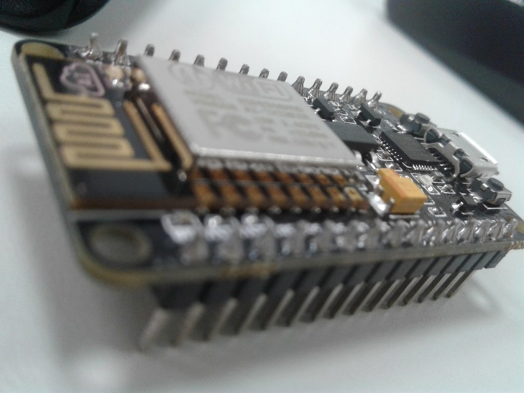
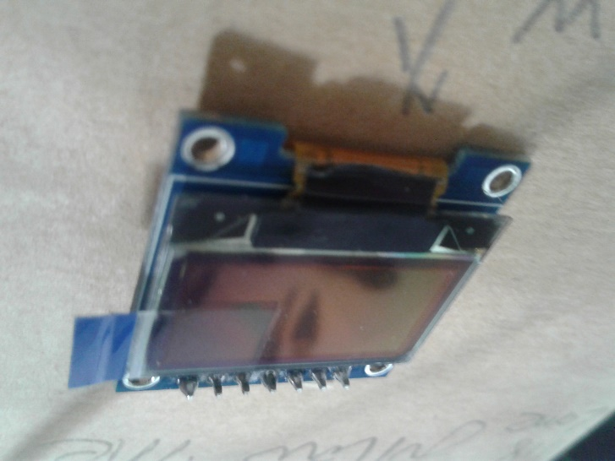
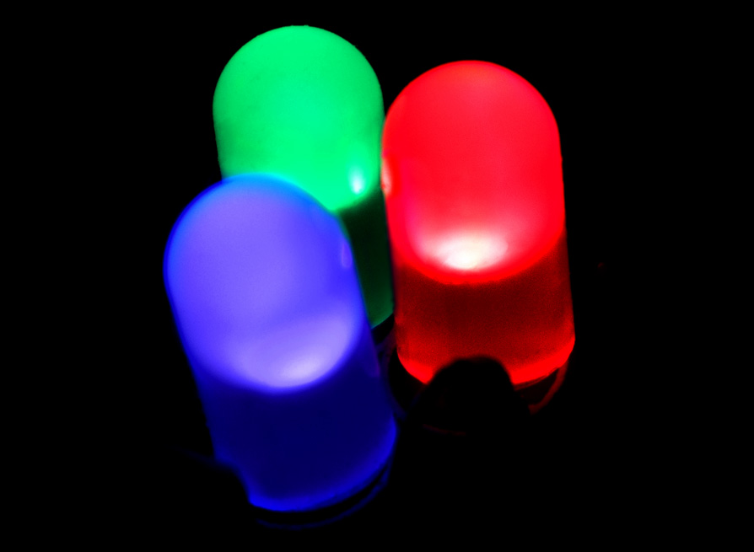
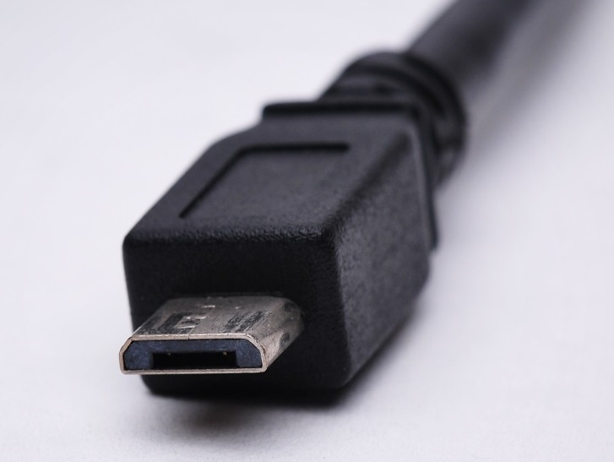
Material
NodeMCU*1
“brain”
LED*3
Pointer~
OLED*1
Target
Micro USB*1
“heart”

Slide 5
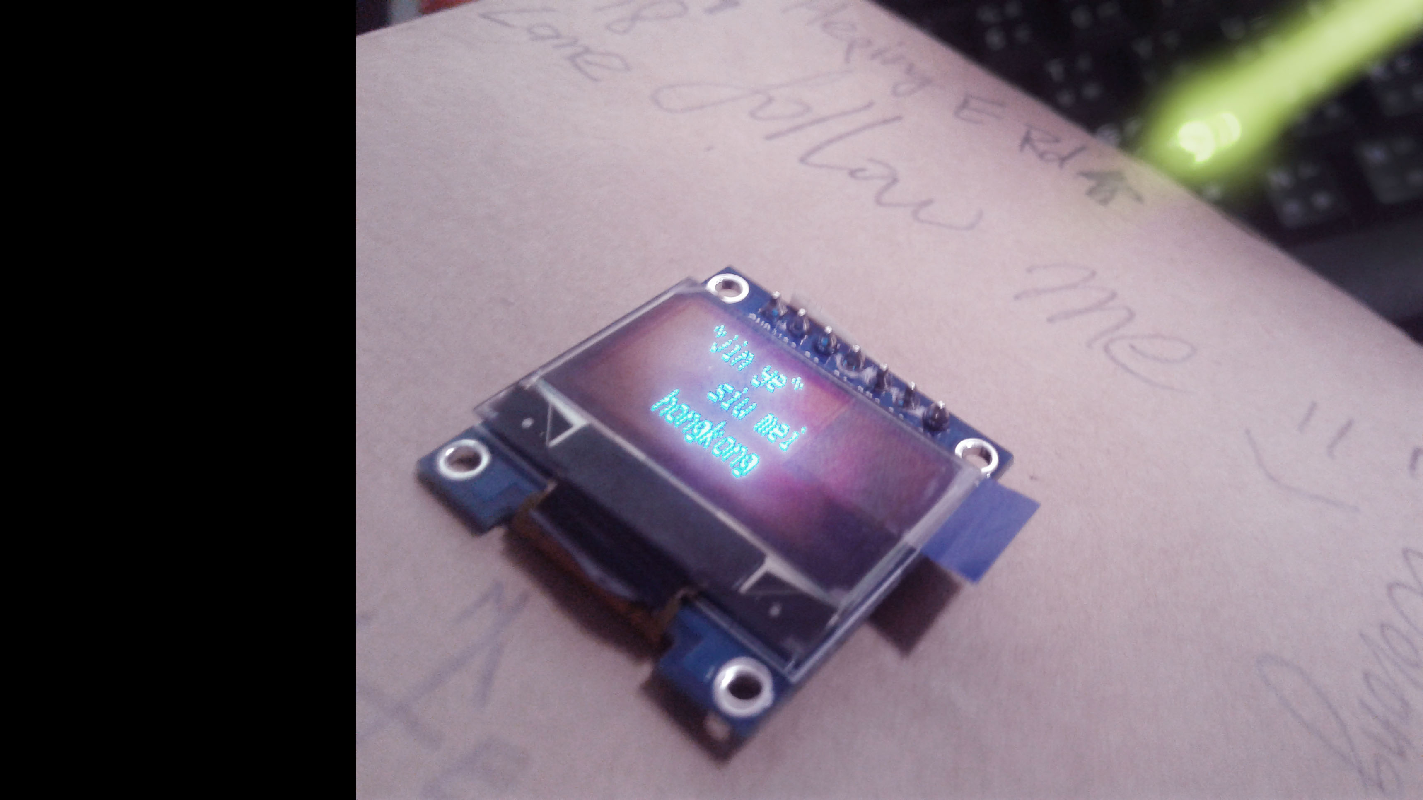
Instructions
Ready?~
FOLLOW ME! : )

Slide 6
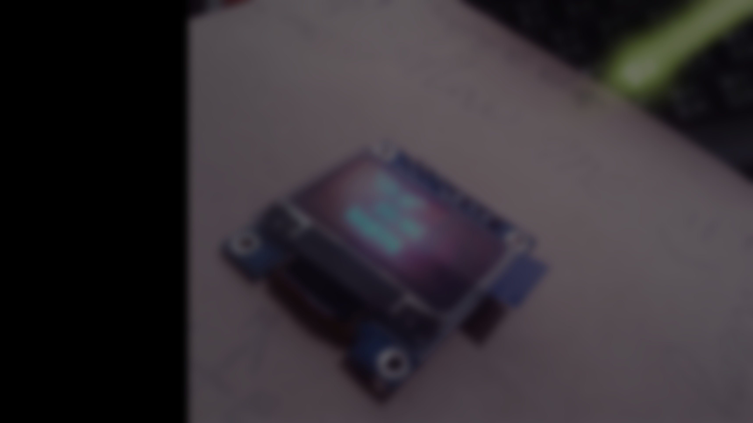
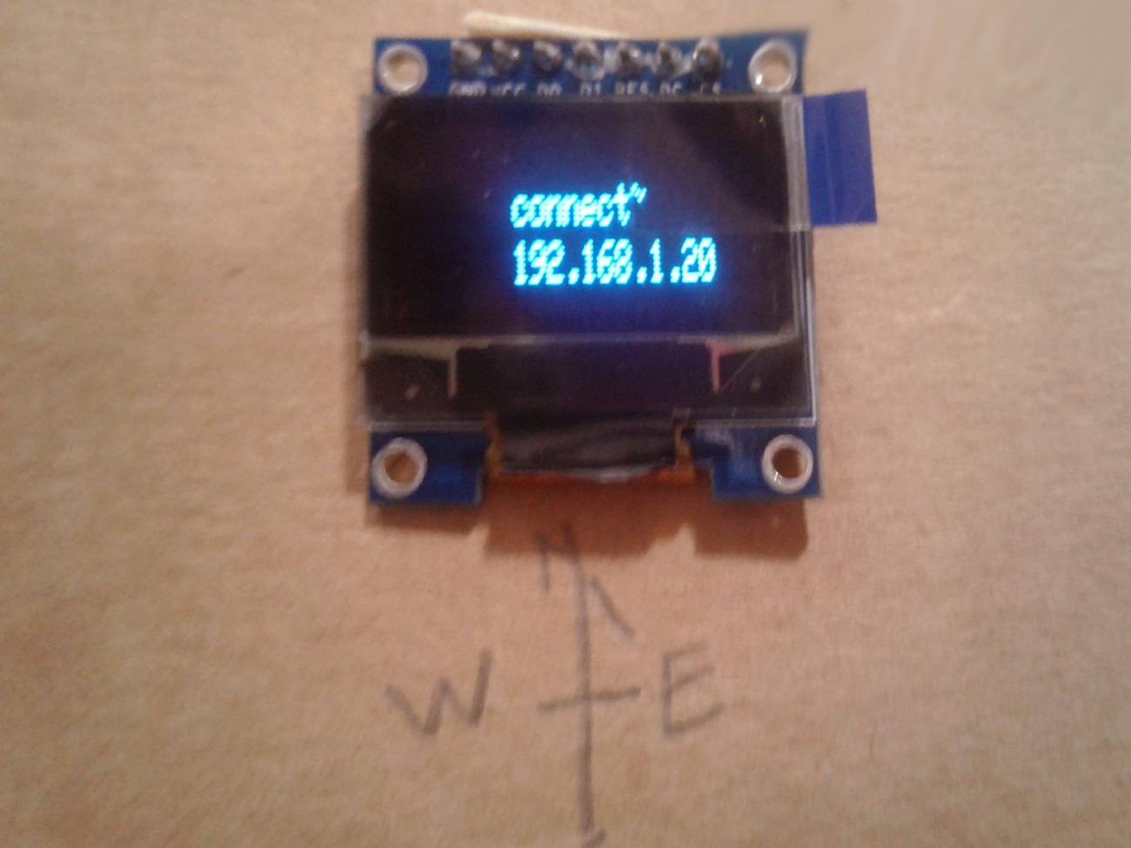
Instructions
1 Set your LunchBox WiFi
>then you can see the IP on the OLED~

Slide 7
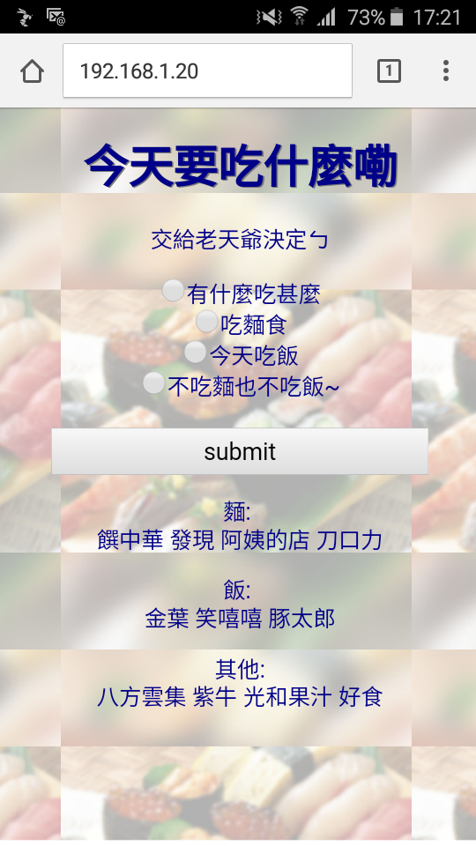
Instructions
2-1 Link to the website!
2-2 Choose your favor!

Slide 8
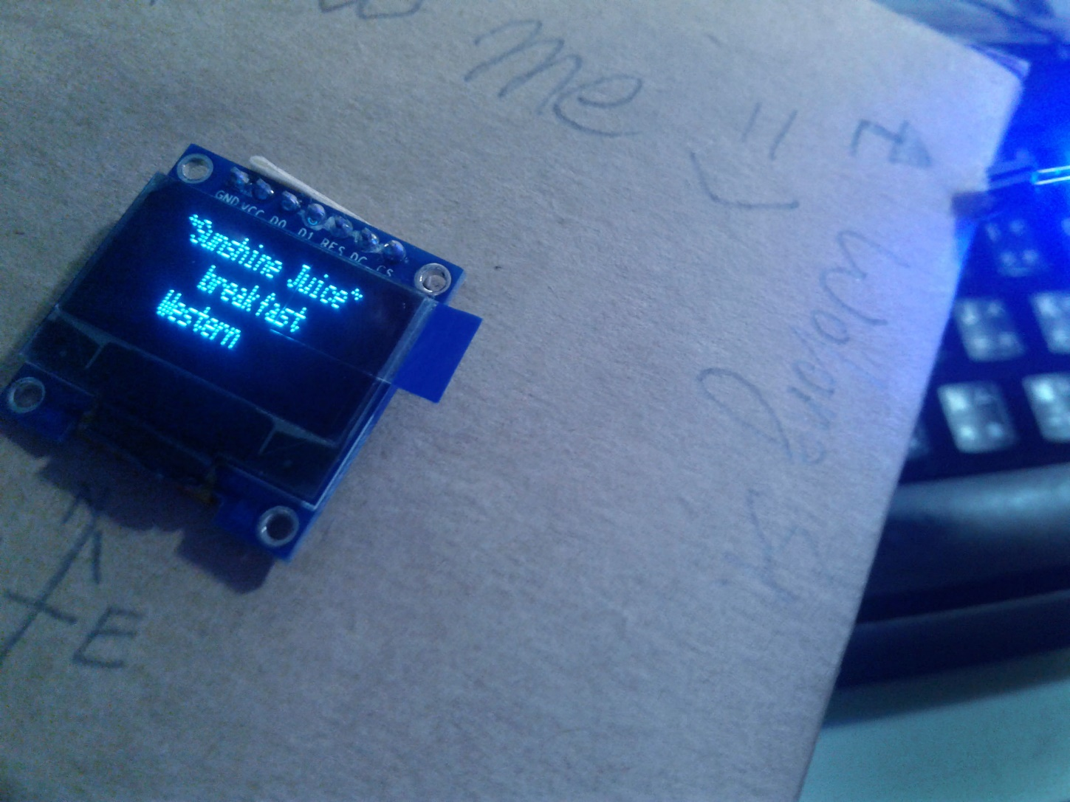
Instructions
Here comes your order~
Info:
-Name
-Food Type
-Style
Tips:
When you’re facing North,
The light will guide your way~

Slide 9
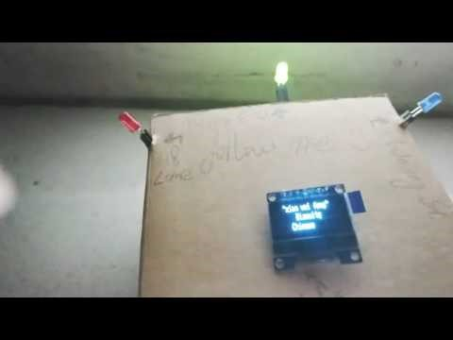
DEMO
https://www.youtube.com/watch?v=BfKDfYMDnZE

Slide 10
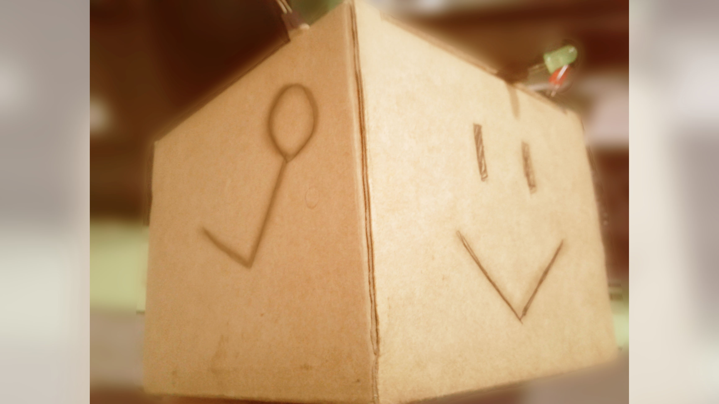
LUNCH TIME~

Slide 11
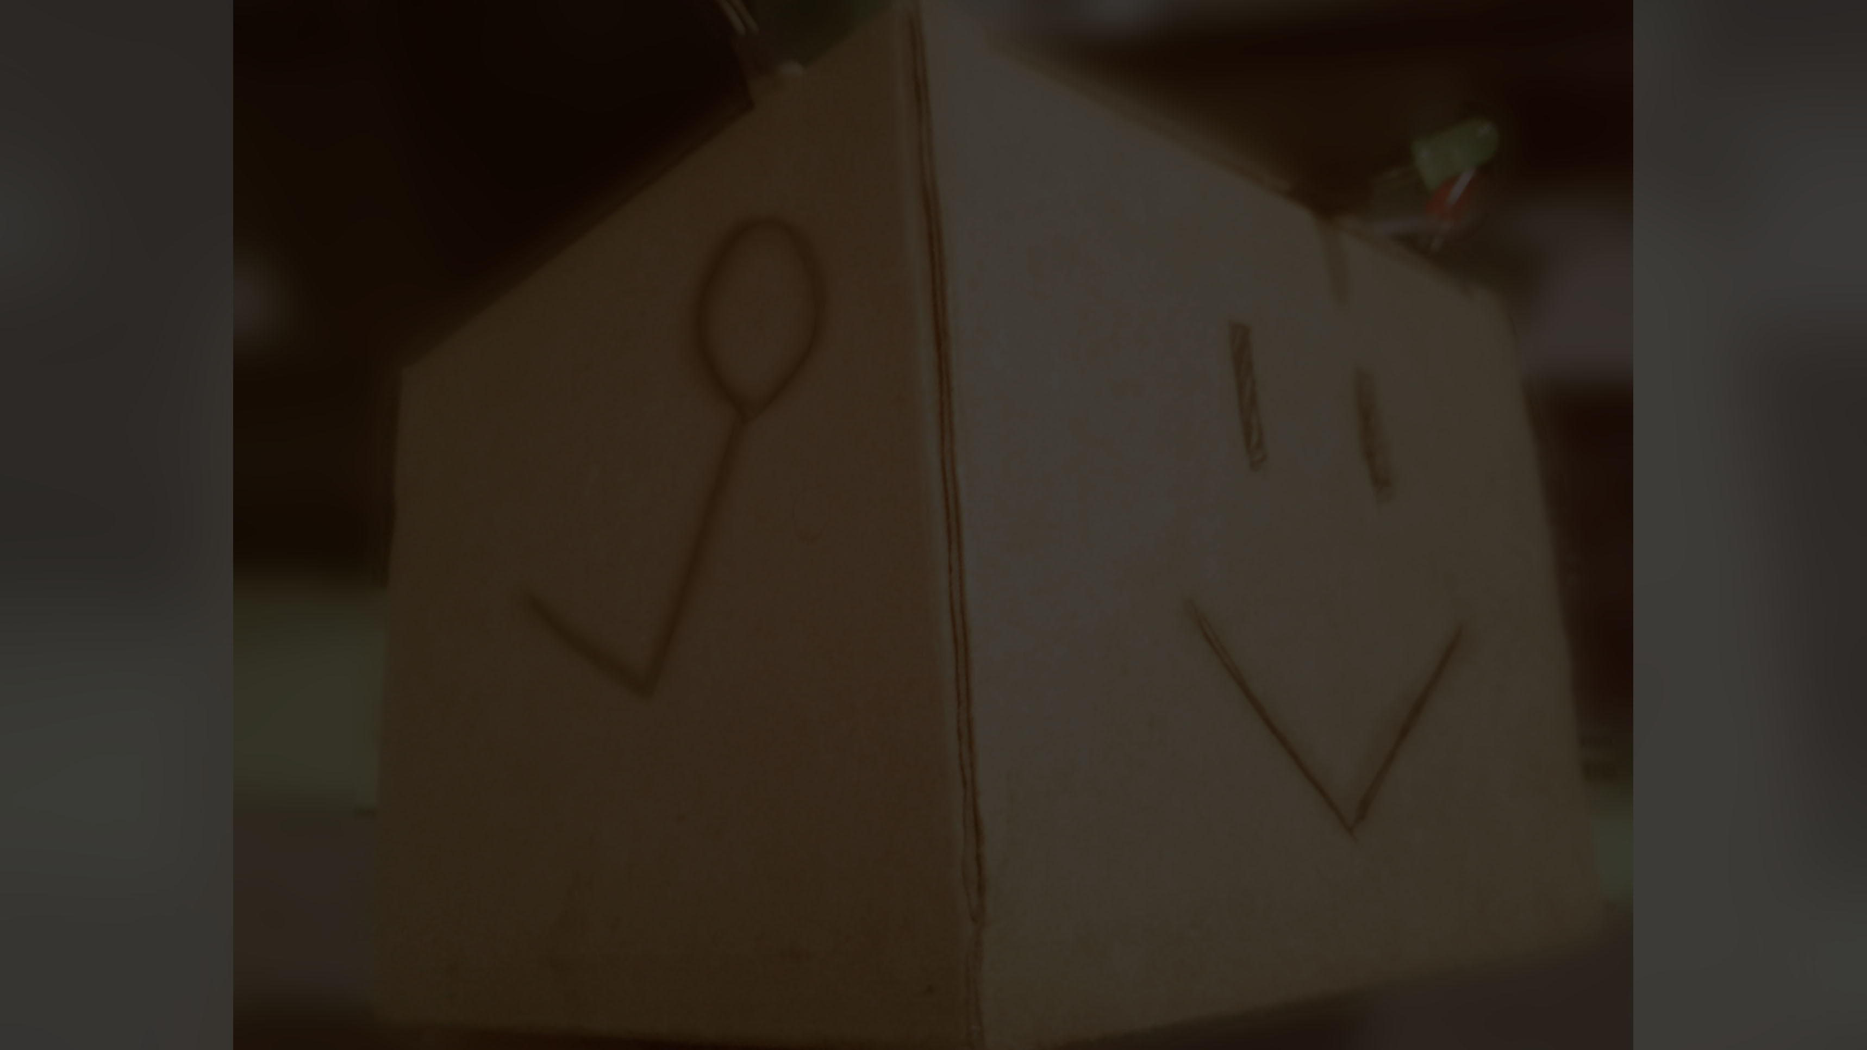
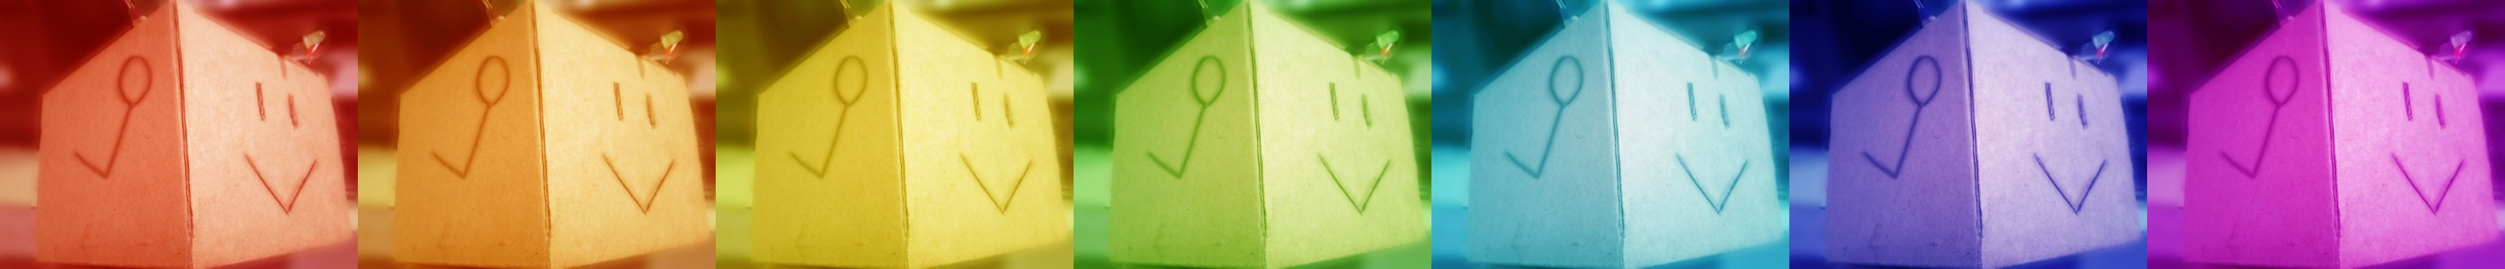
分工表 : )
徐尉秦 – 構想
房駿慈 – 構想、撰寫網頁骨架
王柏尊 –
構想、網頁美化、程式撰寫、電路配置、成品製作、PPT製作、報告書製作。

