Slide 1
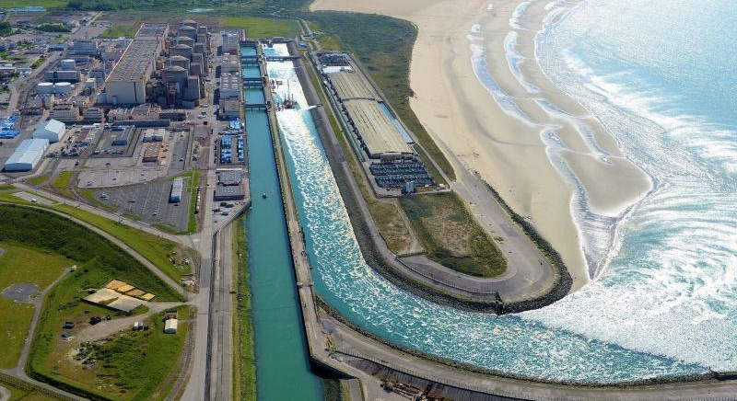
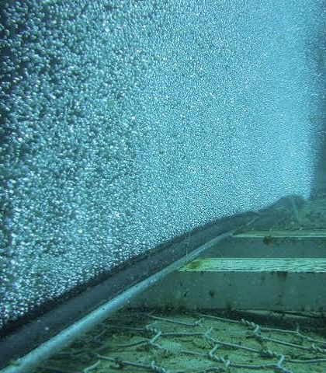
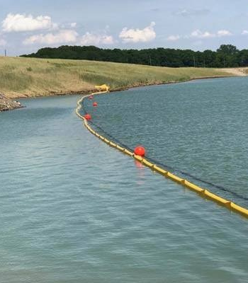
ATP 2026 | ENEC CHALLENGE
MARLIN
Marine Adaptive Response and Lifecycle Intervention Network
A layered, proven response to jellyfish blooms, with less manual work
Post-alert management of seasonal blooms: bubble curtain plus angled boom, adaptive control software and a manual-catch backup
TEAM Bashger Aljneibi | Keyal Doshi | Abdul Fattah Mohammed | Abdul Bari Mohammed
Notes:
Intro (10 s): We are MARLIN. ENEC asked how to manage jellyfish blooms AFTER the early warning. Our answer layers two proven barriers, a bubble curtain and an angled floating boom, steered by control software that adapts to the bloom, with a manual crew as the last backup. One monitored collection point replaces repeated manual clearing.

Slide 2
Two proven layers, adaptive control, a manual-catch Layer 3
01 | EXECUTIVE SUMMARY
1
The problem
2
The solution
3
Why it is credible
Bloom swarms clog cooling-water screens and can trip reactors. Gravelines lost four units in Aug 2025 and three in Aug 2026. After the warning, clearing is still manual, equipment-heavy and sustained.
A seabed bubble curtain lifts drifting jellyfish to the surface and an angled floating boom guides them to one collection point. Control software adapts both to the bloom. Layer 3, a small manual-catch crew, sweeps any straggler; the existing screens stay as the last line.
A flume study found a bubble plume plus floating boom gathers jellyfish for pump removal (Lo, 1996). Bubble curtains cut jellyfish by 77% in Tasmanian pens. Booms have flume-based design guidance for power-station intakes.
Next step Build and test the controller in simulation and a bench flume with density-matched analogues, then a sheltered-water pilot. No change to plant or nuclear-safety systems.
Notes:
Summary (20 s): Problem, solution, proof. Gravelines lost four reactors in 2025 and three in 2026. Our two layers are each established technology, with a manual-catch Layer 3 behind them, and a published flume study already tested them together. Control software adjusts air and boom angle to the bloom and stops when nothing arrives. A manual crew and the existing screens are backups. Nothing touches plant or safety systems.

Slide 3
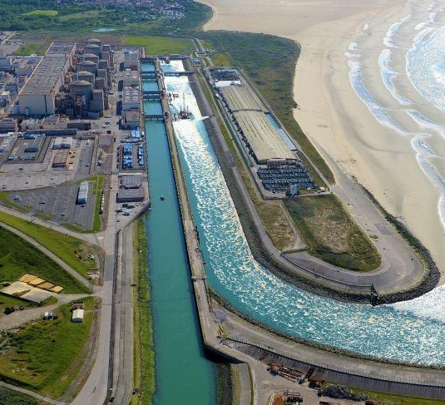
Jellyfish blooms are shutting down coastal plants
02 | THE PROBLEM
4 of 6
Gravelines, France, Aug 2025: jellyfish in the pump-station filter drums shut four reactors. It happened again in Aug 2026.
300 t
Ghubra desalination, Oman: 300 tonnes of jellyfish damaged intake screens and cut output by 50%.
Gulf-wide
2002-03 Crambionella bloom damaged power-plant cooling systems in the Gulf of Oman and Persian Gulf. Al-Zour, Kuwait, saw screens blocked in 2017.
Target Catostylus mosaicus, 30-45 cm, dense and firm (ENEC brief). The system must handle large, continuous volumes, not single animals.
Seawater intake channel at a coastal nuclear plant (team reference photo)
Notes:
Problem (15 s): Once-through seawater cooling pulls huge volumes through an intake. A bloom blocks the screens faster than crews can clear them. This is real and regional: Oman and Kuwait have both been hit. ENEC's target species is large and dense, so the answer must handle volume.

Slide 4
How it works: lift, guide, collect, back up
03 | SYSTEM DESIGN
1
clean flow to intake
1
Bubble curtain
2
5
Seabed air hose lifts drifting jellyfish to the surface.
4
PLANT INTAKE
existing screens stay as backup
CREW + NETS
2
Angled boom
Guides them along its face to one collection point.
3
Collection point
Gentle pump to a holding tank, then supervised release.
3
4
Layer 3: manual catch
COLLECTION POINT
pump to holding tank, then release
A small crew with dip nets clears any rare straggler.
5
Intake stays as is
Current and bloom drift
Existing screens remain the last line of defense.
lifted to surface
SHORE / BREAKWATER
Control software adapts layers 1 and 2
Schematic top view, not to scale. Boom angle, curtain length and crew station need site data.
Notes:
Concept (25 s): Left to right. The bloom drifts with the current. The seabed bubble curtain lifts jellyfish to the surface layer. The angled floating boom, set across the current, guides them along its face to one collection point near shore. A small manual crew with dip nets is the third layer for the rare straggler. The intake and its existing screens are untouched and stay as the independent last line. Control software, shown at the bottom right, adjusts the curtain and boom to the bloom.

Slide 5
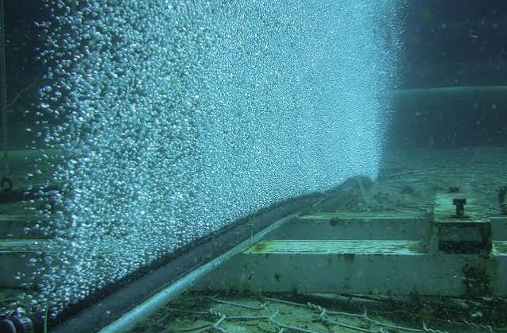
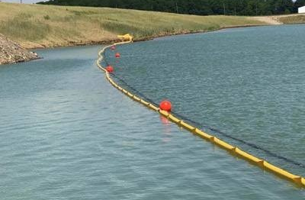
Each layer is already used in the field
04 | PROVEN BUILDING BLOCKS
Layer 1 | Bubble curtain
1
Tasmania: 77% fewer jellyfish in a 12-pen trial, now rolled out to 160+ pens
Ireland: an 8 m high-airflow curtain deflected large jellyfish (Haberlin et al., 2021)
Chile: 70+ salmon sites, plus power-plant inlets (vendor-reported)
Design limit: waves and low airflow let jellyfish through; small fragments pass.
Layer 2 | Angled floating boom
2
Flume-based design guidance for debris booms at power-station intakes; bent booms suit the widest flow range
Flush-faced booms clear themselves when set at an angle to the current (manufacturer data)
Net-skirt booms already keep jellyfish out of desalination intakes (Elastec)
Design limit: holds only at low current across the boom, so the angle sets the load.
Notes:
Proof of parts (25 s): Both layers are real products. Bubble curtains protect salmon farms in Chile, Tasmania, Scotland and Ireland, and some power-plant inlets. Debris booms are standard at power-station intakes and have published flume design guidance. We list each limit openly because our design works around it.

Slide 6
The hybrid is backed by published tests
05 | RESEARCH EVIDENCE
Claim | Evidence | Strength
A bubble barrier alone is not enough | Lo (1991), flume: a net downstream of the barrier is recommended | Lab
Bubbles plus a boom gather jellyfish for removal | Lo (1996), flume: the plume lifted jellyfish to the surface, where they gathered at the boom for pump removal | Lab
Bubble curtains cut jellyfish at scale | Tasmania: 77% fewer in 12 pens. Mowi Portnalong: up to 80% fewer inside the curtain | Field, operator-reported
Results depend on size, waves and airflow | Haberlin et al. (2021): large jellyfish deflected; waves and low airflow raised pass-through | Peer-reviewed field and flume
Angled booms guide debris at intakes | Ettema and Kubit (2000): flume-tested design guidelines for debris booms at power-station intakes | Published flume study
Airflow and boom angle are real control knobs | Haberlin et al. (2021): airflow and waves changed how many got through. Adjustable-angle booms exist (US patent 5,695,300) | Flume plus patent
Gap we will close No published test of this hybrid on a dense 30-45 cm species at full scale, and none of an adaptive controller for it. Our simulation and flume plan target both.
Notes:
Evidence (25 s): The key result is Lo 1996: in a flume, a bubble plume lifted jellyfish to the surface and they gathered at a floating boom where a pump could remove them. Lo 1991 showed bubbles alone fail. Field data from Tasmania and Scotland show curtains work at scale. We are honest that nobody has tested this on a dense 30 to 45 cm species at full scale, which is exactly what our simulation and flume plan do. The controller is our own design, with airflow and boom angle as the adjustable settings.

Slide 7
A software brain that adapts the response
06 | CONTROL SOFTWARE
01 | ALERT
02 | SENSE
03 | DECIDE
04 | ACT
ENEC bloom warning
Count and track
Estimate and choose
Adjust or stop
Existing offshore detection starts the loop.
Camera or sonar estimates arrivals; sensors read current and waves.
Software sets air level and boom angle from arrival rate and direction.
Air, boom and collector follow the bloom; all stop when arrivals stop.
If the software sees | Then it
Arrivals rise | Raise air flow to its set-point; re-angle the boom to keep cross-flow within its limit
Arrival direction shifts | Swing the boom toward the new approach
Arrivals near zero for a set time | Stop air, park the boom, keep watching
Waves, boom load or intake pressure too high | Air off or boom retracted; alert the operator
Guardrails
Local interlocks bound every set-point
Operators authorize deployment and releases
Rules first; machine learning only once data exist
Starts from the ENEC alert; does not replace detection
Notes:
Control software (25 s): ENEC's detection warns us. From that moment our software estimates how many jellyfish are arriving and from which direction, using a camera or sonar count plus current and wave sensors. It then sets the bubble air level and the boom angle, and stops everything when arrivals stop. Simple rules first; machine learning only once real data exist. Local interlocks and operators bound every action. It controls only our barrier, not the plant.

Slide 8
Built around the known limits and marine life
07 | SUSTAINABILITY AND RISK
KNOWN LIMIT
OUR RESPONSE
Waves cut curtain performance
Use the breakwater-sheltered approach; software stops air in rough seas
Marine-life safeguards
Air and floating guides only: no chemicals, no shredding
Gentle handling aims to release jellyfish alive, away from the intake; survival is measured
Non-target animals are detected before handling; pause and release by protocol
Bubble noise and light effects on fish are measured in sheltered-sea tests
Mass balance recorded: delivered, held, escaped, bycatch
Small fragments pass through
Boom skirt, manual crew and existing screens act as further lines
Boom face can clog; intake flow may change
Angle lets current clear the face; retract at pressure limit
Dense 30-45 cm bodies may resist lift
Test lift in the flume with density-matched analogues
Sensor counts may be wrong in turbid water
Conservative defaults, operator override, counts validated in the flume
Notes:
Sustainability (20 s): We designed around each documented weakness. Waves hurt bubble curtains, so we use the breakwater-sheltered approach and the software stops air in rough seas. Fragments get past a curtain, so the skirt, the manual crew and the existing screens are further lines. Sensor counts can be wrong in turbid water, so defaults are conservative and operators can override. Marine-life protection is a pass or fail gate in every test stage.

Slide 9
Low-cost, modular, and testable before any pilot
08 | COST, SCALE AND TEST PLAN
1
Bench flume (Demo Days)
Cost-conscious by design
Scaled curtain and boom with density-matched analogues. Test the controller on changing arrival rates and directions.
Passive first: boom needs no power; air runs only while jellyfish arrive
Modular: sections are repaired or extended one at a time
Off-the-shelf: booms, diffuser hose, compressors, pumps
Scales by length: add sections for a wider channel
Layer 3 crew on call: manual catch is a rare backup
2
Sheltered-water trial
Permitted deployment with ecological observation, load cells and intake-pressure logging.
3
ENEC-approved pilot
Operator-led demonstration under approved boundaries, with no change to plant systems.
Capital and running costs need supplier quotes; none are assumed here.
To prove A clear cut in bloom mass reaching the intake versus no response (our screening model suggests roughly 50-65% in calm seas and about 12% in a 2 m storm, so flume tests must measure the real figure); the controller re-aims and stops correctly; bycatch, pressure change, kWh per tonne and staff-hours recorded.
Notes:
Cost and test plan (20 s): Everything is standard marine hardware, and the software keeps air off unless jellyfish are arriving. We do not quote prices without supplier data. Gate one is a bench flume plus a controller simulation we can show at Demo Days. Our v5 screening simulation compares strategies under uncalibrated assumptions: roughly 50 to 65 percent less mass reaching the intake in calm seas and about 12 percent in a 2 metre storm. Those are not field claims; the flume will measure the real values.

Slide 10
Assumptions, limits, and sources
09 | ASSUMPTIONS AND SOURCES
KEY ASSUMPTIONS
SOURCES
Public information only; no ENEC facility or operating data used
Breakwater-sheltered approach with low waves (to confirm)
Target: Catostylus mosaicus, 30-45 cm, dense (ENEC brief); lift behavior untested
Current, depth and bathymetry unknown; boom angle and curtain length follow a site survey
Aquaculture and lab results do not guarantee performance at a nuclear intake
Sensor counts and the controller are unvalidated; first built and tuned on simulated and flume data
Lo (1991), IAHR: iahr.org/library/info?pid=6399
Lo (1996), Ocean Engineering 23(6): trid.trb.org/View/480225
Haberlin et al. (2021), Aquaculture: research.ucc.ie (bubble curtain study)
Ettema and Kubit (2000), ASCE: ascelibrary.com/doi/10.1061/40517(2000)236
Pulse Tasmania: Tassal bubble-curtain rollout
Eurofish: Mowi Portnalong bubble curtain
Fish Farming Expert: PSP Solutions bubble curtains
Politico (Aug 2025), NEI Magazine (Aug 2026): Gravelines shutdowns
Gulf News: Jellyfish choke Oman desalination plants
J. Mar. Biol. Assoc. UK: Crambionella orsini bloom, 2002-03
PAAET Kuwait: Preventing jellyfish attacks on power plants
Elastec; EcoCoast/Bolina: boom and debris-boom product data
US patent 5,695,300: adjustable-angle recovery boom
ENEC: ATP 2026 challenge statement (challengeon.atrc.ae)
Declaration AI tools supported research and drafting. The team reviewed every claim and owns the proposal.
Team: Bashger Aljneibi, Keyal Doshi, Abdul Fattah Mohammed, Abdul Bari Mohammed
Notes:
Close (10 s): We are clear about what is evidence and what is assumption. Sources are listed so judges can check each claim. We would welcome a bounded technical review with ENEC to confirm site conditions, then calibrate the flume model.

