Slide 1
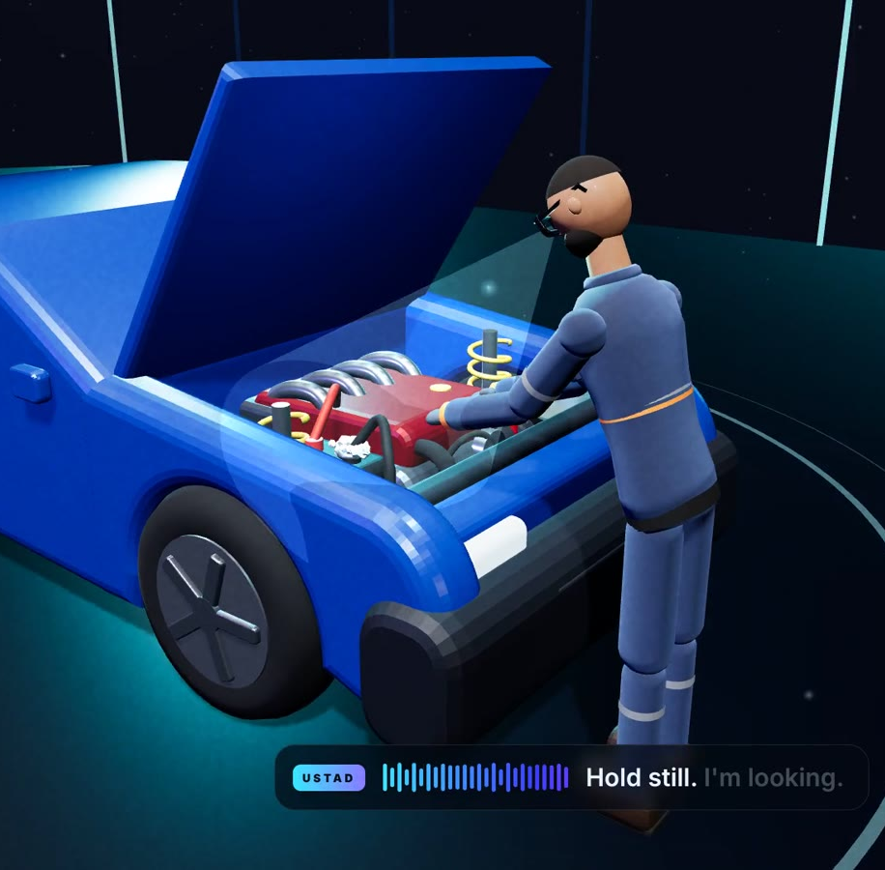
USTAD
WEARABLES STUDIO UAE 2026 · EDUCATION
The master technician in your glasses.
On-the-job training for technicians, on Meta glasses.
Shabeer Ahamed Kamal · Keval Doshi
Notes:
PITCH 3:00 · DEMO 2:00 · Q&A 2:00 0:00–0:08 (8 s) “Hi, we’re Shabeer and Keval, the founders of Ustad: on-the-job training for technicians, on Meta glasses.”

Slide 2






Every repair business has a few experts and many juniors.
THE PROBLEM · WHERE WE FOUND IT
Industries we serve
Car service
AC repair
Appliances
Any repair
Garages and fleets
Split and central AC
Washing machines, fridges
Electronics, EVs, batteries
The expert
The junior
Knows every fault by sight and sound, but can’t stand beside everyone. When they retire, the knowledge leaves.
Doesn’t know every problem yet. Guesses, swaps parts that were fine, and waits for the expert.
Ustad · 02
So we let the expert teach through Meta glasses →
Notes:
0:08–0:40 (32 s) “We found this problem in repair and service workshops: car service, AC repair, washing machines and home appliances — really, any business that repairs products. Every one of them has two kinds of people. A few experts, who know every fault, but can’t stand beside everyone, and take that knowledge with them when they retire. And many juniors, who don’t know every problem yet — so they guess, swap parts that were fine, and wait for the expert.”

Slide 3

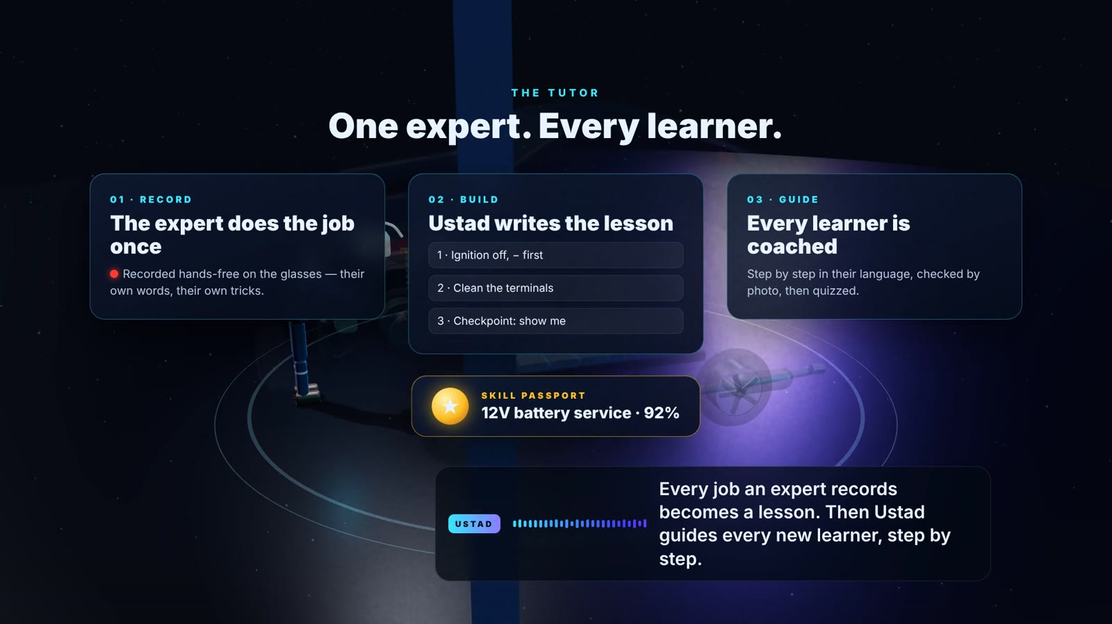



The expert teaches once. Every learner learns.
THE SOLUTION · LEARNING MODE
The expert does the job once
The glasses record what they do and say, faces blurred.
AI turns it into a lesson
Steps in the expert’s own words, safety, checkpoints, a quiz. The expert approves it.
The learner is coached on the job
Hands-free, in English or Arabic, every step checked by photo.
They earn a Skill Passport
Quiz and checkpoints passed: a badge at 80+, seen by the supervisor.
Ustad · 03
Here’s the learner on the job, step by step →
Notes:
0:40–1:05 (25 s) “So Ustad lets the expert teach through Meta glasses. The expert does a job once while wearing them. Ustad turns it into a lesson — steps, why each matters, safety, checkpoints and a quiz — in the expert’s own words, and the expert approves it. Then every learner is coached through it hands-free and earns a Skill Passport.”

Slide 4
Six steps, from photo to fix
ON THE JOB · WHAT THE LEARNER DOES, AND THE TECH BEHIND IT
0 1
Snap & listen
0 2
Privacy first
0 3
Read symptoms
“Ustad, inspect.” A photo and a few seconds of sound.
Faces and number plates are blurred on the phone.
“White crust on the terminal, slow crank.”
Gemini vision · offline: Llama 3.2
Meta glasses · Device Access Toolkit
Google ML Kit, on the phone
0 4
Find the cause
0 5
Try it safely
0 6
Fix & learn why
Causes ranked: corroded 12V terminals, 71%.
A 10-second test. Dangerous jobs are stopped.
Voice coaching step by step, checked by photo.
Ustad’s Bayesian knowledge graph
Safety Stop rules
ElevenLabs voice · photo check
Every confirmed fix updates the brain, so the next learner gets a better answer.
Ustad · 04
Plus an add-on: a 3D model of the machine →
Notes:
1:05–1:55 (50 s) “Here’s what the learner does on the job, and the tech behind each step. One: they say ‘Ustad, inspect’ — the glasses take a photo and listen to the engine. Two: faces and plates are blurred on the phone before anything leaves. Three: Gemini reads the symptoms — white crust on the terminal, a slow crank. Four: our own Bayesian knowledge graph ranks the causes — corroded battery terminals, 71%. Five: the learner tries a 10-second test, and safety rules stop anything dangerous. Six: Ustad coaches the fix by voice, explains why, and checks the result from a photo. Every confirmed fix makes the brain smarter.” If asked about the CNN: sound is measured on the phone today (loudness, pitch, spectrum); a CNN sound classifier is the next step.

Slide 5
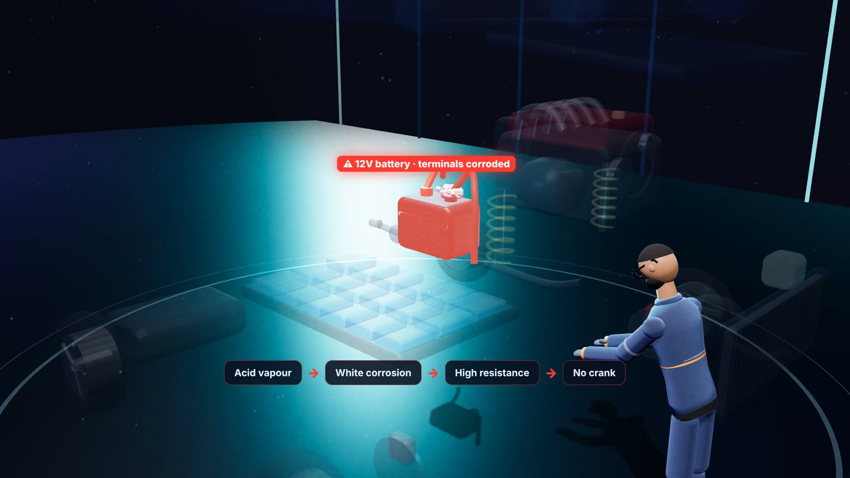



We added a 3D model of the machine
ADD-ON · 3D MODEL
Opens the machine up
An exploded view of every part.
Shows the failing part
Highlighted in red, with the chain of causes.
English and Arabic
Voice coaching in both languages.
Ustad · 05
So how do we make money? →
Notes:
1:55–2:08 (13 s) “We also added a feature that builds a 3D model of the machine, opens it up, and highlights the failing part in red with its causes — with voice coaching in English and Arabic.”

Slide 6
A monthly fee per technician
HOW WE MAKE MONEY · MONTHLY SUBSCRIPTION
Starter
Pro
Most popular
Enterprise
Small garages and shops
Workshops that train juniors
Chains and training centres
AED 99
AED 149
Custom
per technician / month
per technician / month
from AED 25,000 / year
Fix coaching on every job
Built-in lessons
1 machine type
Everything in Starter
Record expert lessons
Skill Passport + dashboard
All machine types
Private Expert Library
UAE data hosting
Onboarding and support
How it works
Example
Free 30-day pilot → pay monthly, or yearly with 2 months free → add seats as the team grows
10 technicians on Pro: AED 1,490 / month
Ustad · 06
Pilot pricing · Benchmark: Dynamics 365 Guides, $65/user/month
Notes:
2:08–2:45 (37 s) “How we make money: a simple monthly subscription, like any business software. The company pays for each technician. Starter, 99 dirhams, gives fix coaching on every job. Pro, 149, adds learning mode — recording expert lessons, Skill Passports and the supervisor dashboard. Enterprise is a yearly licence with a private Expert Library. Every customer starts with a free 30-day pilot, and a ten-technician workshop on Pro pays about 1,500 dirhams a month.” If asked about costs: the customer buys the glasses; our running cost is AI calls per inspection, kept low by sending one blurred photo and text. Benchmark: Microsoft Dynamics 365 Guides was $65 (≈ AED 240) per user per month.

Slide 7
One expert’s knowledge, in every technician’s glasses.
USTAD
Thank you. Now, the 2-minute demo.
Shabeer Ahamed Kamal · Keval Doshi · github.com/Shaaha7/meta-1
Notes:
2:45–3:00 (15 s, includes a breath before the demo) “One expert’s knowledge, in every technician’s glasses. Thank you — let us show you.” Then go to the next slide: the demo video.

Slide 8
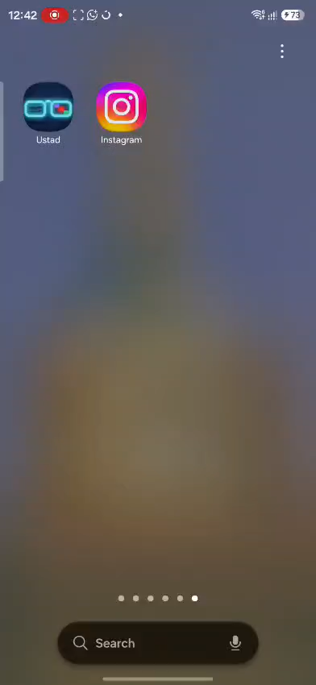
Ustad on a real job
LIVE DEMO · 2:0 0
Ustad · 08
Notes:
DEMO 3:00–5:00 (2 min) Play the recording; let it run without talking over it. To add your video: select the frame, then use Image or video in the toolbar and pick your .mp4 (H.264, 20 MB or less). Turn its sound on in Properties, and set it to start on click if you want to control when it plays.

Slide 9
Questions?
USTAD
The expert teaches once. Every learner learns on the job.
Shabeer Ahamed Kamal
Keval Doshi
Team Lead · AI and computer vision
AI and app developer
github.com/Shaaha7/meta-1 · Meta Wearables Studio UAE 2026
Notes:
Q&A 5:00–7:00 (2 min). Short answers to likely questions: • Accuracy? 9/9 on labelled public photos of visible faults, learning off. The engine-bay end-to-end field test is next. • Why not just ask an AI? The AI only reports symptoms; our Bayesian knowledge graph decides, cites a source and explains itself, so answers are checkable. • Which AI? Gemini through our key server; Meta’s Llama 3.2 Vision offline. Sound is measured on the phone; a CNN sound classifier is next. • Privacy? Capture on command, faces and plates blurred on the phone, every request logged in the app. • Safety? Fixed Safety Stop rules on every AI step and lesson; high-voltage, gas, refrigerant and airbag jobs stop. • Who pays? The company, per technician per month: Starter AED 99, Pro AED 149 (learning mode), Enterprise from AED 25,000 a year. Free 30-day pilot. • Does it work? A working Android app on Meta’s toolkit with 80+ automated tests. • Why now? Microsoft’s Dynamics 365 Guides and Remote Assist reach end of support on 31 Dec 2026. • Other languages? English and Arabic today; more after the pilot. • Without Display glasses? Works on Ray-Ban Meta with voice, on the phone, or with no glasses via Meta’s Mock Device Kit.

