Slide 1
Shree Swami Atmanand Saraswati
Institute of Technology
-: Subject :-
“Digital Healthcare and Contact Tracing”
-: Prepared By :-
Keval Makadiya Team Leader
Rahul Bhojani Team Member
Binita Kapadiya Team Member
Kruti Rabadiya Team Member
1

Slide 2
Contents
Domain Introduction
Problem Statement
Solution of Problem
Proposed Modules
Technologies
Screenshots
Future Enhancements
2

Slide 3

Domain Introduction
HealthCare
3

Slide 4
Problem Statement
Technology made life easier, sometimes patient forget their record file and lost somewhere then it’s difficult to keep secure. Uneducated people don’t know that which hospital record file and some people don’t know which treatment had taken and which issues created.
Also it is difficult to know what is travelling history of patient, where the patient travel in last 15 days. In market there is lots of software to keep record of patient’s history. But there is no any option for patient’s travelling history and quick services
Laboratory person have to visit hospital and give patient’s report and sometimes he/she can’t give report on time.
4

Slide 5

Solution of Problem
Solution for this problem is Electronical Health Record system.
Many EHR solutions are available in the market but not working properly. We propose the system that is works with the unique number and based on that number all the data store and retrieve from the server.
With our propose system data is available for the patient and doctor at anytime and anywhere
With data security/privacy standard within their mobile phone.
5

Slide 6
Modules
For Laboratory Attendant
For Doctors
DHCT
For Shops
For Patients
6

Slide 7


Technologies
Flutter is a technology used for a app development.
With the help of we it we can develop for a multiple systems like iOS, android, web etc.
Firebase will be the backend to store the data of applications.
Firebase is a service of google which provides faster data rendering and storing.
7

Slide 8
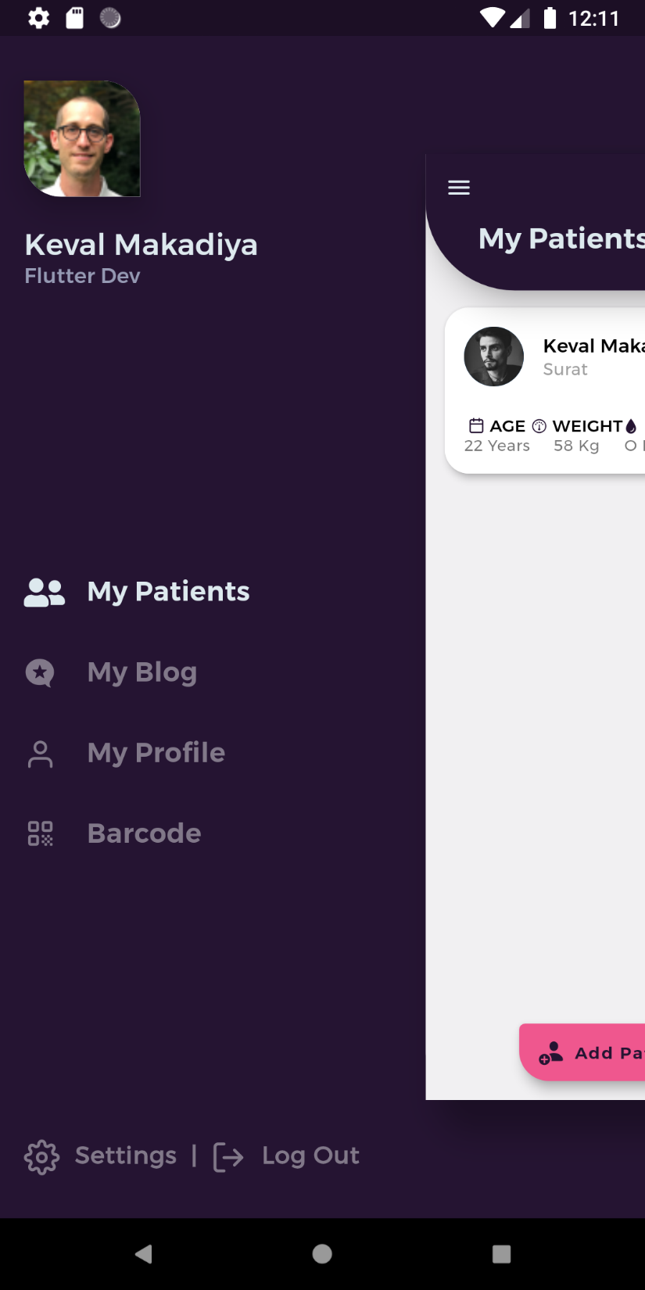
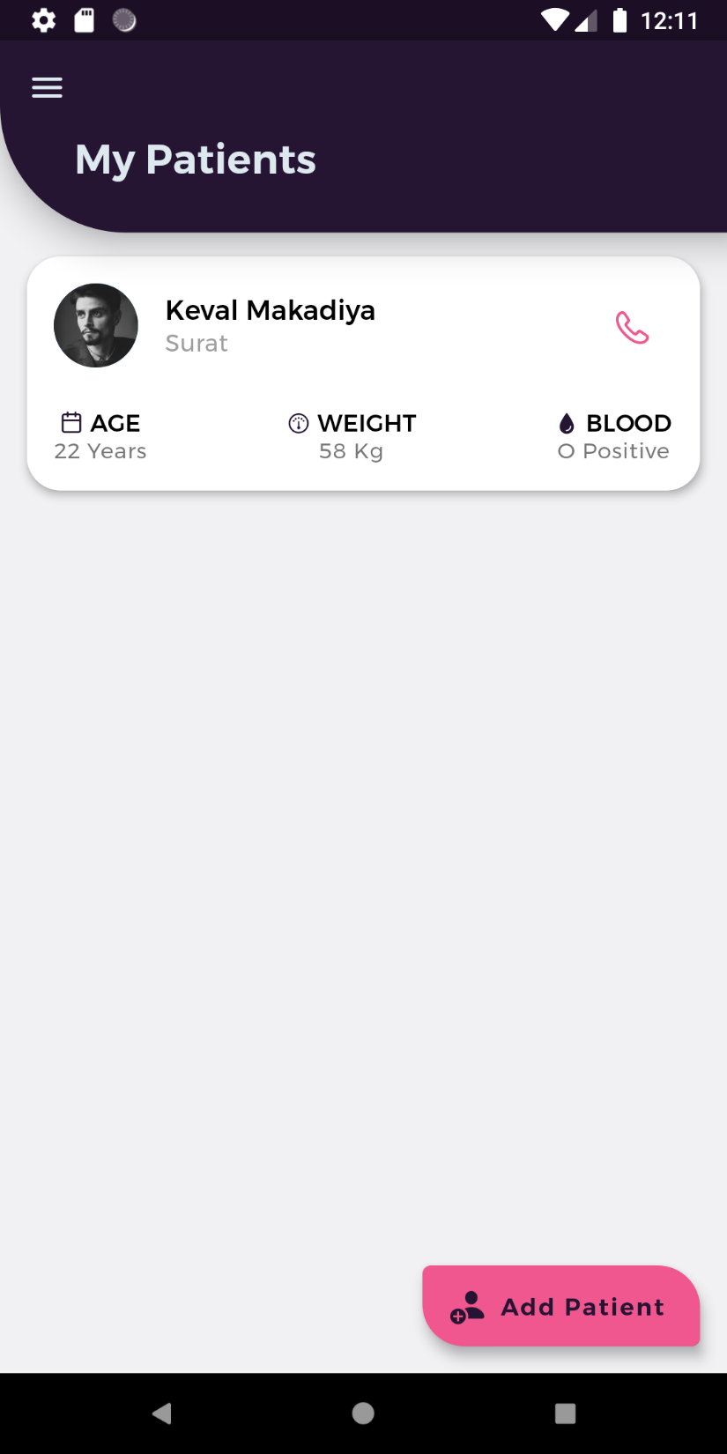
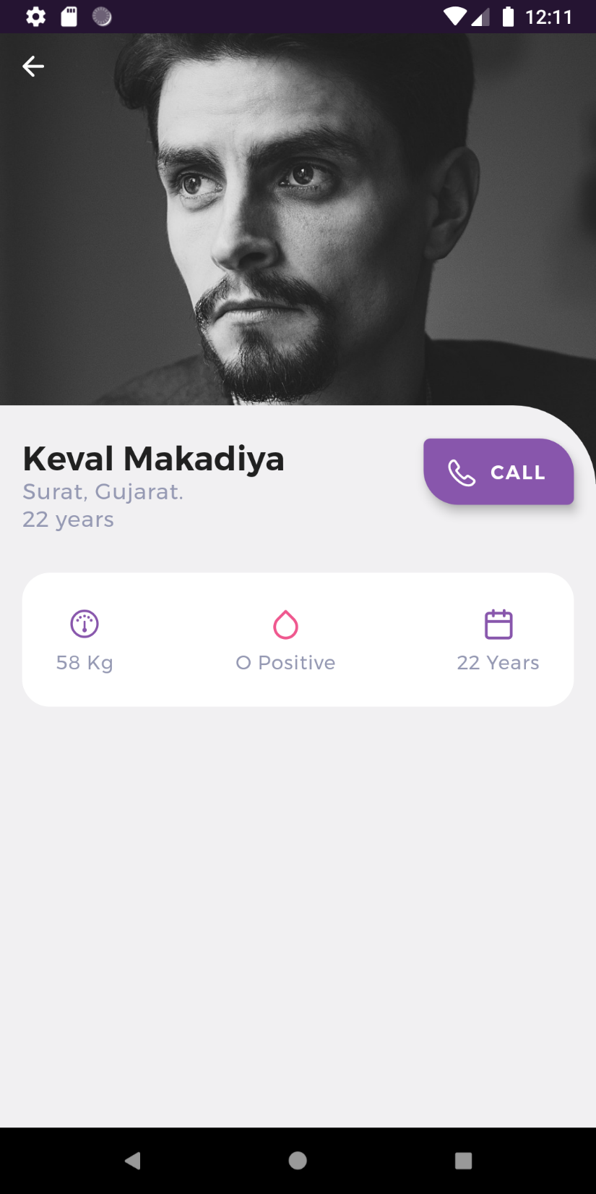
Prototype
Doctor side:
8

Slide 9
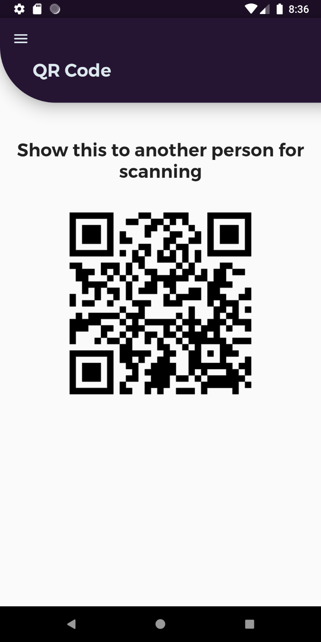
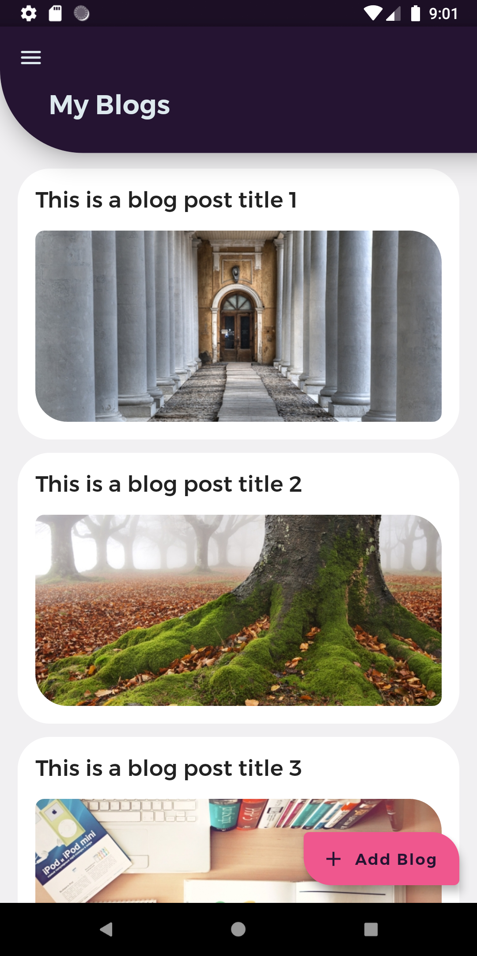
Prototype
Doctor side:
9

Slide 10
Future Enhancement
In future we can add following functionalities like:
Notification for the documents
Medicine reminder facility
Ambulance request and tracing facility.
Desktop software for a doctors to easily interact with service.
Support for iOS Devices
10

Slide 11
Thank You
11

