Slide 1
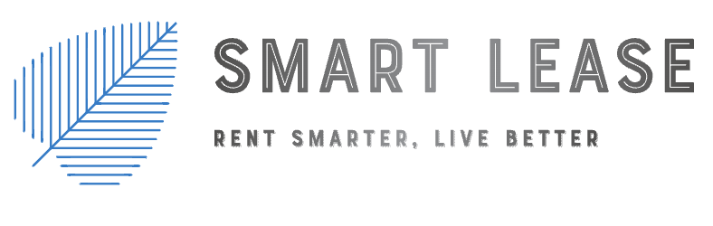

Slide 2
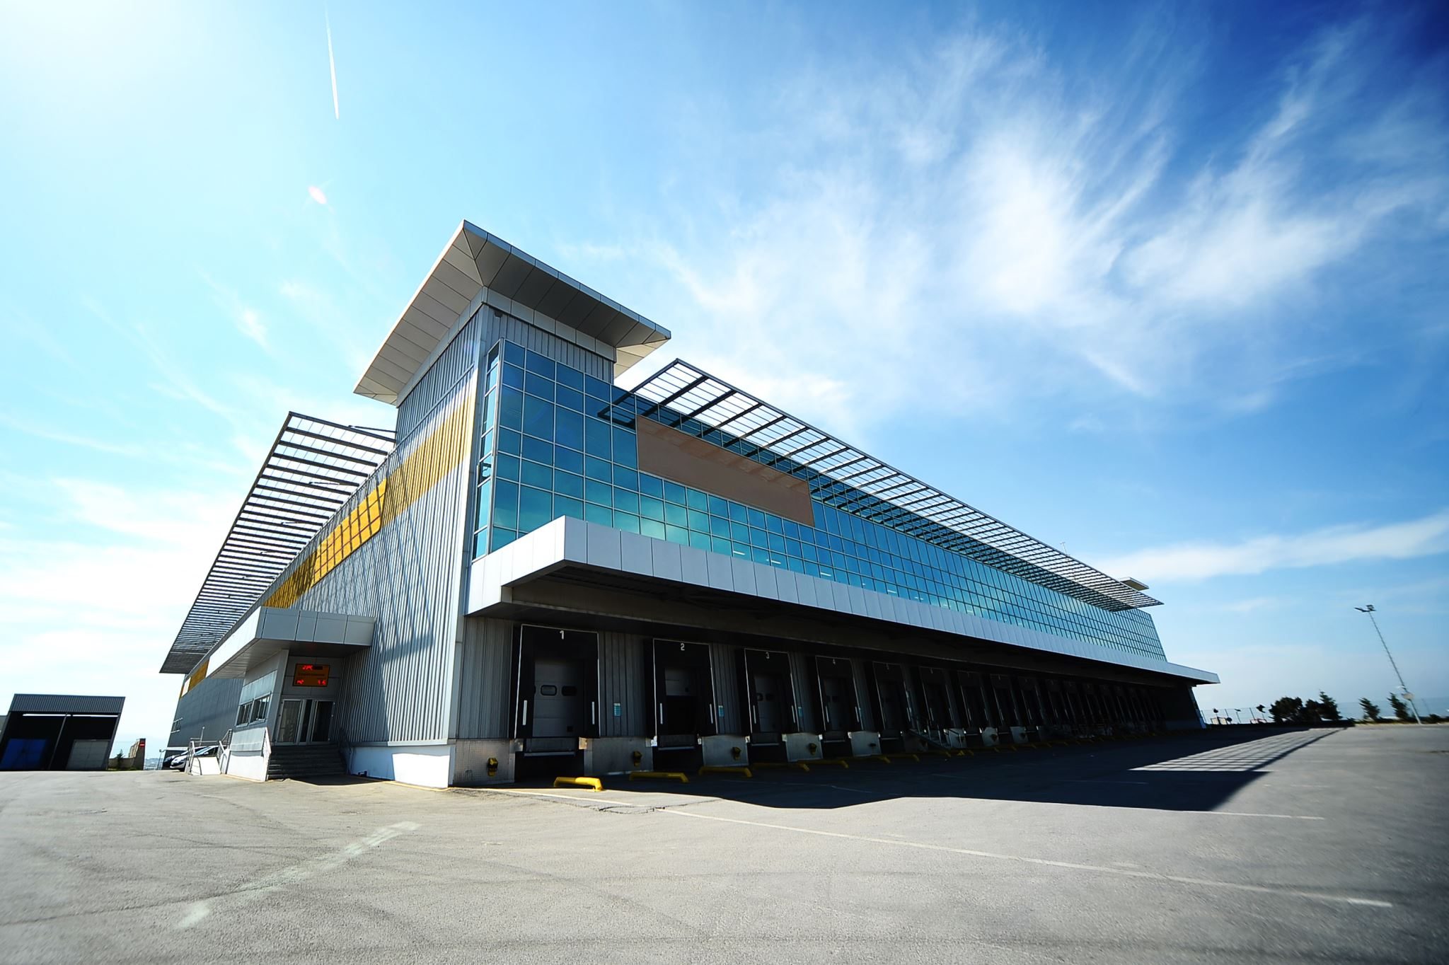
Executive Summary
Our app streamlines property managers/landlord to manage property while enhancing tenant experience. Offering features like property information, rent tracking, request management, and a comprehensive dashboard.

Slide 3
Problem
Lack of centralized information
Communication gaps between landlord/tenant
Maintenance request bottlenecks

Slide 4

Solution
Database with App – Consolidating property details, lease agreements, maintenance history, and tenant information.
Robust Communication System – Features such as in-app messaging, notifications, and updates ensure everyone stays informed in real-time.
Maintenance Request Feature – Landlords and property managers receive immediate notifications, enabling faster response times and efficient resolution of maintenance issues.

Slide 5

Mockup and Prototypes

Slide 6

The End
Nathan Nguyen
Keval Rakholiya
Rafael Melkumian
Aaron Morales
Liliana Rangel

