Slide 1
Stock Price Trend Prediction
Group 25
Mentor : Prof. M. V. Joshi

Slide 2
Team Members
Yash Shah - 201801131
Keval Thakarar - 201801157
Param Modi - 201801168
Jaymin Chauhan - 201801454

Slide 3
Objective
Short term price trend prediction of the stock
Input :
Past Trading Data (High, Low, Open, Close, Volume)
Index Data (Dow Jones, S&P 500)
Technical Indicators
Google Trends
News Sentiments
Output : Prediction of Close Price for (n+1)^{th} Day

Slide 4
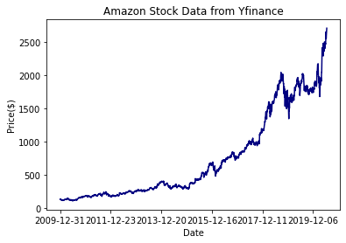
Dataset & Resource
Past Trading Data (High, Low, Open, Close, Volume)
Yfinance Ticker Module
S&P 500 Companies Data

Slide 5
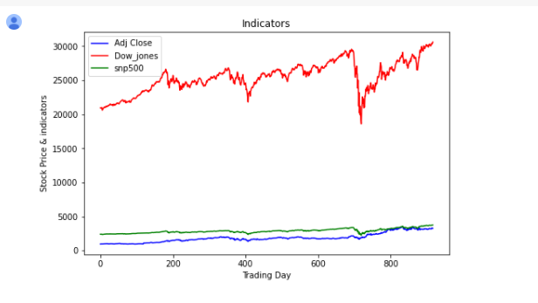
Dataset & Resource
Index Data
Dow Jones
S&P 500
Stock Market Sentiment
Macrotrends

Slide 6
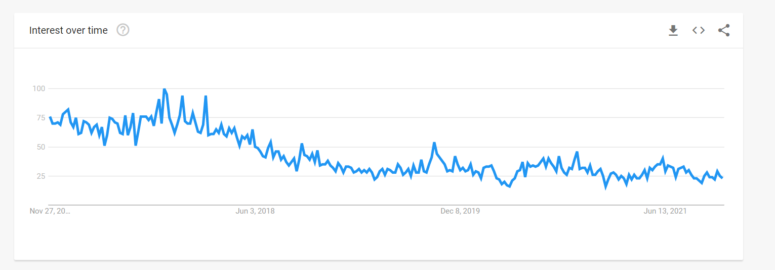
Dataset & Resource
Google Trends
Popularity based on Search
Indicate Public Sentiment
Financial News
Seeking Alpha

Slide 7
Methodology
RAW Data
Feature Expansion
News Sentiment Analysis
LSTM
Result

Slide 8
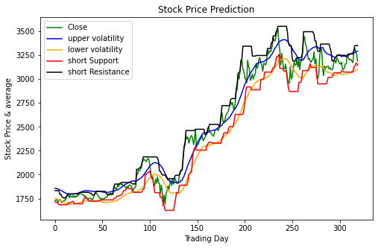
Feature Expansion
Technical Indicators
Moving Average
Volatility Index (Upper & Lower)
Support (Long & Short)
Resistance (Long & Short)
Companies with Highest Correlation

Slide 9
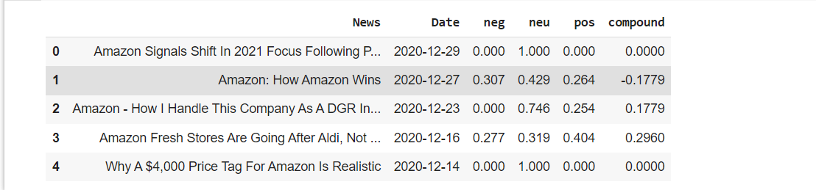
News Sentiments and Analysis
VADER Model
SentimentIntensityAnalyzer()
Polarity
Positive
Negative
Strength
How much Positive ?

Slide 10
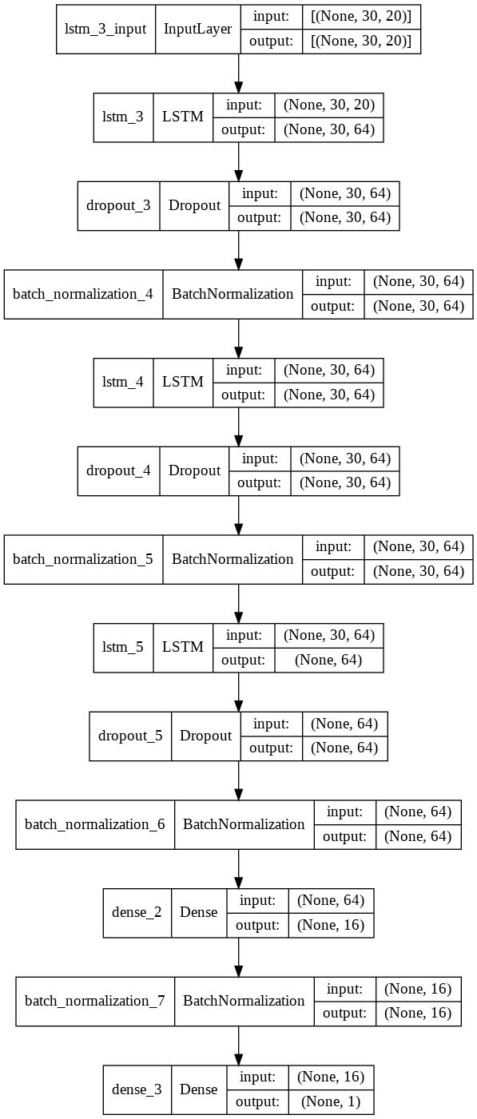
LSTM
Input Layer
LSTM Layer
Dropout Layer
Batch Normalization
Dense Layer
Training

Slide 11
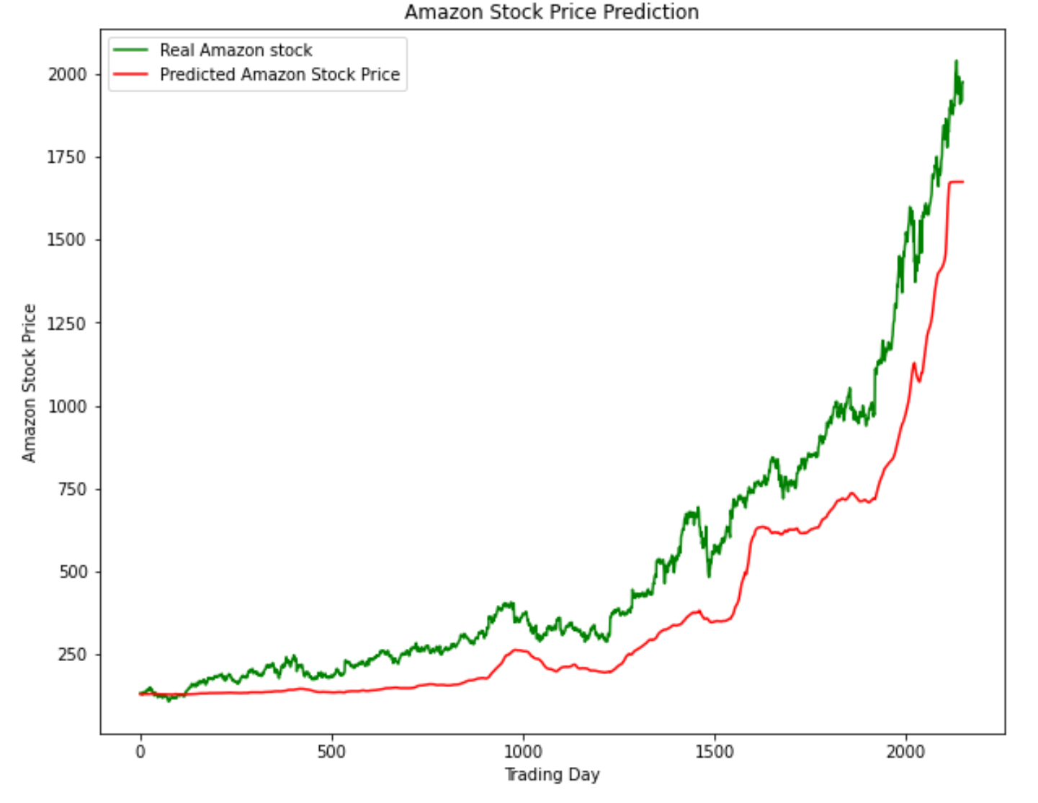
Results & Analysis
Train Dataset
Without External Data
Index
Google Trend
News Sentiments
RMSE = 190.27

Slide 12
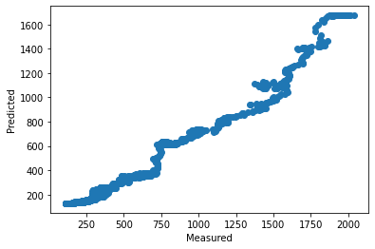
Results & Analysis
Train Dataset
Without External Data
Index
Google Trend
News Sentiments
RMSE = 190.27
R2 Score = 0.807

Slide 13
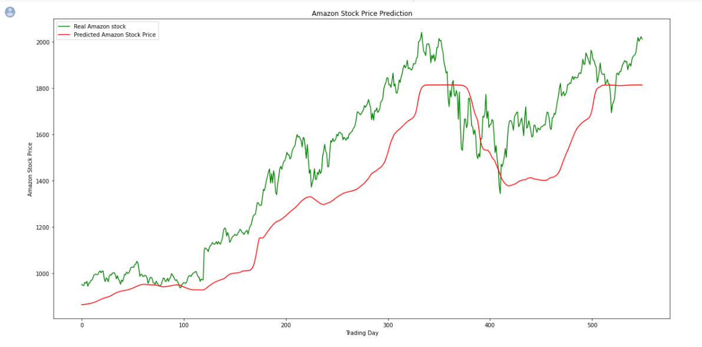
Results & Analysis
Test Dataset
Without External Data
Index
Google Trend
News Sentiments
RMSE = 185.54

Slide 14
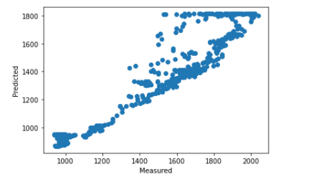
Results & Analysis
Test Dataset
Without External Data
Index
Google Trend
News Sentiments
RMSE = 185.54
R2 Score = 0.709

Slide 15
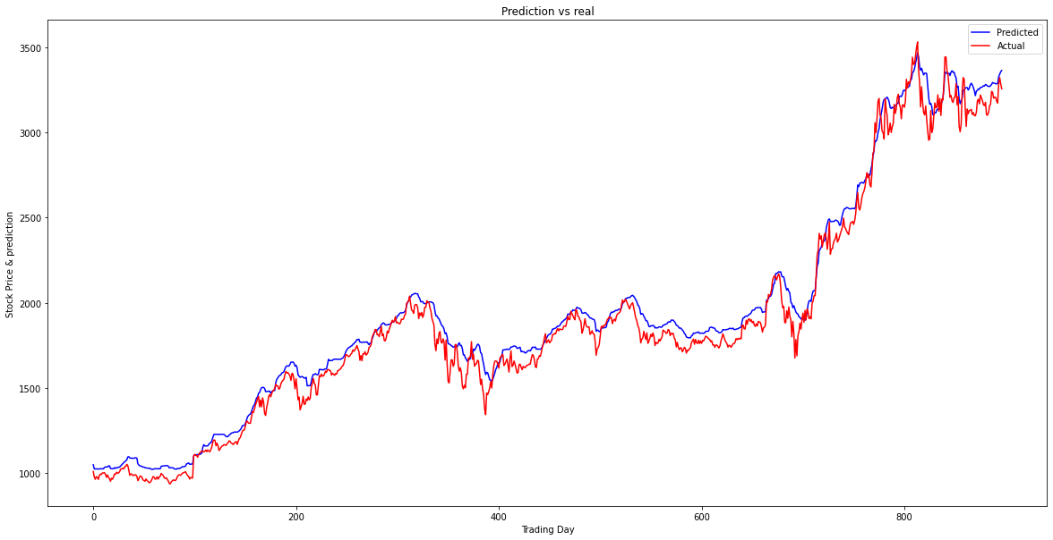
Results & Analysis
Train Dataset
With External Data
Index
Google Trend
News Sentiments
RMSE = 85.61

Slide 16
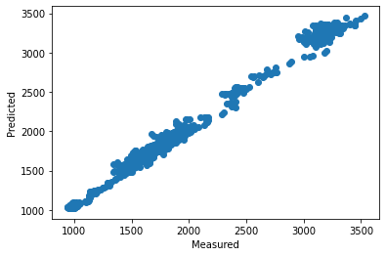
Results & Analysis
Train Dataset
With External Data
Index
Google Trend
News Sentiments
RMSE = 85.61
R2 Score = 0.98

Slide 17
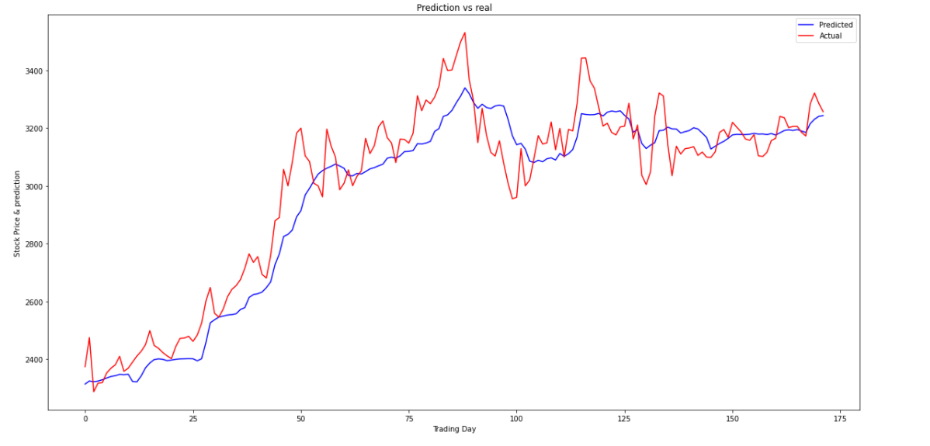
Results & Analysis
Test Dataset
With External Data
Index
Google Trend
News Sentiments
RMSE = 100.21

Slide 18
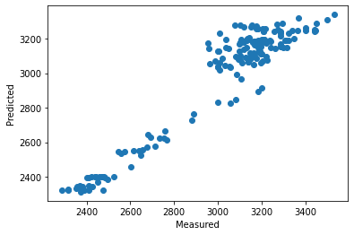
Results & Analysis
Test Dataset
With External Data
Index
Google Trend
News Sentiments
RMSE = 100.21
R2 Score = 0.89

Slide 19
References
Research Paper
YFinance
Macrotrends
Seeking Alpha
Google Trends

Slide 20
Thank You

