Slide 1

SCo 2.0
Salesforce.com Implementation
10 may 2013

Slide 2
Content
Introduction
Global design
Overview of business process
Administration
Sales process

Slide 3
introduction
Goal and objectives
Due to obsolete technology, replace current SCO application with SCO 2.0 Salesforce solution
Provide Headquarters with a global insight on the field offices operations.
Provide field offices a convenient tool to manage their daily operations and standardize operations
Introduction

Slide 4
introduction
Executive summary
The application SCO 2 shall support the daily field operations of Commercial division offices in its two countries, France and UK
By doing so SCO 2 becomes a key information repository and shall provide Commercial division the necessary reporting capabilities to support operational and strategic decisions.
Finally SCO 2 as Information System and set of work procedures shall facilitate Standard ISO/IEC 17020 accreditation of the field offices.
Introduction

Slide 5
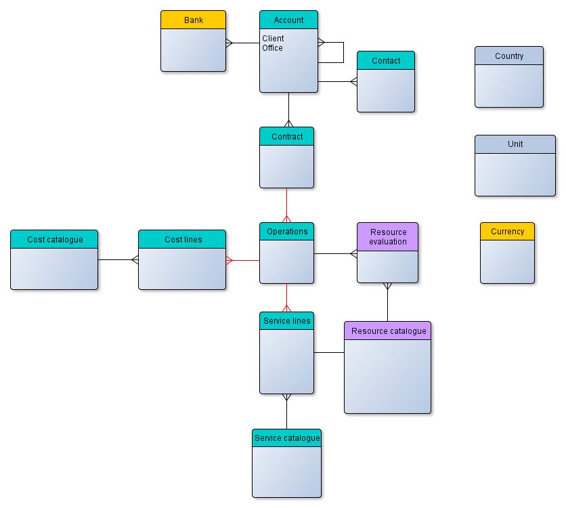
Global design
Target data model
Global design

Slide 6
Global design
Object properties
Refer to the last version of the following Excel file for the data model and Salesforce object properties
SCO_ObjectsProperties.xlsx
Global design

Slide 7
Global design
Profiles administration
A Salesforce user profile contains user permissions and access settings that control what users can do within their organization
Profile name | Description
System Administrator | Standard System Administrator - Has full access to all functionalities Can configure and customize the application Used by IT Support
Local Admin | Cloned from Standard User with limited rights Manages local data catalogues but will not customize application
Coordinator | Cloned from Standard User - Responsible of contracts and operations
Global design

Slide 8
Global design
Roles
Roles can control the level of visibility that users have into the organization’s data
The role hierarchy will consist of one role by country
Global design

Slide 9
Global design
Role hierarchy
Headquarter
UK
France
Global design

Slide 10
Global design
Organization-wide defaults
Organization-wide default sharing settings gives a baseline level of access for each object and allows to extend this level of access using hierarchies or sharing rules
Account is Public Read only and all other objects is Private
Refer to the Excel file Cotecna_ObjectsProperties.xlsx for more detail
Global design

Slide 11
Global design
Sharing rules
Sharing rules represent the exceptions to organization-wide default settings and give users access to records they do not own.
Sharing rule for accounts to give Read/Write access to users of same role/country level
Private objects (local catalogue) will be shared in Read/Write within the same country role
Global design

Slide 12



Administration
Super admin: Define global catalogues
Unit
Define global unit of measures
Currencies
Define currencies and exchange rates
Country
Define countries
Administration

Slide 13



Administration
Local admin: Define local data and catalogues
Service catalogues
Define local service catalogue
Cost catalogue
Define local costs
Resource catalogues
Define local resources
Administration

Slide 14
Sales process
Coordinator: Define clients and contacts
Client created
Enter client information
Contact/s created
Link contact/s to client
Sales process

Slide 15
Sales process
Coordinator: Define contract, operations, services and costs
Contract created
Enter contract information
Contract-client link created
Define services
Choose from global services
Operation created
Enter operation details by contract business line
Link contract to client
Choose from service catalogue
Define costs
Choose from cost catalogue
Sales process

Slide 16
Sales process
Evaluate resource: Evaluate resources per operation
Display resources per operation
Enter resource score
Resource evaluation created
Generate average score for resource
Sales process

Slide 17
BUSINESS RULES
Client number
There must a client number generated automatically. The format of the client number is
Country code – counter
Counter should be per country.
For example,
UK
Client 1 : UK – 0001
Client 2 : UK – 0002
France
Client 1 : FR - 0001

Slide 18
BUSINESS RULES
Resource evaluation
The coordinator should be able to evaluate all the resources defined on an operation’s service on the same page.
For example,
Evaluate resources
Resource | Accuracy | Speed | Reliability
John Doe
Alain Dupont

