Slide 1



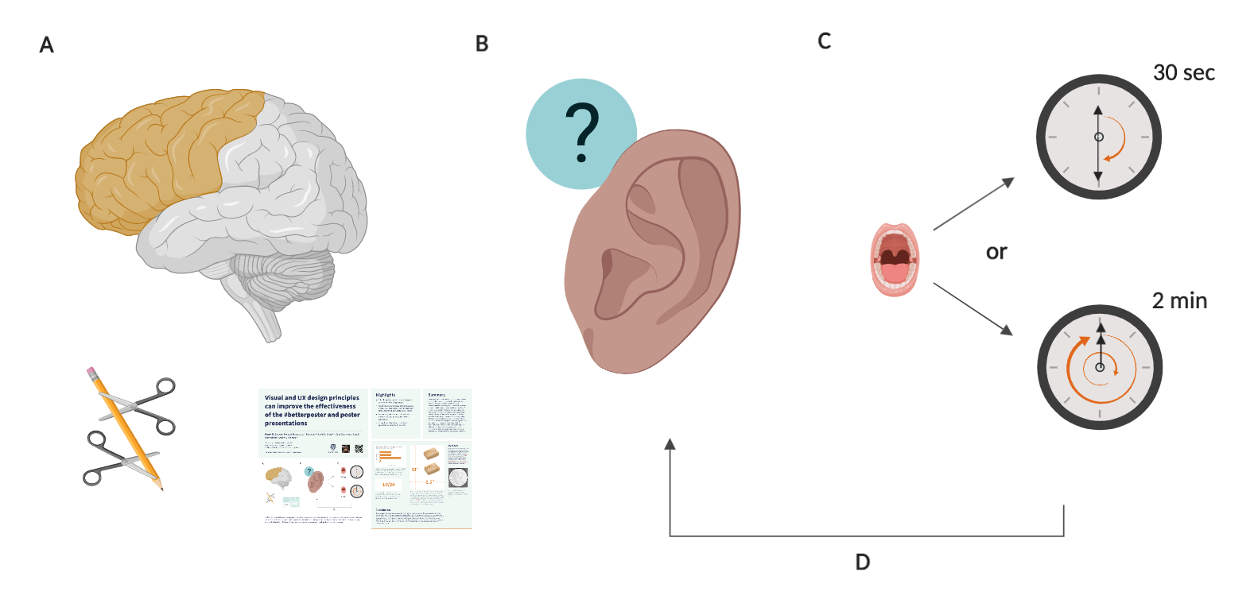
Visual and UX design principles can improve the effectiveness of Morrison’s Better Poster and poster presentations
Rearrange, subtract, and add these dividers to make subsections that help you tell your story. Don’t just use them as they are. The next slide shows them with some real data so you can see how they worked in a real poster
Derek B. Crowe¹, Melanie Rogala³, S.P. Margolis^{1,2}, Luke H. Shaw^{1,3}, David Sanchez², Sarah Rutherford², Amber V. Odhner²
1 University of Rochester, Rochester, NY
2 Karhide University, Erhenrang, Gethen
3 College at The Bog of Eternal Stench, Labyrinth
Correspondence: derek_crowe@urmc.rochester.edu
Highlights
A well-crafted message is more important than any layout design.
Visual design strategies can be employed to incorporate lessons from Morrison’s Better Poster without sacrificing valuable poster space.
Posters are performances and audience members should have a voice in their experience.
All academic disciplines can help us approach our world with curiosity.
Summary
Mike Morrison’s better poster style encourages scientists to distill their message, a critical step in creating effective posters. Dramatic physical layout constraints are the primary mechanism employed to help users consolidate their story, though this strategy costs a significant portion of the available poster space. Principles of visual design can guide users to achieve the same effective communication as intended by Morrison without sacrificing valuable real estate, as demonstrated here in a series of butter poster layouts. These designs also incorporate user experience (UX) considerations of realistic time and social expectations during audience interactions at poster presentations. Multiple variations are offered in attempt to accommodate a wide variety of preferences and use cases. Also they’re just some free powerpoint templates on a website; you monsters can do whatever you want with them.
Graphical Abstract
(A) Plan, cut, edit, and distill your message. Write a brief, descriptive title. Use a layout that takes advantage of the whole poster. Prepare two versions of your poster intro: a short one and a long one. (B) When another human seems like they might be interested in your work, ask to be sure. Then ask if they want the short intro or the long intro. Don’t be afraid to ask questions to learn about your audience first. Use their background to change your talks up on the fly; they’re not elevator pitches. (C) Oblige them. Use the graphical abstract for the short version and get into your data figures for the long version. (D) Listen to their verbal and non-verbal responses as you continue the conversation.

Slide 2
Visual and UX design principles can improve the effectiveness of Morrison’s Better Poster and poster presentations
Derek B. Crowe¹, Melanie Rogala³, S.P. Margolis^{1,2}, Luke H. Shaw^{1,3}, David Sanchez², Sarah Rutherford², Amber V. Odhner²
1 University of Rochester, Rochester, NY
2 Karhide University, Erhenrang, Gethen
3 College at The Bog of Eternal Stench, Labyrinth
Correspondence: derek_crowe@urmc.rochester.edu
Highlights
A well-crafted message is more important than any layout design.
Visual design strategies can be employed to incorporate lessons from Morrison’s Better Poster without sacrificing valuable poster space.
Posters are performances and audience members should have a voice in their experience.
All academic disciplines can help us approach our world with curiosity.
Summary
Mike Morrison’s better poster style encourages scientists to distill their message, a critical step in creating effective posters. Dramatic physical layout constraints are the primary mechanism employed to help users consolidate their story, though this strategy costs a significant portion of the available poster space. Principles of visual design can guide users to achieve the same effective communication as intended by Morrison without sacrificing valuable real estate, as demonstrated here in a series of butter poster layouts. These designs also incorporate user experience (UX) considerations of realistic time and social expectations during audience interactions at poster presentations. Multiple variations are offered in attempt to accommodate a wide variety of preferences and use cases. Also they’re just some free powerpoint templates on a website; you monsters can do whatever you want with them.
Graphical Abstract
(A) Plan, cut, edit, and distill your message. Write a brief, descriptive title. Use a layout that takes advantage of the whole poster. Prepare two versions of your poster intro: a short one and a long one. (B) When another human seems like they might be interested in your work, ask to be sure. Then ask if they want the short intro or the long intro. Don’t be afraid to ask questions to learn about your audience first. Use their background to change your talks up on the fly; they’re not elevator pitches. (C) Oblige them. Use the graphical abstract for the short version and get into your data figures for the long version. (D) Listen to their verbal and non-verbal responses as you continue the conversation.

Slide 3




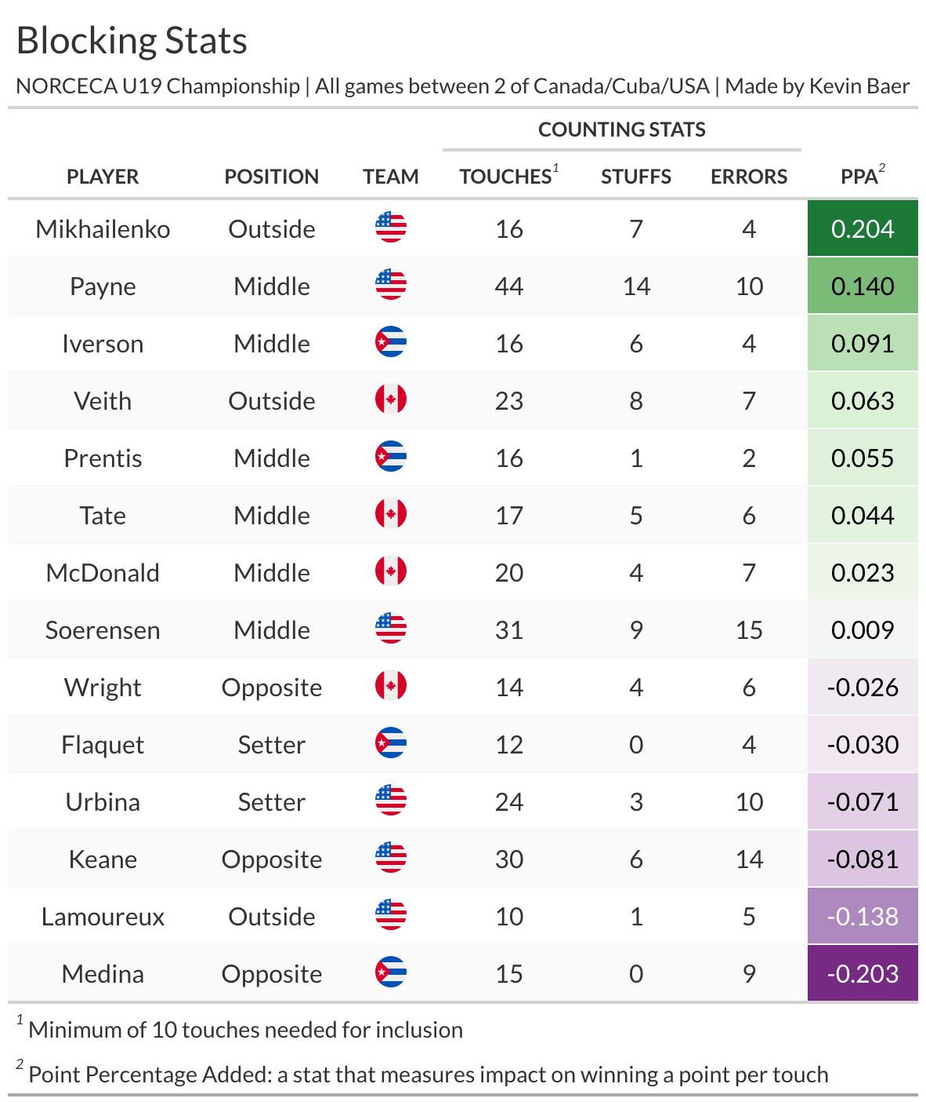
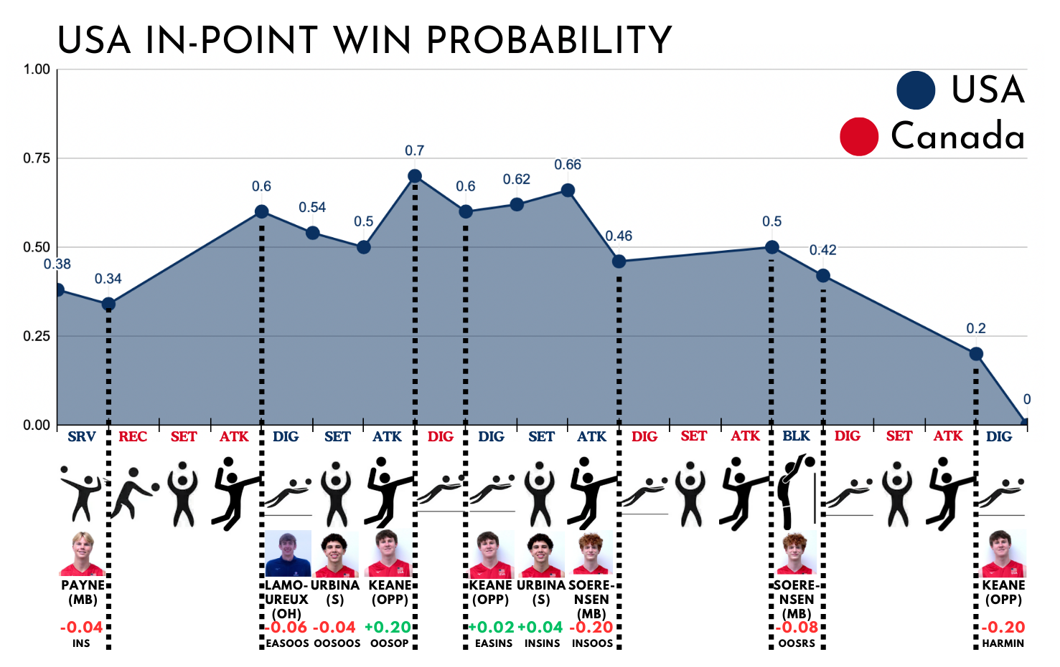
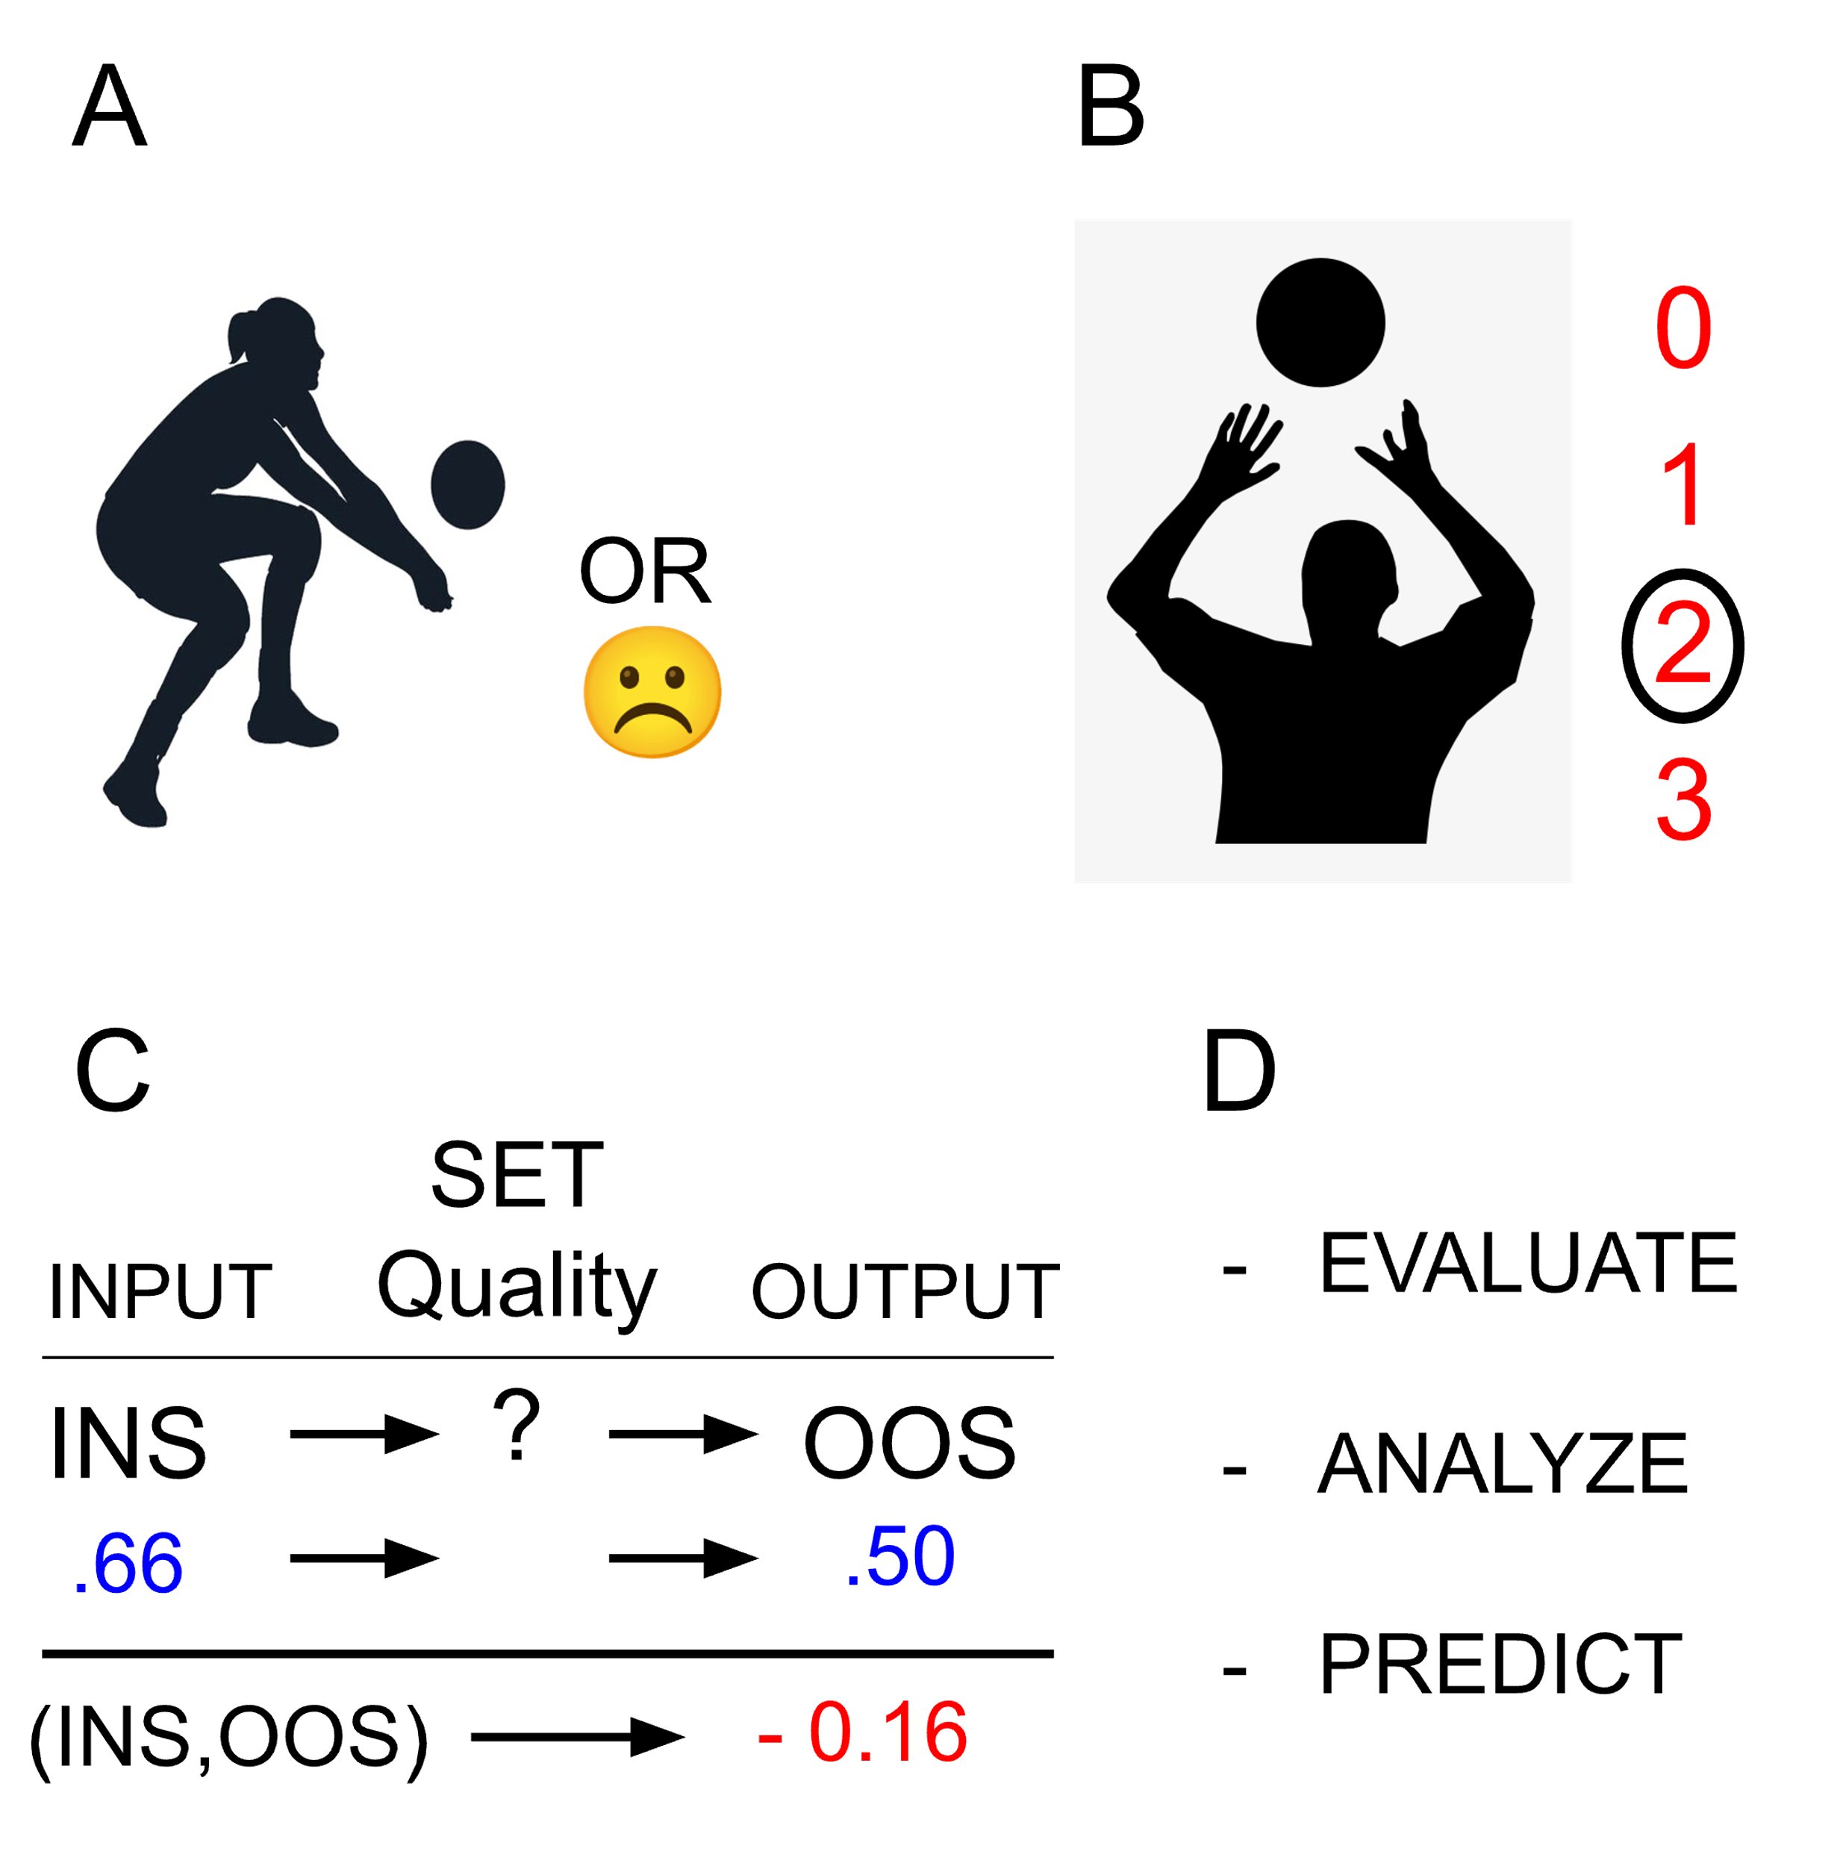

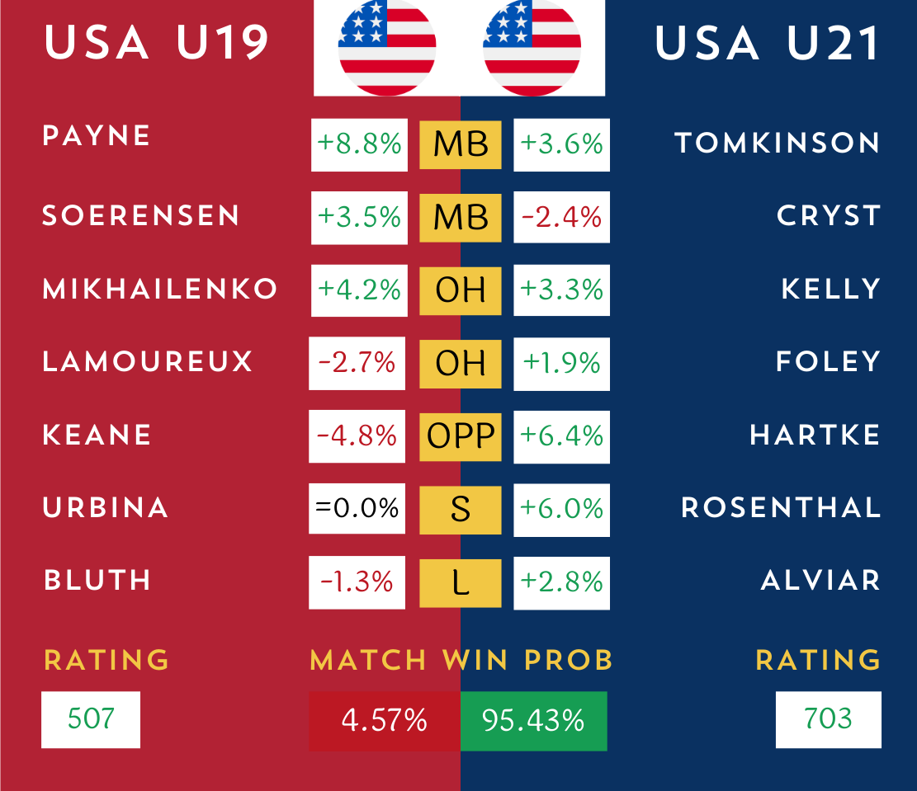
Digging Deeper: Building Volleyball Metrics with Full-Court Coverage and Context
EVALUATE
ICA is a matrix decomposition technique that reduces the dimensionality of our transcriptomic dataset by defining two new matrices which, when multiplied, approximate the original data. These matrices capture the cumulative effects of unknown biological and technical processes. The number of these processes, or components, is predetermined from the original data structure.
Each gene and each sample is given a separate weight for its unique contribution to a component. By correlating these weights with known phenotypic information, such as tumor status, we can identify components of interest. We can then select the genes that contribute significantly to these components, which may also contribute to the biology underlying our phenotypes of interest.
Kevin Baer
Faculty Research Mentor: Dave Zes
University of California, Los Angeles
Data Theory Undergraduate Student
University of California, Los Angeles
Correspondence: kevinbaer@ucla.edu
271263296_116490320891374_7383523803251041163_n.jpg
Highlights
Tumor recurrence is a common response to treatment and many recurrent cells emerge with novel oncogenic drivers and therapeutic resistance.
Transcriptomic analysis of primary and recurrent tumor cells reveals shared, driver-independent gene expression patterns
A pooled CRISPR dropout screen can reveal shared survival mechanisms in primary and recurrent tumors and may point to shared therapeutic vulnerabilities
Methods
A dox-inducible, pancreatic-specific mutant Kras transgene to model PDAC progression and recurrence
Bulk RNA-Seq of primary and recurrent tumor cell lines
Dimension reduction and module detection via Independent Component Analysis in R
An in-vivo, pooled, CRISPR-based competition assay to test the functional contribution of select genes to primary and recurrent tumor cell survival
ANALYZE
ICA is a matrix decomposition technique that reduces the dimensionality of our transcriptomic dataset by defining two new matrices which, when multiplied, approximate the original data. These matrices capture the cumulative effects of unknown biological and technical processes. The number of these processes, or components, is predetermined from the original data structure.
Each gene and each sample is given a separate weight for its unique contribution to a component. By correlating these weights with known phenotypic information, such as tumor status, we can identify components of interest. We can then select the genes that contribute significantly to these components, which may also contribute to the biology underlying our phenotypes of interest.
Here, win probability demonstrates a point the United States could have potentially won. By taking the definite integral we can determine the United States’ control of the total space to be 48.61%. This metric adds considerable context to the interpretation of the 1-0 point score for Canada.
😀
PREDICT
ICA is a matrix decomposition technique that reduces the dimensionality of our transcriptomic dataset by defining two new matrices which, when multiplied, approximate the original data. These matrices capture the cumulative effects of unknown biological and technical processes. The number of these processes, or components, is predetermined from the original data structure.
Each gene and each sample is given a separate weight for its unique contribution to a component. By correlating these weights with known phenotypic information, such as tumor status, we can identify components of interest. We can then select the genes that contribute significantly to these components, which may also contribute to the biology underlying our phenotypes of interest.
(A) Volleyball analytics started out of the wish to quantify the success of actions taken on the court. In this case, a bump would be evaluated based on whether it seemed good or bad, a surprisingly simple and effective way to represent quality. (B) More recently, the 4 point passing scale has broken out as a way to represent a bump by how much the setter must move to set the ball. (C) However, we can make three excellent improvements, firstly looking at both the input and the output of the touch instead of just the output. Second, we can use game states to better classify and compare our “vibes” based charting. And finally, using big data empirical win probabilities for each game state allows for a more accurate depiction of the scale of the impact. (D) What are the benefits of this improved understanding? We can evaluate player performance, analyze points and matches accurately, and predict outcomes of points, sets, and matches in new ways.
Predictive analysis are created through player overall weighted PPA, number of rotations, and Scott Power’s Pythagorean winning percentage. Rating is score out of 1000 points against the “perfectly average” team
We can even compare hypothetical matchups, although care should be taken given the different opposition levels. One area of future exploration will be opponent adjustment.

