Slide 1
Object –Relational Mapping

Slide 2
Object Relational Mapping
What
Why
How
Capture Audience Attention

Slide 3
ORM - What
Object-relational mapping (ORM) is a technique (a.k.a. design pattern) of accessing a relational database from an object-oriented language (Java, for example). ... Hibernate is a big, powerful engine that makes a connection to the database, executes necessary SQL SELECT requests, and retrieves the data.

Slide 4
ORM - What
Person
ID | FirstName | LastName | Gender
1 | John | Doe | Male
2 | Jane | Doe | Female
public class Person
{
public int ID { get; set; }
public string FirstName { get; set; }
public string LastName { get; set; }
public string Gender { get; set; }
}

Slide 5
ORM - Why
Write SQL conversion methods by hand :
○ Tedious and requires lots of code
○ Extremely error-prone
○ Non-standard SQL ties the application to specific databases
○ Vulnerable to changes in the object model
○ Difficult to represent associations between objects
Developers able to perform CRUD operations using same language they are coding the rest of the application in.

Slide 6
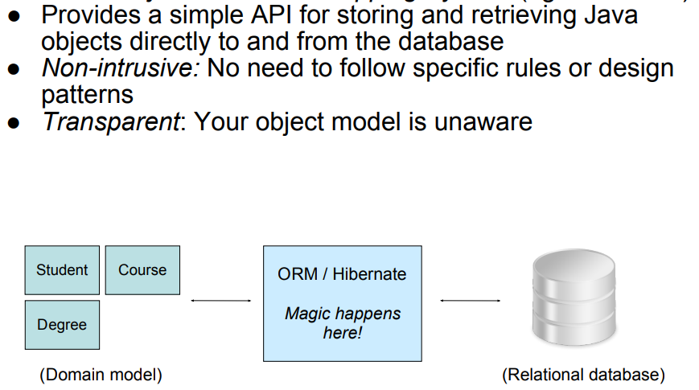
ORM - How

Slide 7
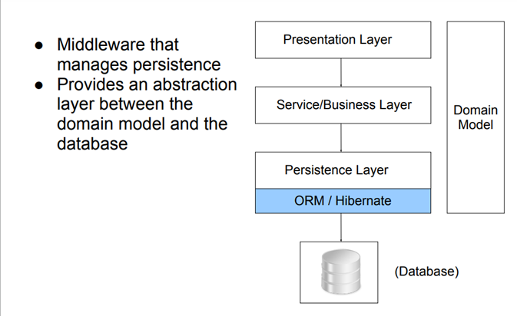
ORM - How

Slide 8
ORM - How
In object-oriented programming, data-management tasks act on objects that are almost always non-scalar values. For example, an address book entry that represents a single person along with zero or more phone numbers and zero or more addresses. This could be modeled in an object-oriented implementation by a "Person object" with attributes/fields to hold each data item that the entry comprises: the person's name, a list of phone numbers, and a list of addresses. The list of phone numbers would itself contain "PhoneNumber objects" and so on. The address-book entry is treated as a single object by the programming language (it can be referenced by a single variable containing a pointer to the object, for instance). Various methods can be associated with the object, such as a method to return the preferred phone number, the home address, and so on.

Slide 9
ORM – from SQL to objects
String sql = "SELECT id, first_name, last_name, phone, birth_date, sex FROM persons WHERE id = 10";
Result res = db.execSql(sql);
String name = res[0]["FIRST_NAME"];
Person p = repository.GetPerson(10);
String name = p.getFirstName();
Person p = Person.Get(10);

Slide 10
ORM – Hands on lab
Data Design Lab

Slide 11
ORM – Summary and conclusion
Discussion & Questions

