Slide 1
Customer Acquisition
Yuecheng Fang
Kevin Gardner

Slide 2
Agenda
Executive Summary
Data Dictionary and ERD
Code Flowchart
Model Performance
Prediction

Slide 3
Executive Summary
Pay more attention to those companies:
Shorter duration of registrations
Registered more recently
Larger number of registrations

Slide 4
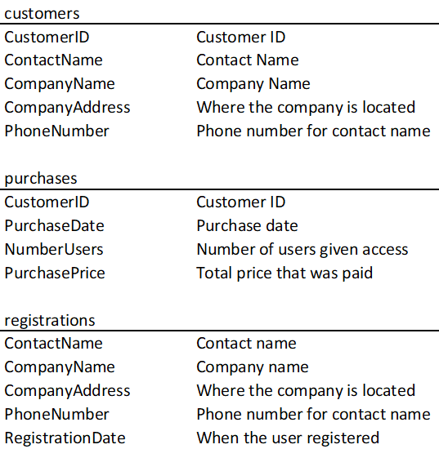
Data Dictionary

Slide 5
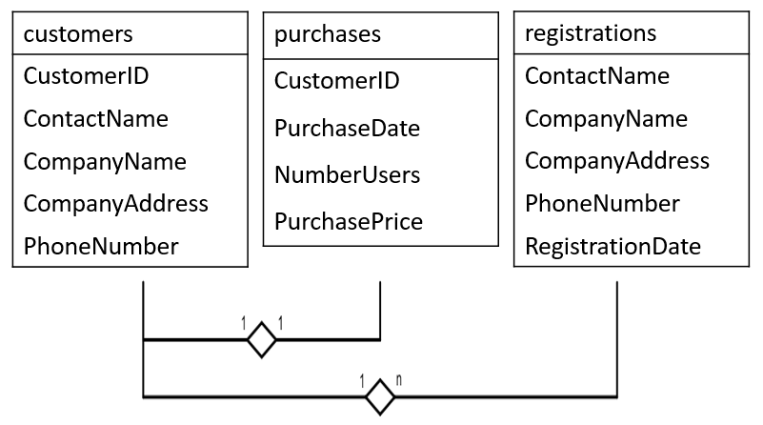
ERD

Slide 6
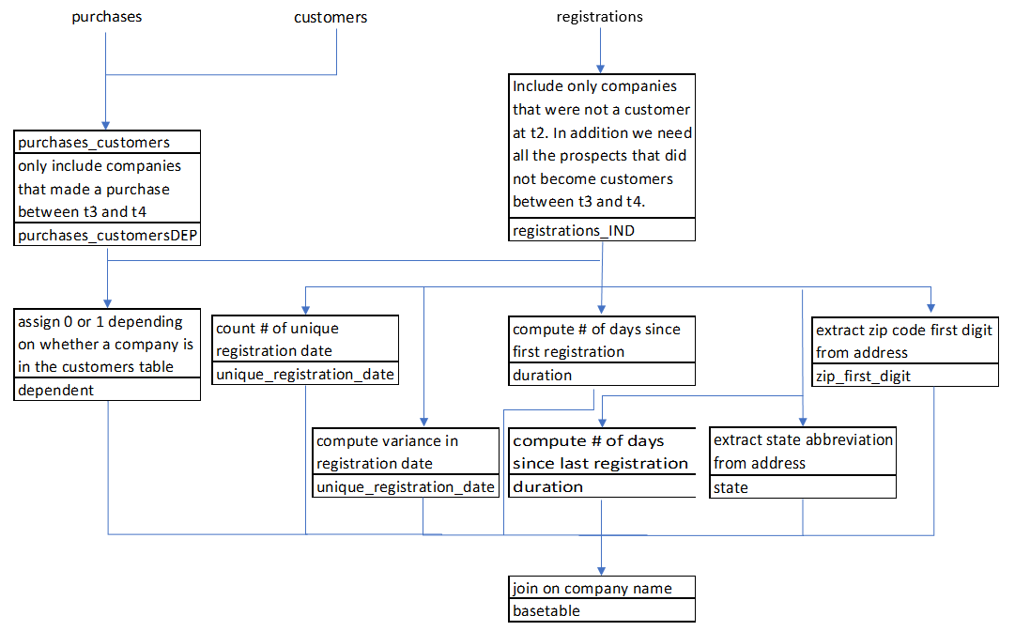
Flowchart

Slide 7
Create Model
AUC | = 0.85
Top Decile Lift | = 2.18
Function Length | = 112 lines
Running Time | = 10.5 seconds
Positively Related Variables | Negatively Related Variables
Number of Registration Dates | Recency of Registration
Number of Registrations | Duration of Registrations
Variance of Registration Date

Slide 8
Deploy Model
Highest propensity leads:
Function Length | = 80 lines
Running Time | = 3.7 seconds
Rainbow Polar
Seashell Consignment
Raisin Fire
Warrior Mania
Mango Videos
6. Mango Dolphin
7. Mushroom Leopard
8. Sunny Room
9. Myth Days
10. Mango Casting Call

Slide 9
Questions?

Slide 10
Appendix
Function calls
AUROC
Variable importance plot
Partial dependence plots

Slide 11
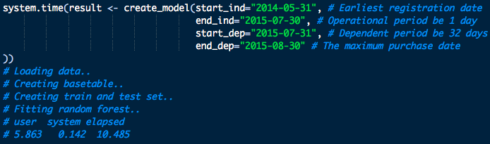
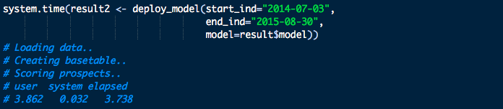
Function Calls

Slide 12
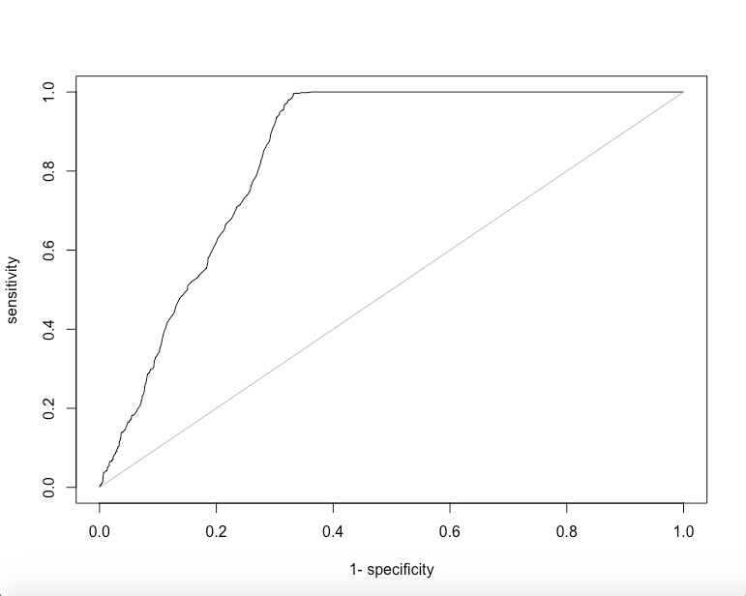
AUROC

Slide 13
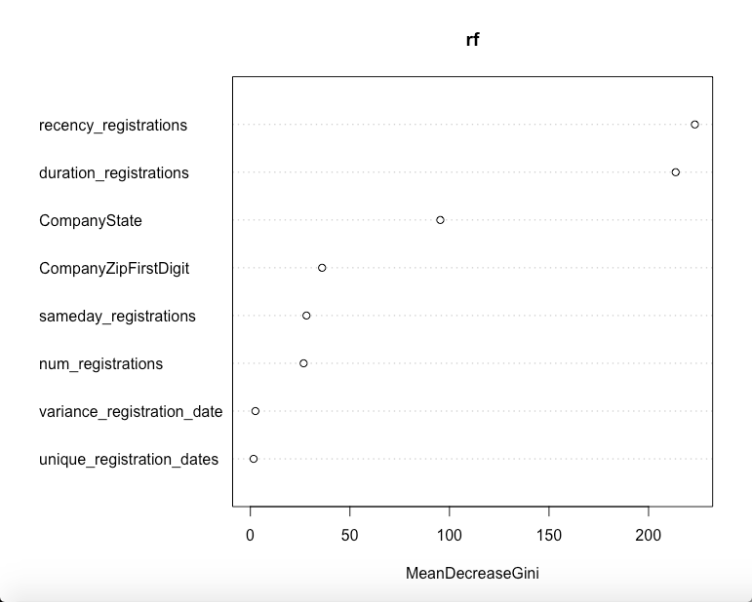
Variable Importance

Slide 14
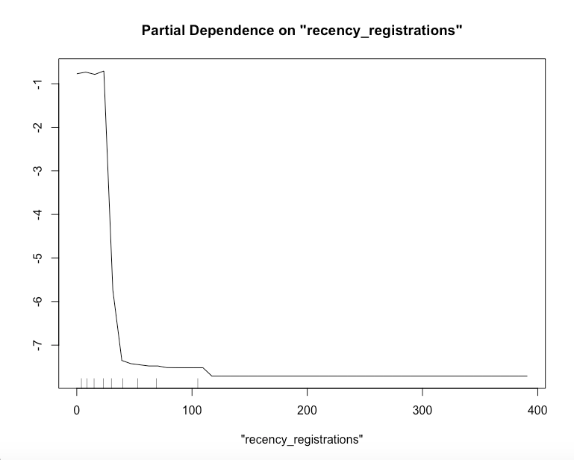
Recency of registrations

Slide 15
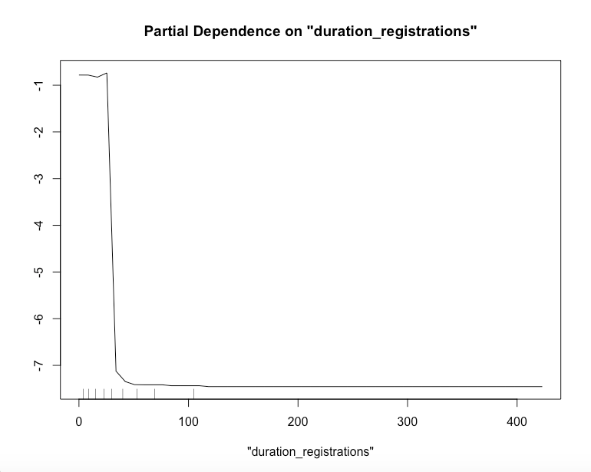
Duration of registrations

Slide 16
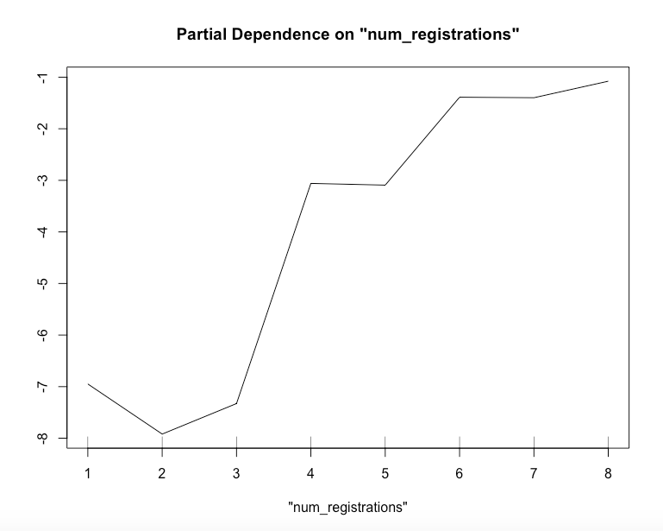
Number of registrations

