Slide 1
Predictive Modeling Breast Cancer Diagnosis
Jianghui “Jack” Wang

Slide 2
Executive Summary
Original Wisconsin Breast Cancer Database was used to test different predictive models
Models:
Logistic regression performs surprisingly well albeit its simplicity
Neural network overfits the data with very good performance on training set but not so good on testing set
Classification tree’ results are comparable with logistic regression results but with visual tree outputs

Slide 3
Data set statistics
Wisconsin breast cancer database
699 records (Benign: 458 Malignant: 241 )
Missing Bare Nuclei: 16
Dependent variable: Class (Benign/Malignant)
Training/testing
Training: 482 (Benign: 318/11 missing Malignant: 164)
Testing: 217 (Benign: 140 Malignant: 77)
Range: 0~10

Slide 4
Feature explanations
Clump thickness: Benign cells tend to be grouped in monolayers, while cancerous cells are often grouped in multilayers
Uniformity of cell size/shape: Cancer cells tend to vary in size and shape.
Marginal adhesion: Normal cells tend to stick together. Cancer cells tend to loose this ability. So loss of adhesion is a sign of malignancy.
Single epithelial cell size: Is related to the uniformity mentioned above. Epithelial cells that are significantly enlarged may be a malignant cell.
Bare nuclei: This is a term used for nuclei that is not surrounded by cytoplasm (the rest of the cell). Those are typically seen in benign tumors.
Bland Chromatin: Describes a uniform "texture" of the nucleus seen in benign cells. In cancer cells the chromatin tends to be coarser.
Normal nucleoli: Nucleoli are small structures seen in the nucleus. In normal cells the nucleolus is usually very small if visible at all. In cancer cells the nucleoli become more prominent, and sometimes there are more of them.

Slide 5
There are strong correlations among all the features
Pearson Correlation Coefficients
 | Thickness | Size | Shape | Adhesion | Epithelial | Nuclei | Bland | Nucleoli | Mitoses | Class
Thickness | 1
Size | 0.64248 | 1
Shape | 0.65347 | 0.90723 | 1
Adhesion | 0.48783 | 0.70698 | 0.68595 | 1
Epithelial | 0.5236 | 0.75354 | 0.72246 | 0.59455 | 1
Nuclei | 0.59309 | 0.69171 | 0.71388 | 0.67065 | 0.58572 | 1
Bland | 0.55374 | 0.75556 | 0.73534 | 0.66857 | 0.61813 | 0.68061 | 1
Nucleoli | 0.53407 | 0.71935 | 0.71796 | 0.60312 | 0.62893 | 0.58428 | 0.6656 | 1
Mitoses | 0.35096 | 0.46075 | 0.44126 | 0.4189 | 0.48058 | 0.33921 | 0.3460 | 0.43376 | 1
Class | 0.71479 | 0.8208 | 0.82189 | 0.70629 | 0.69096 | 0.8227 | 0.7582 | 0.71868 | 0.42345 | 1

Slide 7
Logistic Regression with SAS

Slide 8
Model Summary
Backward selection is used for feature selection
Start with interactions
Model
Somers’D = 0.987
Analysis of Maximum Likelihood Estimates
Parameter | DF | Estimate | Standard | Wald | VIF
 |  |  | Error | Chi-Square
Intercept | 1 | -6.8598 | 0.7637 | 80.6903
Size | 1 | 0.9058 | 0.1676 | 29.1956 | 2.462
Nuclei | 1 | 0.4719 | 0.0829 | 32.4323 | 1.907
Nucleoli | 1 | 0.4554 | 0.1101 | 17.1032 | 1.921

Slide 9
The sloping power is strong

Slide 10
Accuracy is high in both training and testing datasets
 |  | Train |  | Test
 |  | 0 | 1 | 0 | 1
Model | 1 | 8 | 157 | 3 | 66
 | 0 | 299 | 7 | 134 | 9
 |  | 96.82% |  | 94.34%
Note: Accuracy is adopted because of its simplicity compared to others such as informedness, markedness, F1 score, etc.

Slide 11
Neural Networks with R

Slide 12
10 hidden neurons/one hidden layer were used to train the data
Error: 0.5145 Steps: 31168

Slide 13
The model fits the training data very well

Slide 14
Accuracy is very high in training data but is low in testing data
 |  | Train |  | Test
Neural Network |  | 0 | 1 | 0 | 1
Model | 1 | 1 | 164 | 11 | 67
 | 0 | 306 | 0 | 124 | 8
 |  | 99.79% |  | 90.95%
It is very likely that the model over-fits the data
It is hard to explain intuitively the relationship between dependent variable and each independent variable

Slide 15
GUIDE
Classification and Regression Tree

Slide 16
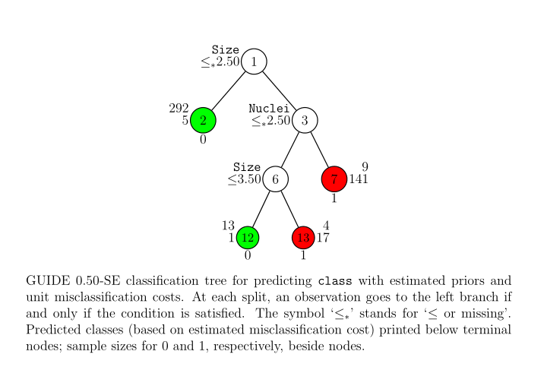
Visual tree also identified size and Nuclei as the most significant variables
Note: Graph was generated using Latex

Slide 17
Accuracy is high in both training and testing datasets
 |  | Train |  | Test
Guide |  | 0 | 1 | 0 | 1
Model | 1 | 13 | 158 | 5 | 70
 | 0 | 305 | 6 | 135 | 7
 |  | 96.06% |  | 94.47%

Slide 18
Conclusions
 | Train | Test | Somers'D
Logistic Regression | 96.82 | 94.34 | 0.987
Neural Network | 99.79 | 90.95 | 0.9666
GUIDE | 96.06 | 94.47 | -
Logistic regression is easy to explain and has good performance. It is easy to follow any governance/regulation
Neural network is more sophisticated machine learning algorithm suitable for artificial intelligence such as handwriting/face recognition
Classification tree includes interactions and gives visualization of the output with good performance on breast cancer dataset

Slide 19
Acknowledgment
This breast cancer databases was obtained from the University of Wisconsin Hospitals, Madison from Dr. William H. Wolberg
GUIDE is designed and maintained by Prof. Wei-Yin Loh at the University of Wisconsin, Madison.

