Slide 1
Broadcast Beam-Steered Optical Wireless Positioning: 3D Localization Without Cooperative Alignment

Slide 2
PROBLEM: Beam-steered OWP, as presented in the TCOM paper, requires a cooperative (K+1)-th measurement to recover distance. This requires PD reorientation, which prevents broadcast operation for multiple users simultaneously. SOLUTION: Exploit the distance information embedded in the K absolute power measurements, assuming that n_r is known from the receiver IMU. --> Broadcast 3D positioning without any cooperative measurement. KEY RESULT PEB analysis
broadcast_distance based on K-measurements (proposal)
NLS + broadcast_distance is equivalent to a profiled MLE and is therefore near-efficient, reaching the broadcast CRLB, PEB_B. The architecture provides full scalability: N simultaneous receivers can be served with a single LED scan.

Slide 3
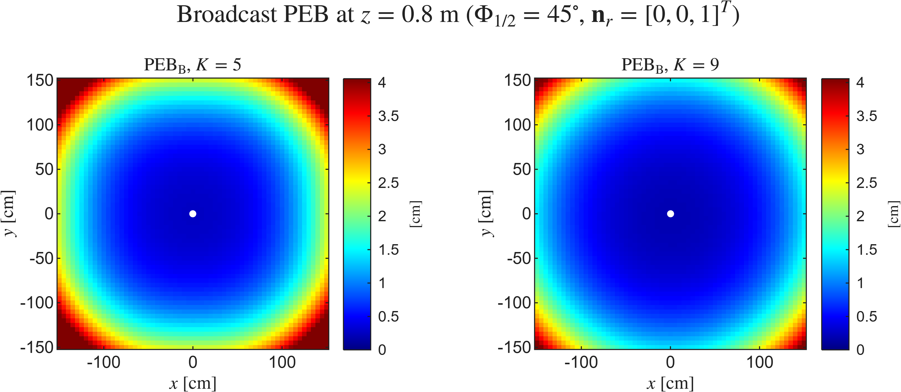
Section III - Broadcast Position Error Bound

Slide 4
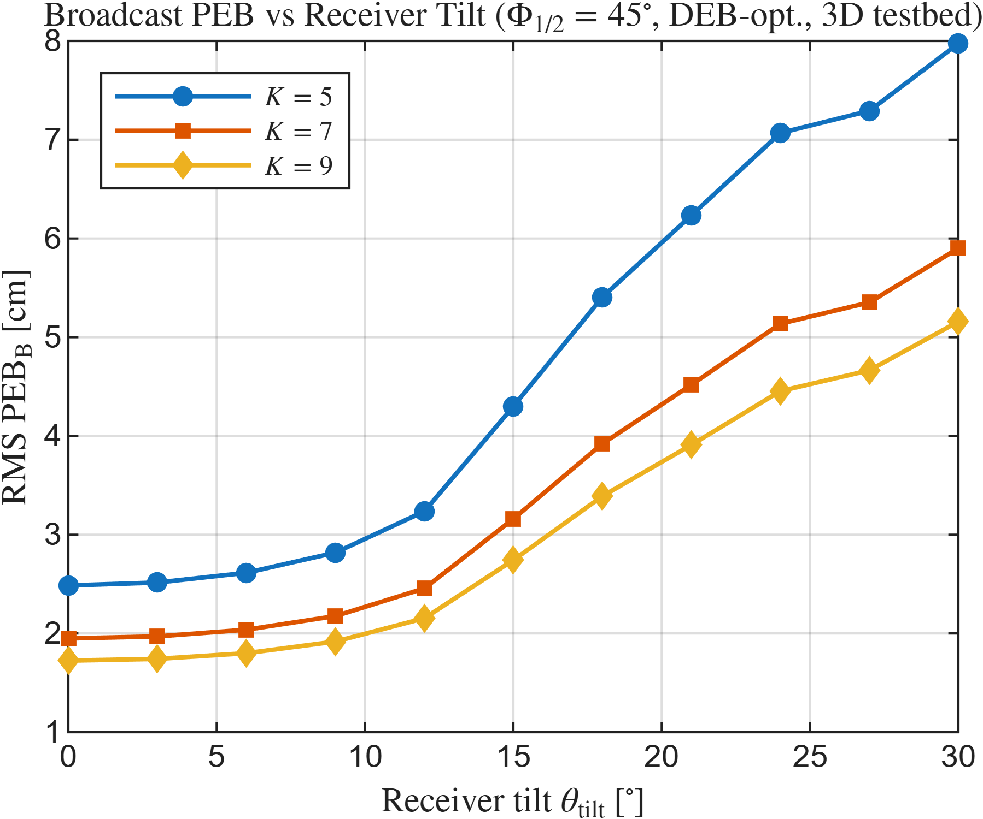
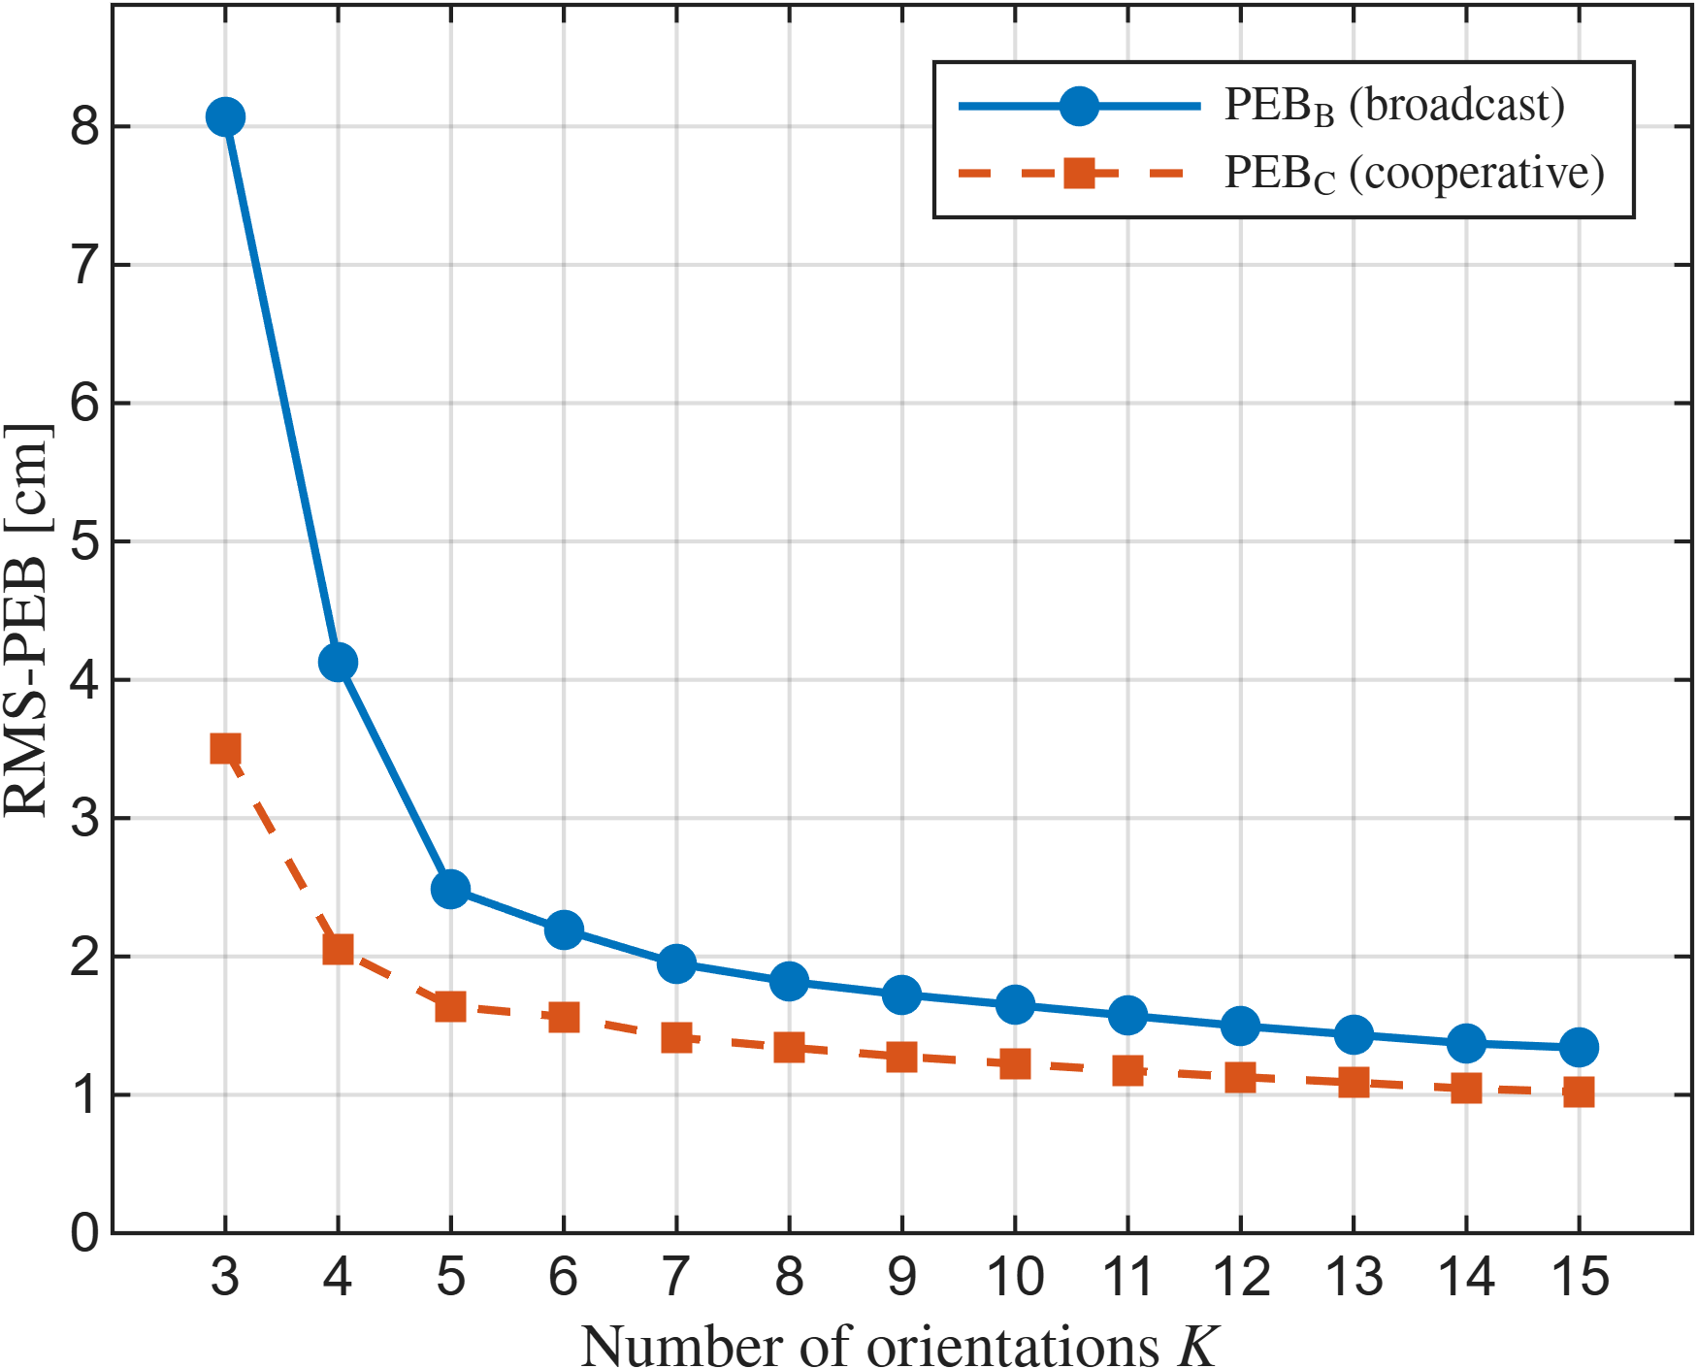
Section IV - Parametric Analysis
A. Effect of K
B. Effect of tilt
*TBD :
DEB-optimized orientations ? Or
PEB_B-optimized orientations?

Slide 5
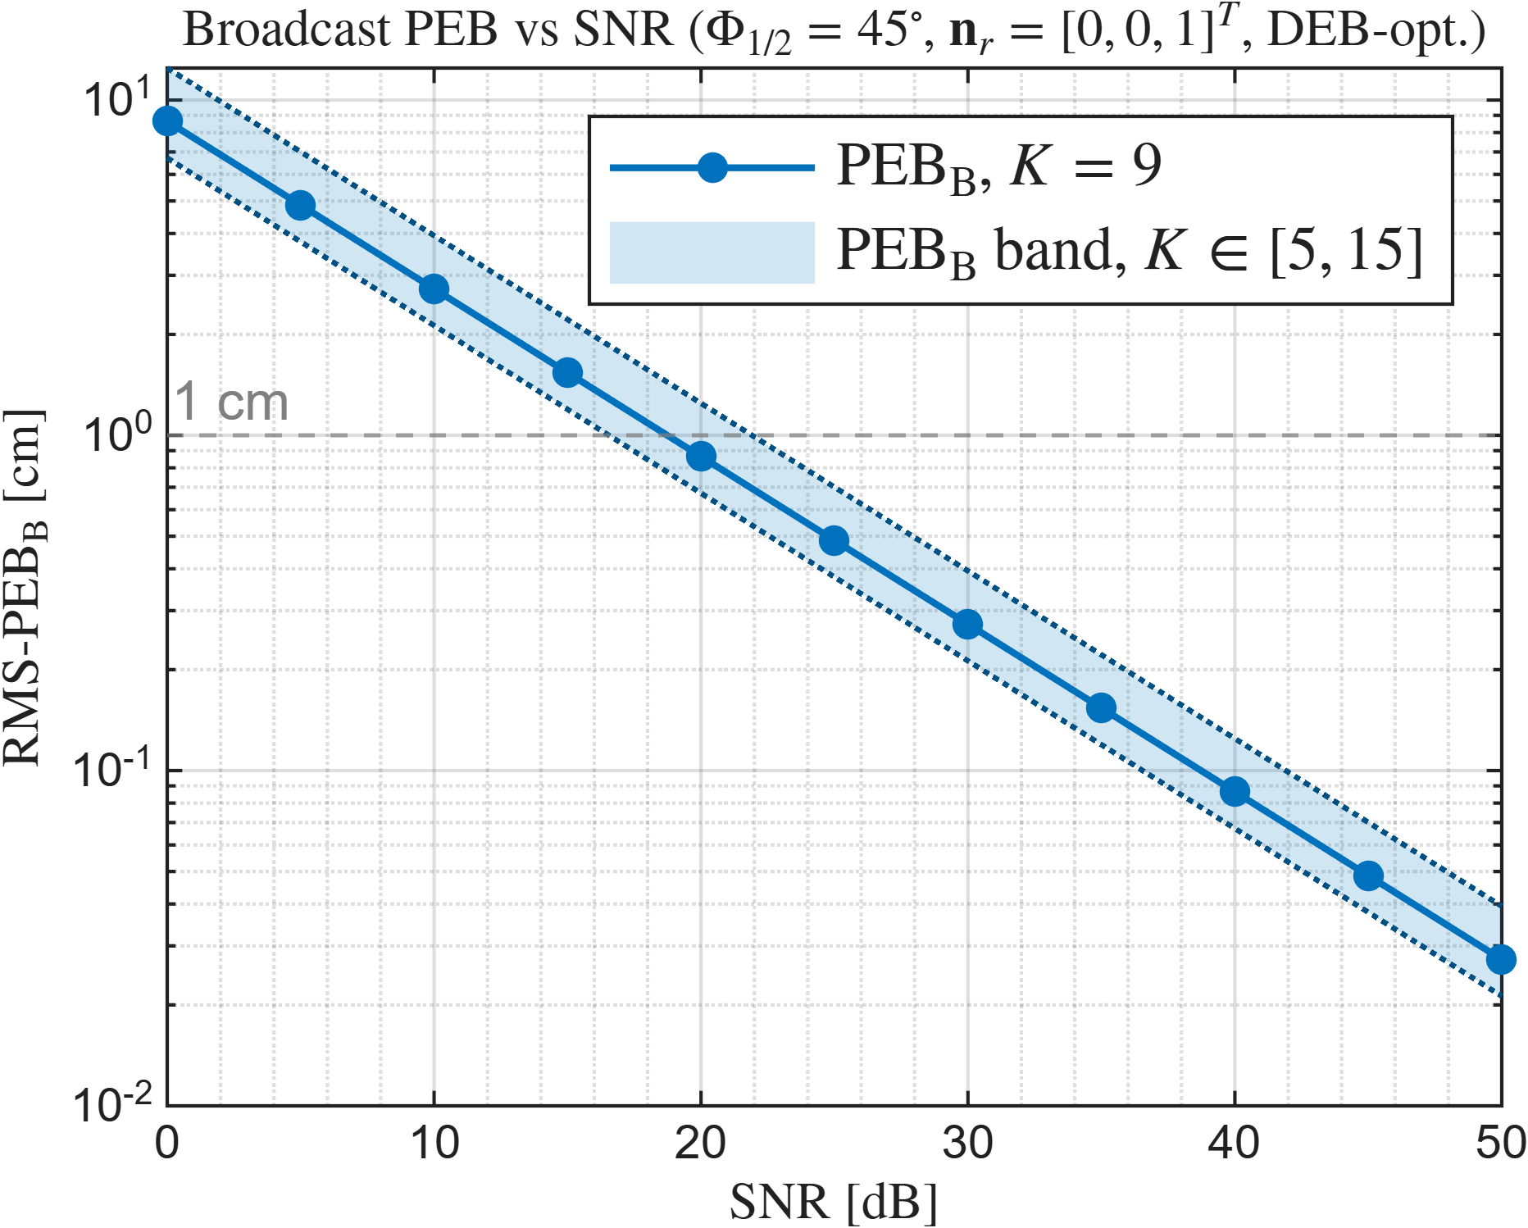
Section IV - Parametric Analysis
C. Effect of SNR

Slide 6
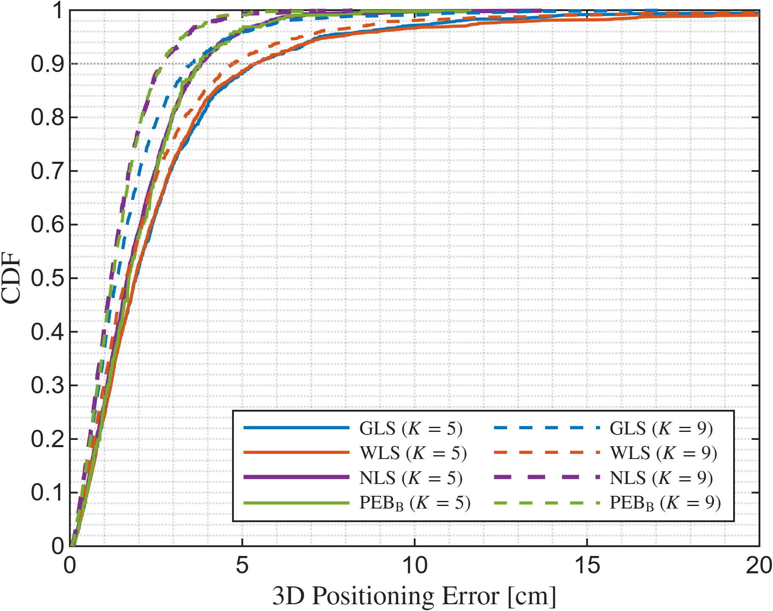
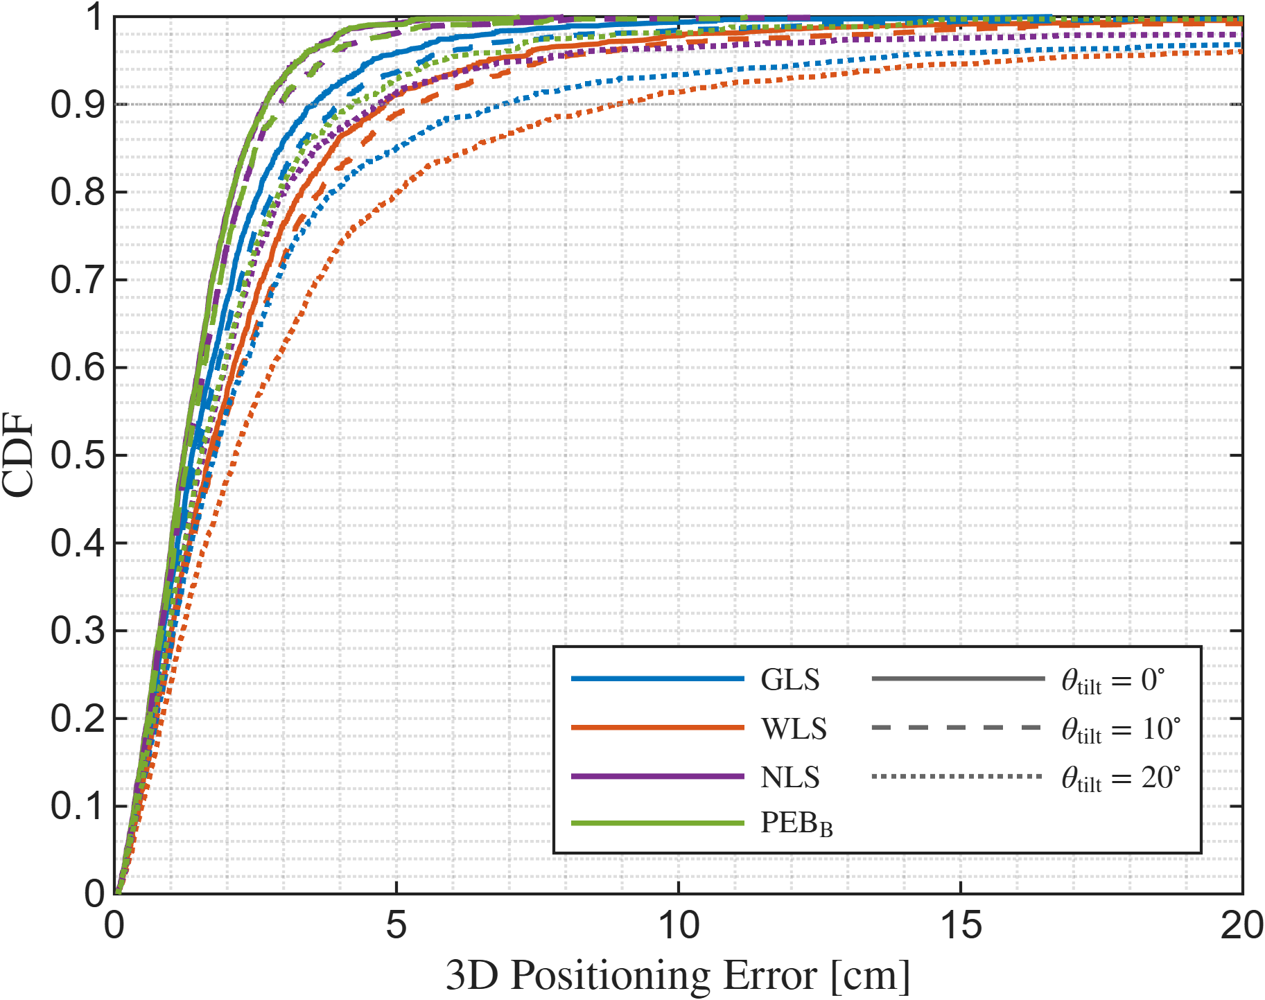
Section V - Estimator Performance
*TBD

Slide 7
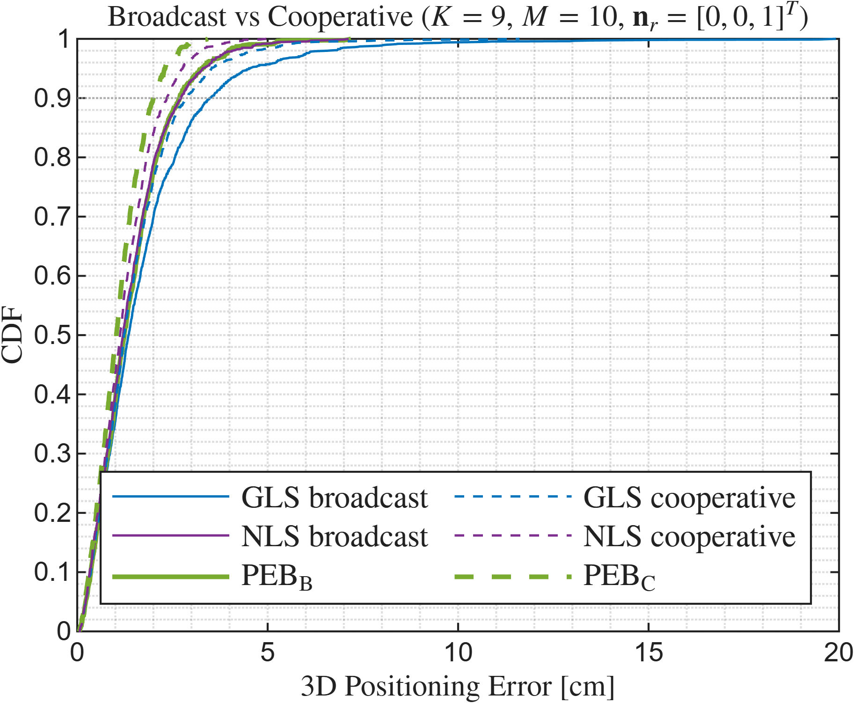
Section V - Estimator Performance
*TBD (comparison with TCOM)

Slide 8
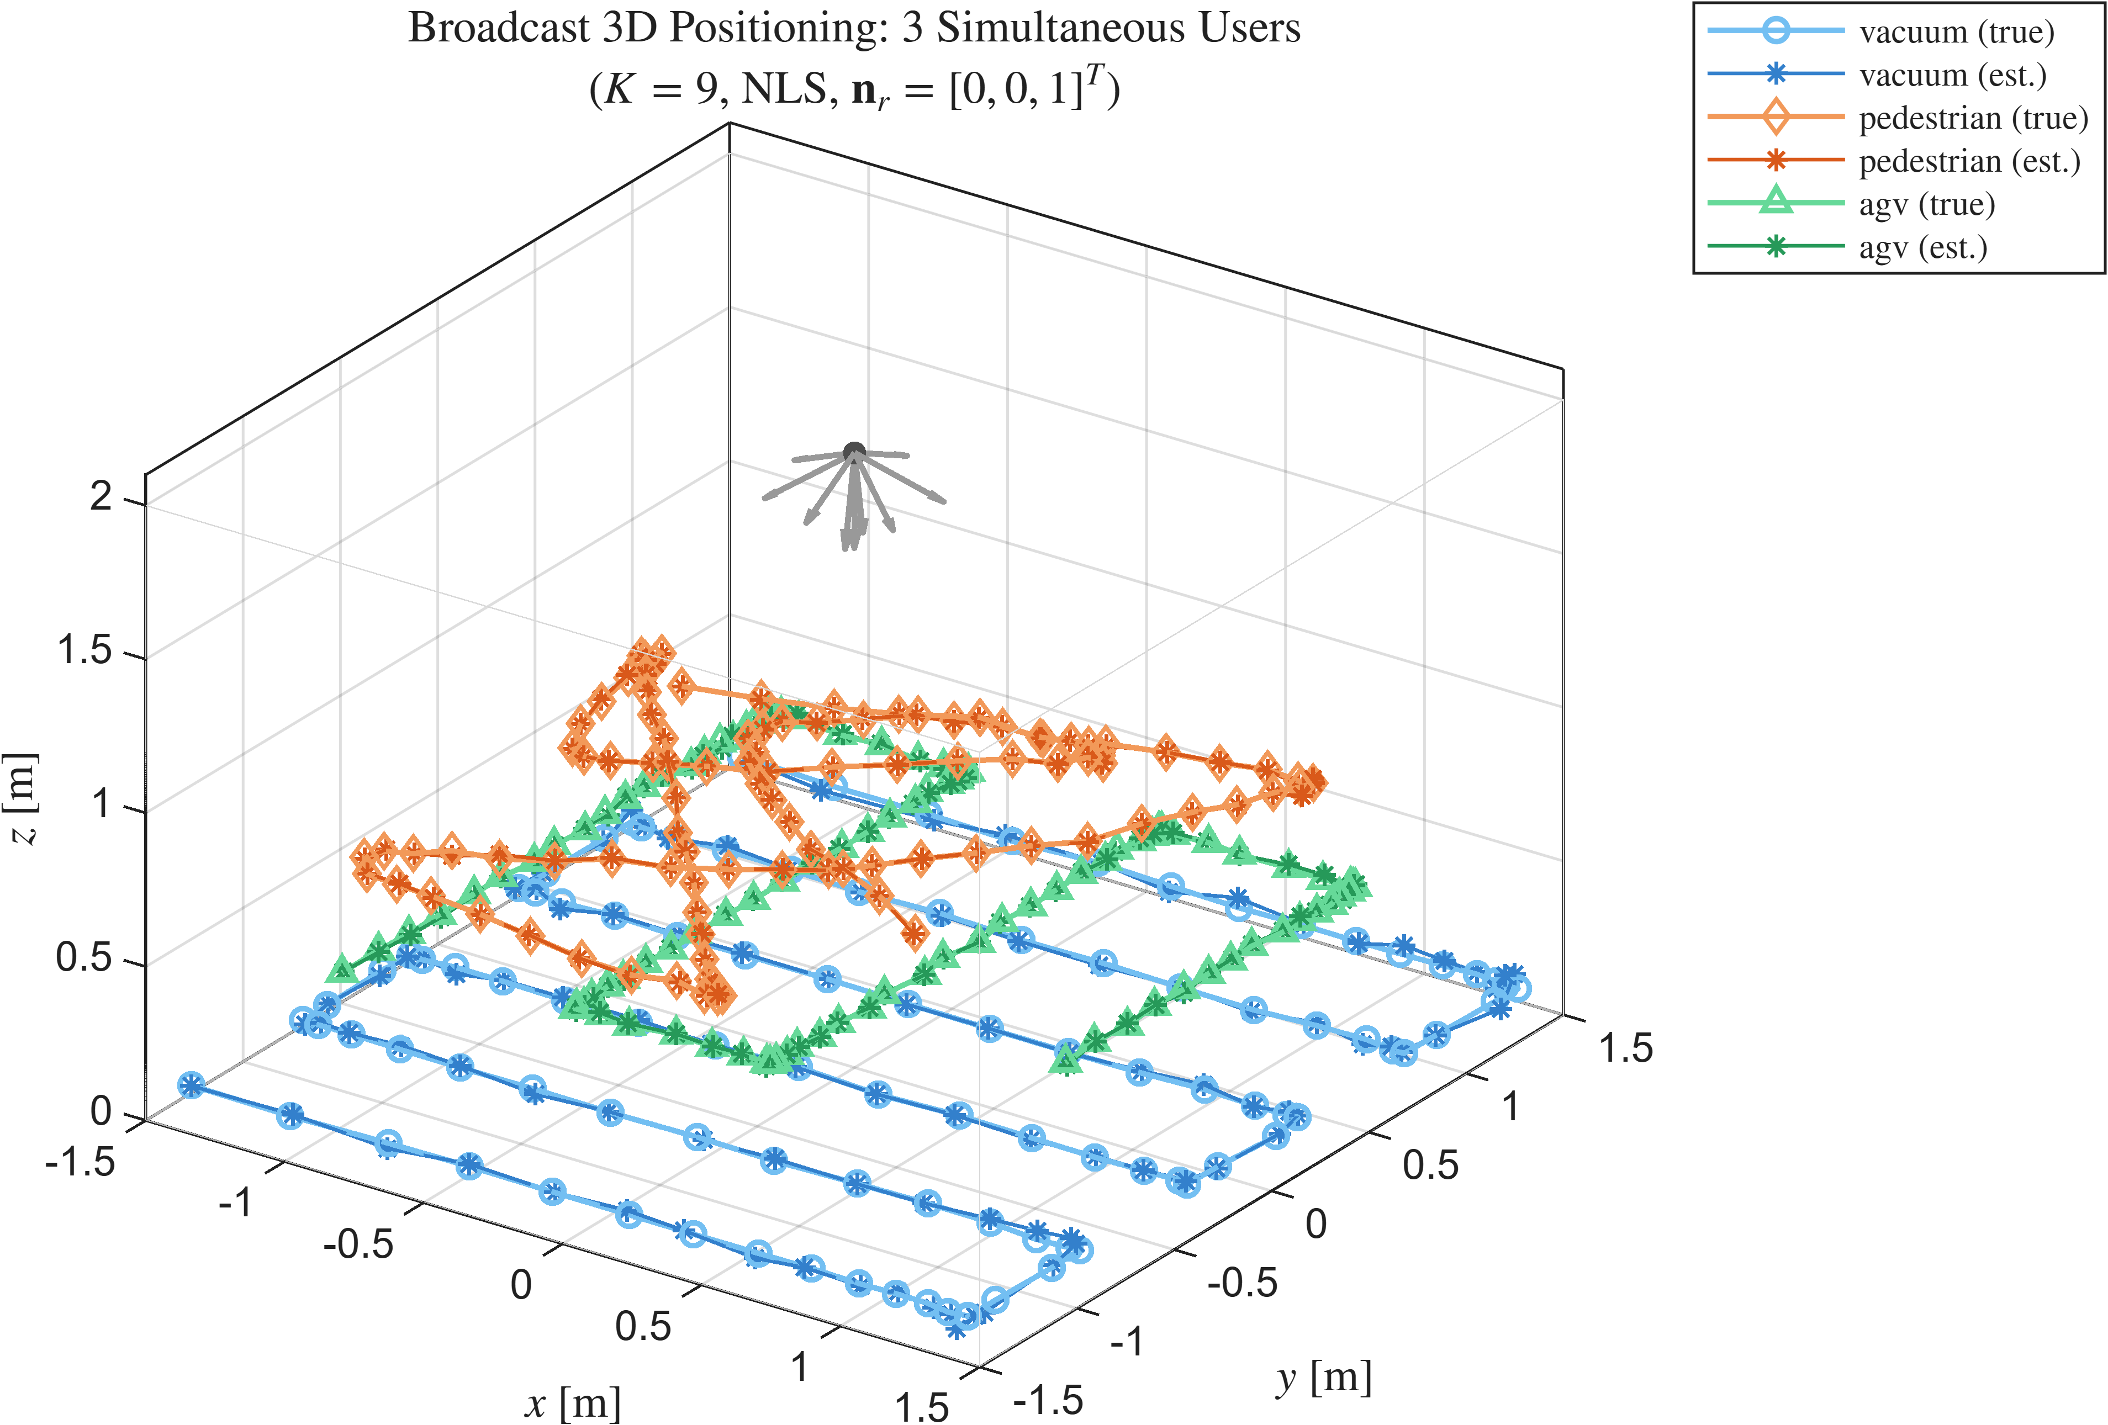
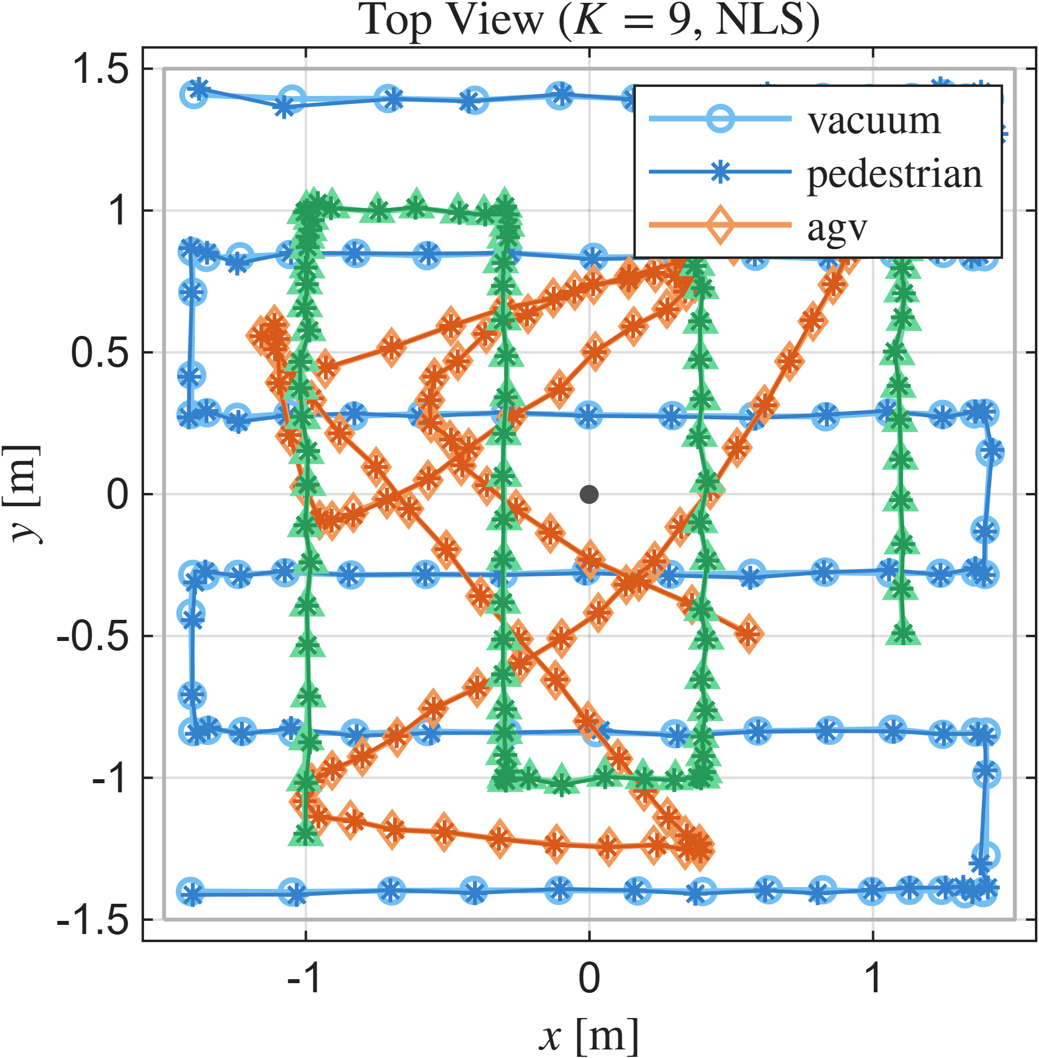
Section V - Estimator Performance
Use case (3 users)

Slide 9
Section I - Introduction (1 page) - OWP state of the art: multi-LED vs. single-LED - Limitation of beam-steered OWP: cooperative K+1 measurement, does not scale - Contribution: broadcast architecture + PEB_B + near-optimal estimator Section II - System Model and Broadcast Architecture (1 page) - Lambertian channel model: brief recap from the TCOM paper - Broadcast architecture: K measurements, known n_r from IMU - Distance recovery* (new: broadcast_distance) Section III - Broadcast Position Error Bound (1 page) - Broadcast FIM - PEB_B Section IV - Parametric Analysis (1.5 pages) IV-A. Effect of K, the number of orientations IV-B. Effect of receiver tilt IV-C. Effect of SNR Section V - Estimator Performance (1 page) - NLS/GLS/WLS + broadcast_distance Section VI - Conclusion (0.5 page)

