Slide 1
PIRAMID

Slide 2
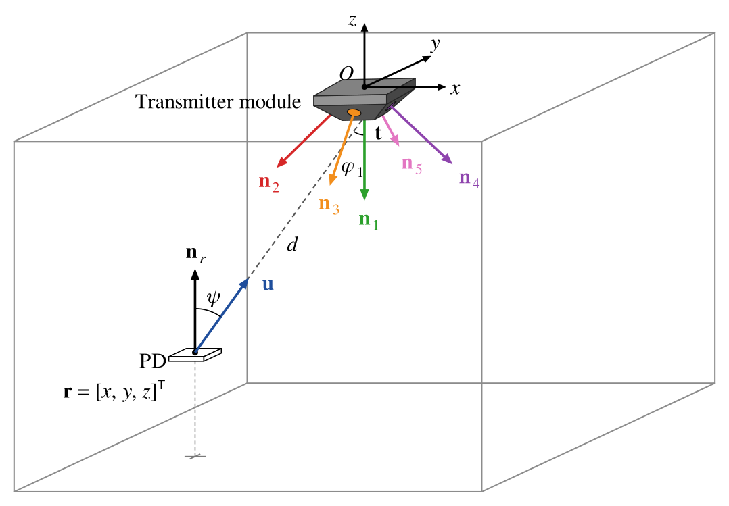
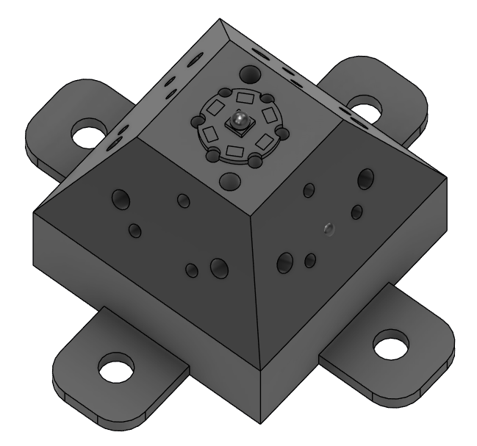

Slide 3
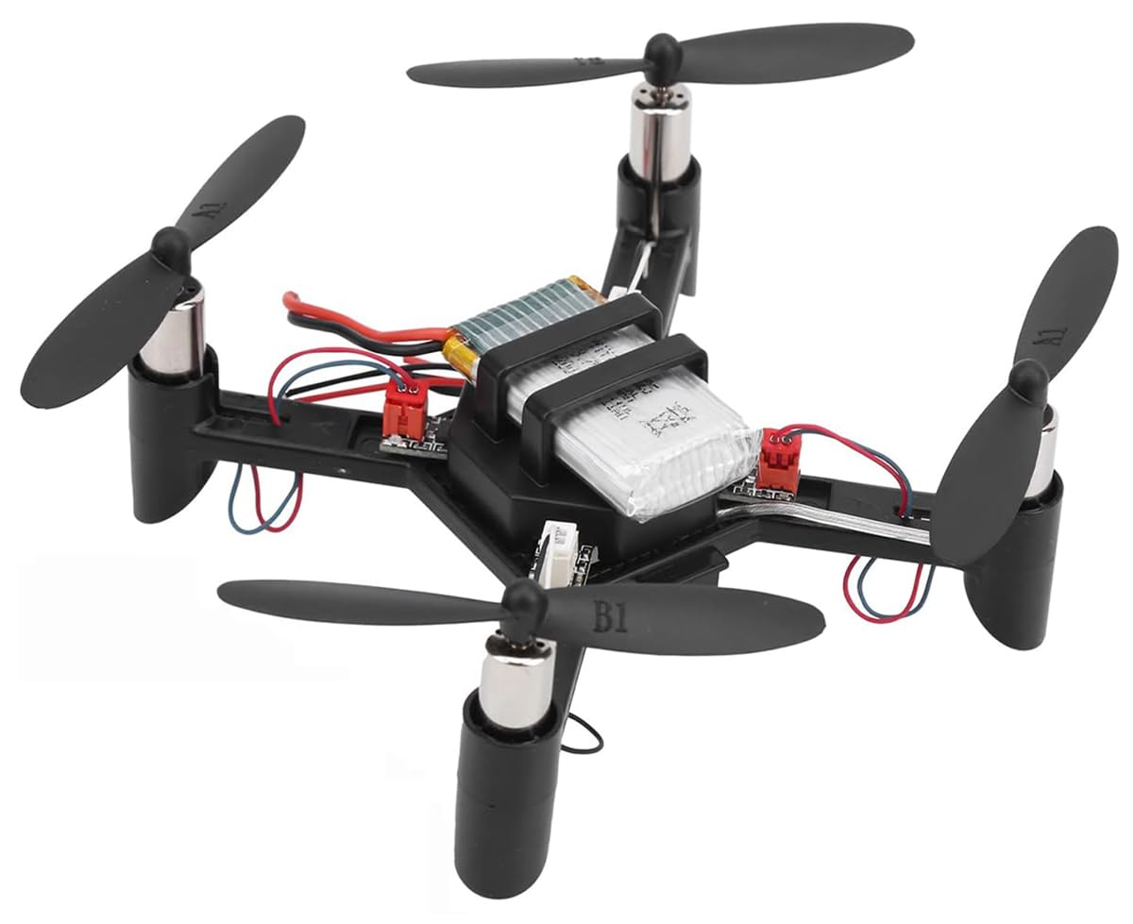
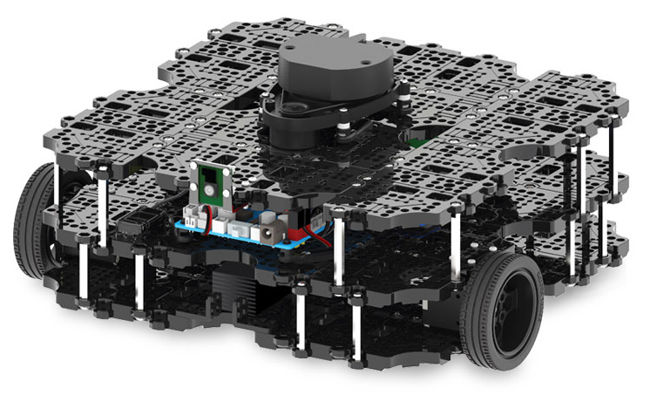
APPLICATION

Slide 4
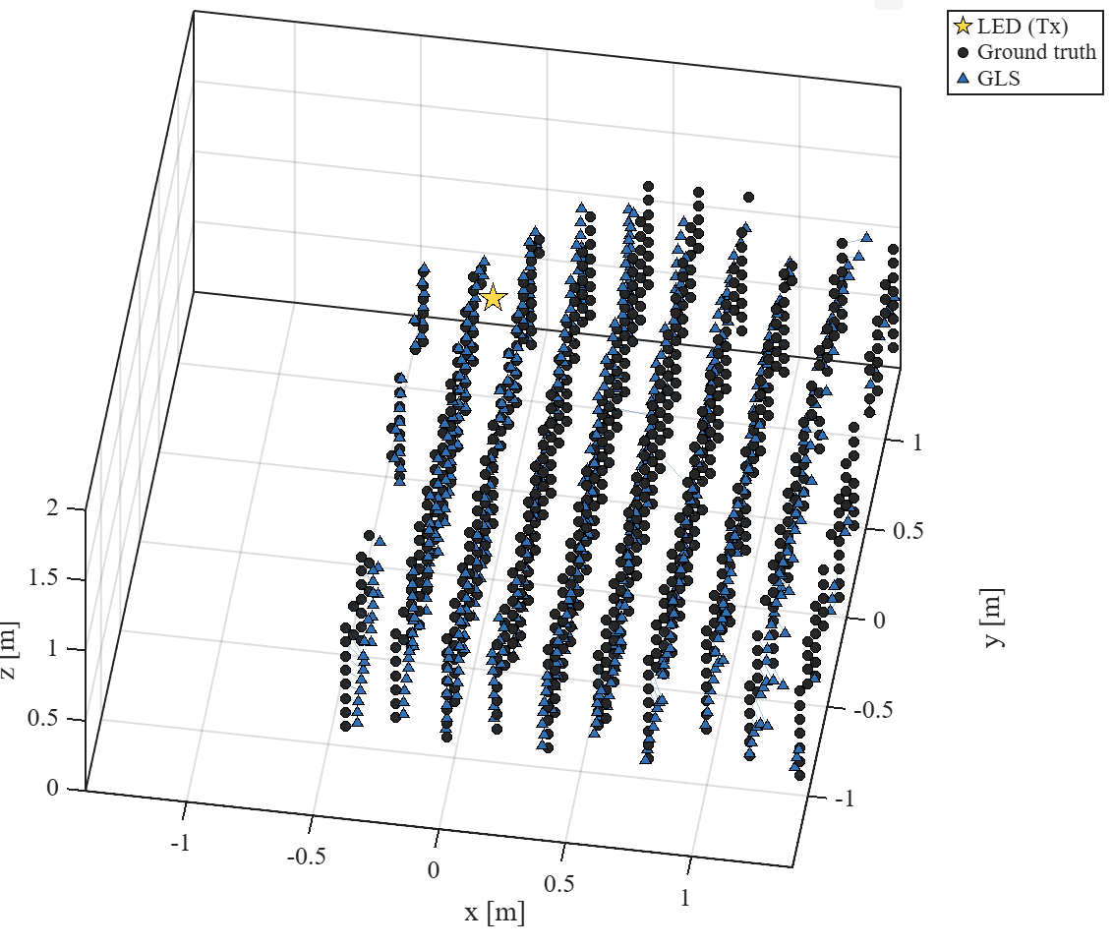
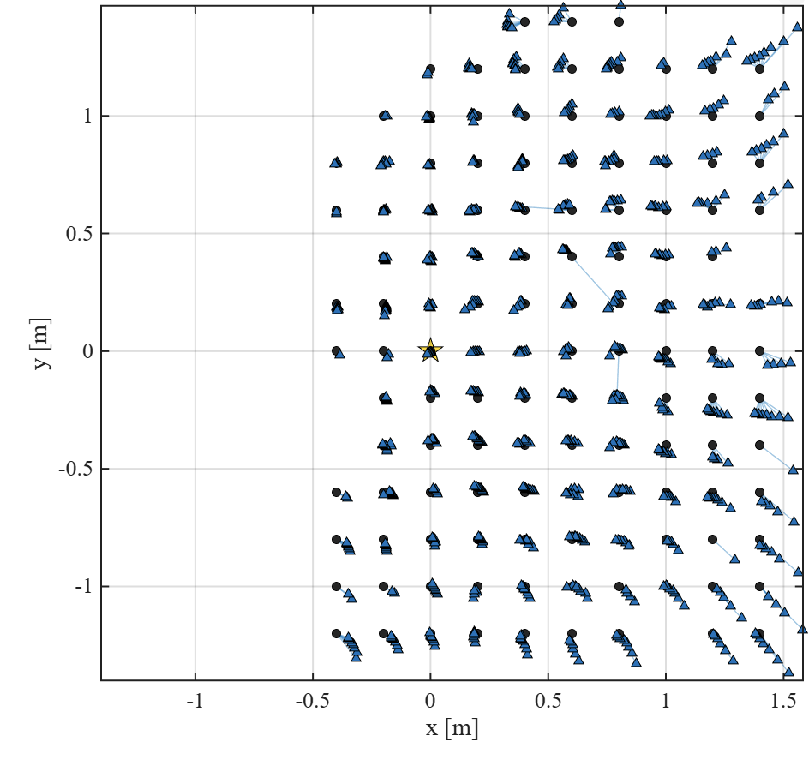
Results with our current setup (with motors)

Slide 5
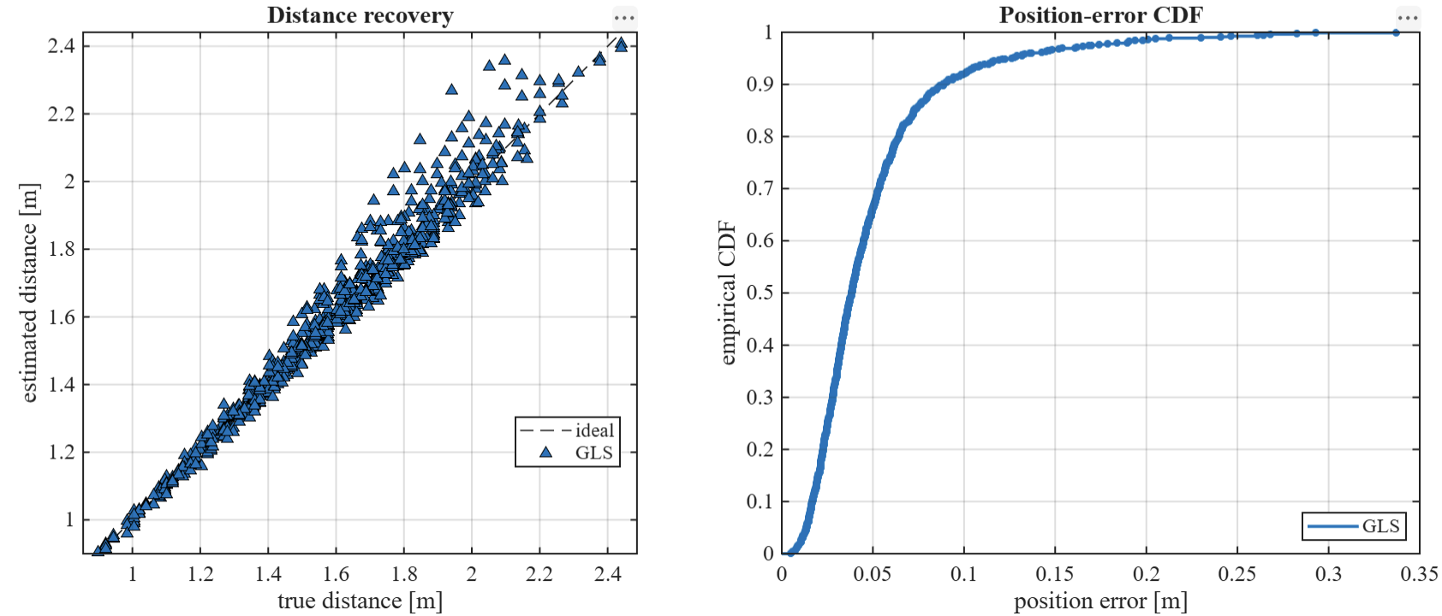

Slide 6
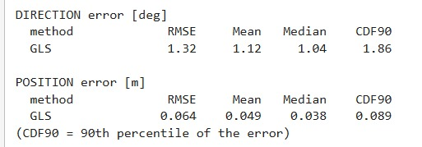
4.9cm of Mean Average Error for 3D Position Estimation
with only analytic methods (no machine learning involve)

Slide 7
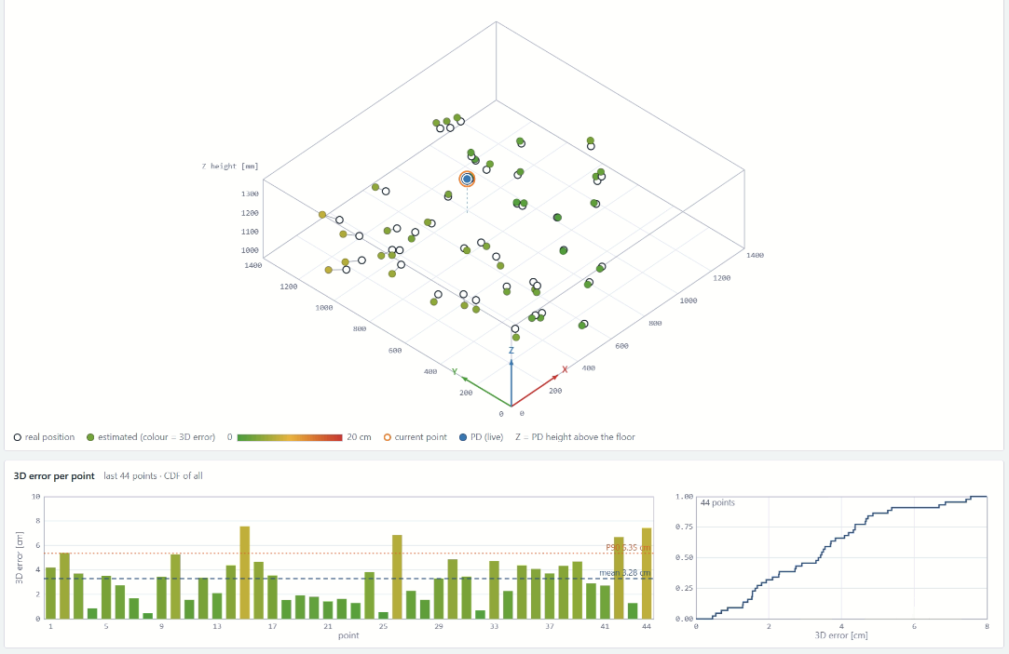
IDEA : Virtual Interface: Estimated vs. Ground-Truth Position (Reference Interface)

