Slide 1
Broadcast Beam-Steered Optical Wireless Positioning: 3D Localization Without Cooperative Alignment Kevin

Slide 2
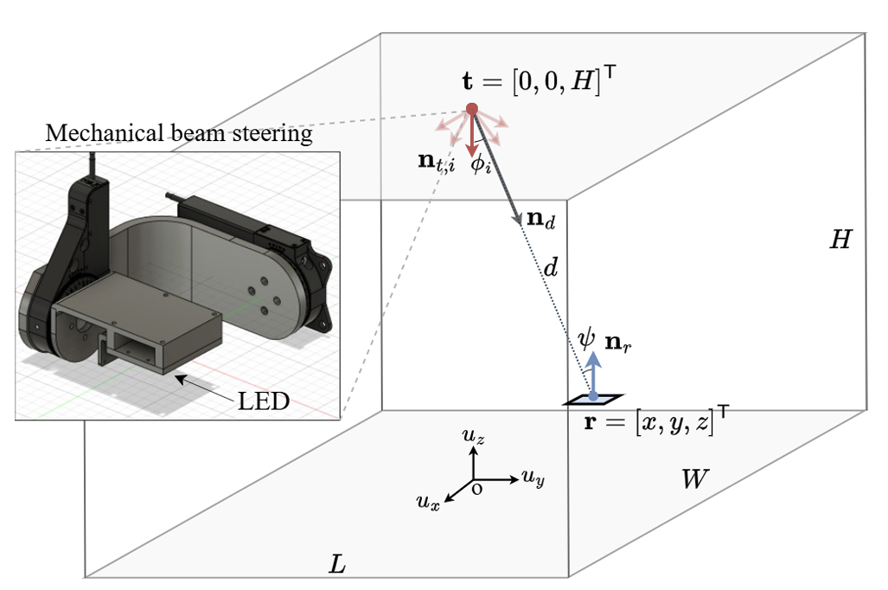
PROBLEM / MOTIVATION: Beam-steered OWP, as presented in the TCOM paper, requires a cooperative (K+1)-th measurement to recover distance. This requires PD reorientation, which prevents broadcast operation for multiple users simultaneously. SOLUTION: Exploit the distance information embedded in the K absolute power measurements, assuming that n_r is known from the receiver IMU. --> Broadcast 3D positioning without any cooperative measurement.
KEY RESULT - PEB analysis
- broadcast_distance based on K-measurements (proposal)
- NLS + broadcast_distance is equivalent to a profiled MLE and is therefore - near-efficient, reaching the broadcast CRLB, PEB_B. - The architecture provides full scalability: N simultaneous receivers can be served with a single LED scan.

Slide 3
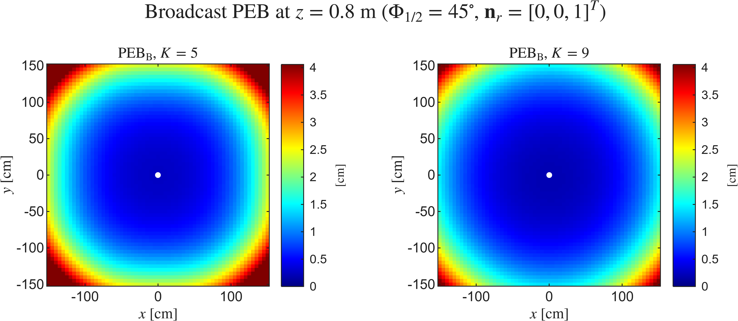
Section III - Broadcast Position Error Bound

Slide 4
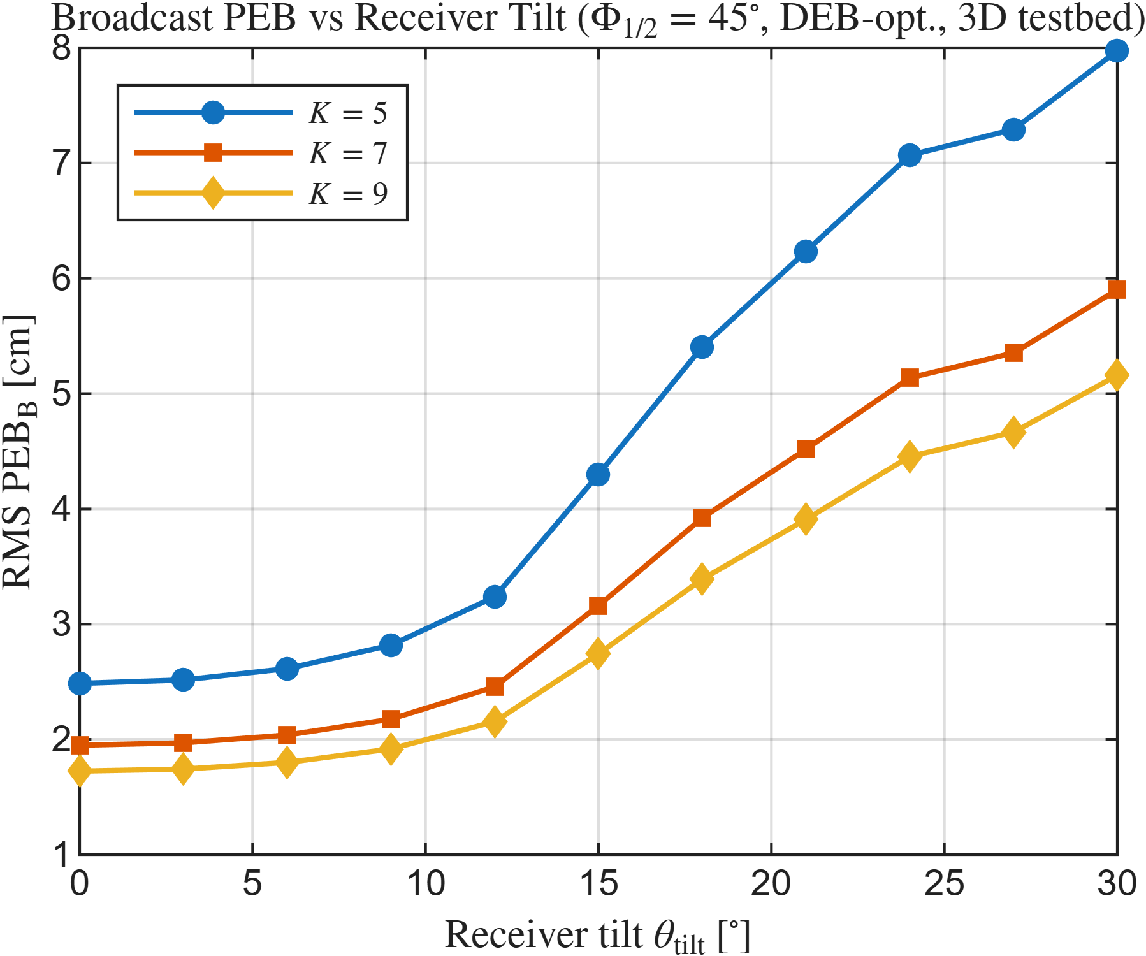
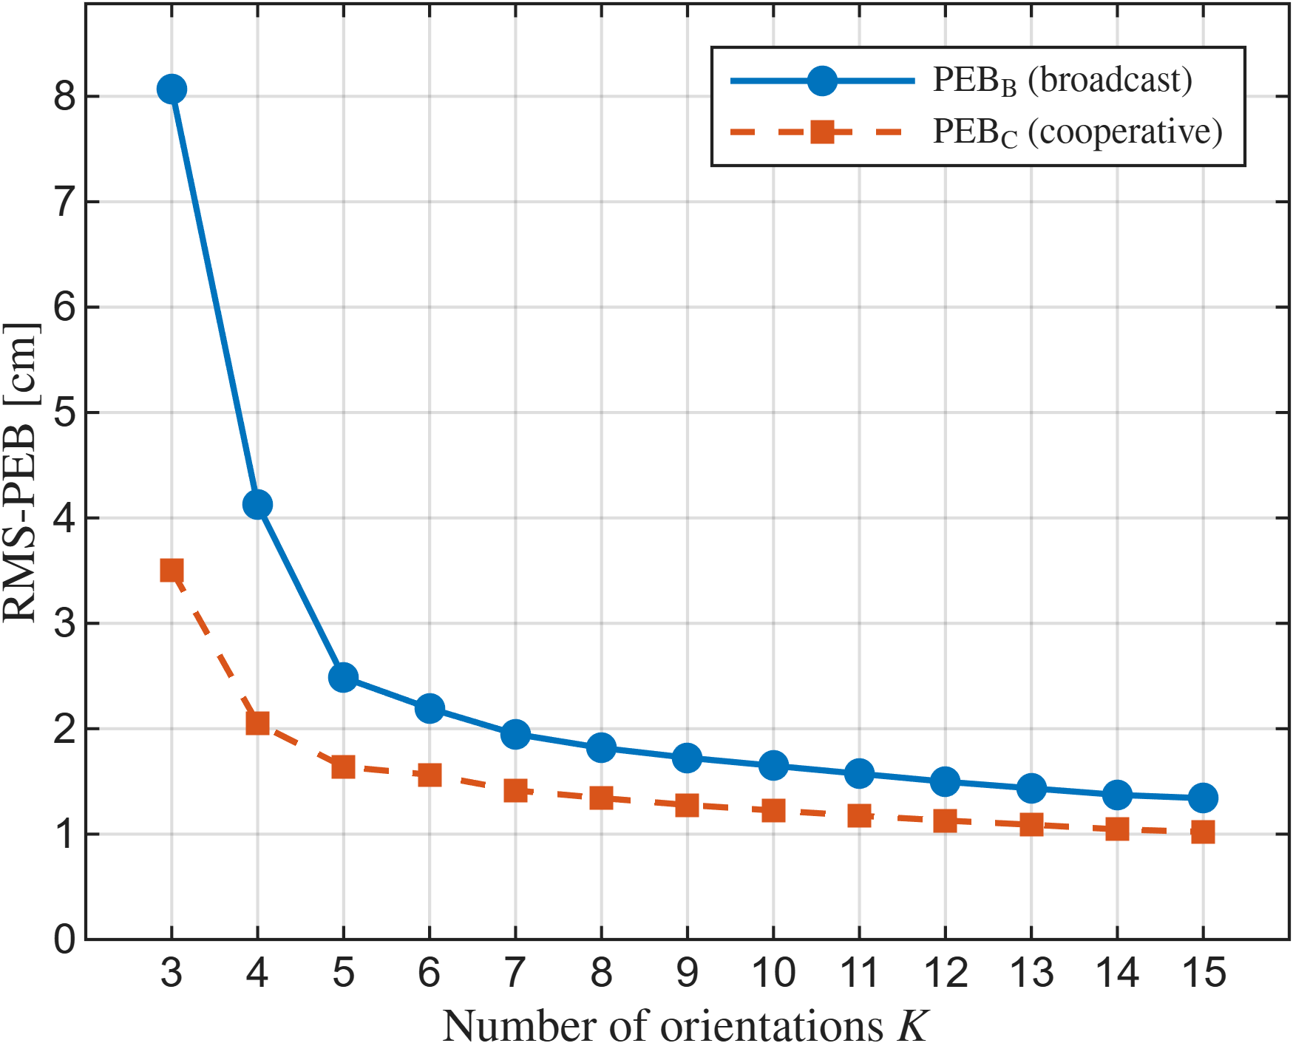
Section IV - Parametric Analysis
A. Effect of K
B. Effect of tilt

Slide 5
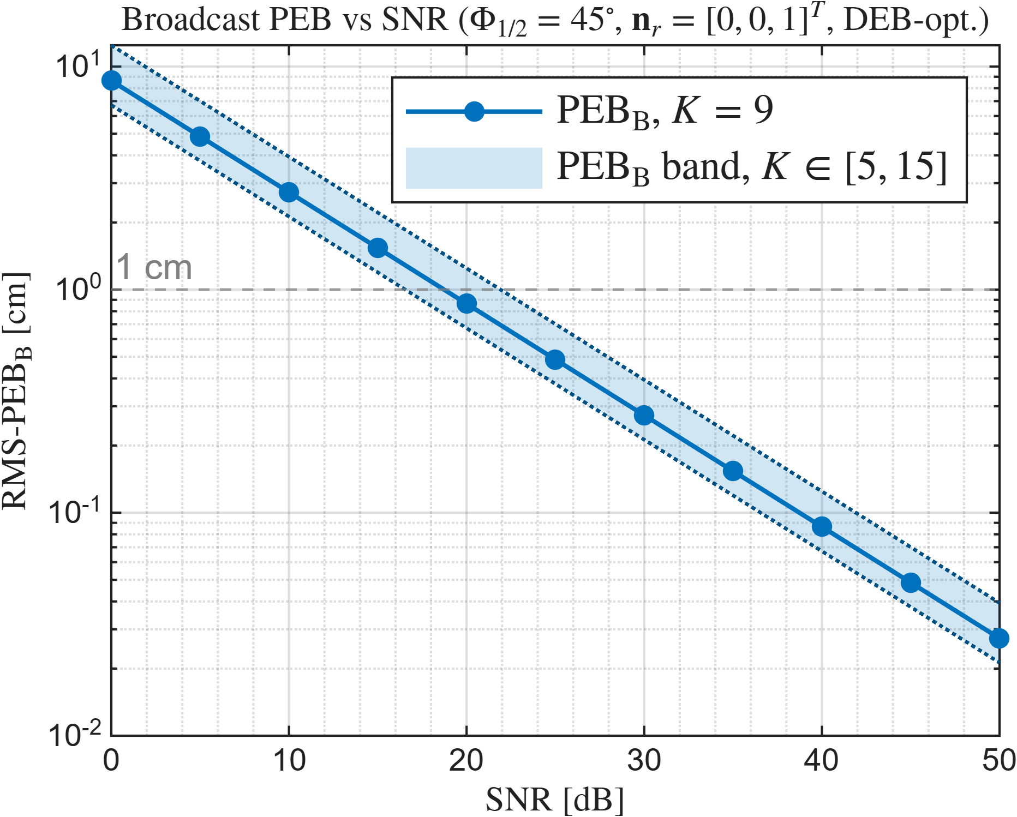
Section IV - Parametric Analysis
C. Effect of SNR

Slide 6
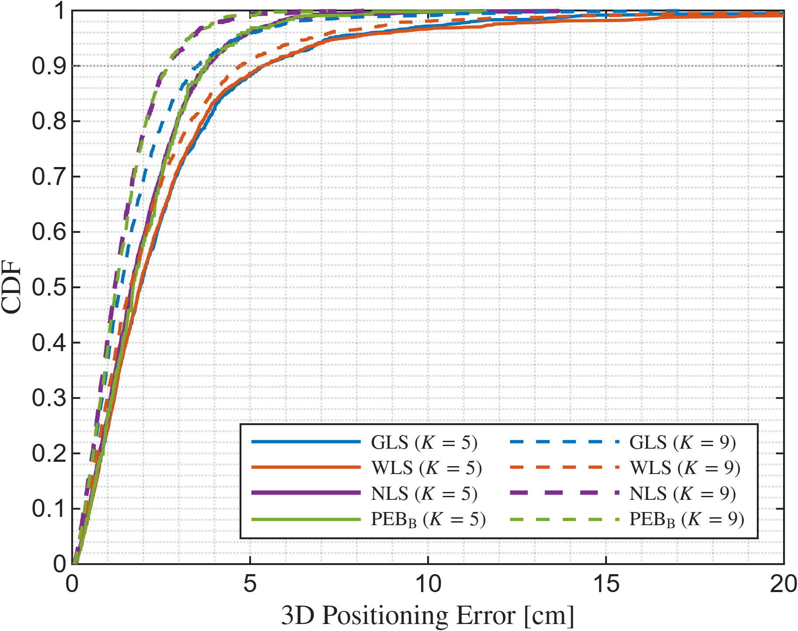
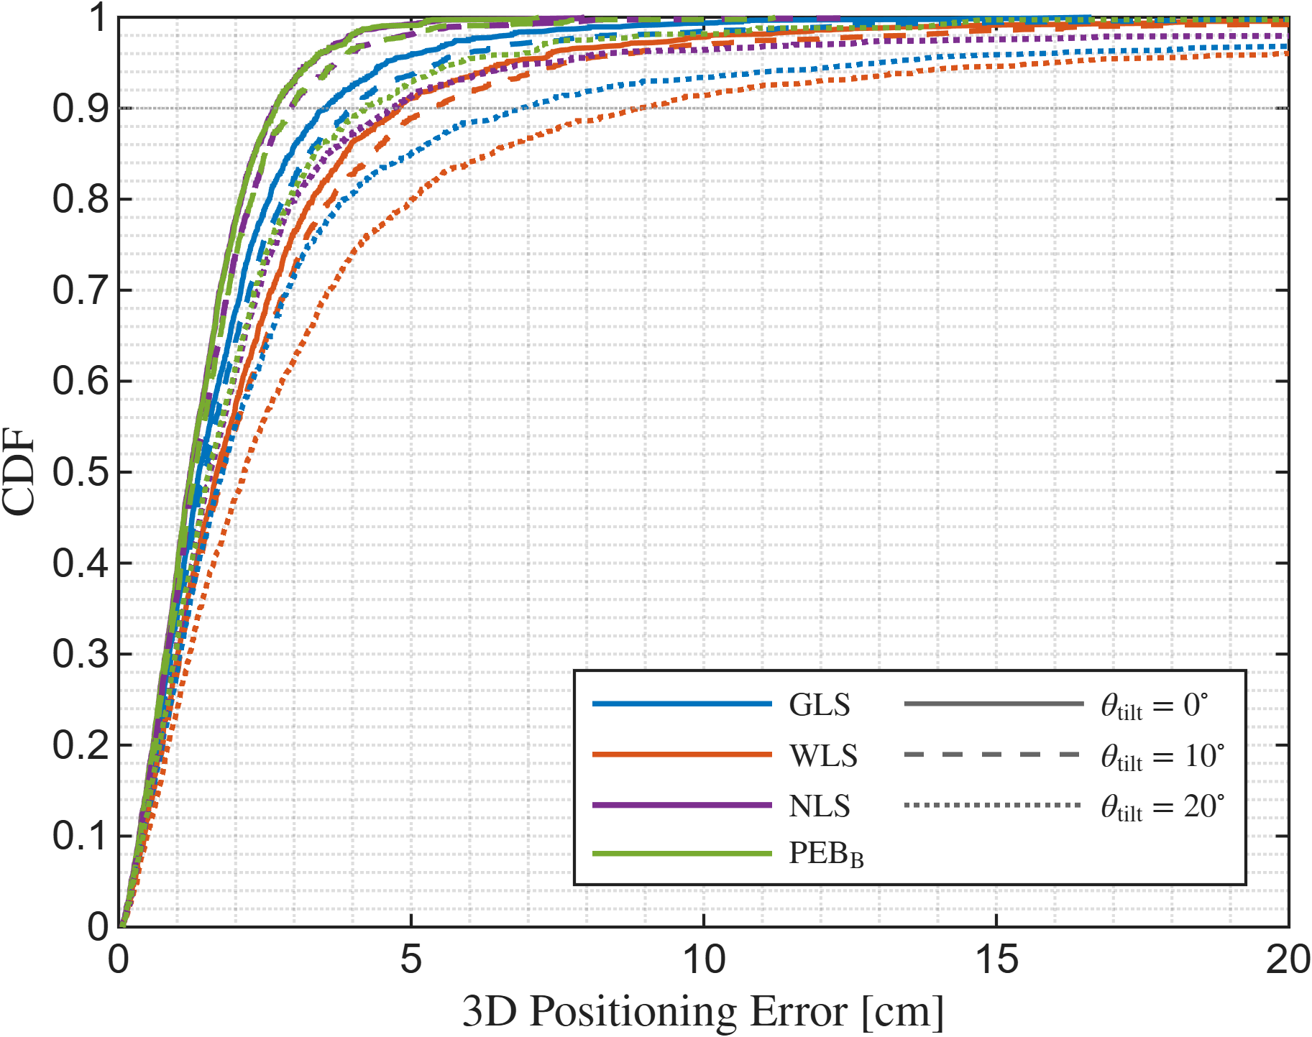
Section V - Estimator Performance

Slide 7
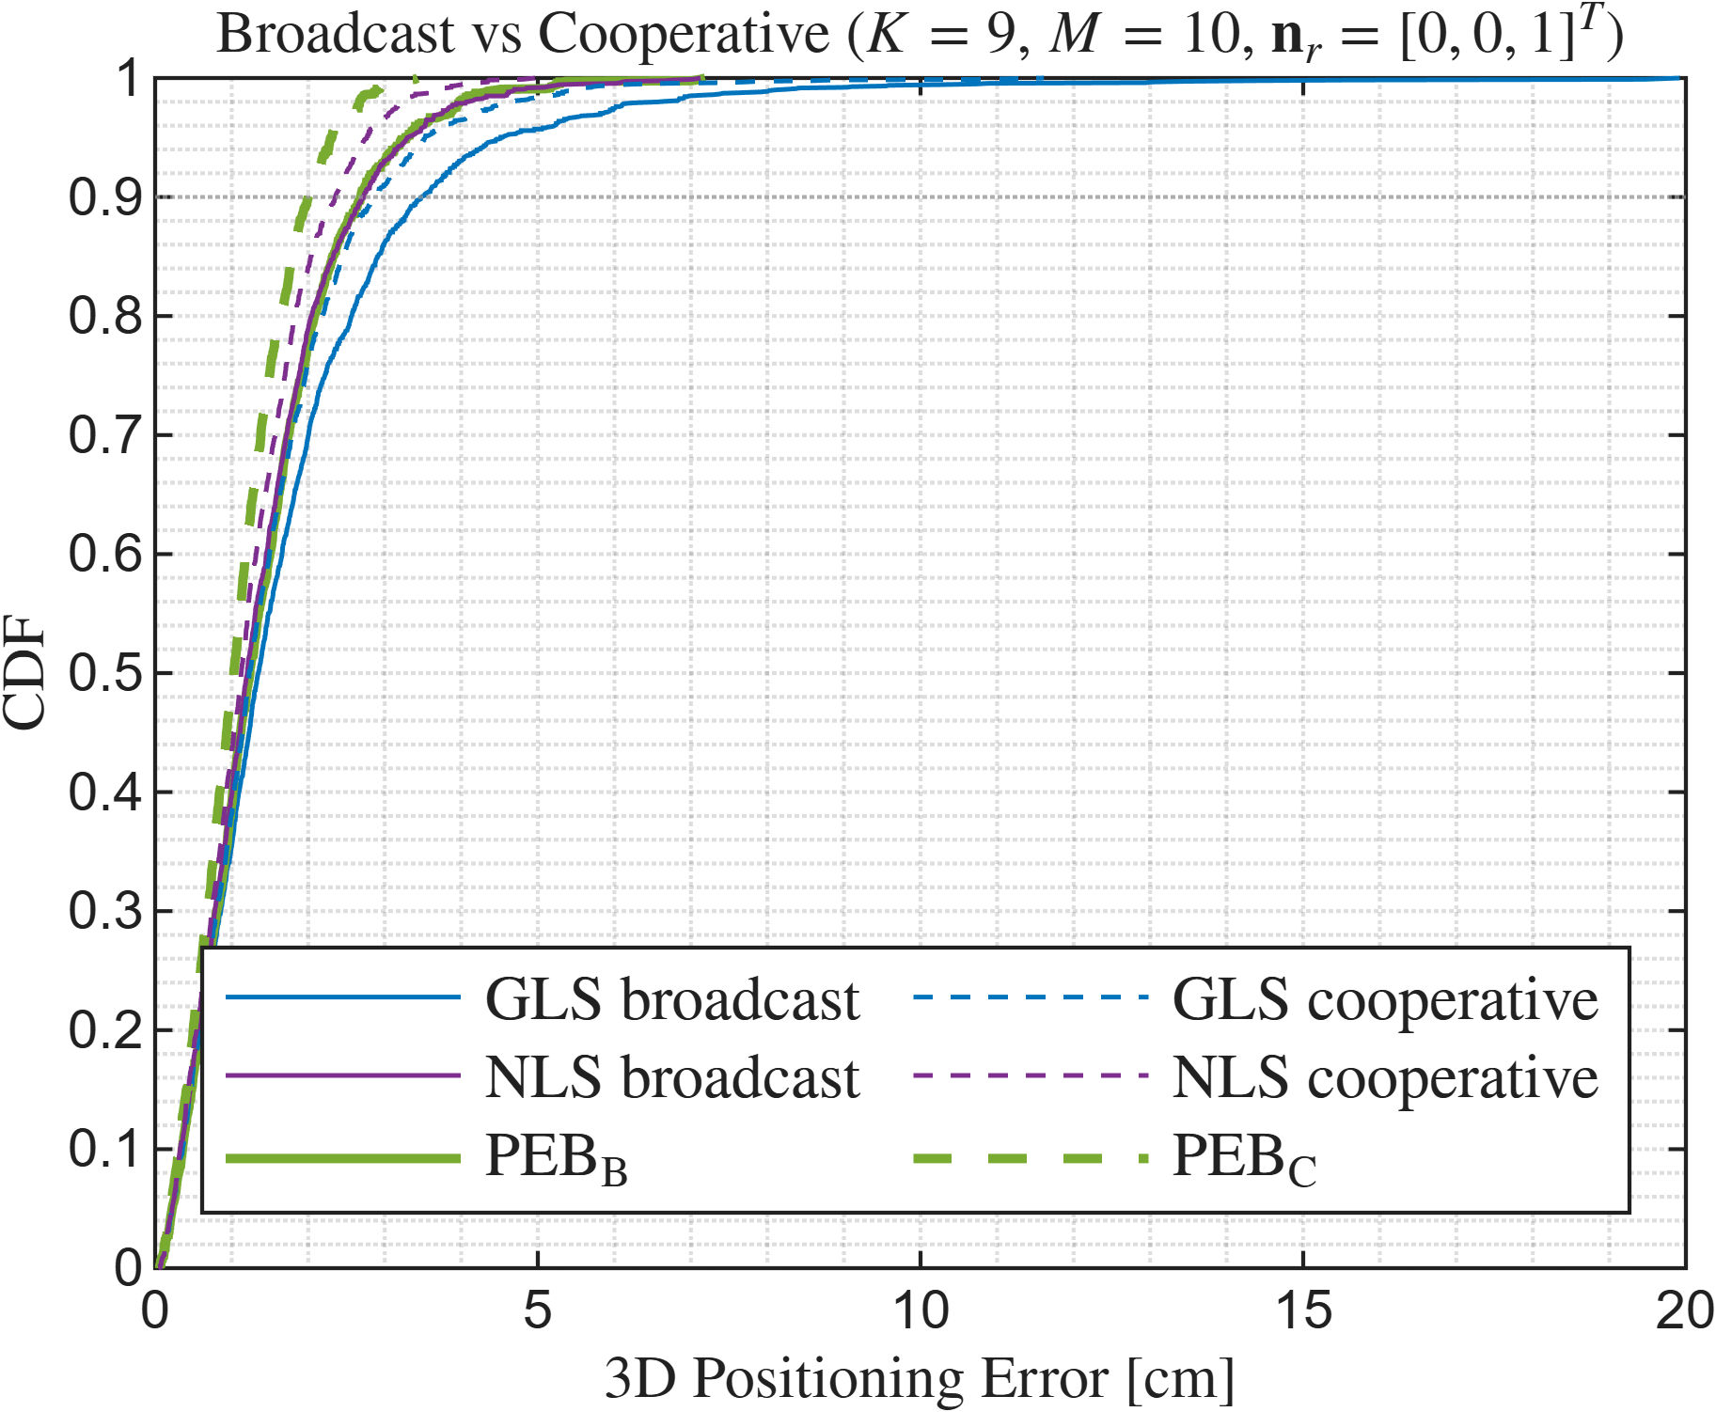
Section V - Estimator Performance

Slide 8
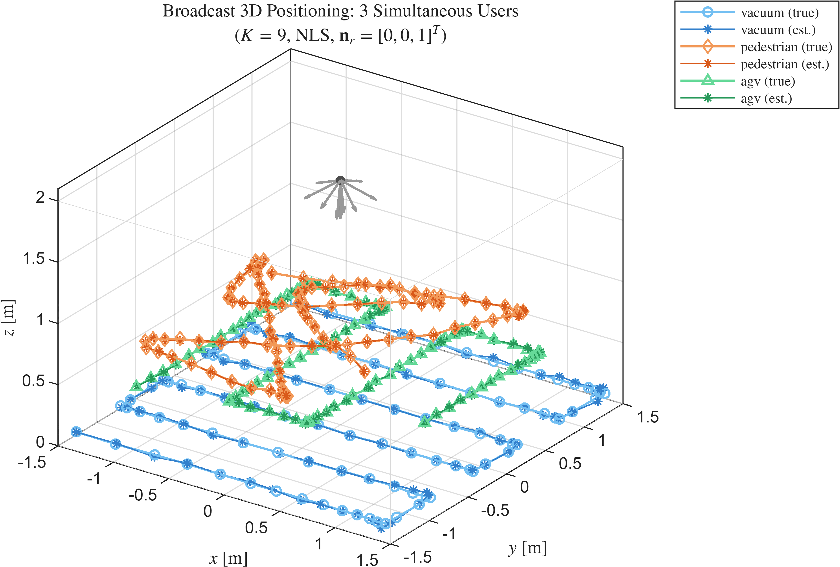
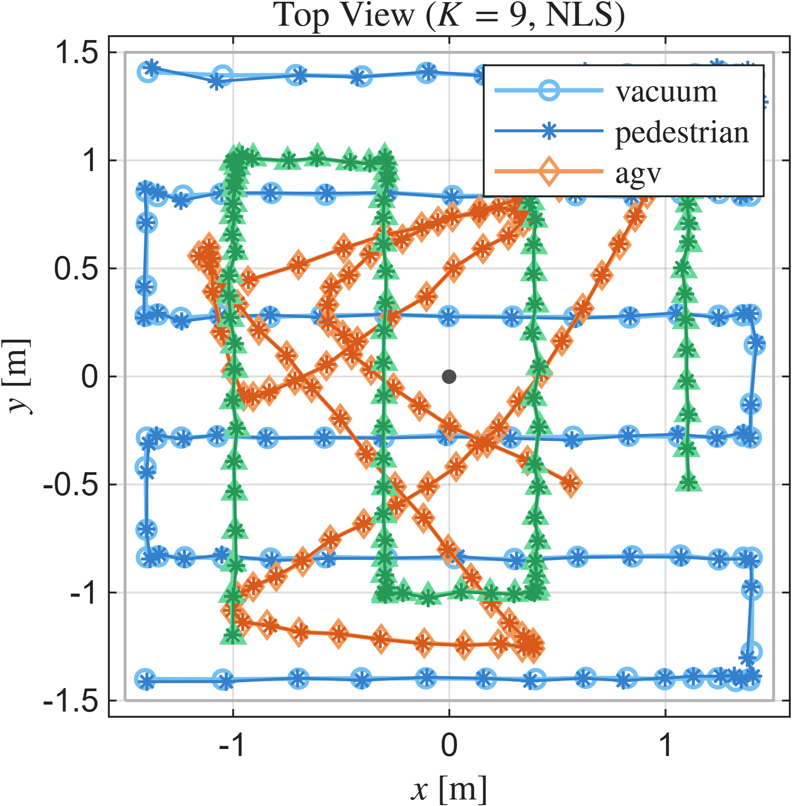
Section V - Estimator Performance
Use case (3 users)

