Slide 1
Location from OWC Beam Steering
from a Single Access Point
3D positioning with one beam-steered LED and one photodiode
Kevin Acuña-Condori, Bastien Béchadergue, Hongyu Guan and Luc Chassagne
Université Paris-Saclay, UVSQ, LISV | OPTI-6G WP4 – Task 4.2
SNS JU 6G Architecture Working Group · 20 November 2026
Notes:
Title. Thank John and Bastien. I am Kevin Acuna-Condori (UVSQ-LISV), main developer of the beam-steering-based positioning method in OPTI-6G Task 4.2. Topic requested by the WG: location from optical wireless beam steering using a single access point. Structure: motivation and principle, a brief 2D proof of concept, then the focus: 3D theory and the new 3D experimental results, KPIs and how this fits a 6G architecture.

Slide 2
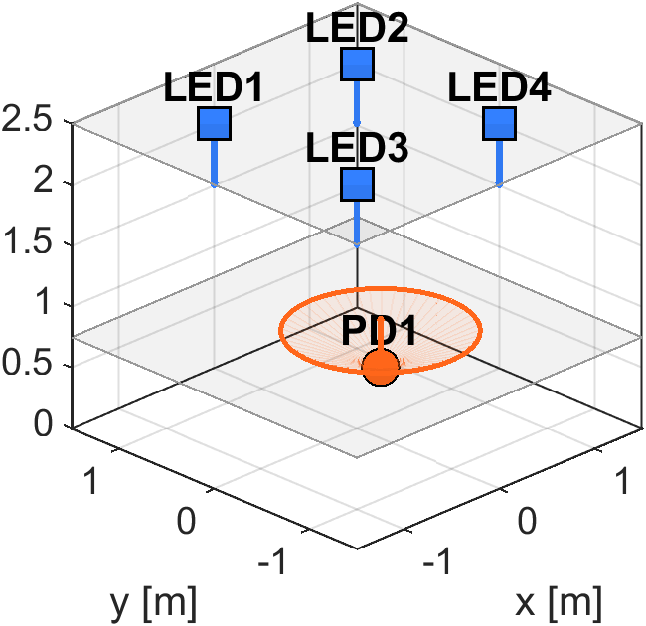
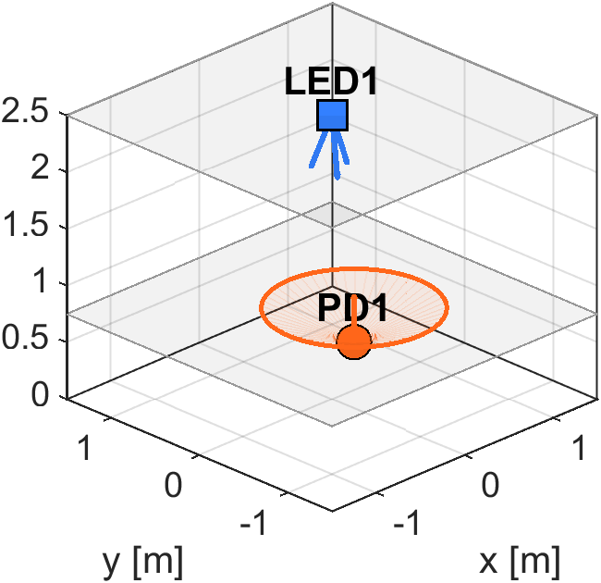
Why Positioning from a Single Optical Access Point?
6G (IMT-2030): positioning becomes a native network service – cm-level indoor accuracy for robots, AGVs, XR.
OPTI-6G: near-IR optical cell-free access integrated with 5G – every optical AP (O-RU) can be a positioning anchor.
Classical optical RSS / TDoA needs ≥ 3–4 APs in line of sight at once, identified and calibrated.
Optical cells are small and directional: a UE often sees only one AP.
PD arrays, cameras or rotating PDs add cost to every UE.
Classical: 4 fixed APs
Proposed: 1 steerable AP
 | Conventional RSS | Single steered AP
APs in line of sight | ≥ 3–4 | 1
UE hardware | 1 PD (assumed vertical) or PD array / camera | 1 PD
Receiver orientation | must be known or vertical | not needed for direction
Source of diversity | more anchors / Rx hardware | beam steering at the AP
Our approach
Move the spatial diversity to the infrastructure: one AP steers its beam through K known directions; a single-photodiode UE localises itself in 3D.
OPTI-6G proposal §1.1.2.3: “modulate the angle of emission of the source and, thus, simplify the receiver”.
2
Notes:
Architecture problem first. 6G positions localisation as a native service. In OPTI-6G each optical AP is an O-RU of a cell-free network. Classical optical positioning (RSS/TDoA) needs 3-4 APs visible at the same time with known geometry; with small directional optical cells this is often not the case. Instead of adding anchors or receiver hardware we let the AP steer its beam: the angular diversity is created at the infrastructure and the UE keeps a single photodiode. This is exactly the UVSQ idea written in the proposal.

Slide 3
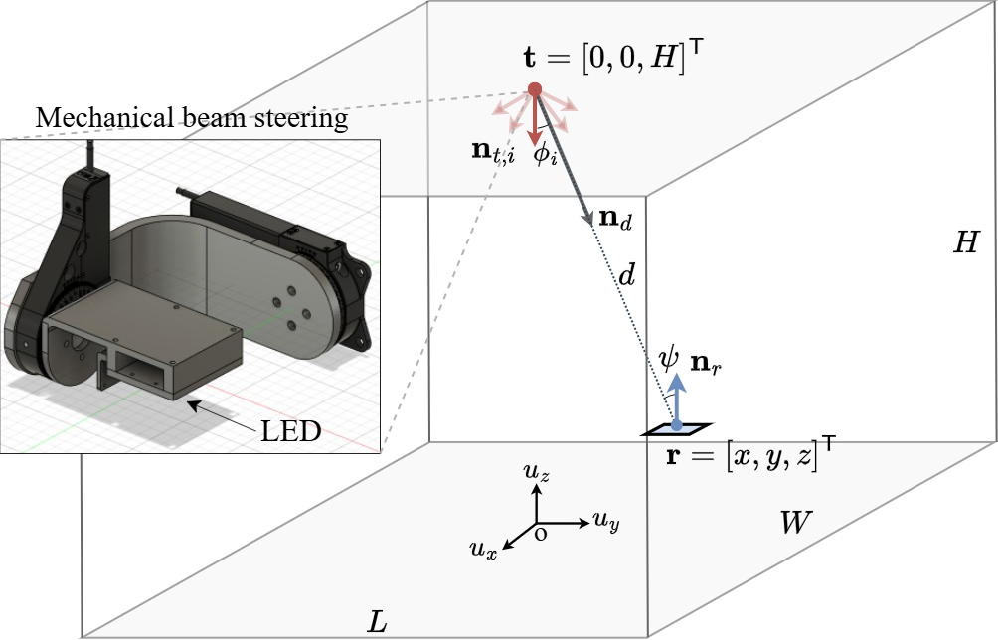
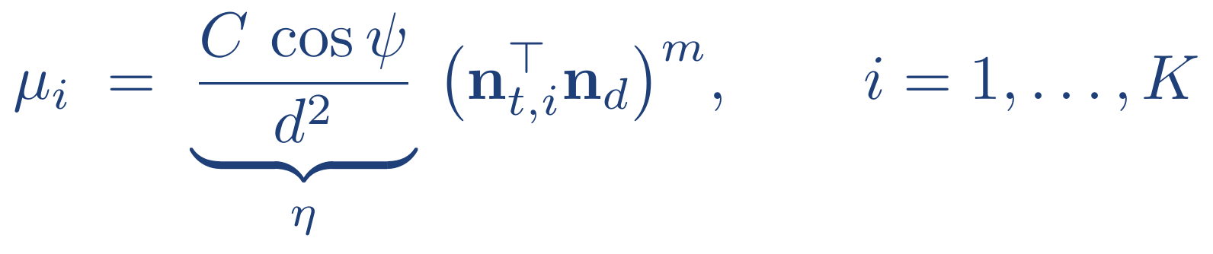
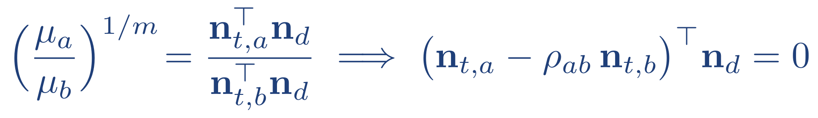
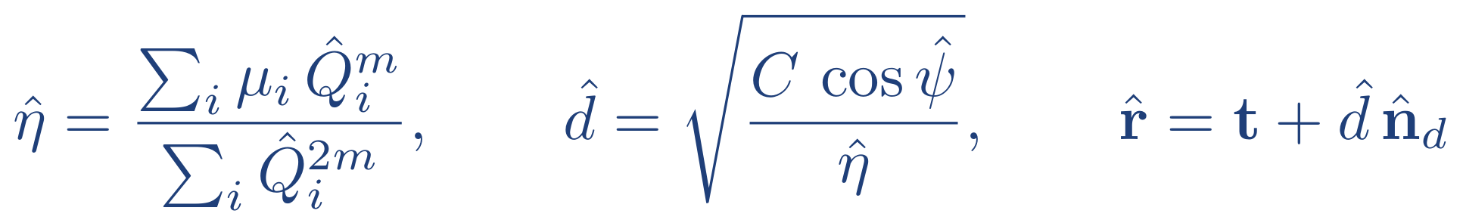
Principle: Beam Sweep → RSS → 3D Position
1
Beam sweep at the AP
The AP points its beam along K known directions (codebook); the UE averages the received power for each one.
2
Direction finding (AoD-like)
Power ratios cancel η (distance, Tx power, PD gain, receiver tilt) → linear constraints on n_{d}; closed-form eigenvector (GLS/WLS) or NLS.
3
Range and 3D position
AP at t steered through K known orientations n_{t,i}; single-PD UE at unknown r with unknown orientation n_{r}.
Cooperative: one extra beam-aligned measurement (K+1). Broadcast: closed form from the same K powers, using n_{r} from an IMU.
Only the average received power per beam is used → transparent to the data waveform (ISAC-ready).
Chassagne et al., Opt. Express 2025 (concept); Acuña-Condori et al., IEEE ICC 2026 (SVD estimator), IEEE Trans. Commun. 2026 (3D, GLS/WLS/NLS).
3
Notes:
Three steps. (1) The AP sweeps K known orientations; for each the UE only needs the mean received power, so any communication waveform can be used. (2) Taking ratios between two orientations cancels everything that is common: distance, transmit power, PD gain and the receiver incidence angle. Each ratio gives a linear constraint on the direction vector; with K>=3 we get the direction as the eigenvector of a 3x3 matrix (GLS/WLS) or with a nonlinear fit (NLS). This direction finding is independent of the receiver orientation. (3) The range comes either from one extra beam-aligned measurement (cooperative) or in closed form from the same K powers if the UE knows its own orientation from an IMU (broadcast).

Slide 4
Roadmap: From Concept to 3D Experiments
1
2
3
4
5
Concept
2D experiment
3D theory
Broadcast multi-UE
3D experiment
2025
Steer the source orientation instead of adding anchors (2D, simulation)
Chassagne et al., Opt. Express 2025
2025–26
SVD ratio estimator on a robot testbed: 2.66 cm RMSE under random tilts
IEEE ICC 2026 · OPTI-6G D4.2
2026
DEB/PEB bounds, GLS/WLS/NLS, GA codebook: ≈ 2 cm (sim.)
IEEE Trans. Commun. 2026
2026
Range from the same K powers + IMU: 1.73 cm RMS (sim.)
Letter, 2026
2026
808 positions × 4 Rx orientations: P90 4.8 cm in the AP half-power cone
Journal paper in preparation
◄ focus of this talk: 2D briefly, then 3D theory and 3D experiments ►
OPTI-6G work-plan links
Task 4.2
OWC RSS & AoA localisation (UVSQ lead)
D4.1
system design
D2.3
test method & KPIs
D4.2
construction & 2D tests
D4.3
integration & KPI validation (Sec. 5)
D4.3 (in preparation) – this material is intended as the basis of Section 5 “Beamsteered AoA localisation over wireless OWC”.
4
Notes:
Maturity path. Concept published in Optics Express in 2025 (2D, simulation). Then a 2D experimental proof (ICC 2026, also reported in D4.2). Then the 3D theory in IEEE TCOM: bounds, estimators and codebook design, and a broadcast extension for multiple users. The newest piece is the 3D experimental validation done this summer. In OPTI-6G this is Task 4.2 led by UVSQ, linked to D4.1, D2.3 (KPIs), D4.2 and the upcoming D4.3.

Slide 5
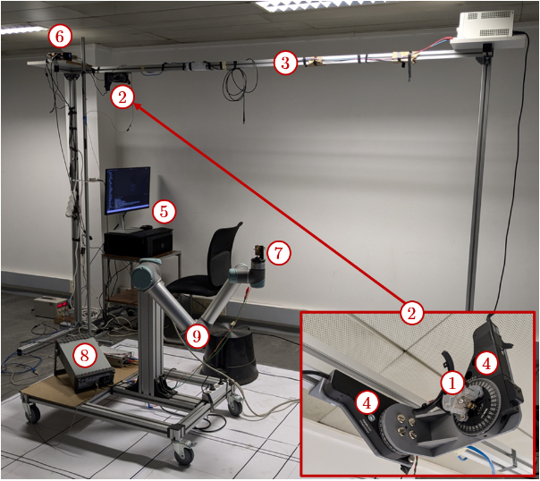
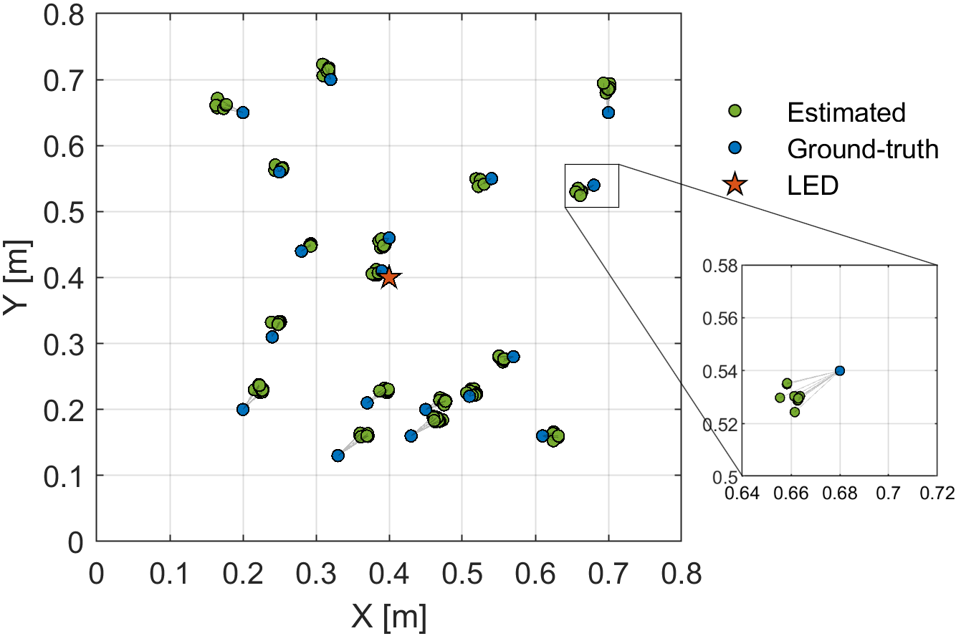
2D Experimental Proof of Concept (IEEE ICC 2026)
2.66 cm
RMSE (all positions & tilts)
2.35 cm
mean error
4.32 cm
P90 error (OPTI-6G target ≤ 5 cm)
4.8 mm
repeatability under tilt (WRMS)
LISV testbed: IR LED on a 2-axis motorized gimbal (ceiling), single PD on a UR5 robot arm
Ground truth (blue) vs. estimates (green), 10 random tilts each
Setup
0.8 × 0.8 m² · K = 3 AP orientations (20° tilt; 0/120/240°) · 18 positions × 10 random receiver tilts (≤ 20°, any azimuth) · 1000 samples per orientation · closed-form SVD ratio estimator · extra latency of a few ms
Why steering?
Simulation, 3 × 3 m², random receiver tilt ≤ 20°: P90 = 3.16 cm with one steered LED vs 34.45 cm with four fixed LEDs (classical RSS). ML-assisted variant (OPTI-6G D2.3): P90 = 2.8 cm over 1.8 × 1.8 m².
K. Acuña-Condori et al., “Robust optical wireless positioning with beam steering: pose estimation and tilt robustness,” IEEE ICC 2026; OPTI-6G D4.2.
5
Notes:
Brief 2D part. Same lab: IR LED on a two-axis gimbal on the ceiling, a single photodiode on a UR5 robot. Three AP orientations, 18 positions, and at each position 10 random receiver tilts up to 20 degrees. RMSE 2.66 cm, mean 2.35 cm, P90 4.32 cm, i.e. inside the OPTI-6G 5 cm target, and the repeatability across tilts is 4.8 mm: the estimate barely moves when the receiver is tilted. In simulation, under the same random tilt, a classical 4-LED RSS system degrades to 34 cm P90 while the steered LED stays at 3 cm. These results are in D4.2 and were presented at ICC 2026.

Slide 6
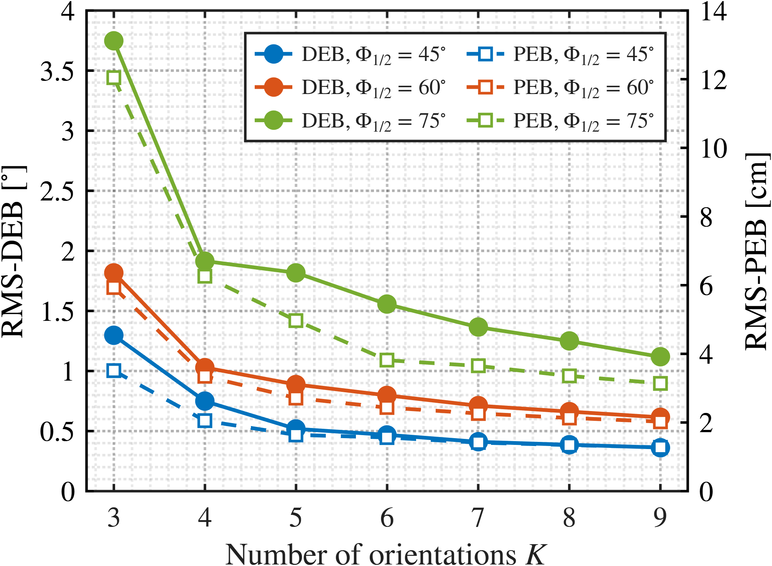
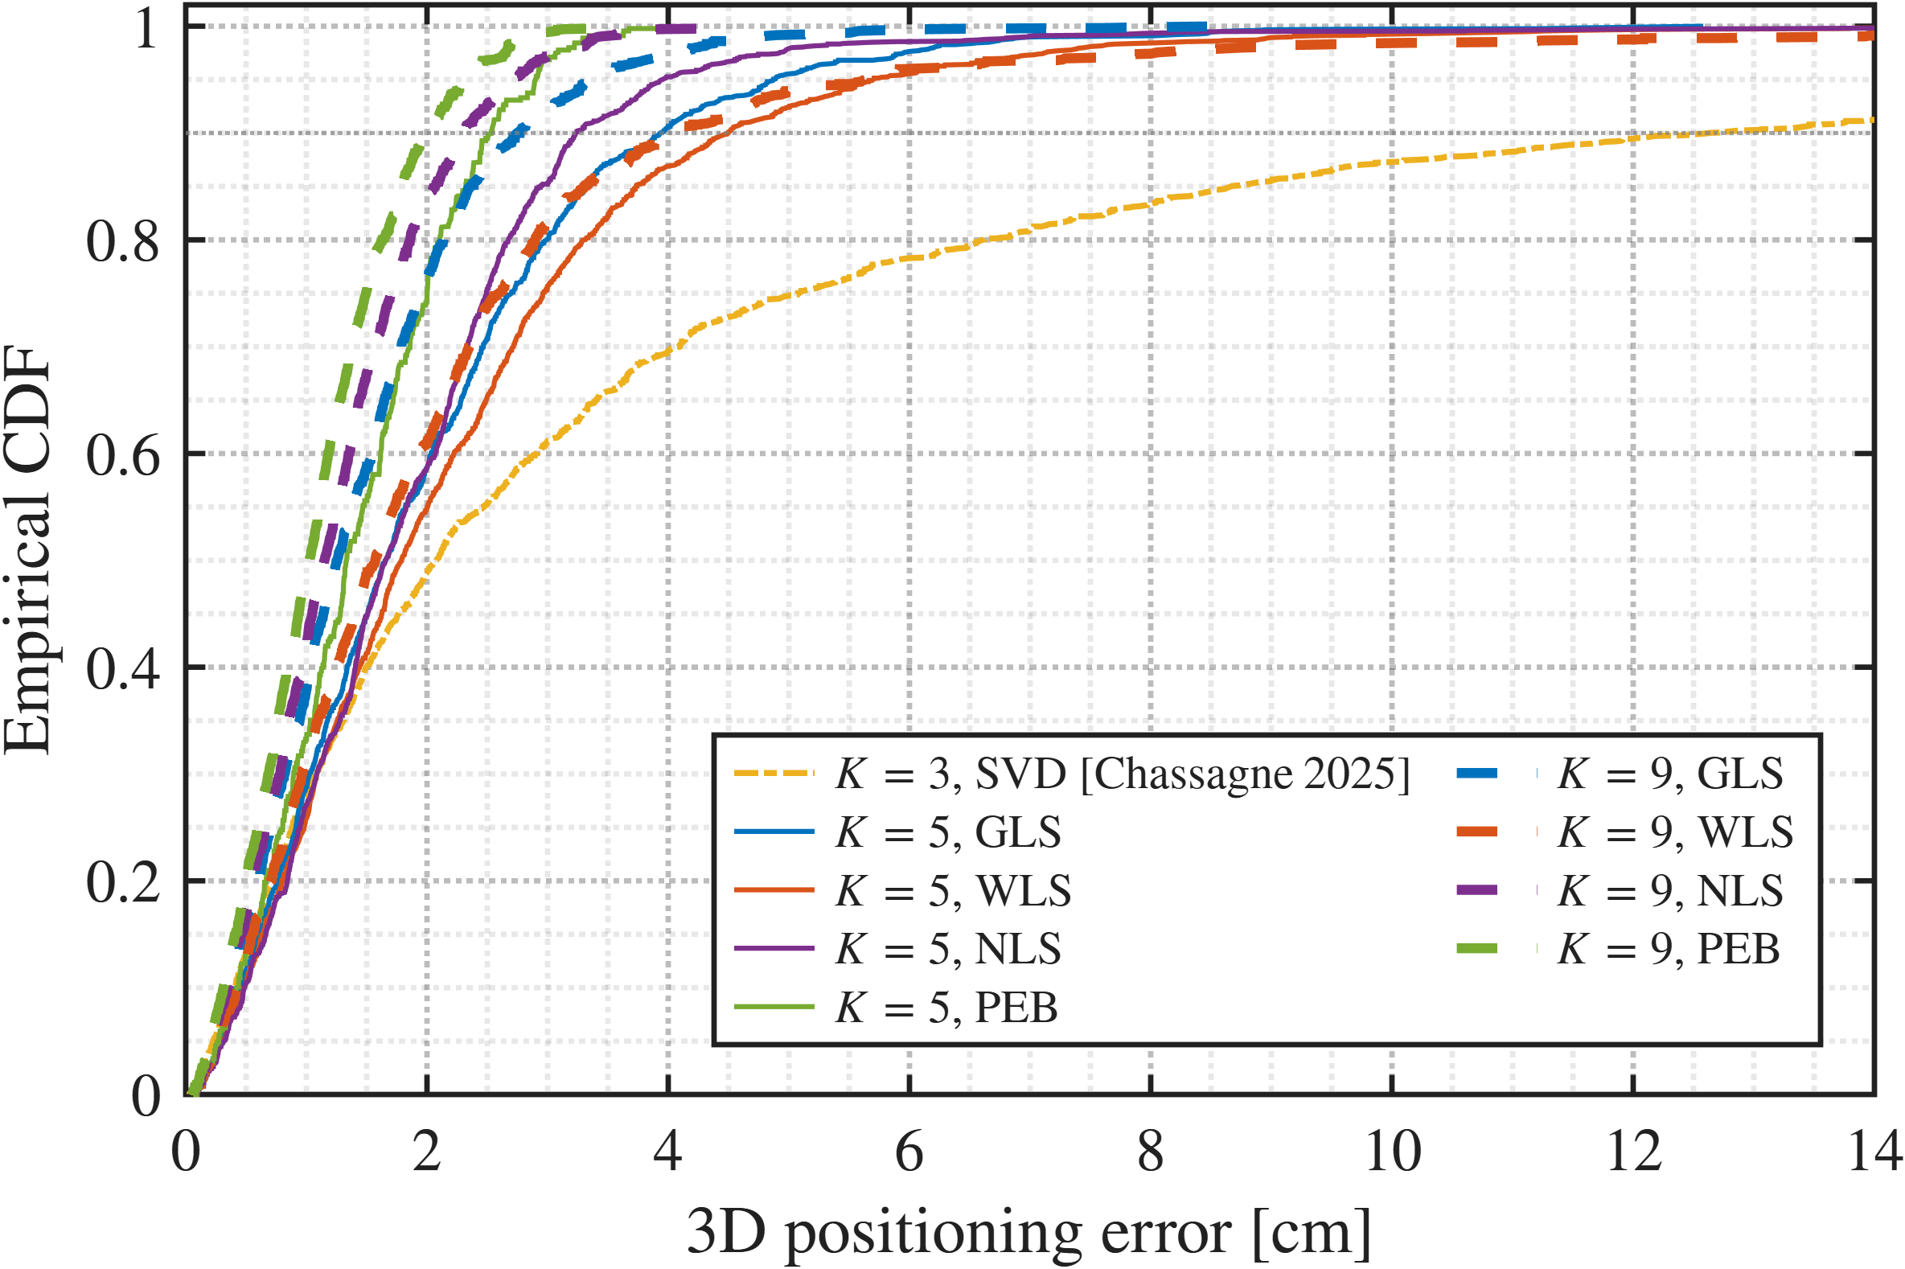
3D Theory: Bounds, Estimators, Codebook
0.52°
RMS direction bound (K = 5)
−49 to −72 %
median DEB: GA vs random codebooks
1.9–2.3 cm
mean 3D error (sim., K = 5)
< 3 %
DF degradation, random Rx tilt
0.02–0.65 ms
computation per fix (GLS→NLS)
(a) RMS direction / position bounds vs. number of beams K
(b) CDF of the 3D error: estimators vs. PEB (K = 5, 9)
Cramér–Rao direction (DEB) and position (PEB) bounds; estimators GLS (closed form, efficient), WLS (lightweight), NLS (iterative) – all provably independent of the receiver orientation.
Codebook optimised offline by a genetic algorithm: one universal orientation set per room; K trades accuracy against scan time.
Simulated 3 × 3 × 2 m³ room, 1,792 positions × 1,000 noise trials.
K. Acuña-Condori et al., “Model-based beam-steered optical wireless positioning with single-LED single-photodiode for 3D localization,” IEEE Trans. Commun., 2026.
6
Notes:
3D theory (IEEE Transactions on Communications). We derived Cramer-Rao bounds for the direction and for the 3D position, and three estimators: GLS is closed form and statistically efficient, WLS is lighter, NLS is iterative and closest to the bound. All three are mathematically independent of the receiver orientation. The set of K orientations is optimised offline with a genetic algorithm: it halves the median direction bound compared with random sets. With K=5, simulation gives about half a degree in direction and about 2 cm 3D mean error, less than 3% degradation under random receiver tilt, and sub-millisecond computation.

Slide 7
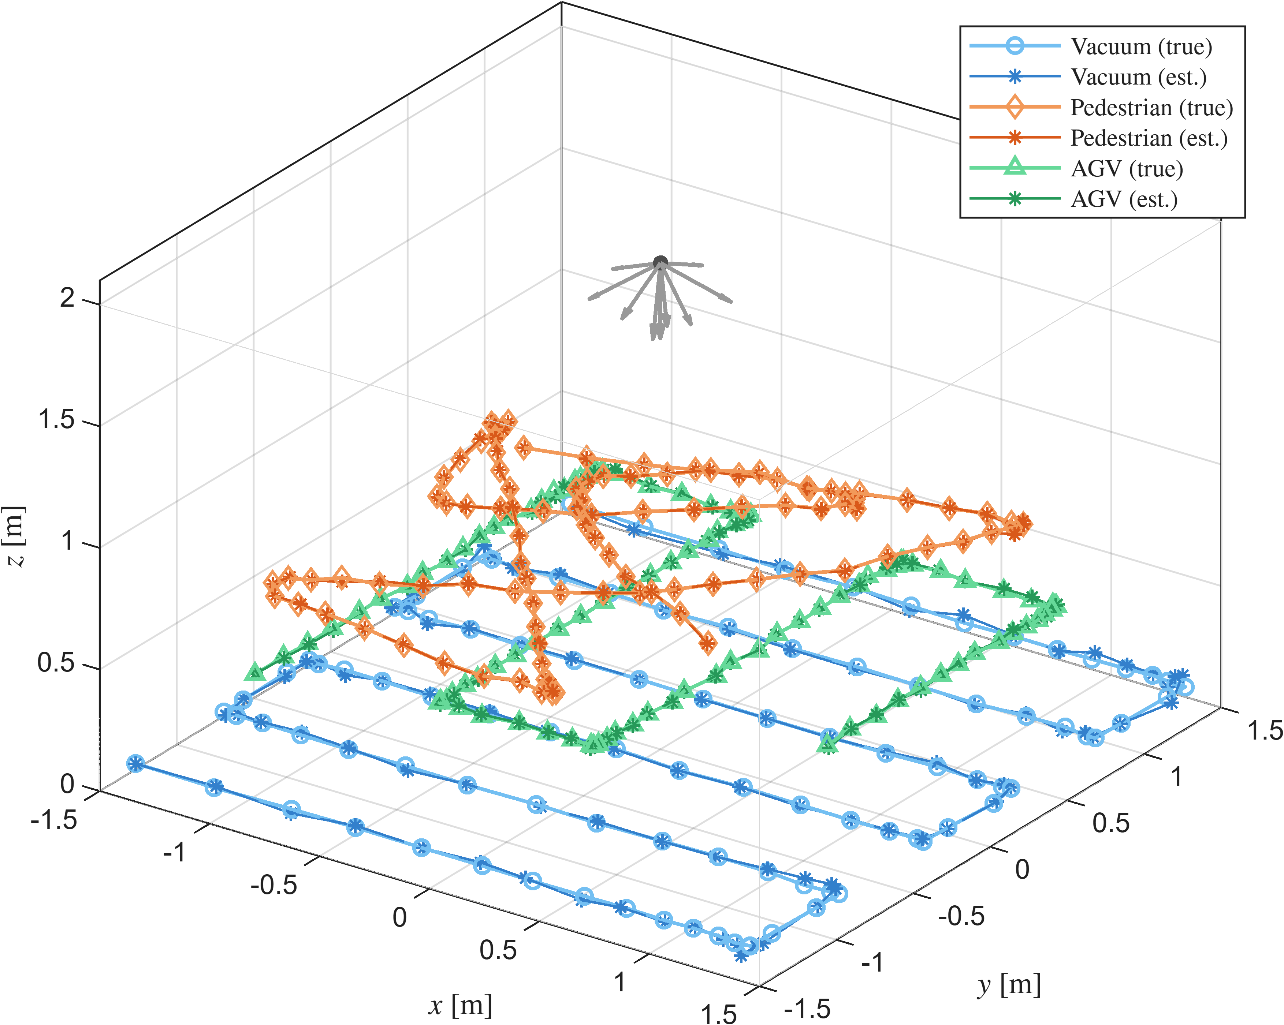
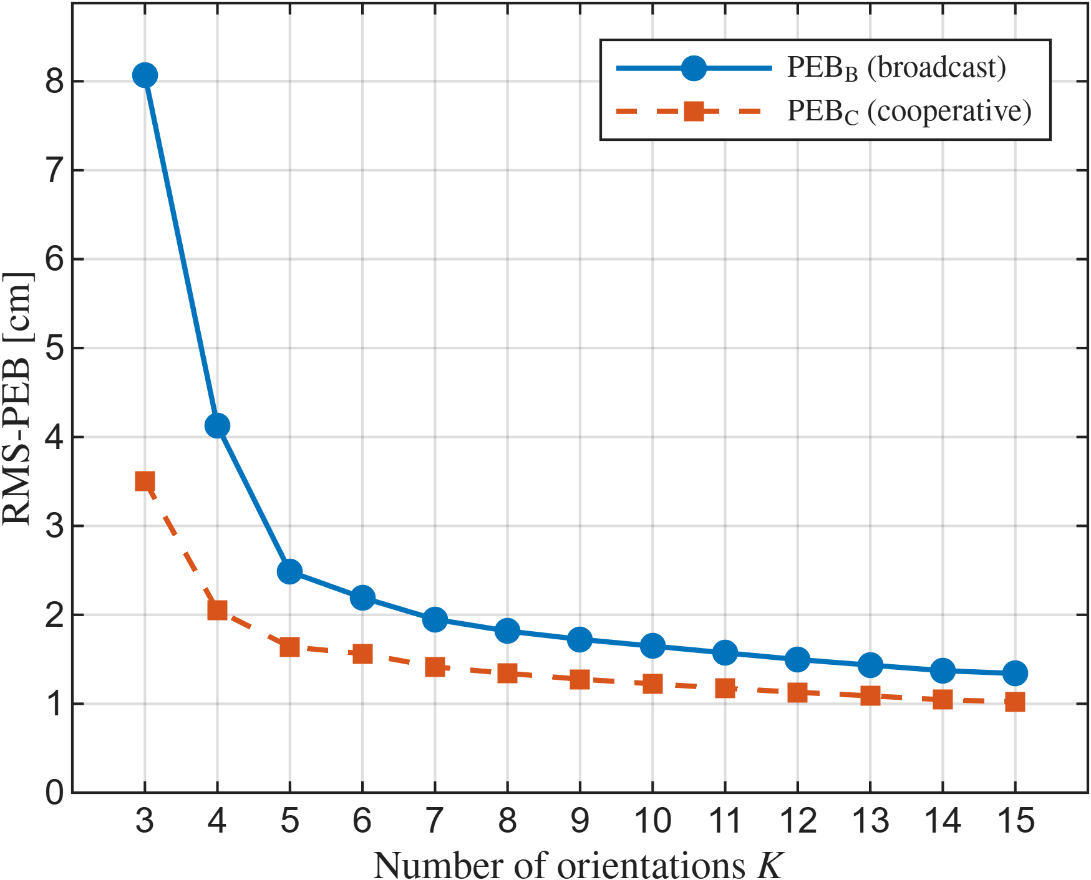
Broadcast Mode: One Sweep Serves All UEs
1.73 cm
RMS 3D error (K = 9, sim.)
× 1.3–1.5
RMS bound vs. cooperative (K ≥ 5)
any number
of UEs per sweep, no uplink needed for the fix
Cooperative mode: one beam-aligned (K+1) exchange per UE – best accuracy, but does not scale.
Broadcast mode: the AP periodically sweeps a common codebook; each UE gets its range in closed form from the same K powers and its own orientation (IMU).
Optical analogue of an SSB-like beam sweep with UE-based positioning.
The 3D experiments that follow use the broadcast pipeline.
Simulated simultaneous 3D tracking of a robot vacuum, a pedestrian and an AGV from the same sweeps (K = 9, NLS)
K. Acuña-Condori et al., “Broadcast 3D indoor positioning with a single beam-steered LED,” 2026. PEB_B / PEB_C: broadcast / cooperative position error bounds.
7
Notes:
Architecture-relevant extension. The cooperative mode needs one extra aligned measurement per user, so it does not scale. In broadcast mode the AP just keeps sweeping a common codebook, like an SSB beam sweep, and every UE computes its own position from the same K powers using its orientation from an IMU. The price is a factor 1.3 to 1.5 on the RMS bound for K>=5, but any number of UEs can be served, without uplink for the fix itself. Example: three different mobile users tracked from the same sweeps. The experiments use this mode.

Slide 8
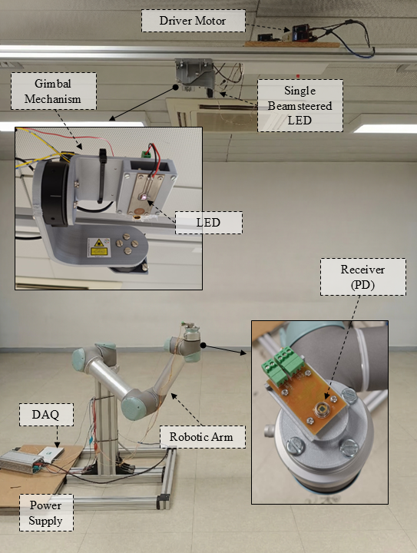
3D Experimental Testbed (UVSQ–LISV)
Element | Implementation
AP transmitter | 940 nm IR LED (OSRAM SFH 4725S), 500 mA, ceiling-mounted at 2.0 m
Beam steering | 2-axis motorized gimbal, 2 × Thorlabs PRM1Z8 (0.1° resolution)
Measured beam | Φ_{1/2} = 36.7° → Lambertian order m = 3.13
Codebook | 12 orientations recorded; K = 9 used (3 at 16° + 6 at 60–64°), optimised for this beam
UE receiver | single Si PIN photodiode (OSRAM BPX61) + transimpedance amplifier
Acquisition | DAQ at 1 kHz; 1000 samples (1 s) averaged per orientation
Ground truth | UR5 robot arm (sub-mm repeatability), relocated to 15 base positions
Receiver attitude | per point: vertical + 3 random tilts (0–15°, uniform azimuth)
Processing | GLS / WLS / NLS direction + broadcast range; one calibration constant C (measured under the AP); no training data
Experimental campaign UVSQ-LISV, Jul.-Sep. 2026 (journal paper in preparation). GLS/NLS: generalized / nonlinear least squares.
8
Notes:
The 3D testbed. A 940 nm IR LED on the motorised gimbal at 2 m height plays the role of the steerable optical AP. The UE is a single BPX61 photodiode with a transimpedance amplifier on a UR5 robot arm, which gives sub-millimetre ground truth; we moved the robot to 15 base positions to cover the room. Twelve orientations were recorded at each point and nine are used. Each point is measured with the PD vertical and with three random tilts. Processing is purely model-based: one calibration constant, no training data.

Slide 9
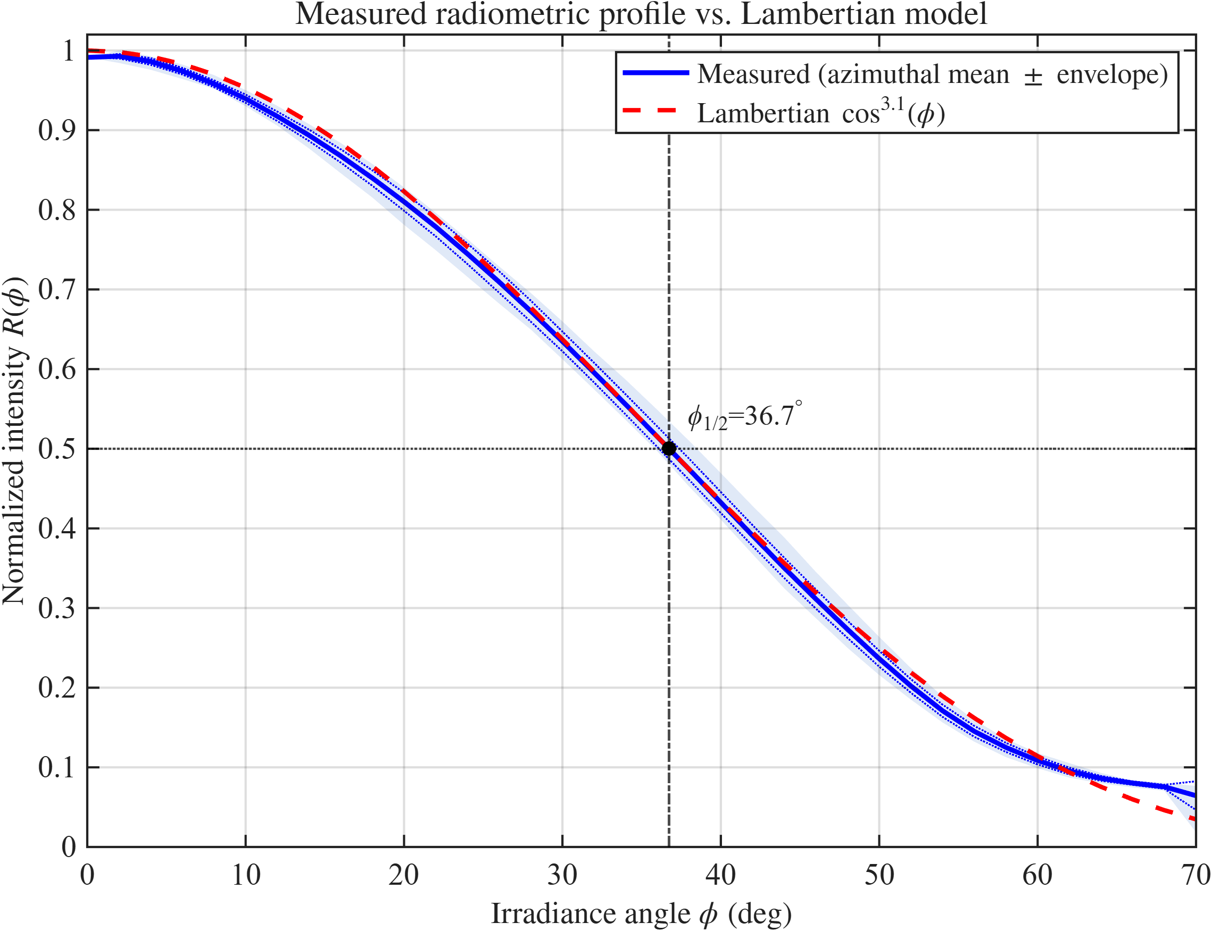
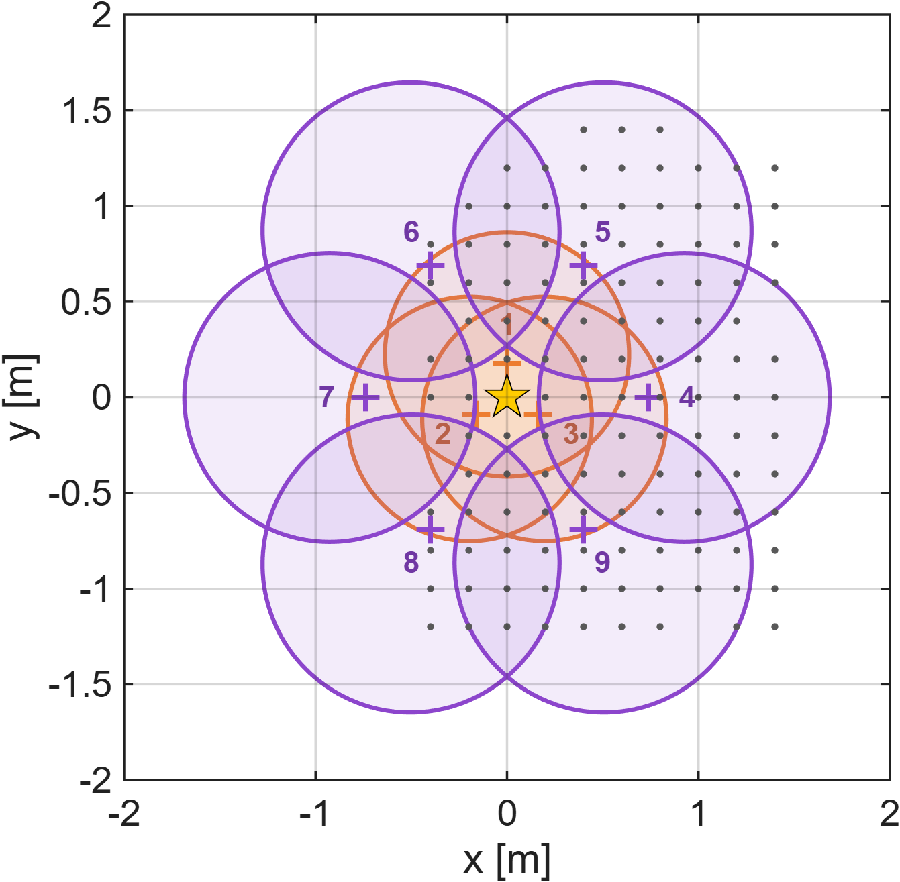
Optical Channel and Beam Codebook
Measured radiation profile follows a Lambertian law cos^{m} (m = 3.13) up to ≈ 60° → ideal model kept.
9 beams (3 inner, 6 outer) tile ≈ 3 × 3 m at UE height.
One radiometric calibration: C from measurements directly under the AP.
Only the mean power per beam is exploited.
(a) Measured LED profile vs. Lambertian model (Φ_{1/2} = 36.7°)
(b) Half-power footprints of the K = 9 beams at z = 0.75 m; dots: measured (x, y) positions
Experimental campaign UVSQ-LISV, Jul.-Sep. 2026 (journal paper in preparation). GLS/NLS: generalized / nonlinear least squares.
9
Notes:
Before positioning we characterised the optical channel: the measured LED profile is very close to a Lambertian law with m=3.13 (half-power angle 36.7 degrees), so the ideal model is kept in the estimators. On the right, the half-power footprints of the nine beams at UE height: three inner beams and six outer ones tile about 3 by 3 metres; the dots are the measured positions. Only one constant C is calibrated, from the measurements taken directly under the AP.

Slide 10
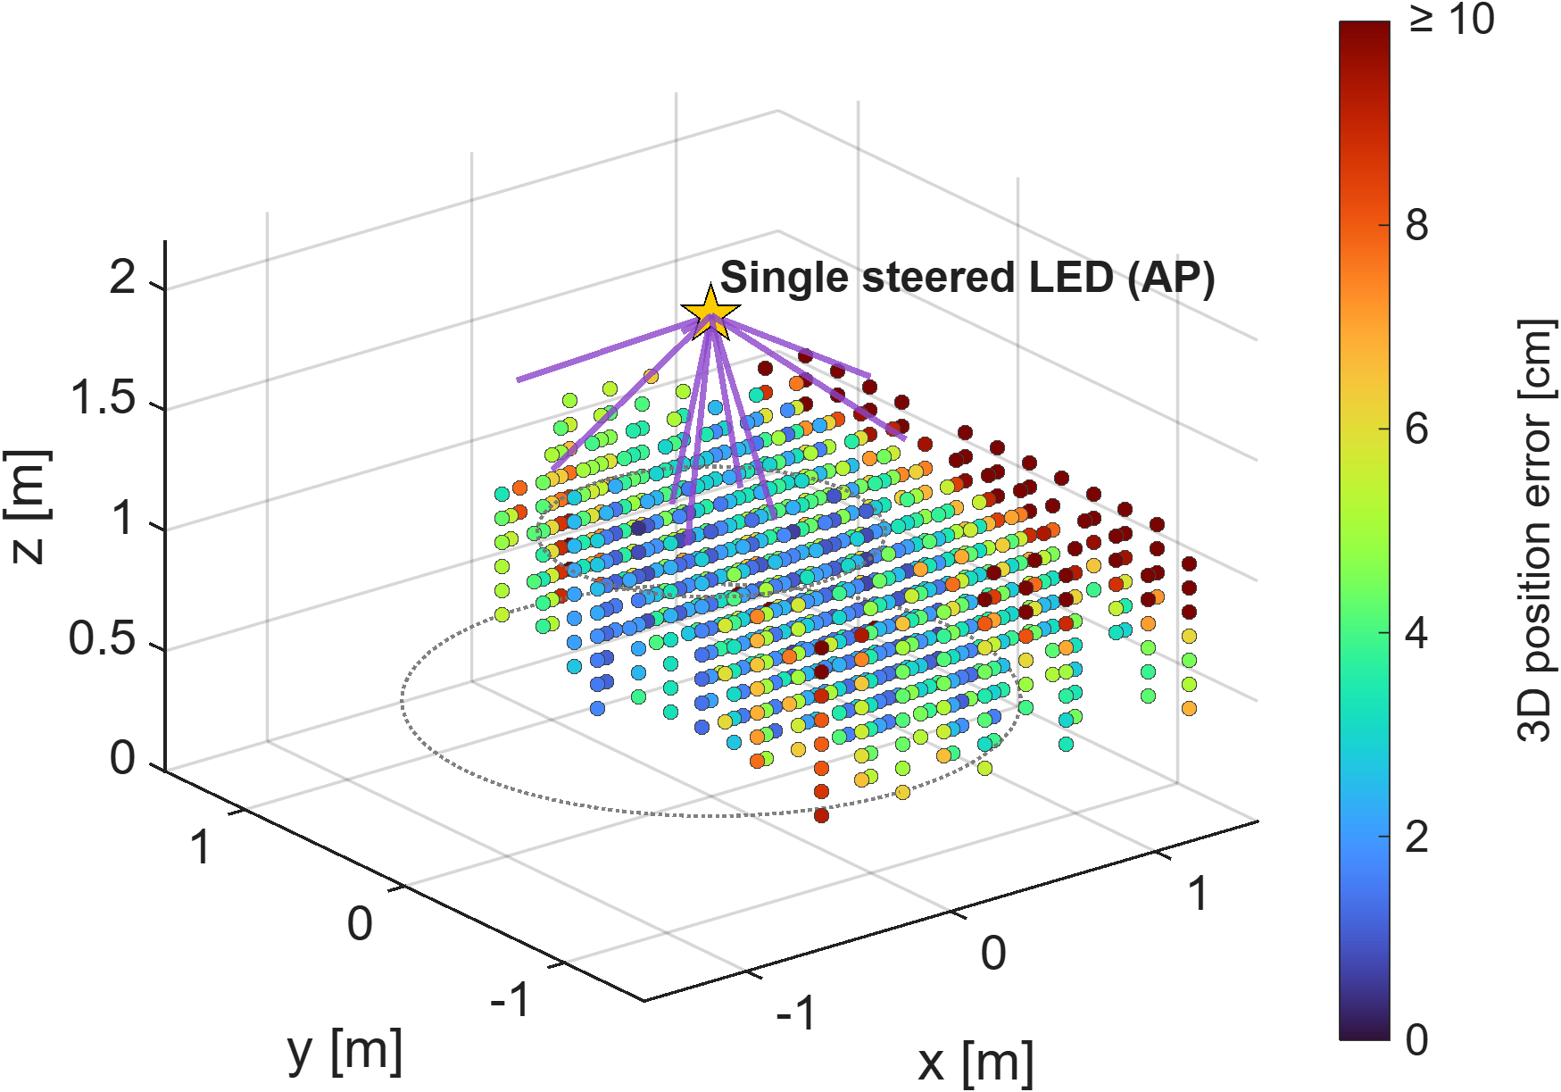
3D Measurement Campaign and Localisation Map
808
3D ground-truth positions
8 heights
z = 0.4–1.1 m (0.9–1.6 m below the AP)
3,232
3D fixes (1 vertical + 3 tilted Rx per point)
38,784
beam-RSS measurements, 22 sessions
0.2 m grid; up to 2.0 m horizontal offset (64° from the AP nadir).
Same data processed by GLS / WLS / NLS + broadcast range – no training, no fingerprinting.
Colour = 3D error (NLS, vertical PD): cm-level inside the AP footprint, degrading towards the periphery.
Experimental campaign UVSQ-LISV, Jul.-Sep. 2026 (journal paper in preparation). GLS/NLS: generalized / nonlinear least squares.
10
Notes:
The 3D campaign: 808 ground-truth positions on a 0.2 m grid at 8 heights, i.e. 0.9 to 1.6 m below the AP, and up to 2 m horizontal offset. Each position is measured four times with different receiver attitudes, giving 3,232 3D fixes from almost 39,000 beam power measurements over 22 sessions. The colour is the 3D error: blue/cyan, i.e. 1-4 cm, under the AP, and growing at the periphery.

Slide 11
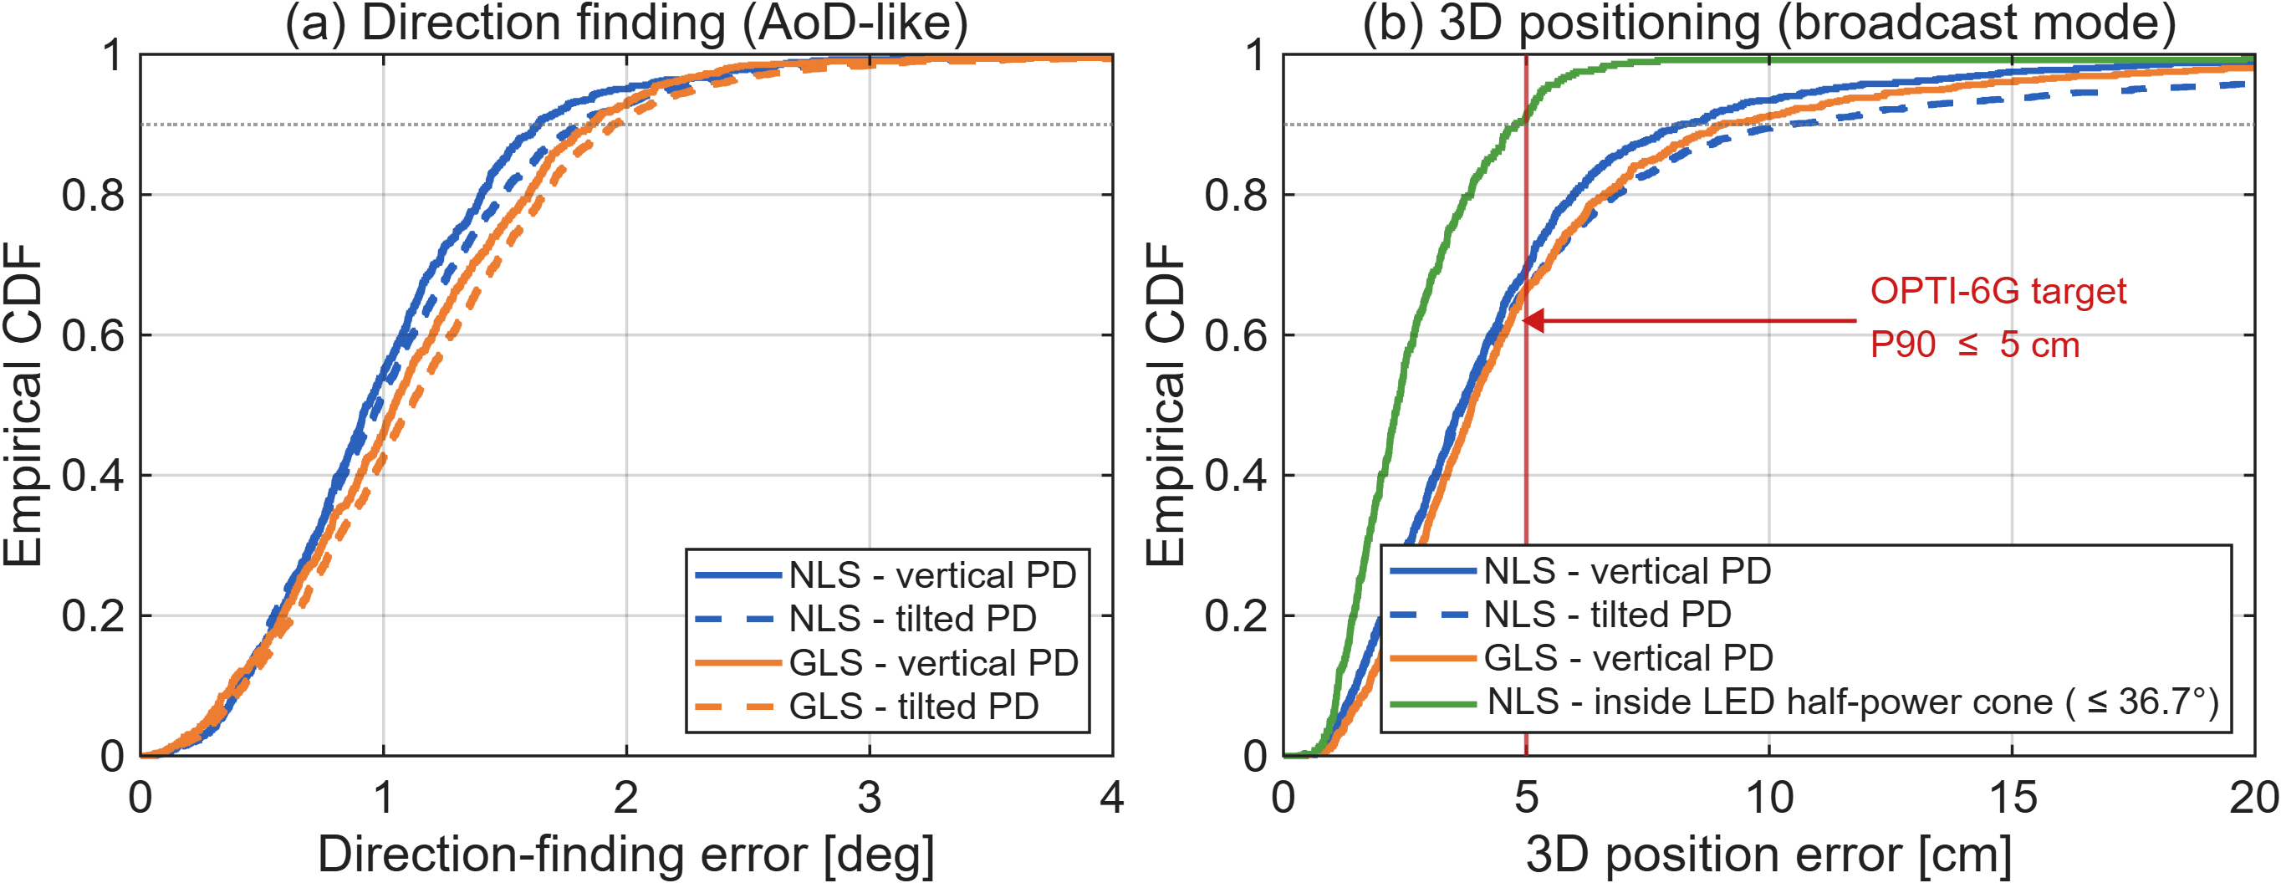
3D Results: Direction and Position Accuracy
≈ 1.0°
mean direction error, all positions
3.7 cm
median 3D error, all 808 positions
2.3 | 4.8 cm
median | P90 inside the AP half-power cone
8.2 cm
P90 over the whole sampled region
UVSQ-LISV campaign, Jul.-Sep. 2026. Half-power cone: positions within 36.7° of the AP nadir (n = 368 of 808).
11
Notes:
Main result. Left: direction finding, about 1 degree mean error, and the curves for vertical and tilted receivers almost overlap. Right: 3D error in broadcast mode. Over all 808 positions the median is 3.7 cm and the P90 8.2 cm. Inside the half-power cone of the AP (368 positions) the median is 2.3 cm and the P90 4.8 cm, which meets the OPTI-6G 5 cm target. NLS is consistently the best estimator, GLS close behind, as predicted by the theory.

Slide 12
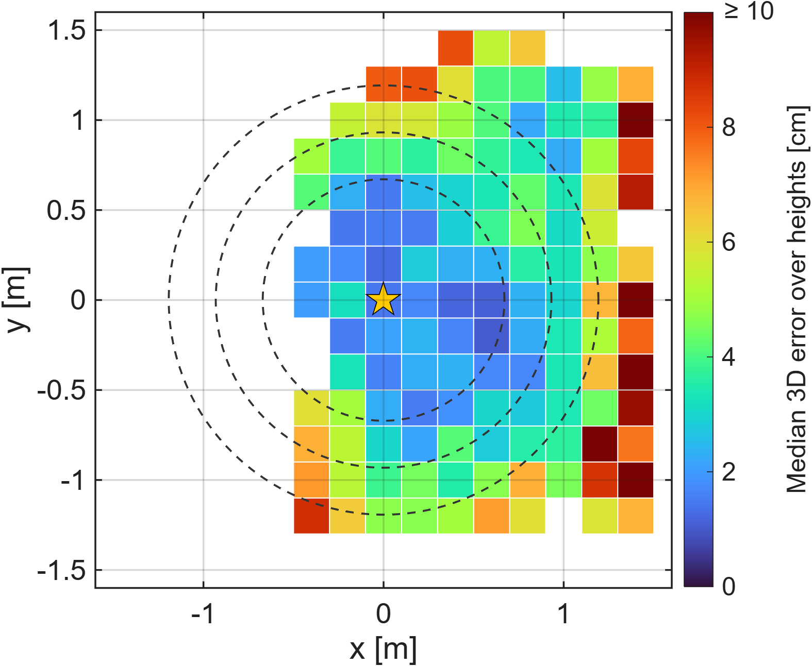
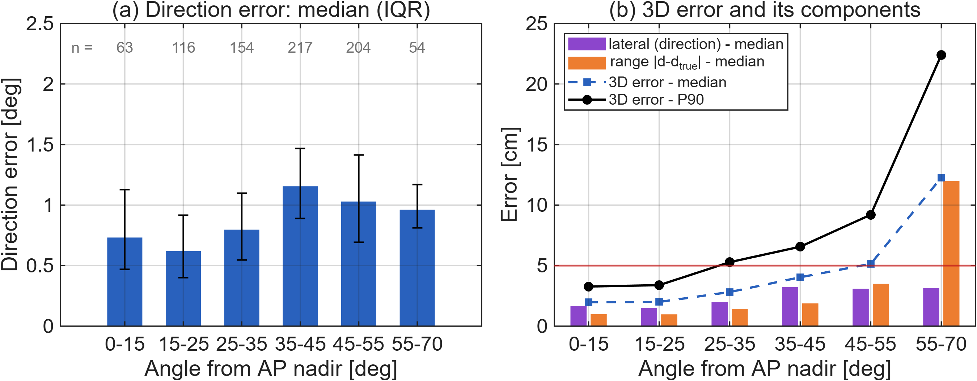
Where Does the Error Come From?
Direction error stays ≈ 1° at all angles → lateral error 1.5–3 cm.
Beyond ≈ 45° the 3D error is dominated by the range term (12 cm median at 55–70°).
Causes: lower SNR and radiometric model mismatch at large angles (pattern tails, PD field of view, single C).
Remedies: measured-pattern model, more outer beams, hand-over to neighbouring APs (cell-free).
Median 3D error per (x, y) over the 8 heights; dashed: AP half-power footprint at z = 1.1 / 0.75 / 0.4 m
Experimental campaign UVSQ-LISV, Jul.-Sep. 2026 (journal paper in preparation). GLS/NLS: generalized / nonlinear least squares.
12
Notes:
Where does the error come from? The map shows a clear centre-to-periphery trend. Splitting the error, the direction error stays around 1 degree everywhere, which gives a lateral error of 1.5 to 3 cm. What grows is the range error: beyond about 45 degrees from the nadir it dominates. This is the amplitude model: lower SNR, deviation from the ideal pattern at large angles, the PD field of view and a single calibration constant. So the direction-finding part is robust, and the range part is where calibration and codebook design, or a neighbouring AP in a cell-free deployment, can help.

Slide 13
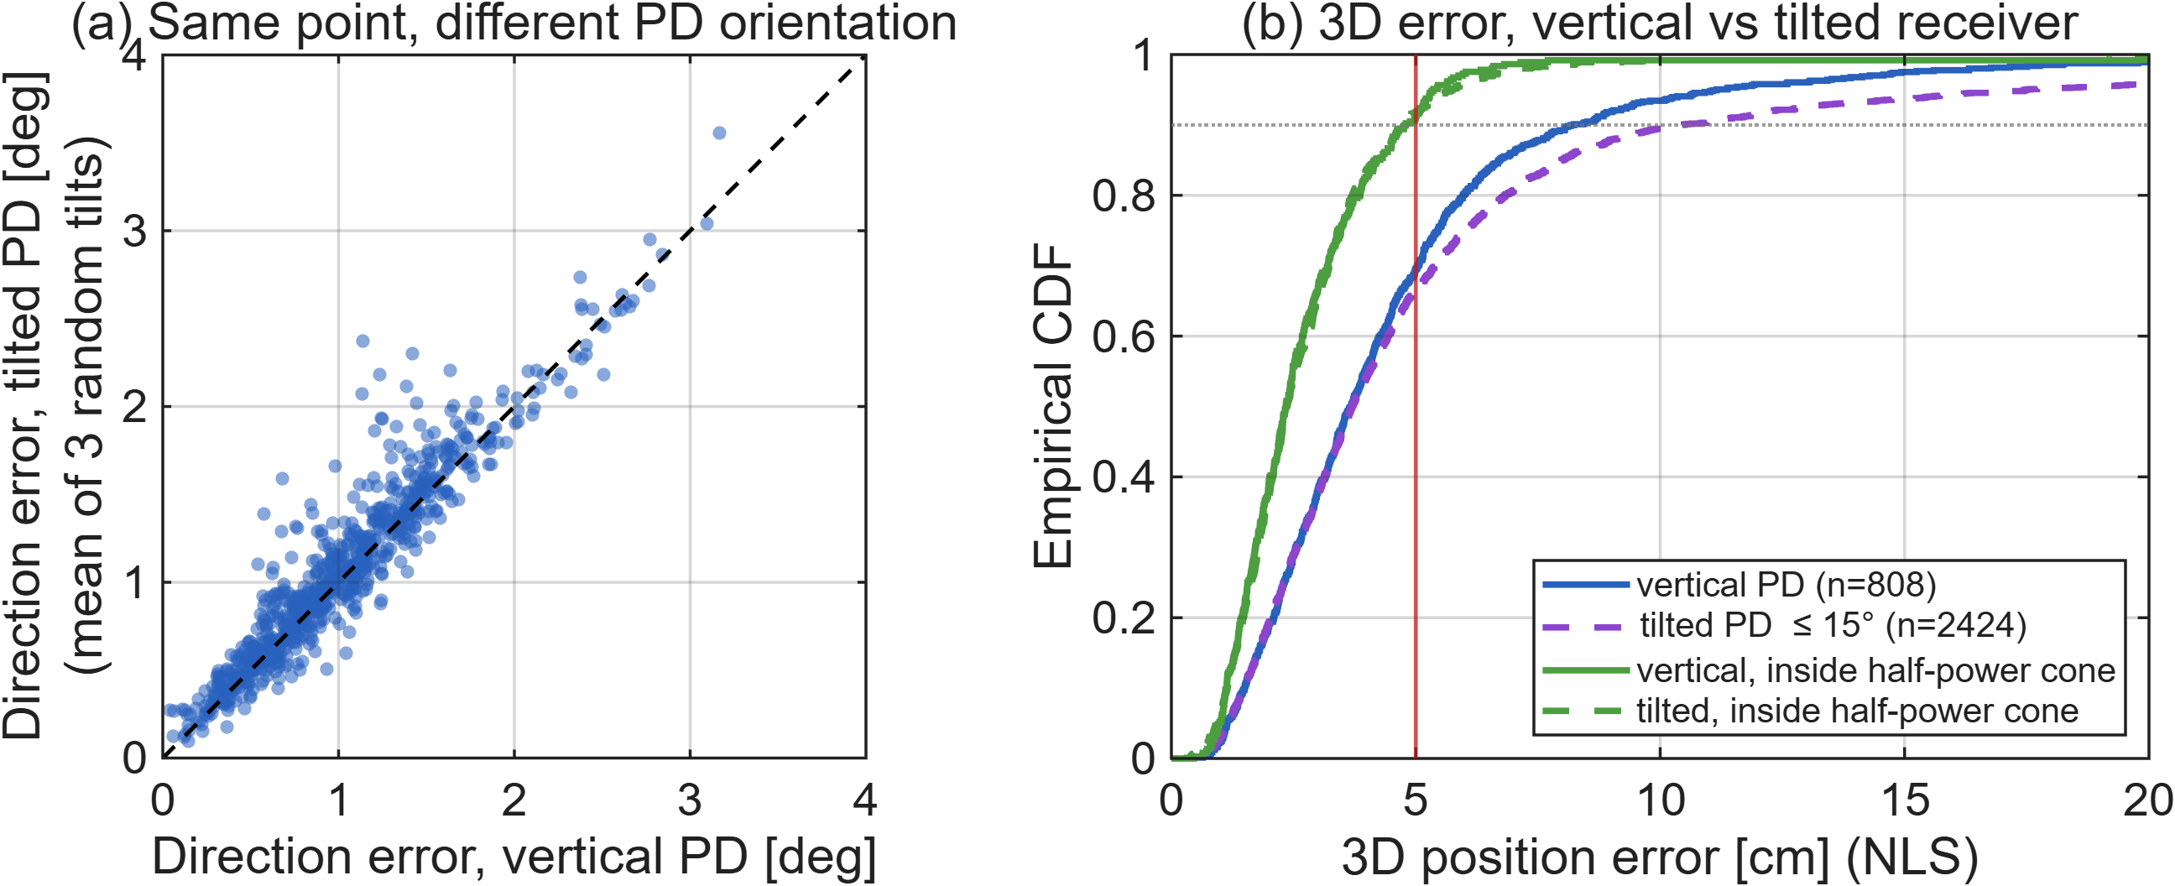
Robustness to Receiver Orientation
0.28°
direction spread over 4 receiver orientations at the same point (≈ 0.9 cm)
1.03° → 1.08°
mean direction error, vertical → randomly tilted PD (NLS)
4.7 cm
P90 3D error with random tilts, inside the half-power cone
UVSQ-LISV campaign, Jul.-Sep. 2026. Tilts uniform in 0–15° (mean 7.6°), uniform azimuth; receiver orientation used only for the range.
13
Notes:
Receiver orientation. Each point was measured with the PD vertical and with three random tilts. Left: the direction error with a tilted PD versus vertical, point by point: they lie on the diagonal, the mean goes from 1.03 to 1.08 degrees, and the four estimates at the same point are within 0.28 degrees of each other. This experimentally confirms the orientation independence proven in theory. Right: the 3D error degrades slightly with tilt because the range uses the receiver orientation, but inside the half-power cone P90 is still 4.7 cm.

Slide 14
KPI Assessment against OPTI-6G Targets (D2.3)
KPI | Target (D2.3) | 2D experiment | 3D experiment (this work) | Status
Accuracy (P90 error) | ≤ 5 cm | 4.32 cm 0.8 × 0.8 m², tilts ≤ 20° | 4.8 cm inside the AP half-power cone (4.7 cm with tilts ≤ 15°) 8.2 cm over the whole sampled region (up to 64° off-nadir) | Met in 2D and in the 3D core zone
Coverage (single AP) | 2 × 2 × 2 m³ | 0.64 m² | ≈ 2 m³ at P90 ≤ 5 cm (half-power cone, z = 0.4–1.1 m; sampled on one side, symmetric setup) positions up to 2 m off-axis located with P90 ≈ 8 cm | Partially met
Extra latency (excl. steering) | ≤ 20 ms | a few ms | 0.02 ms (GLS) – 0.65 ms (NLS) computation per fix mechanical gimbal: seconds per beam (not optimised) | Met (estimator)
ISAC compatibility | yes | – | only the mean power per beam is used → transparent to the data waveform joint data + positioning demo pending integration | By design; demo pending
Scope: laboratory LED + mechanical gimbal demonstrator; integration with the OPTI-6G optical antennas is the next step (D4.3). The proposal's sub-cm ambition (RSS + AoA + ToA fusion) is not reached by RSS beam steering alone; the 5 cm target follows the revised KPIs of D2.3.
Targets: OPTI-6G D2.3, “Beam-steered based localisation KPIs”. 3D values: NLS estimator, broadcast range. Latency: IEEE Trans. Commun. 2026 (PC implementation).
14
Notes:
KPIs as defined in D2.3 for the beam-steered method. Accuracy: met in 2D and in 3D inside the AP half-power cone, 4.8 cm P90; over the whole sampled region it is 8.2 cm. Coverage: about 2 cubic metres at P90 below 5 cm with a single AP (truncated half-power cone between 0.9 and 1.6 m below the AP; the robot sampled mainly one side of it, the setup being rotationally symmetric), against 8 cubic metres targeted, so partially met. Latency: the estimator is below a millisecond; the mechanical steering is not part of the KPI and is slow in the lab. ISAC: by design, since only the mean power is used, but the joint demonstration requires the integration with the OPTI-6G antennas. I want to be explicit that the sub-centimetre ambition of the proposal is not reached by RSS beam steering alone.

Slide 15
Integration into the OPTI-6G / 6G Architecture
Optical AP (O-RU)
optical antenna (Tx/Rx)
beam steering: gimbal → MEMS / LC / OPA
codebook scheduler: periodic K-beam sweep
data downlink continues during the sweep
beam sweep n_{t,1…K}
UE (robot, AGV, XR …)
single photodiode
RSS per beam (e.g. TruPwr™ port of the OPTI-6G antenna)
IMU (broadcast mode)
estimator GLS / WLS / NLS (< 1 ms)
Localisation server (NIB / edge)
collects positions; fusion with RSS / TDoA
position report
(OWC uplink)
5G core & applications
robot / AGV control, XR, digital twin
mean power only
UE-based – broadcast mode
AP announces codebook + beam timing (system information)
each UE computes its own 3D position (needs its orientation)
scales to any number of UEs; uplink only to report
privacy-friendly: the position stays in the UE unless reported
Network-assisted – cooperative mode
UE reports per-beam RSS; server/AP estimates the direction
one beam-aligned (K+1) measurement gives the range and the beam for the data link (beam management)
highest accuracy; per-UE signalling; no IMU needed
Architecture needs: codebook & beam-timing signalling · AP pose calibration · RSS / position reporting over the OWC uplink · position exposure to applications
Planned OPTI-6G integration: OLEDCOMM optical antenna with up/down-converters and AD8361 TruPwr™ RSS output (D3.2/D4.2); Brunel 5G/6G Autonomous IoT Lab.
15
Notes:
How it fits the architecture. Positioning becomes a function of the optical RU itself: the AP periodically sweeps a codebook while data keeps flowing, because only the mean power matters. The UE needs a single photodiode and an RSS readout; in OPTI-6G this is the TruPwr output of the optical antenna. Two modes: UE-based broadcast, scalable to any number of UEs, where the codebook and beam timing are announced like system information; and network-assisted cooperative, where the direction estimate is reused for beam alignment of the data link. What the architecture must provide: codebook and beam-timing signalling, AP pose calibration, reporting over the OWC uplink and exposure of the position to applications.

Slide 16
Trade-offs, Limitations and Next Steps
Trade-offs and current limitations
Scan time: K sequential beams; the lab gimbal needs seconds per orientation (the estimator itself < 1 ms).
Accuracy vs. coverage: best inside the AP half-power cone; range errors grow beyond ≈ 45° off-nadir.
Mode trade-off: broadcast needs the UE orientation (IMU); cooperative needs one aligned exchange per UE.
Calibration: one radiometric constant C per AP / receiver type; ideal Lambertian model assumed.
Line of sight to the AP is required (as for any optical link).
Next steps
Solid-state steering (MEMS, liquid crystal, OPA, switched VCSEL/LED segments) → ms-level fixes and tracking.
Pattern-aware / physics-informed calibration and codebooks optimised for the measured beam.
Integration with the OPTI-6G optical antennas (TruPwr™ RSS, positions over the OWC uplink) at Brunel → D4.3.
Multi-AP fusion in the cell-free network; moving UEs (tracking) and cooperative mode on the testbed.
Joint communication + positioning (ISAC) demonstration; beam-sweep signalling as input to the ArchWG.
16
Notes:
Honest trade-offs. The scan is sequential, and our lab gimbal is slow, although the estimator is sub-millisecond: solid-state steering is the key enabler for real-time tracking. Accuracy is best inside the AP cone; periphery range errors call for pattern-aware calibration or neighbouring APs. Broadcast needs the UE orientation, cooperative needs one exchange per UE. Line of sight is required as for any optical link. Next steps: solid-state steering, physics-informed calibration, integration with the OPTI-6G antennas at Brunel for D4.3, multi-AP fusion and a joint ISAC demonstration.

Slide 17
Key Takeaways
1
One AP is enough
Beam steering at a single optical AP + a single-PD UE yields a 3D position: no anchor constellation, no camera, no PD array.
2
Validated in 2D
2.66 cm RMSE, P90 4.32 cm and 4.8 mm repeatability under random receiver tilts up to 20° (IEEE ICC 2026).
3
Theory for 3D
Bounds (DEB/PEB), orientation-independent GLS/WLS/NLS estimators, GA codebook; broadcast mode serves any number of UEs from one sweep.
4
Demonstrated in 3D
808 positions, 3,232 fixes: ≈ 1° direction error; median 2.3 cm and P90 4.8 cm inside the AP half-power cone (≈ 2 m³); robust to receiver tilt.
5
Architecture-ready
Positioning as a native, ISAC-compatible function of optical RUs; next: solid-state steering and integration with the OPTI-6G antennas (D4.3).
This work is part of the EC Horizon Europe project OPTI-6G, Grant Agreement No. 101139292.
17
Notes:
To conclude: a single steerable optical AP and a single-photodiode UE are enough for 3D positioning. Validated in 2D, theory for 3D with bounds and efficient estimators, a broadcast mode for many users, and now a 3D experimental demonstration with about 1 degree direction error and 2.3 cm median / 4.8 cm P90 inside the AP cone, robust to receiver tilt. For the architecture, positioning becomes a native and ISAC-compatible function of optical RUs. Thank you.

Slide 18
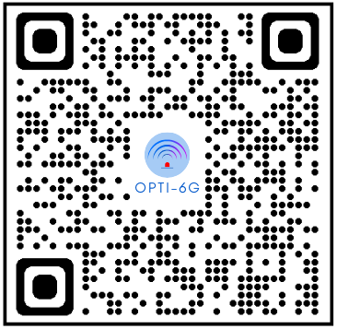
Thank you for your attention!
kevin-jose.acuna-condori@uvsq.fr · bastien.bechadergue@uvsq.fr
Notes:
Questions.

