Slide 1
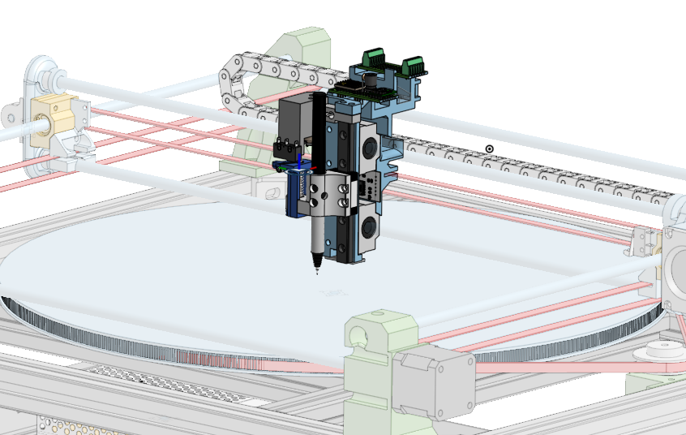
XY Theta Pen Plotter
SUMMER PROGRESS UPDATE
Notes:
[Sources]
- User-provided toolhead CAD render.
- No external assets or claims.

Slide 2
SUMMER PROGRESS
MECHANICAL TOOLHEAD
CONTROL SPLIT
COMMISSIONING
Built and iterated
Ownership definitions
Planned
N20 lead-screw actuator
Spring preload
Load-cell force path
Finalized X Y Theta frame
18” Diameter 720 tooth bed.
Converter app converts .SVG files to .gcode
iosender sends .gcode to GRBLHAL OS on RP23CNC
RP23CNC owns X/Y/A, M3/M5 motion orchestration.
Pro Micro owns control system(N20 motion, force sensing) and toolhead safety.
Test definitions for:
Force calibration
Lift-home repeatability
M5 clearance
Interchangeable-tool checks
Finish motor wiring
Progress is being documented as measured tests in TEST_PLAN.md
E – Electrical/Electronics
F – Firmware/Controller
M – Motion
T - Toolhead
THETA PEN PLOTTER • SUMMER PROGRESS UPDATE
2
Notes:
[Sources]
- Internal project architecture, test plan, and user-provided CAD.
- No external assets or claims.

Slide 3
HIGH-LEVEL ARCHITECTURE
Separating coordinated motion and local force control
Gcode creation
Movement
Toolhead control system
Host PC
G-code
RP23CNC / grblHAL
M3 / M5
Toolhead Pro Micro
force
Pen + paper
→
→
→
SVG → G-code
ioSender streams commands
Plans X/Y/A motion
Homing and P100 registration
Reads load cell
Controls N20 and safety
Writing force
creates the mark
THETA PEN PLOTTER • SUMMER PROGRESS UPDATE
3
Notes:
[Sources]
- Internal system architecture and interface documents.
- No external assets or claims.

Slide 4
INTERFACE PROTECTION
Opto-isolation keeps the controller interface safe
Three isolated digital paths carry commands and status without sharing grounds.
RP23CNC / controller
PC817C isolation
Pro Micro / toolhead
5 V and ~12 V domain
3.3 V domain
ENA - M3 / M5
U1
GP29 - command input
Aux 0 - arm request
U2
GP28 - request input
LIMA / PRB* - input
U3
GP27 - status output
Why this matters
Only digital states cross the boundary; power, grounds, load-cell data, motor current, and UART stay in their own domains.
* GP27 currently returns through LIMA; PRB remains a candidate pending F-08 verification.
THETA PEN PLOTTER • SUMMER PROGRESS UPDATE
4
Notes:
[Sources]
- Internal system architecture and interface documents.
- No external assets or claims.

Slide 5
HOW THE MACHINE HOMES
Homing: machine position and toolhead touch calibration
Retraction for homing safety
Homing movement
1
2
3
4
5
P100 requests toolhead-home handshake
Pro Micro verifies toolhead switch trigger
Toolhead replies “ready”
RP23CNC homes X/Y
Magnetic scan registers G54
→
→
→
→
RP23CNC sends the existing GP28 request.
N20 retracts; the upper switch defines LIFT_HOME.
Existing GP27 signals success; a timeout becomes a fault.
Physical switches
Center point magnet sets X/Y zero
outer magnet sets A zero.
The toolhead switch remains local to the Pro Micro; the existing GP28/GP27 pair lets P100 receive the result
THETA PEN PLOTTER • SUMMER PROGRESS UPDATE
5
Notes:
[Sources]
- firmware/grblhal/HOMING_AND_MAGNETIC_CALIBRATION.md
- No external assets or claims.

Slide 6
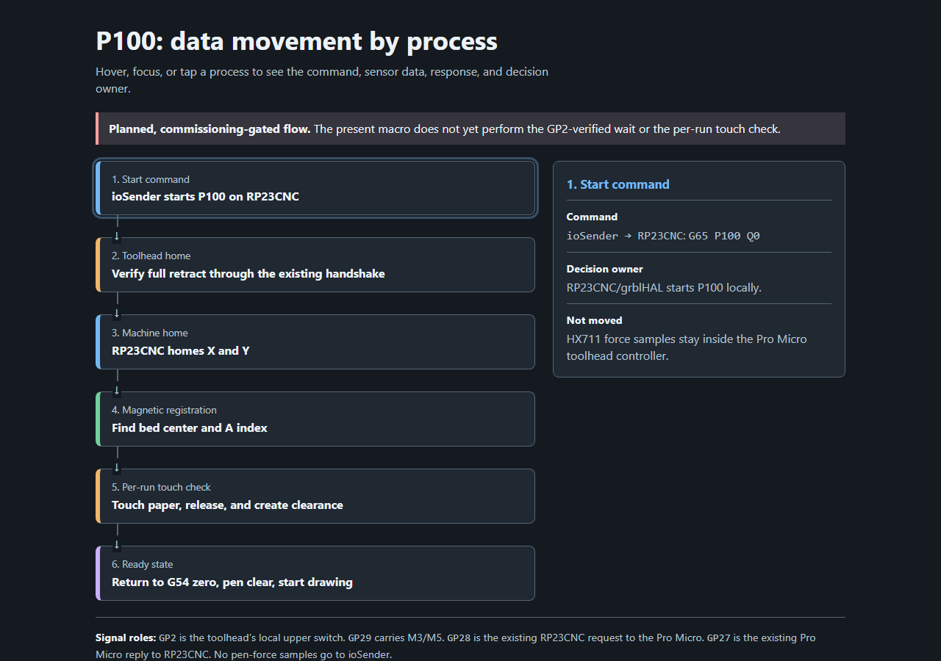
1. Start command
Command ioSender → RP23CNC: G65 P100 Q0 Decision owner RP23CNC / grblHAL starts P100 locally. Not moved HX711 force samples stay inside the Pro Micro toolhead.
Notes:
[Sources]
- docs/p100-data-movement.html rendered as a static image.
- firmware/grblhal/HOMING_AND_MAGNETIC_CALIBRATION.md
- No external assets or claims.

Slide 7
2. Toolhead home
Request P100 asserts GP28. Pro Micro action N20 retracts until GP2 confirms LIFT_HOME. Reply GP27 ready, or a timeout becomes a fault.
Notes:
[Sources]
- docs/p100-data-movement.html rendered as a static image.
- firmware/grblhal/HOMING_AND_MAGNETIC_CALIBRATION.md
- No external assets or claims.

Slide 8
3. Machine home
Command RP23CNC runs . Result Physical X/Y switches establish gantry coordinates. Toolhead stays at LIFT_HOME.
Notes:
[Sources]
- docs/p100-data-movement.html rendered as a static image.
- firmware/grblhal/HOMING_AND_MAGNETIC_CALIBRATION.md
- No external assets or claims.

Slide 9
4. Magnetic registration
Request / reply GP28 requests the scan; GP27 reports TMAG. Result Center magnet sets G54 X/Y zero. Outer magnet sets A zero.
Notes:
[Sources]
- docs/p100-data-movement.html rendered as a static image.
- firmware/grblhal/HOMING_AND_MAGNETIC_CALIBRATION.md
- No external assets or claims.

Slide 10
5. Per-run touch check
M3 Seek down to the load-cell contact threshold. M5 Release, then make a bounded clearance pulse. Abort Fail to touch, release, or clear.
Notes:
[Sources]
- docs/p100-data-movement.html rendered as a static image.
- firmware/grblhal/HOMING_AND_MAGNETIC_CALIBRATION.md
- No external assets or claims.

Slide 11
6. Ready state
Ready G54 registered; pen clear of paper. Drawing M3 writes. M5 releases and travels. GP2 is not used for each lift.
Notes:
[Sources]
- docs/p100-data-movement.html rendered as a static image.
- firmware/grblhal/HOMING_AND_MAGNETIC_CALIBRATION.md
- No external assets or claims.

Slide 12
HOW THE MACHINE PRINTS
The print cycle uses force feedback to find paper and maintain pressure
M3 • engage and write
M5 • release and travel
1. N20 lowers the carriage slowly.
2. Load cell crosses the contact threshold.
3. Controller holds the selected writing force while X/Y/A move.
1. N20 retracts until the load cell says the pen released.
2. A bounded clearance pulse creates an air gap.
3. The machine travels to the next mark without moving to the distant home switch.
The spring provides compliance; the load cell determines pressing versus clear.
THETA PEN PLOTTER • SUMMER PROGRESS UPDATE
7
Notes:
[Sources]
- firmware/pen_pressure/CONTROL_STRATEGY.md
- No external assets or claims.

Slide 13
NEXT STEPS
Next: toolhead-home step completion
E-07
Calibrate load cell
Convert HX711 readings into reliable force units.
T-01G/H
Verify lift and clear
Prove GP2 homing and repeatable M5 release/clearance.
T-01J
Check writing tool
Touch and clear before every run; works with pens or pencils.
F-05 / integration
Connect M3/M5
Verify the motion controller and toolhead work together.
Calibration drawing
Adjust system based on calibration results
Measure line quality, force trace, and geometry.
THETA PEN PLOTTER • SUMMER PROGRESS UPDATE
8
Notes:
[Sources]
- docs/testing/TEST_PLAN.md
- No external assets or claims.

