Slide 1

Design Pattern Refactoring by
Pretty-Printing
Jongwook Kim Don Batory Danny Dig
主讲人：褚灵强
2021年12月14日

Slide 2
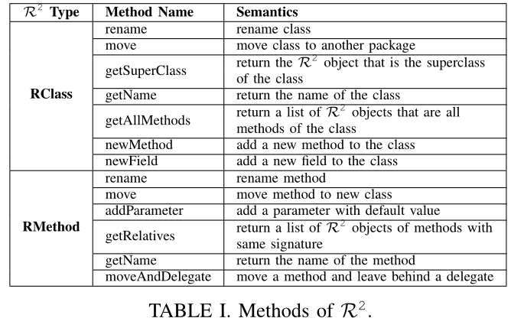
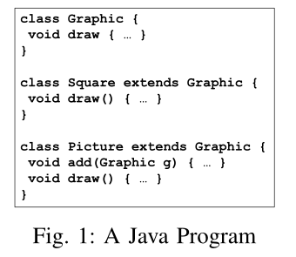
A review of R2
The program in Figure 1 has 7 R2 objects:
3 classes: Graphic,Square,Picture
4 methods: Graphic.draw,Square.draw,
Picture.add,Picture.draw.
Table I lists a few methods that can be performed on
R2 class and method objects
Notes:
R2是一个java包，R2对象的方法是JDT（java工具包）的重构，或者是对象搜索
这是R2类和方法的例子

Slide 3
R2 revealed JDTRE is ill-suited
R2 is a plug-in that uses the JDT Refactoring Engine (JDTRE) as it represents state-of-the-practice in refactoring. But experiments with R2 revealed JDTRE is ill-suited for scripting for three reasons:
1、JDTRE is buggy. We found over 25 new bugs to date, but only a fraction have been fixed in the latest version of JDT.
2、We found the need for additional primitive refactorings and to repair existing refactorings.
3、JDTRE is slow. While a single JDT refactoring has acceptable speed, executing many is not.
Notes:
JDTRE有很多的bug，影响R2运行
并且如果要在JDTRE上运行R2的话，需要附加的原语重构和修复现有重构，因为JDTRE的话会阻止某些操作
同时JDTRE速度很慢，执行20次重构需要10秒多，一般我们希望这种重构是即时的，所以R2是不太好的

Slide 4
R3 :A new generation of refactoring engines
The contributions of this paper are:
1、 A novel foundation using database+pretty printing for designing a new generation of refactoring engines that allows scripting.
2、 An efficient way to evaluate refactoring preconditions.
3、 R3’s codebase is a mere 4K LOC and does not use Eclipse program transformation utilities.
4、 R3 runs at least 10×faster, in two cases 290×faster than JDTRE.
Notes:
作者提出的方法叫做R3，使用database+pretty printing 并且支持脚本的重构引擎
它的速度、代码大小上都比原来的R2更优
并且作者提出了一个高效的评估重构先决条件的方法

Slide 5
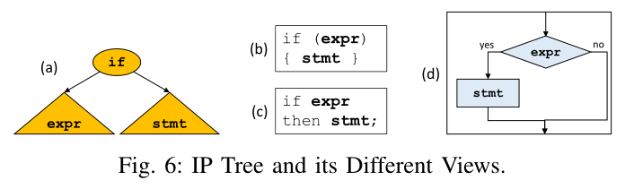
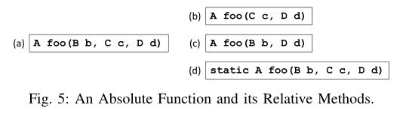
R3 : Relativistic Displays
Generally, if we ‘view’ a function as a member of different class, its signature would appear different. R3 strips away OO notation, use absolute Function that all method parameters are explicit as Figure 4(a).
Connecting these ideas to refactoring, recallIntentional Programming (IP), we can observe that an AST is never altered by a display, The AST is ‘absolute’. The same holds for other primitive refactorings in R3.

Slide 6
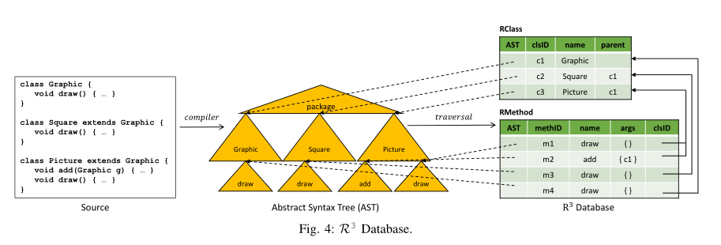
R3 : Database
R3 maintains an internal, non-persistent database to remember changes in perspective.
It creates relational database tables for all declaration types in a program.
Program source is compiled into ASTs which are traversed to populate R3 tables.
Figure 4 shows the basic set-up with a few attributes per table.
Notes:
R3维护一个内部的、非持久性的数据库，以记住透视图中的更改,为所有声明类型创造数据库，
Rcclass中保存不同类的声明，有指向该类AST的指针
Rmethod中保存了程序中所有的方法 也就是绝对方法，指向AST和对应的类
每一次重构都是对这个数据库的更新

Slide 7
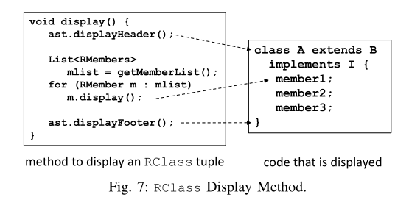
R3 : Database
When a class is displayed, the tuples of the fields, methods,constructors, etc. that belong to it are extracted from the database.

Slide 8
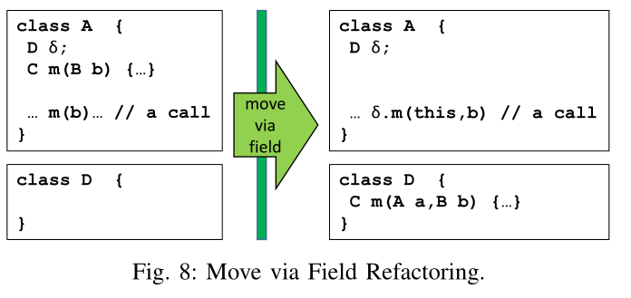
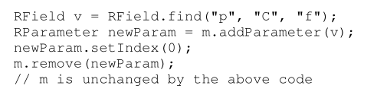
R3 : Primitive Refactorings
R3 has separate methods to add, remove, and reorder parameters.

Slide 9
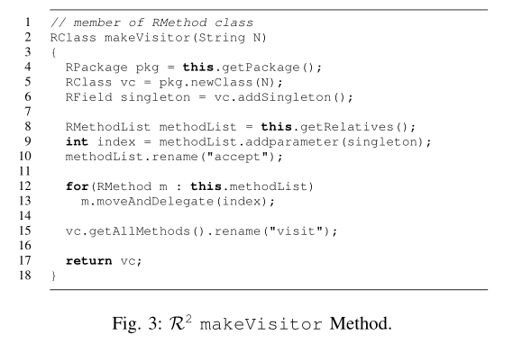
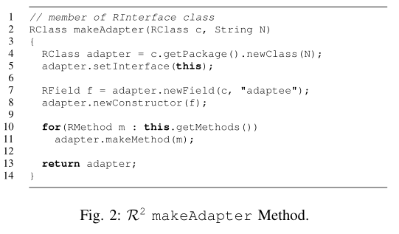
R3 : Scripting Refactorings
R3’s interface is compatible with R2. That is, R2 scripts port to R3.
These are example scripts for makeAdapter and makeVisitor.

Slide 10
R3 : Preconditions
Many (not all) checks can be determined at database build time:
they are simple properties of an AST.
For them, we add a boolean attribute to R3 tables to indicate whether a tuple’s AST satisfies that check.
The R3 database is created by AST traversal and semantic analysis:
1、populates the R3 database with tuples.
2、assigns boolean values to these checks.
Notes:
很多先决条件的检查可以在数据库创建的时候进去,这样可以加快速度，所以R3加入了一些供检查所用的布尔值.
所以R3数据库的遍历分为两步，先正常填充数据，再给布尔值

Slide 11
R3 : Preconditions
Boolean Checks Made by a Single Tuple Lookup:
In R3,15 preconditions are AST-harvestable at database build time as boolean values.
Here is a sample:
Abstract, Native, Constructor, Interface Declaring Type , Non-Local Type Reference …
2) Checks that Require Database Search:
There are several precondition checks in the JDTRE move-instance-method that require a database search.
Here is a sample:
Accessibility, Conflicting Method, Duplicate Type Paramete, Conflicting Target Name …
Notes:
一些先决条件是可以直接得到的，，还有一些需要进行查找，这里有几个例子

Slide 12
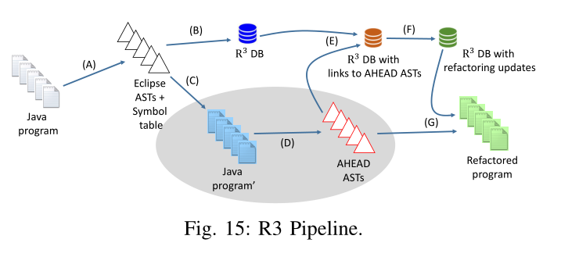
R3 : IMPLEMENTATION
Figure 15 shows the R3 pipeline:
It is a series of stages (A)-(G) that map a target Java program (JDT project) on the left to a refactored program on the right
Notes:
A Eclipse parses a Java program into AST
B JDT ASTs are traversed to harvest a major part of theR3 database.
C A limitation of AHEAD is that it requires a context-free parser. AHEAD限制是它需要一个上下文无关的解析器。需要重新生成一个代码文件
D parses the manufactured-identifier program 对新的代码文件进行解析
E 将数据库和AST链接起来
F 执行重构
G 输出重构后的文件

Slide 13
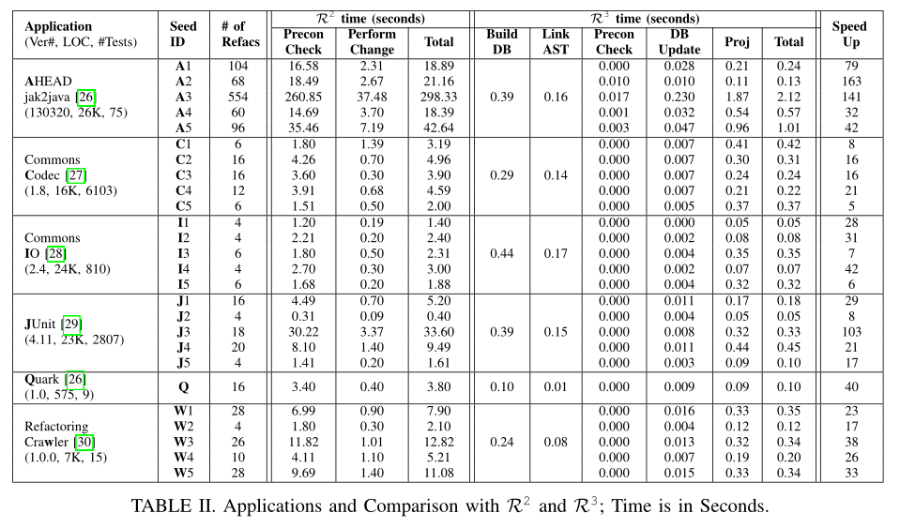
Result
Notes:
The first column of Table II lists these programs， along with their version, size, and number of regression tests 第一列是程序相关的东西
Has five methods that serve as a Visitor seed 每一个程序都有五个Visitor seed
Vistior 访问者模式：表示一个作用于某对象结构的各元素的操作，它使你可以在不改变各元素的类的前提下定义作用于这些元素的新操作。
时间分为先决代码检查和重构时间

Slide 14
感谢蒋老师和各位同学的耐心聆听！

