Slide 1

Exploring Periodicity and Interactivity in Multi-Interest Framework for
Sequential Recommendation
IJCAI 2021
Gaode Chen Xinghua Zhang Yanyan Zhao Cong Xue Ji Xiang
主讲人：褚灵强
2021年12月16日

Slide 2
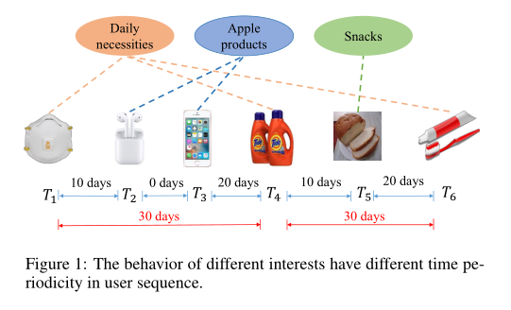
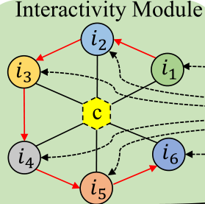
Main idea
Focus on relative length of the time interval.
Use virtual central node to aggregates information.
Use the K vector representation of the user to reflect the different interests.

Slide 3
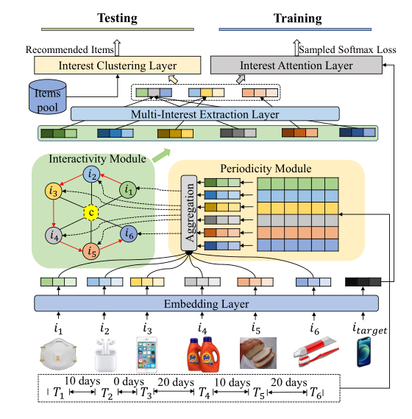
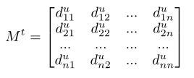





Methods and process
Initialization
time interval embedding matrix
feature vectors of items
attention weight of each item
feature vectors of nodes
central node

Slide 4
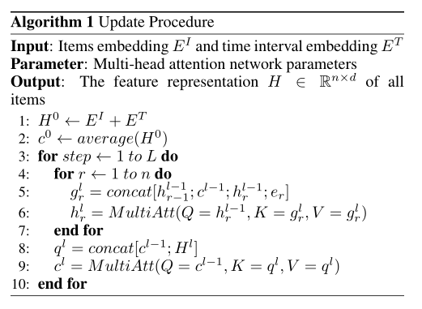
Methods and process
Interactive
Only interact with neighbor nodes and central node

Slide 5

Methods and process
Scores
reflecting the K interest of the user

Slide 6
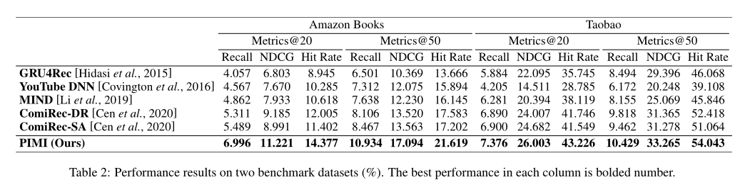
ReSULT

Slide 7
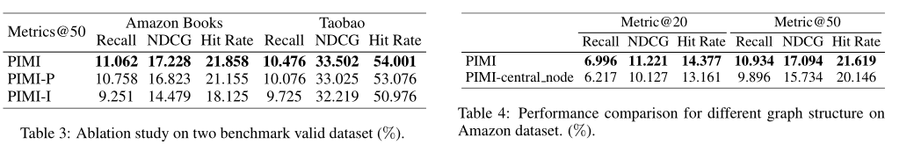
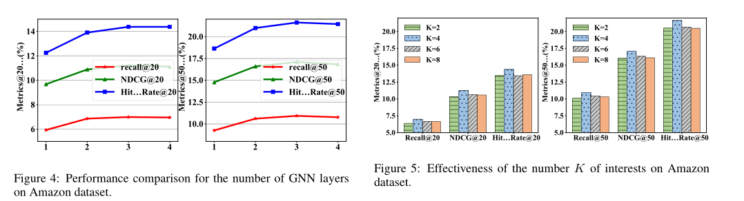
ReSULT

Slide 8
感谢谭老师和各位学长学姐的耐心聆听！

