Slide 1

Design Pattern Refactoring by
Pretty-Printing
Jongwook Kim Don Batory Danny Dig
主讲人：褚灵强
2021年12月16日

Slide 2
R2 revealed JDTRE is ill-suited
R2 is a plug-in that uses the JDT Refactoring Engine (JDTRE) as it represents state-of-the-practice in refactoring.But experiments with R2 revealed JDTRE is ill-suited for scripting for three reasons:
1、JDTRE is buggy. We found over 25 new bugs to date, but only a fraction have been fixed in the latest version of JDT.
2、We found the need for additional primitive refactorings and to repair existing refactorings.
3、JDTRE is slow. While a single JDT refactoring has acceptable speed, executing many is not.

Slide 3
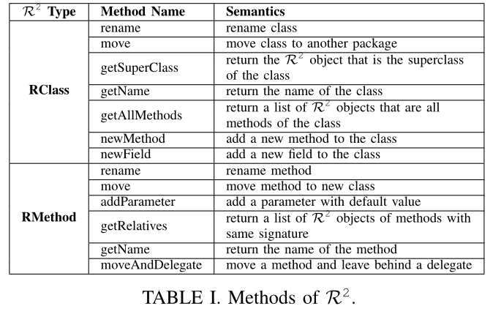
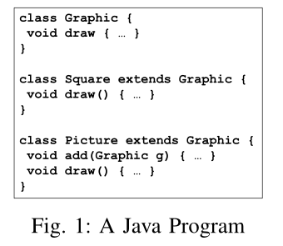
A review of R2
The program in Figure 1 has 7 R2 objects:
3classes:Graphic,Square,Picture
4 methods: Graphic.draw,Square.draw,
Picture.add,Picture.draw.
Table I lists a few methods that can be performed on
R2class and method objects

Slide 4
R3 :A new generation of refactoring engines
R3 is a novel foundation using database+pretty printing for designing a new generation of refactoring engines that allows scripting, which yields a significant increase in refactoring speed and has smaller codebase, and comparable reliability to JDTRE.
The contributions of this paper are:
1、 A novel foundation using database+pretty printing for designing a new generation of refactoring engines that allows scripting.
2、 An efficient way to evaluate refactoring preconditions.
3、 R3’s codebase is a mere 4K LOC and does not use Eclipse program transformation utilities.
4、 R3 runs at least 10×faster, in two cases 290×faster than JDTRE.

Slide 5
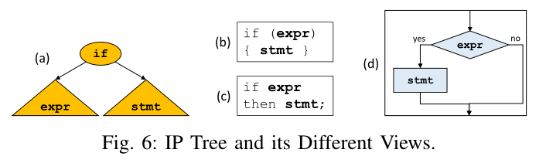
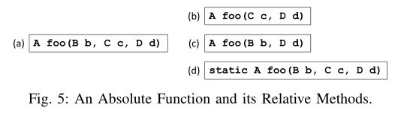
R3 : Relativistic Displays
Generally, if we ‘view’ a function as a member of different class, its signature would appear different. But we can observe that an AST is never altered by a display.
The move-method refactoring, which is what Figure 5 is about, is a coordinate transformation for software; it should preserve the semantic properties of a program. The same holds for other primitive refactorings in R3.

Slide 6
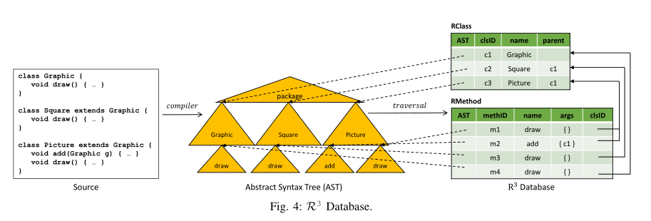
R3 : Database
R3 maintains an internal, non-persistent database to remember changes in perspective.
It creates relational database tables for all declaration types in a program.
Program source is compiled into ASTs which are traversed to populate R3 tables.
Figure 4 shows the basic set-up with a few attributes per table.

Slide 7
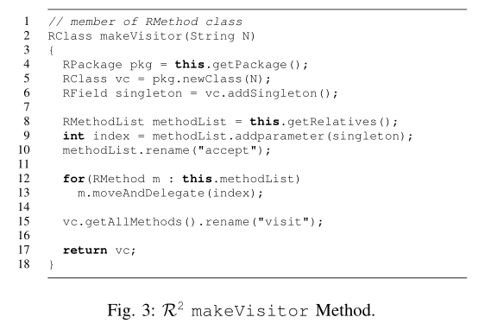
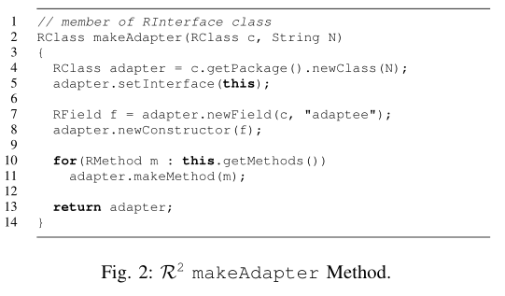
R3 : Scripting Refactorings
R3’s interface is compatible with R2. That is, R2 scripts port to R3.
These are example scripts for makeAdapter and makeVisitor.

Slide 8
R3 : Preconditions
Many (not all) checks can be determined at database build time:
they are simple properties of an AST.
For them, we add a boolean attribute to R3 tables to indicate whether a tuple’s AST satisfies that check
The R3 database is created by AST traversal and semantic analysis:
1、populates the R3 database with tuples
2、assigns boolean values to these checks.

Slide 9
R3 : Preconditions
Boolean Checks Made by a Single Tuple Lookup:
In R3,15 preconditions are AST-harvestable at database build time as boolean values.
Here is a sample:
Abstract, Native, Constructor, Interface Declaring Type , Non-Local Type Reference …
2) Checks that Require Database Search:
There are several precondition checks in the JDTRE move-instance-method that require a database search.
Here is a sample:
Accessibility, Conflicting Method, Duplicate Type Paramete, Conflicting Target Name …

Slide 10
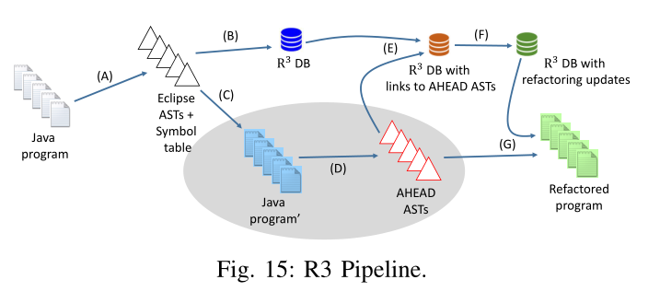
R3 : IMPLEMENTATION
Figure 15 shows the R3 pipeline:
It is a series of stages (A)-(G) that map a target Java program (JDT project) on the left to a refactored program on the right

Slide 11
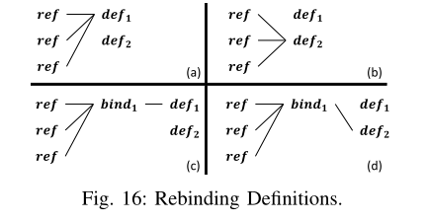
R3 : IMPLEMENTATION
R3 introduced an Rbinding table where declaration bindings are represented once (Figure 16c)
and with one update, all references can be rebound (Figure 16d).

Slide 12
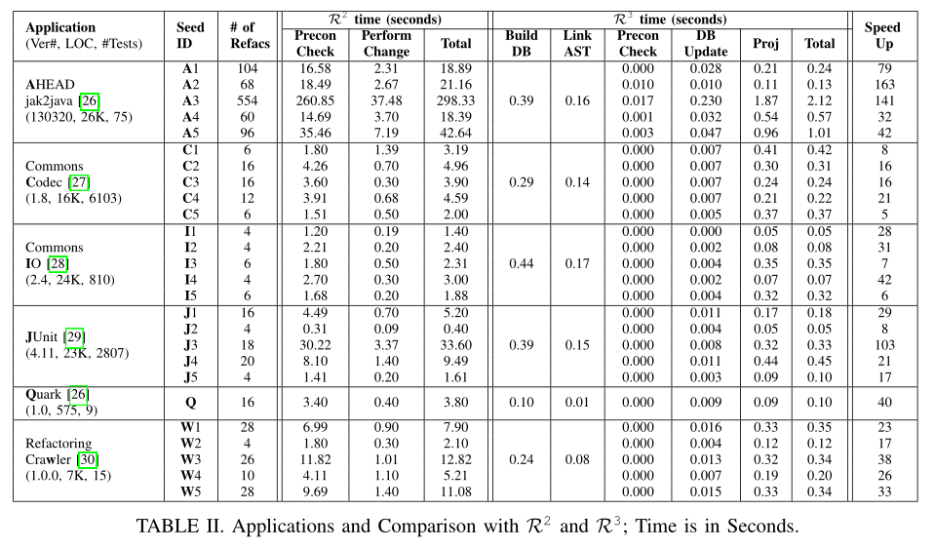
Result

Slide 13
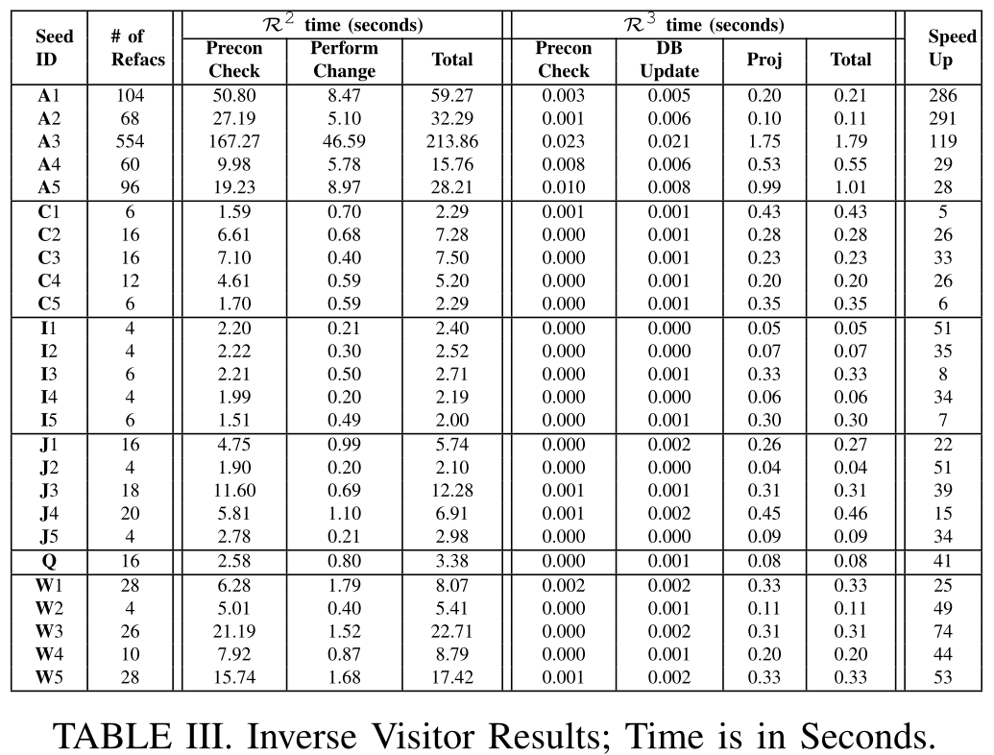
Result

