Slide 1
Decorator Pattern
28th group:Jie Ruan,Yong Ding,Danhui Ye,and Junjie Zhu
2019.10.15

Slide 2
Catalogue
Backgroud
Instance
Comment
Notes:
分三个部分介绍Decorator Pattern

Slide 3
Backgroud
Induction
The decorator design pattern is used to modify the functionality of an object at runtime. At the same time, other instances of the same class will not be affected by this, so individual object gets the modified behavior. The decorator design pattern is one of the structural design pattern (such as Adapter Pattern, Bridge Pattern, Composite Pattern) and uses abstract classes or interface with the composition to implement.
In decorator pattern, there are 4 roles: component、 Concrete Component、 Decorator、 Concrete Decorator
Effect
Dynamically add additional responsibilities to an object.In terms of adding functionality, the decorator pattern is more flexible than subclassing.
Notes:
介绍一下什么是Decorator Pattern？它有什么样的作用？照着读就可以

Slide 4
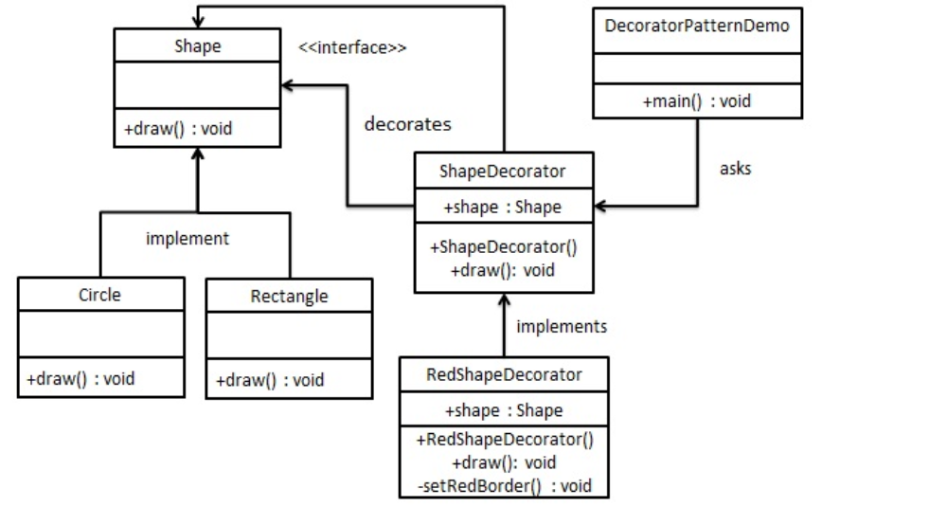
Instance
For instance
Notes:
为了更形象的说明说明是Decorator Pattern？举个例子
Shape是一个接口，Circle、Rectangle是实现Shape接口的类，ShapeDecorator是实现了 Shape 接口的抽象装饰类, RedShapeDecorator是继承了 ShapeDecorator 类的装饰类.
代码就是main函数

Slide 5

Instance
Create an interface
Shape.java
Notes:
现在来看看具体的代码

Slide 6
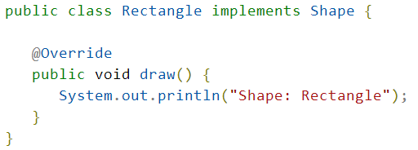
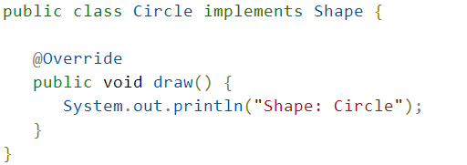
Instance
Create an class that implements the interface
Rectangle.java
Circle.java

Slide 7
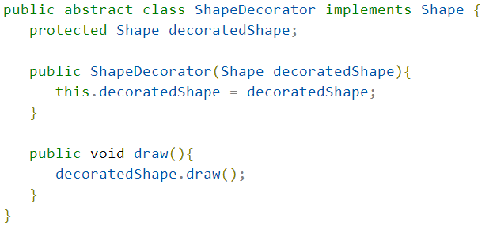
Instance
Create an decorator class that implements the Shape interface
ShapeDecorator.java

Slide 8
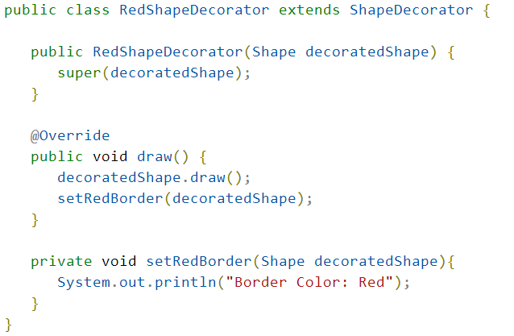
Instance
Create an decorator class that extends the ShapeDecorator class
RedShapeDecorator.java

Slide 9
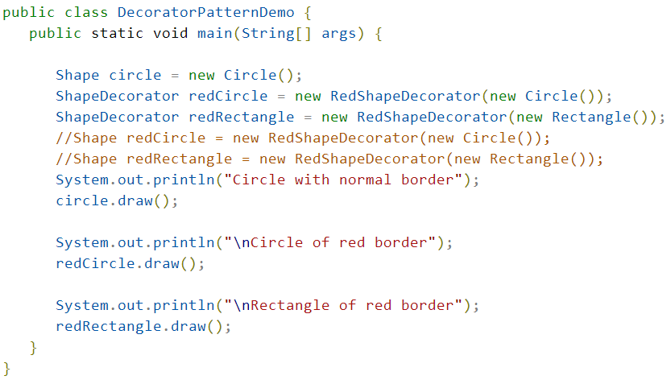
Instance
Use RedShapeDecorator to decorate the Shape object
DecoratorPatternDemo.java

Slide 10
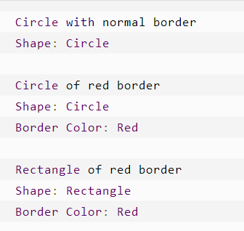
Instance
Results
Notes:
这就是代码运行的结果：
第1-2行是一个普通Circle类的对象的输出
第3-5行是一个使用 RedShapeDecorator 来装饰 Circle类的对象的输出
第6-8行是一个使用 RedShapeDecorator 来装饰 Rectangle类的对象的输出
可以看到RedShapeDecorator增加了普通Circle类和Rectangle类的方法:setRedBorder方法，具体在结果上的体现就是多了一行输出:Border Color: Red

Slide 11
Comment
Advantages
Decoration class and decorated class can develop independently without coupling with each other. Decoration pattern is an extension alternative pattern, and decoration pattern can dynamically extend the functions of an implementation class.
Disadvantages
Multilayer decoration is more complicated.
Notes:
讲讲Decorator Pattern有什么优点和缺点？照着读就行

Slide 12
Thanks for watching
28th group:Jie Ruan,Yong Ding,Danhui Ye,and Junjie Zhu
2019.10.15
Notes:
可能会问到这个跟子类继承有啥区别？
答:更为灵活

