Slide 1
《Learning Semantic Concepts and Order for Image and Sentence Matching》
汇报人：MIL-李娉

Slide 2
1.Motivation[image and sentence matching]
主要问题：像素级别的图片描述缺少高层次的语义信息
（解法：之前的做法都是提取一个全局的CNN特征向量。）
该文章提出语义增强图片以及语句匹配模型(semantic-enhanced image and sentence matching model),该模型可以通过学习语义概念并且按照正确的语义顺序组织它们，从而来改善图像描述（image representation）

Slide 3
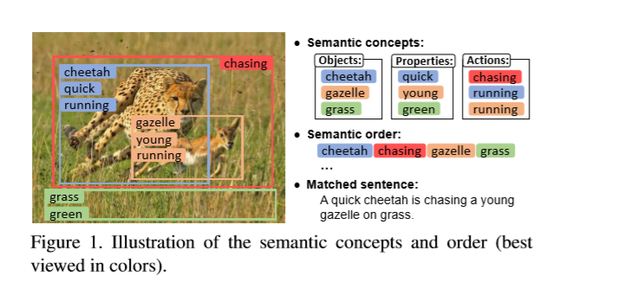
2.Main task and Related Application task:Image and sentence matching (measuring the visual-semantic similarity between an image and a sentence.)
Related Application:
<1>image annotation(图片标注)
(given an image query to find similar sentences)
<2>texted-based image search（基于文本查找图片）
(given a sentence query to retrieve matched images)
<3>image captioning（看图说话）
(based an image, generate a sentence)

Slide 4
3.Advantage and contribution of the proposed model
该文章的优势：
1.提取高层次的语义信息
2.通过学习语义概念和语序，消除视觉语义差异
3.设计了一个gated fusion unit门融合单元将全局和局部特征组合在一起（全局和局部的重要性在不同图中并不同）
4.用语句生成作为图像特征学习的监督，相似度测量
贡献：通过学习语义概念，然后按照正确的语义顺序组织它们，从而改善图像表示
Improve the image representation by learning semantic concepts and then organizing them in a correct semantic order.

Slide 5
4.Model introduction Image and sentence matching: measuring the visual-semantic similarity between an image and a sentence.
Image
Multi-regional Multi-label CNN
predict
Semantic concepts
context-gated sentence generation
Correct semantic order
Joint matching and generation learning

Slide 6
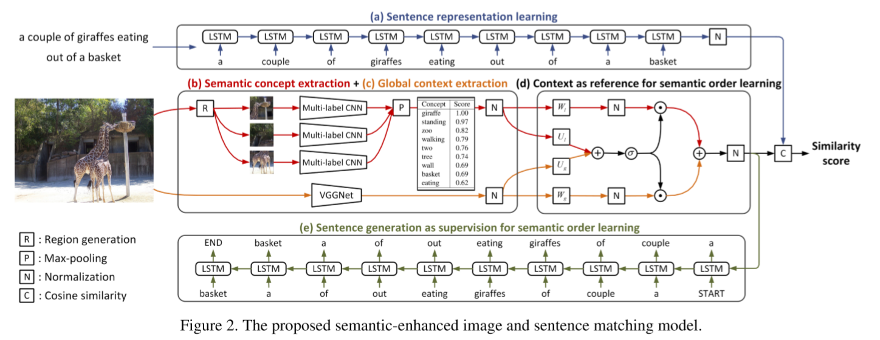
Semantic-enhanced Image and Sentence Matching Model

Slide 7

Four aspects of proposed model
1).sentence representation learning[a]
将 句子中的全部word输入到LSTM，得到文本特征,最后一个timestep的隐藏状态作为sentence representation标记s（维度为H）

Slide 8
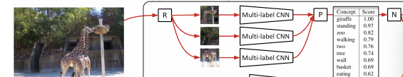
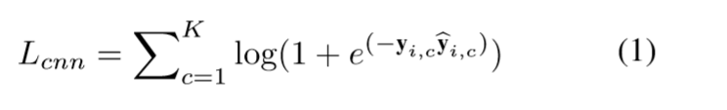
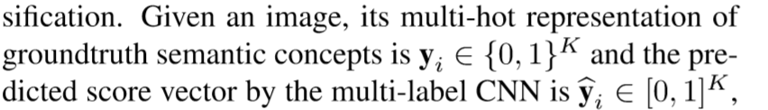
2).image semantic concept extraction (with a multi-regional multi-label CNN),[b]
[b] semantic concept extraction
提取图像的多个proposal，然后用multi-label CNN对每一个proposal进行分类得到多个（proposal的个数）分类的向量，用max-pooling得到一个向量（predicted confidence scores vector）为p

Slide 9
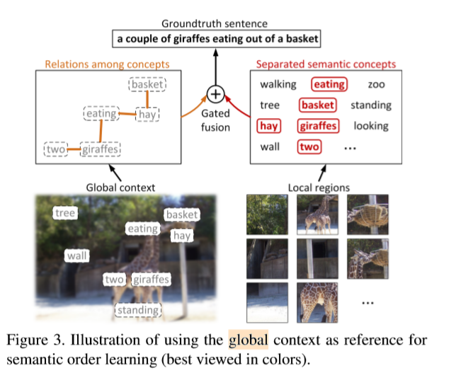

(3)Image Semantic Order Learning
[c]global context extraction
global context 的产生：image->pre-trained VGGNet->process the whole image content->extract vector(in the last fc layer)->desired global context
global context的作用：［1］describe all the semantic concepts in a coarse level;[2]indicate spatial relations
例如，两只长颈鹿站在左边，而篮子在左上角。

Slide 10
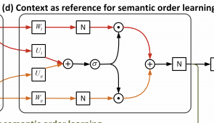
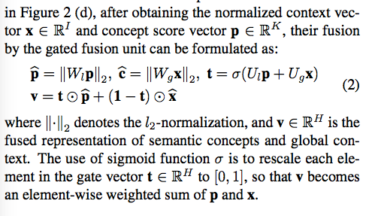
[d]context as reference for semantic order learning
融合global context 和semantic concepts特征，得到image representation

Slide 11
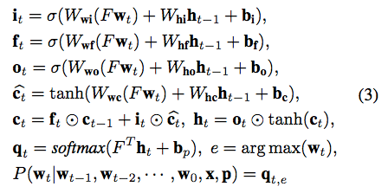
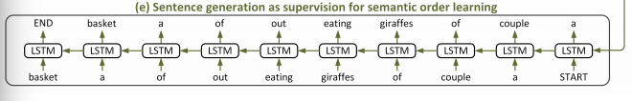
[e]sentence generation as supervision
input：［d］中输出的image representation
output：generate sentence
处理过程（LSTM）：
c，h，i，f，o

Slide 12

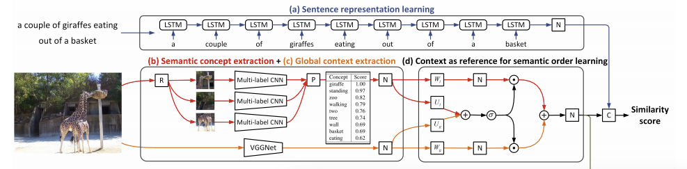
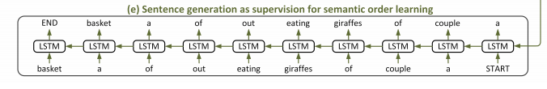
4).joint matching and generation
为了共同实现图像与句子匹配[a-d]和句子生成[e]，我们需要最小化L
λ is a tuning parameter for balancing
Lmat是一个结构化的目标，它鼓励匹配图像和句子的余弦相似度得分大于不匹配图像和句子的余弦相似度得分。
Lgen是给定语义概念p和上下文语义x的匹配句子的负条件对数可能性。

Slide 13
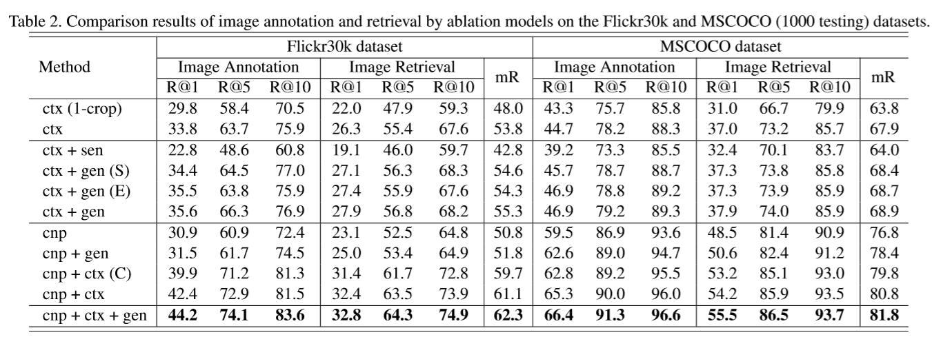
5.Results
注：ctx(1-crop): cropping 1 image regions ctx: cropping 10 image regions
ctx+sen: directly using the pre-generated sentences as image representations
ctx + gen: using the sentence generation as supervision for semantic order learning
ctx + gen(S): additionally performing the scheduled sampling ctx + gen(E): using a shared word embedding matrix
cnp: only using the semantic concepts
cnp+gen: using the semantic concepts and the sentence generation for semantic order learning
cnp+ctx(C):simply summing the concept and context cnp+ctx: using the proposed gated fusion unit
cnp + ctx+gen: combines the 10-cropped extracted context with semantic concepts via the gated fusion unit,and exploits the sentence generation for semantic order learning
结论：cnp + ctx + gen 这种组合的结果最佳。

Slide 14

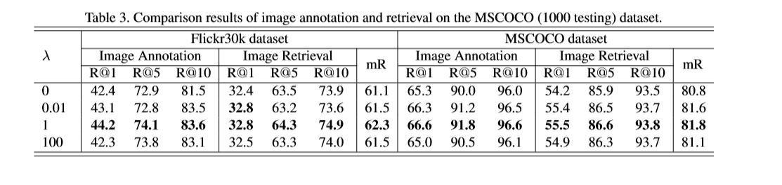

λ
注：R@N指代的是recall rates at the top N results;
Top-N正确率是指图像识别算法给出前N个答案中有1个正确的概率。
结论：λ=1 有最好的准确率，意味着在该模型中，generation objective 和matching objective同等重要。

Slide 15
Thank you!
MIL-李娉

