Slide 1
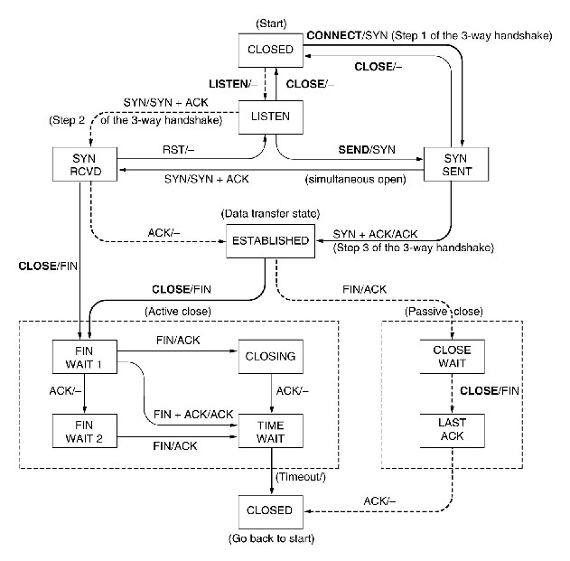
Problem I: TCP connection management
Example: TCP connection management

Slide 2
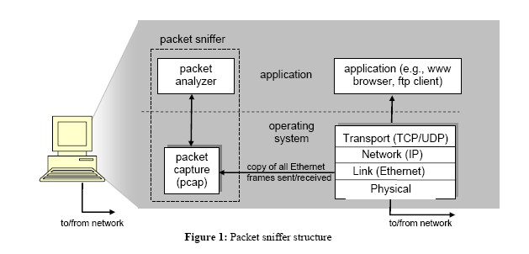
Sample Project: TCP Traffic Analysis
Goal: The purpose of this project is to learn the connection management of Transmission Control Protocol (TCP). You are required to write a C program with the pcap or winpcap library to analyze the TCP protocol behavior.

Slide 3
Requirements:
You will be given a TCP trace file (e.g., sample-capture-file in connex resource). During the period traced, a single web client accesses web pages from different web sites on the Internet. This trace is to be used to for your own test. Your code might be tested with another trace file, which will be disclosed after your final submission.
You need to write a C program with the pcap library for parsing and processing the trace file, and tracking TCP state information. In particular, the program processes the trace file and computes summary information about TCP connections. Note that a TCP connection is identified by a 4-tuple (IP source address, source port, IP destination address, destination port), and packets can flow in both directions on a connection (i.e., from host A to host B, and from host B to host A). Also note that the packets from different connections can be arbitrarily interleaved with each other in time, so your program will need to extract packets and associate them with the correct connection.

Slide 4
Requirements:
Besides the above information for each TCP connection, your program needs to provide the following statistical results for the whole trace data:
➢the number of reset TCP connections observed in the trace
➢the number of TCP connections that were still open when the trace capture ended
➢the number of complete TCP connections observed in the trace
➢Regarding the complete TCP connections you observed:
•
the minimum, mean, and maximum time durations of the complete TCP connections
the minimum, mean, and maximum RTT (Round Trip Time) values of the complete TCP connections
•
•
the minimum, mean, and maximum number of packets (both directions) sent on the complete TCP connections
•
the minimum, mean, and maximum receive window sizes (both sides) of the complete TCP connections

Slide 5
Sample Output:
Total number of connections:
Connections' details: Connection 1:
•
•
•
•
•
•
•
•
•
•
•
•
•
•
Source Address: Destination address: Source Port: Destination Port:
Status: (Only if the connection is complete provide the following information) Start time:
End Time: Duration:
Number of packets sent from Source to Destination: Number of packets sent from Destination to Source: Total number of packets:
Number of data bytes sent from Source to Destination: Number of data bytes sent from Destination to Source: Total number of data bytes:

Slide 6
Sample Output:
C) General
•
•
•
Total number of complete TCP connections: Number of reset TCP connections:
Number of TCP connections that were still open when the trace capture ended:
D) Complete TCP connections:
•
•
•
•
•
•
•
•
•
•
•
•
Minimum time durations: Mean time durations: Maximum time durations:
Minimum RTT values including both send/received: Mean RTT values including both send/received: Maximum RTT values including both send/received:
Minimum number of packets including both send/received: Mean number of packets including both send/received: Maximum number of packets including both send/received: Minimum receive window sizes including both send/received: Mean receive window sizes including both send/received: Maximum receive window sizes including both send/received:

Slide 7
Problem II: A technique for counting NATed Hosts?
Paper: Steven M. Bellovin, A technique for counting NATed Hosts, IMW 02.
Assumptions: Suppose that you are interested in detecting the number of hosts behind a NAT. You observe that the IP layer stamps an identification number sequentially on each IP packet. The identification number of the first IP packet generated by a host is a random number, and the identification numbers of the subsequent IP packets are sequentially assigned. Assume that all IP packets generated by hosts behind the NAT are sent to the outside world.
Question: Could you design a simple technique that detects the number of unique hosts behind a NAT?

Slide 8
Idea: Since all IP packets are sent outside, we can use a packet sniffer to record all IP packets generated by the hosts behind a NAT. As each host generates a sequence of IP packets with sequential numbers and a distinct (very likely, as they are randomly chosen from a large space) initial identification number (ID), we can group IP packets with consecutive Ids into a cluster. The number of clusters is the number of hosts behind the NAT.

Slide 9
Problem III: Traceroute
Tool used to trace path from source to destination host.
TCP/IP not designed for traceroute, so it is sometimes unpredictable
Most traceroute programs, including the Cisco IOS traceroute, send UDP packets
Microsoft tracert sends ICMP echo request (ping) packets.

Slide 10
Traceroute Command
! Unix: traceroute
! Cisco IOS: traceroute
! DOS: tracert
(trace)

Slide 11
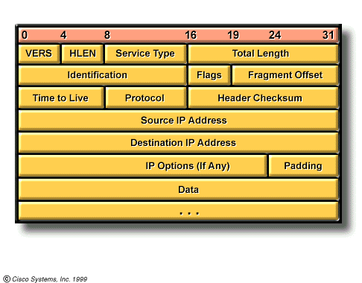
Time to Live Field
TTL

Slide 12

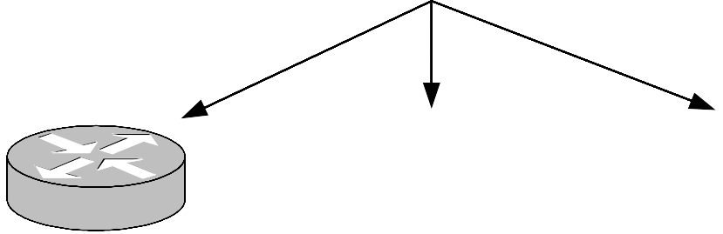


Traceroute Operation
Traceroute returns these IP addresses
& hostnames (via reverse lookup)
Sender
Target
TTL = 1
TTL = 2
TTL = 3
TTL = 4

Slide 13
Sample Project: Analysis of IP Protocol Requirement :
Capture a trace by running: %traceroute mit.edu 2000
Write a c program to analyze the trace:
An example output format is as follows:
The IP address of the source node: 192.168.1.12 62
The IP address of ultimate destination node: 10.216.216.2 The IP addresses of the intermediate destination nodes:
router 1: | 24.218.01.102,
router 2: | 24.221.10.103,
router 3: | 10.215.118.1.
The number of fragments created from the original datagram is: 3 The offset of the last fragment is: 3680
The avg RRT between 192.168.1.12 and 24.218.01.102 is: 50 ms, the s.d. is: 5 ms
The avg RRT between 192.168.1.12 and 24.221.10.103 is: 100 ms, the s.d. is: 6 ms
The avg RRT between 192.168.1.12 and 10.215.118.1 is: 150 ms, the s.d. is: 5 ms
The avg RRT between 192.168.1.12 and 10.216.216.2 is: 200 ms, the s.d. is: 15 ms

