Slide 1
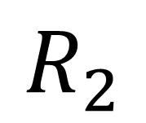

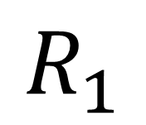
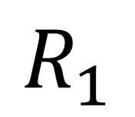
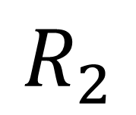


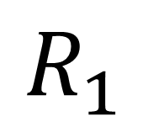


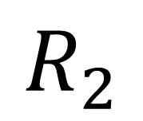

William
$$H$$
9ea847
$$R_{1}$$
is
$$H$$
ea0012
$$R_{2}$$
handsome
no
$$H$$
229811
$$R_{1}$$
more
$$H$$
78a109
$$R_{2}$$
merge
more
$$H$$
78a109
$$R_{1}$$
hahaha
$$H$$
91a921
$$R_{2}$$
good

