Slide 1
Review of Probability and Statistics
(i.e. things you learned in Ec 10 and need to remember to do well in this class!)

Slide 2
Random Variables
X is a random variable if it represents a random draw from some population
a discrete random variable can take on only selected values
a continuous random variable can take on any value in a real interval
associated with each random variable is a probability distribution

Slide 3
Random Variables – Examples
the outcome of a coin toss – a discrete random variable with P(Heads)=.5 and P(Tails)=.5
the height of a selected student – a continuous random variable drawn from an approximately normal distribution

Slide 4
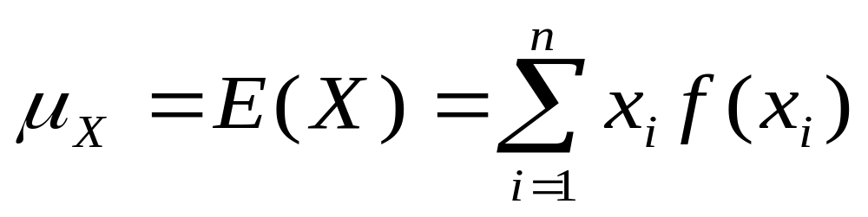
Expected Value of X – E(X)
The expected value is really just a probability weighted average of X
E(X) is the mean of the distribution of X, denoted by μ_{x}
Let f(x_{i}) be the probability that X=x_{i}, then

Slide 5
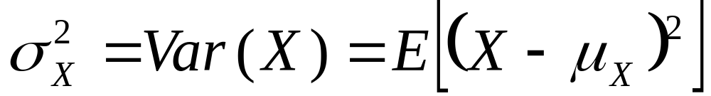
Variance of X – Var(X)
The variance of X is a measure of the dispersion of the distribution
Var(X) is the expected value of the squared deviations from the mean, so

Slide 6
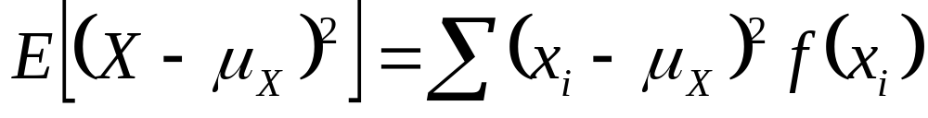
More on Variance
The square root of Var(X) is the standard deviation of X
Var(X) can alternatively be written in terms of a weighted sum of squared deviations, because

Slide 7
Covariance – Cov(X,Y)
Covariance between X and Y is a measure of the association between two random variables, X & Y
If positive, then both move up or down together
If negative, then if X is high, Y is low, vice versa

Slide 8
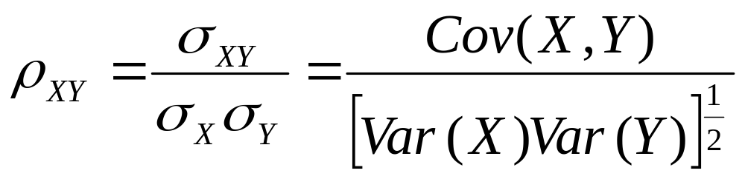
Correlation Between X and Y
Covariance is dependent upon the units of X & Y [Cov(aX,bY)=abCov(X,Y)]
Correlation, Corr(X,Y), scales covariance by the standard deviations of X & Y so that it lies between 1 & –1

Slide 9
More Correlation & Covariance
If σ_{X,Y} =0 (or equivalently ρ_{X,Y} =0) then X and Y are linearly unrelated
If ρ_{X,Y} = 1 then X and Y are said to be perfectly positively correlated
If ρ_{X,Y} = – 1 then X and Y are said to be perfectly negatively correlated
Corr(aX,bY) = Corr(X,Y) if ab>0
Corr(aX,bY) = –Corr(X,Y) if ab<0

Slide 10
Properties of Expectations
E(a)=a, Var(a)=0
E(μ_{X})=μ_{X}, i.e. E(E(X))=E(X)
E(aX+b)=aE(X)+b
E(X+Y)=E(X)+E(Y)
E(X-Y)=E(X)-E(Y)
E(X- μ_{X})=0 or E(X-E(X))=0
E((aX)²)=a²E(X²)

Slide 11
More Properties
Var(X) = E(X²) – μ_{x}²
Var(aX+b) = a²Var(X)
Var(X+Y) = Var(X) +Var(Y) +2Cov(X,Y)
Var(X-Y) = Var(X) +Var(Y) - 2Cov(X,Y)
Cov(X,Y) = E(XY)-μ_{x}μ_{y}
If (and only if) X,Y independent, then
  Var(X+Y)=Var(X)+Var(Y), E(XY)=E(X)E(Y)

Slide 12
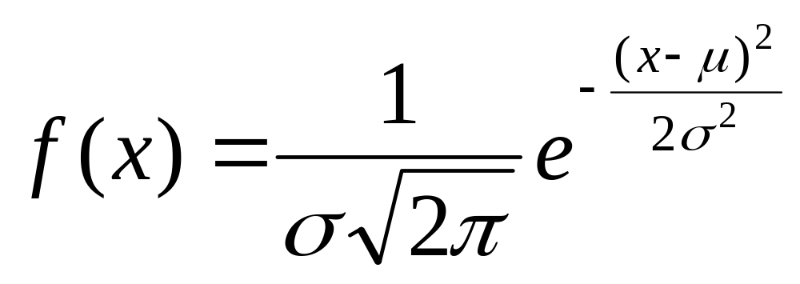
The Normal Distribution
A general normal distribution, with mean μ and variance σ² is written as N(μ, σ²)
It has the following probability density function (pdf)

Slide 13
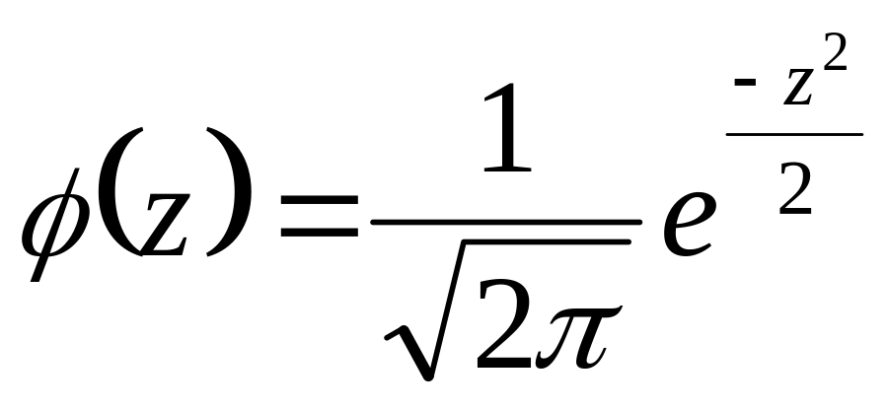
The Standard Normal
Any random variable can be “standardized” by subtracting the mean, μ, and dividing by the standard deviation, σ , so E(Z)=0, Var(Z)=1
Thus, the standard normal, N(0,1), has pdf

Slide 14
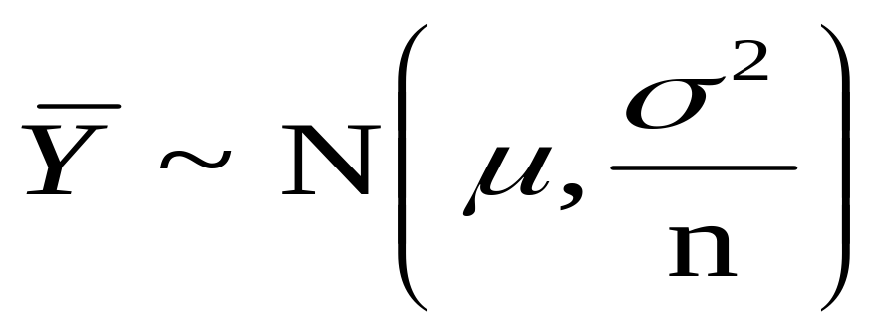
Properties of the Normal
If X~N(μ,σ²), then aX+b ~N(aμ+b,a²σ²)
A linear combination of independent, identically distributed (iid) normal random variables will also be normally distributed
If Y₁,Y₂, … Y_{n} are iid and ~N(μ,σ²), then

Slide 15
Cumulative Distribution Function
For a pdf, f(x), where f(x) is P(X = x), the cumulative distribution function (cdf), F(x), is P(X ≤ x); P(X > x) = 1 – F(x) =P(X< – x)
For the standard normal, φ(z), the cdf is Φ(z)= P(Z<z), so
P(|Z|>a) = 2P(Z>a) = 2[1-Φ(a)]
P(a ≤Z ≤b) = Φ(b) – Φ(a)

Slide 16
The Chi-Square Distribution
Suppose that Z_{i} , i=1,…,n are iid ~ N(0,1), and X=∑(Z_{i}²), then
X has a chi-square distribution with n degrees of freedom (df), that is
X~χ²_{n}
If X~χ²_{n}, then E(X)=n and Var(X)=2n

Slide 17
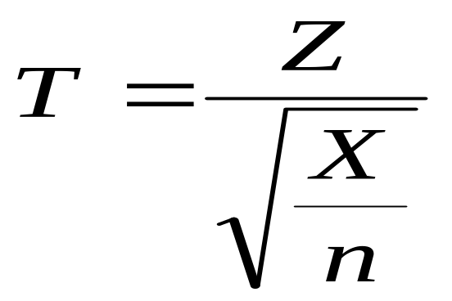
The t distribution
If a random variable, T, has a t distribution with n degrees of freedom, then it is denoted as T~t_{n}
E(T)=0 (for n>1) and Var(T)=n/(n-2) (for n>2)
T is a function of Z~N(0,1) and X~χ²_{n} as follows:

Slide 18
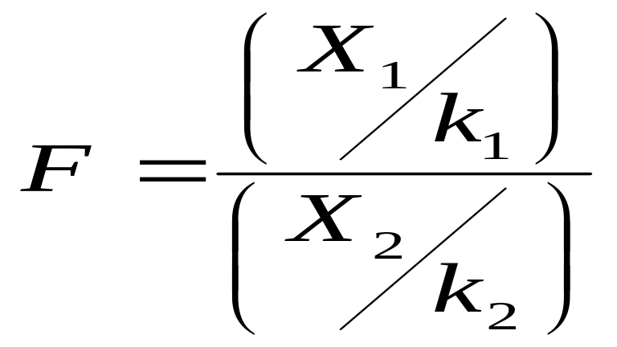
The F Distribution
If a random variable, F, has an F distribution with (k₁,k₂) df, then it is denoted as F~F_{k1,k2}
F is a function of X₁~χ²_{k1} and X₂~χ²_{k2} as follows:

Slide 19
Random Samples and Sampling
For a random variable Y, repeated draws from the same population can be labeled as Y₁, Y₂, . . . , Y_{n}
If every combination of n sample points has an equal chance of being selected, this is a random sample
A random sample is a set of independent, identically distributed (i.i.d) random variables

Slide 20
Estimators and Estimates
Typically, we can’t observe the full population, so we must make inferences base on estimates from a random sample
An estimator is just a mathematical formula for estimating a population parameter from sample data
An estimate is the actual number the formula produces from the sample data

Slide 21
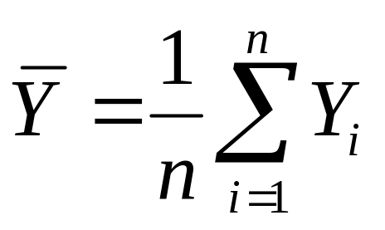
Examples of Estimators
Suppose we want to estimate the population mean
Suppose we use the formula for E(Y), but substitute 1/n for f(y_{i}) as the probability weight since each point has an equal chance of being included in the sample, then
Can calculate the sample average for our sample:

Slide 22
What Make a Good Estimator?
Unbiasedness
Efficiency
Mean Square Error (MSE)
Asymptotic properties (for large samples):
Consistency

Slide 23
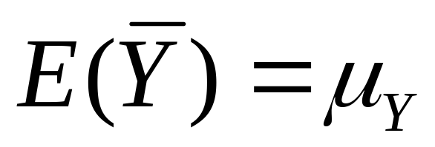
Unbiasedness of Estimator
Want your estimator to be right, on average
We say an estimator, W, of a Population Parameter, θ, is unbiased if E(W)=E(θ)
For our example, that means we want

Slide 24
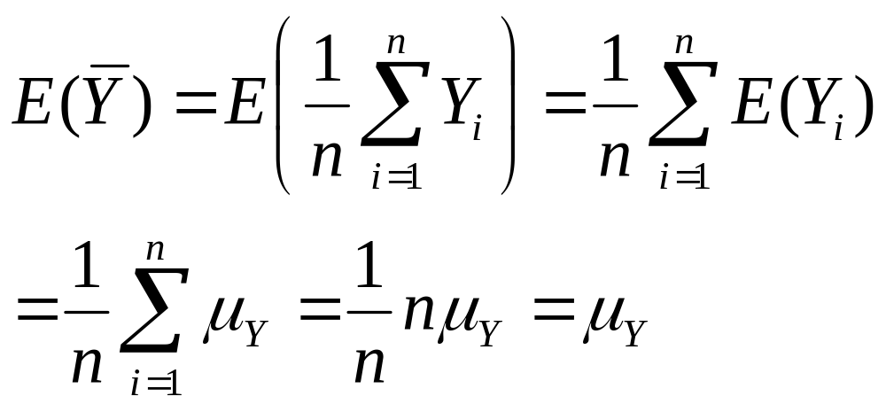
Proof: Sample Mean is Unbiased

Slide 25
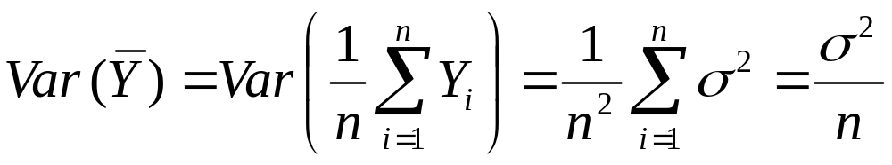
Efficiency of Estimator
Want your estimator to be closer to the truth, on average, than any other estimator
We say an estimator, W, is efficient if Var(W)< Var(any other estimator)
Note, for our example

Slide 26
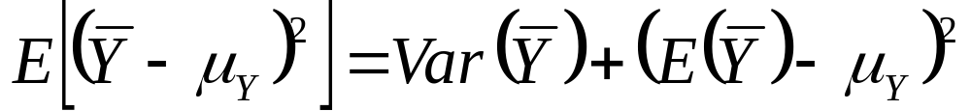
MSE of Estimator
What if can’t find an unbiased estimator?
Define mean square error as E[(W-θ)²]
Get trade off between unbiasedness and efficiency, since MSE = variance + bias²
For our example, that means minimizing

Slide 27
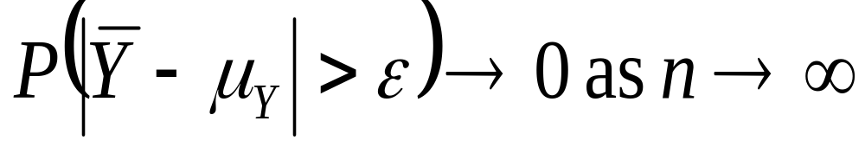
Consistency of Estimator
Asymptotic properties, that is, what happens as the sample size goes to infinity?
Want distribution of W to converge to θ, i.e. plim(W)=θ
For our example, that means we want

Slide 28
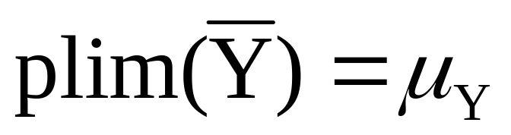
More on Consistency
An unbiased estimator is not necessarily consistent – suppose choose Y₁ as estimate of μ_{Y}, since E(Y₁)= μ_{Y}, then plim(Y₁)≠ μ_{Y}
An unbiased estimator, W, is consistent if Var(W) → 0 as n → ∞
Law of Large Numbers refers to the consistency of sample average as estimator for μ, that is, to the fact that:

Slide 29
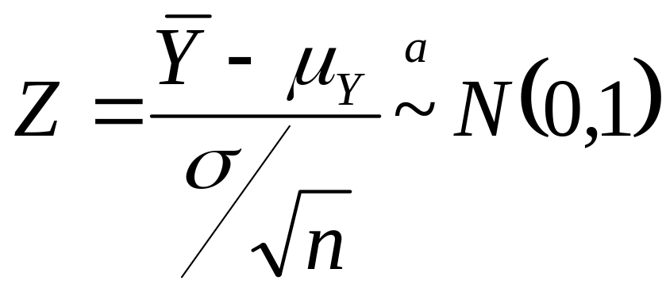
Central Limit Theorem
Asymptotic Normality implies that P(Z<z)→Φ(z) as n →∞, or P(Z<z)≈ Φ(z)
The central limit theorem states that the standardized average of any population with mean μ and variance σ² is asymptotically ~N(0,1), or

Slide 30
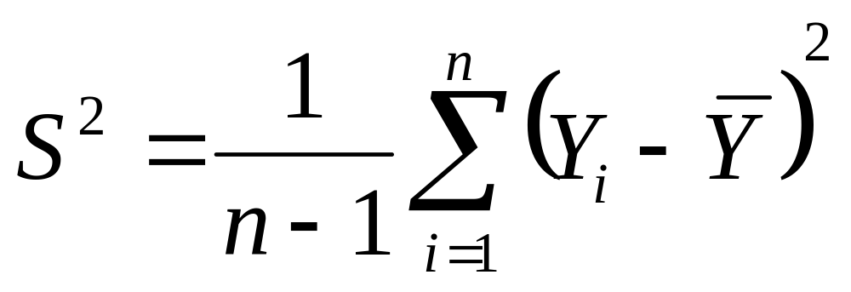
Estimate of Population Variance
We have a good estimate of μ_{Y}, would like a good estimate of σ²_{Y}
Can use the sample variance given below – note division by n-1, not n, since mean is estimated too – if know μ can use n

Slide 31
Estimators as Random Variables
Each of our sample statistics (e.g. the sample mean, sample variance, etc.) is a random variable - Why?
Each time we pull a random sample, we’ll get different sample statistics
If we pull lots and lots of samples, we’ll get a distribution of sample statistics

