Slide 1
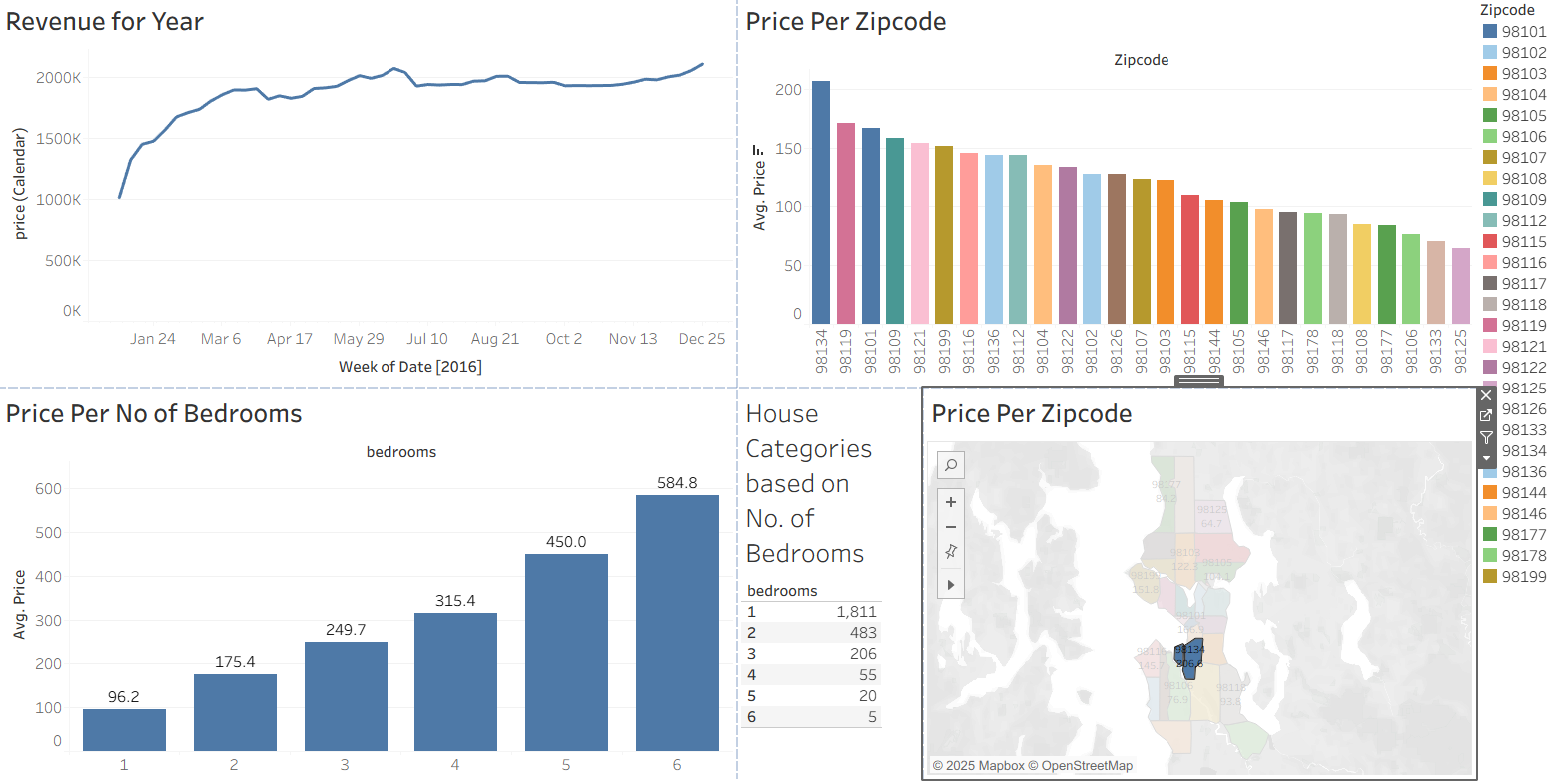
Airbnb Market Analysis
Seattle Region
Tools: Tableau
Author: Kevin Kirui

Slide 2
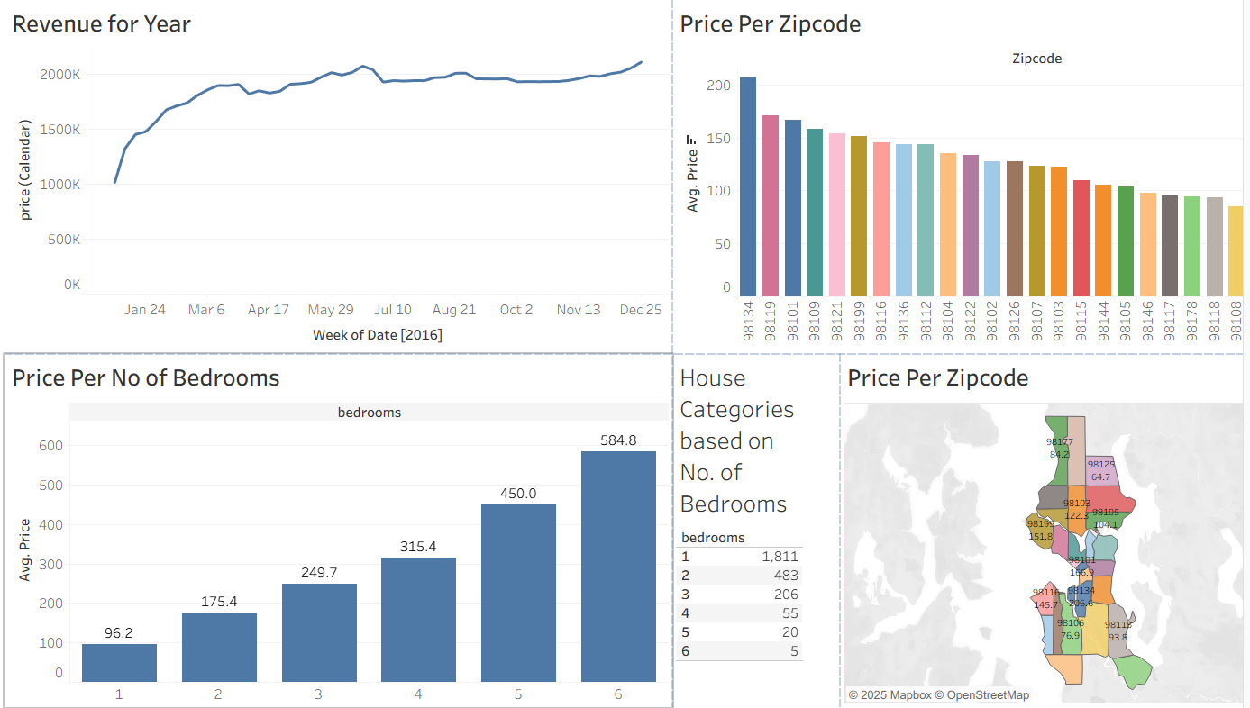
Business Problem
Objective: Understand Airbnb pricing & demand.
Outcome: Pricing strategy & investment insight.

Slide 3
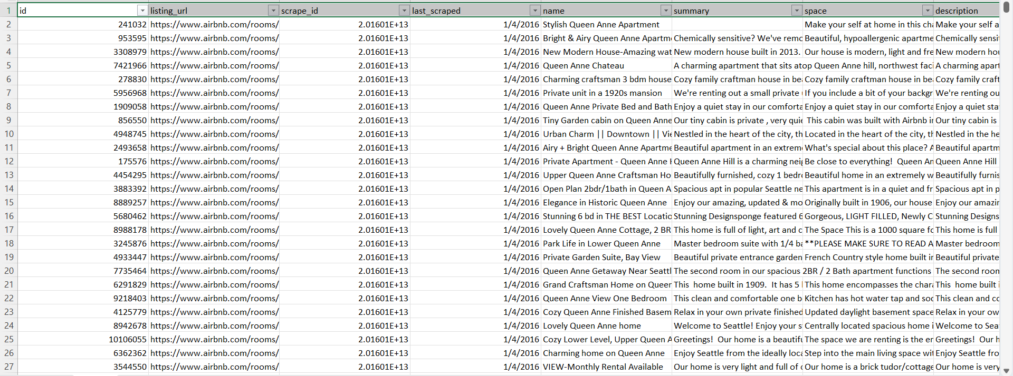
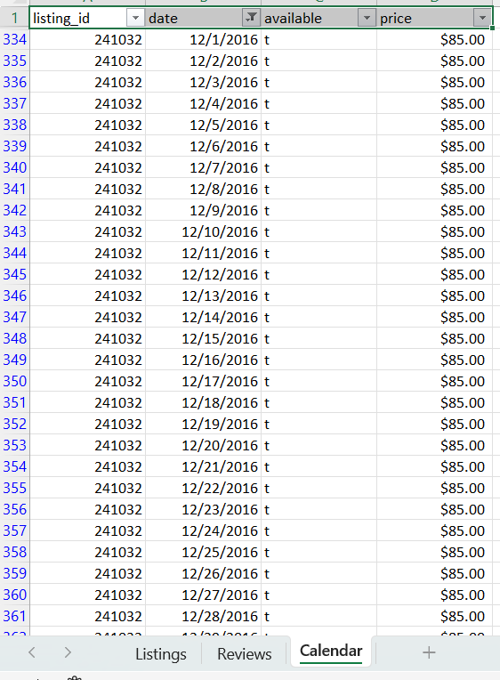
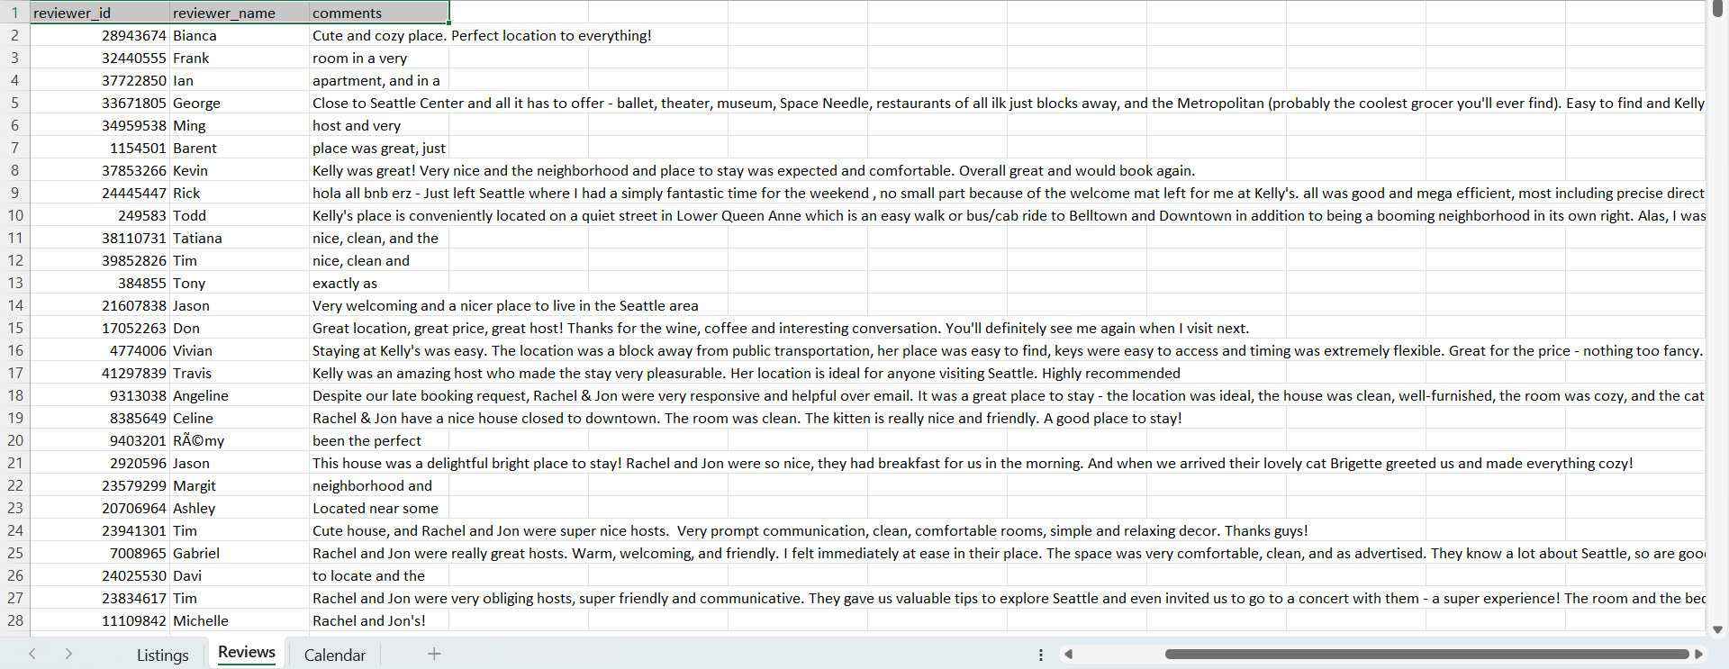
Dataset Overview
3 Sheets: Listings, Reviews, Calendar
Thousands of properties analyzed.

Slide 4
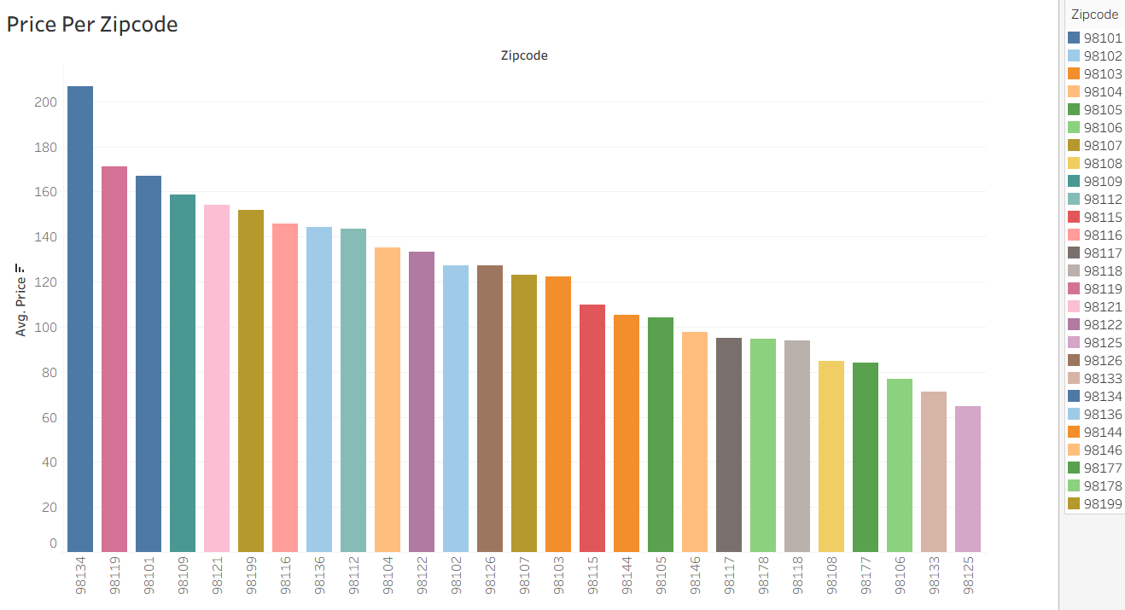
Dashboard Overview
Revenue trends, Price by zipcode, Bedrooms pricing, Map distribution.

Slide 5
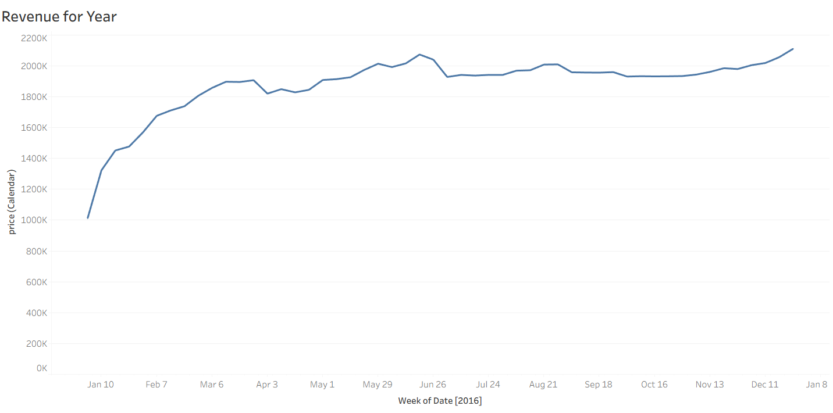
Revenue Trend
Peak in summer and holidays.
Recommendation: use seasonal pricing.

Slide 6
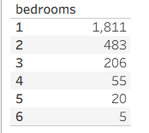
Houses Available
Number of Houses Vs Rooms Rented

Slide 7
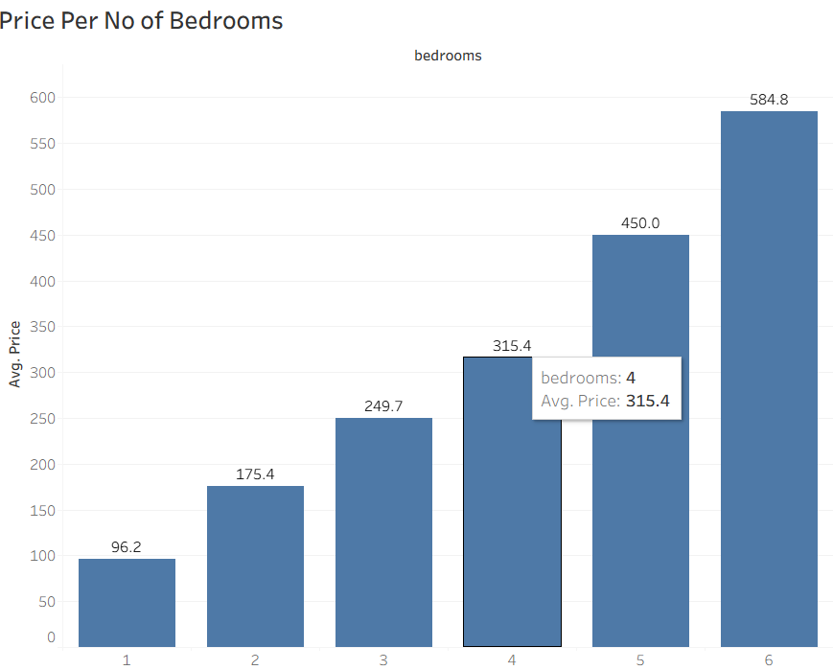
Price by Bedrooms
More bedrooms = higher price.
Luxury homes yield greater returns.

Slide 8
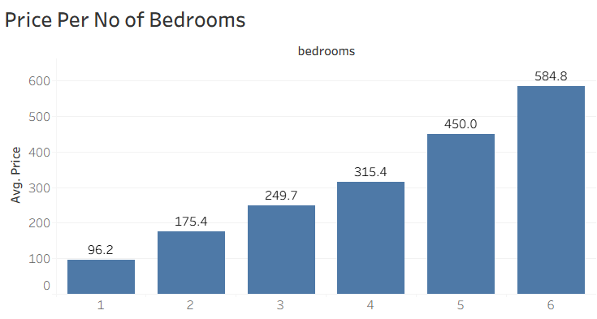
Geographic Heatmap
Downtown Seattle & waterfront areas most expensive.

Slide 9
Recommendations: Hosts
Focus on downtown & luxury homes
Dynamic pricing by season
List unique amenities to justify premium
Maintain strong review reputation
Target business tourists & summer travelers

Slide 10
Recommendations: Investors
Buy near downtown / waterfront
Invest in multi-bedroom rental properties

Slide 11
Conclusion
Location + quality + seasonality impact performance.
Airbnb market behavior in Seattle shows:
Seasonality shapes revenue
Location & size drive priceQuality & reviews determine demand
Effective pricing + quality hosting = higher Airbnb profitability.

Slide 12
Thank You
Questions?

