Slide 1

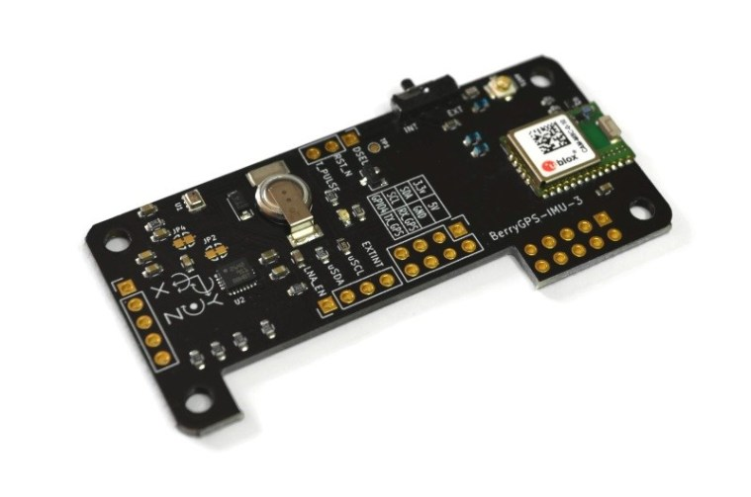
BerryIMU – ESP8266
Accelerometer, Gyrometer, Magnetometer
Kevin Lieng
https://kevin-lieng.github.io/emegensui-automotive-ui/

Slide 2

Proposal
The main project: Automotive-UI (Digital Dashboard)
Design of the main project is meant for paramedics and future ambulances
Hardware: (Gyrometer, Accelerometer, Magnetometer)
Would assist the main features of a regular dashboard of a vehicle
Keep the vehicle’s direction tracked for future GPS purposes
Our goal is to decrease the amount of time needed for information to transfer between dispatcher and paramedics

Slide 3
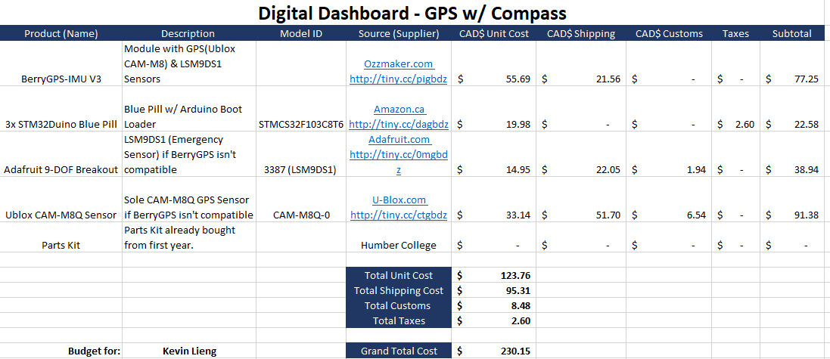
Budget
The original budget ended up being lower due to the not having to purchase the bottom two parts
However, with the addition of outsourcing my PCB and enclosure to a third-party manufacturer, changing my development platform to ESP8266
PCB : $4.90 USD + 21.99 USD shipping Enclosure: $35 CAD + 0 shipping ESP8266: $31.99 CAD + $4.16 Tax Headers: $19.98 CAD + $2.60 ( Group Use )
New Grand Total: $223.56

Slide 4
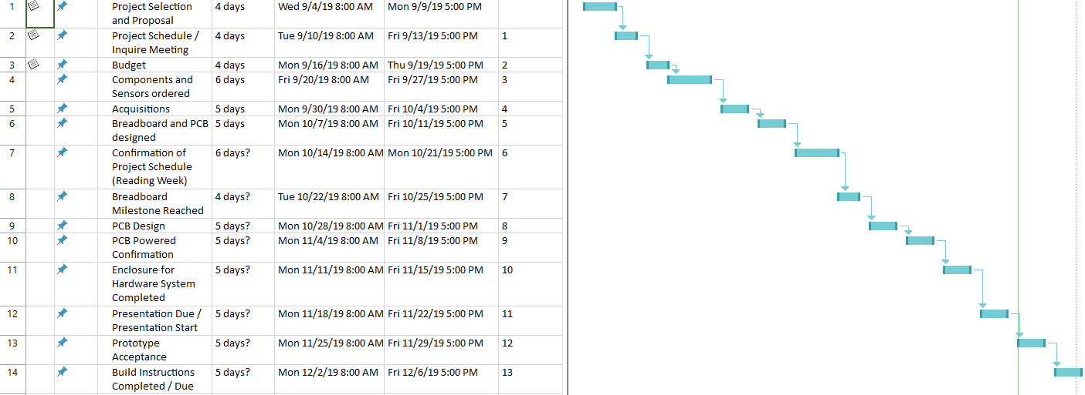
Schedule
There were several points in time, where I fell behind schedule
Week 10 & 11 when during the PCB power up and enclosure due dates
STM32 Blue Pill (faulty) wasn’t able to send 3.3V nor read from the sensors
Had to replace with ESP8266 another Arduino-like development platform, redesign the PCB, get the PCB remade and remake the enclosure accordingly
Received the new PCB, soldered, powered up, checked readings all on the week to design enclosure

Slide 5
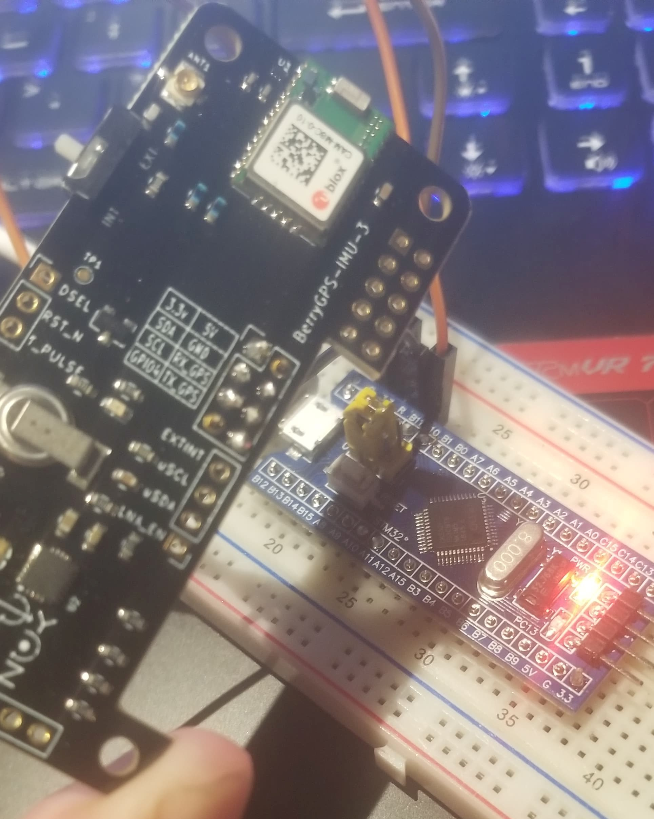
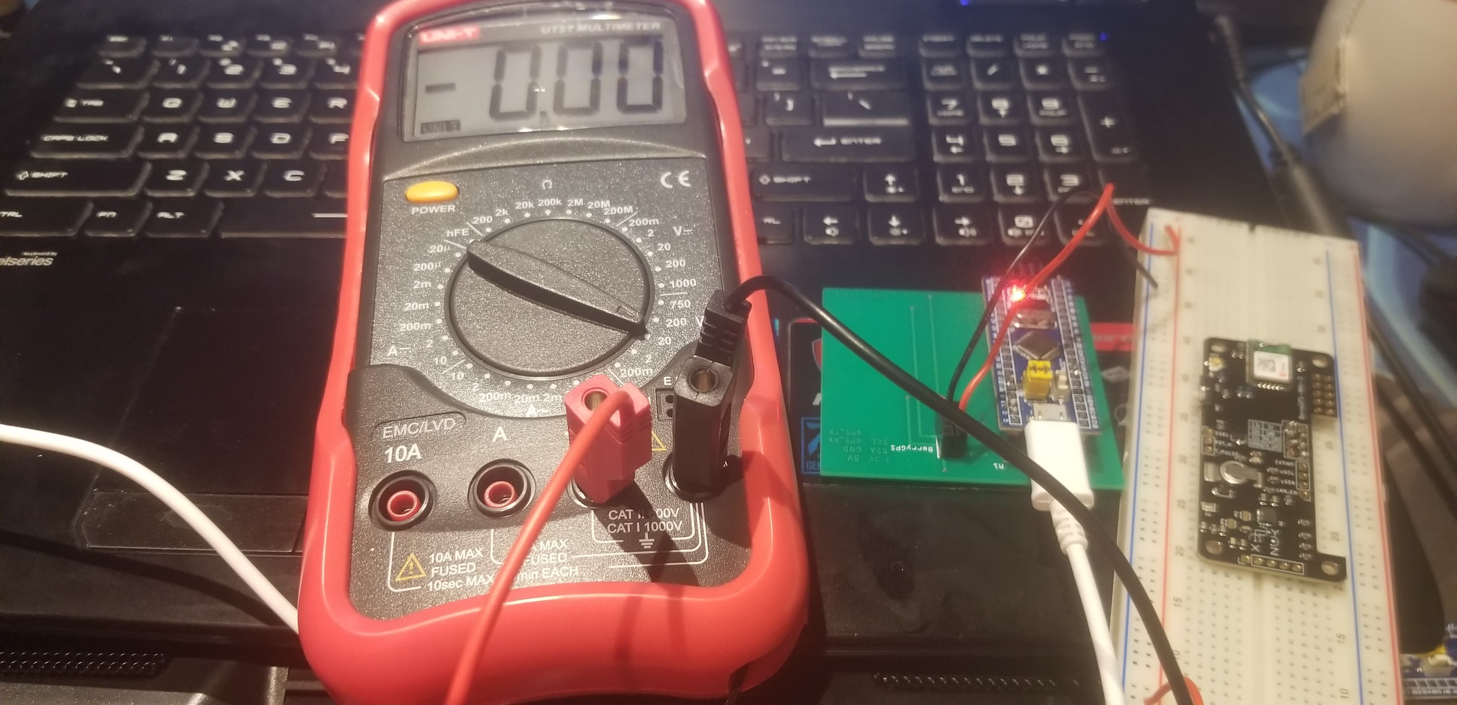
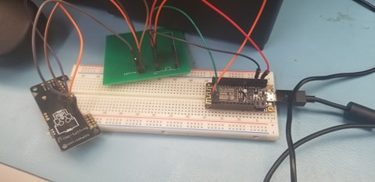
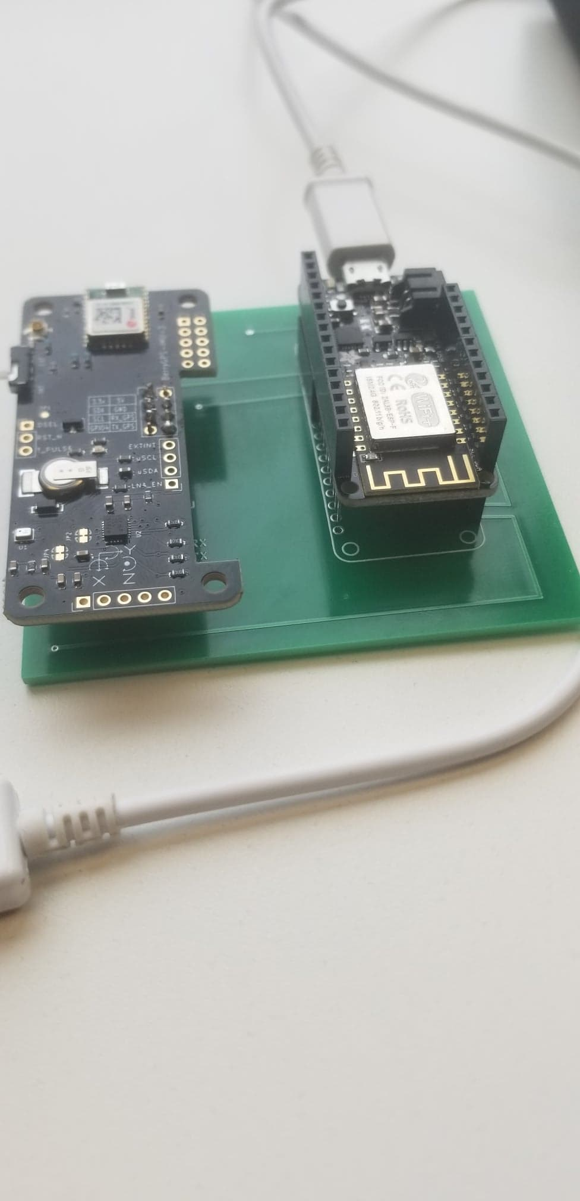
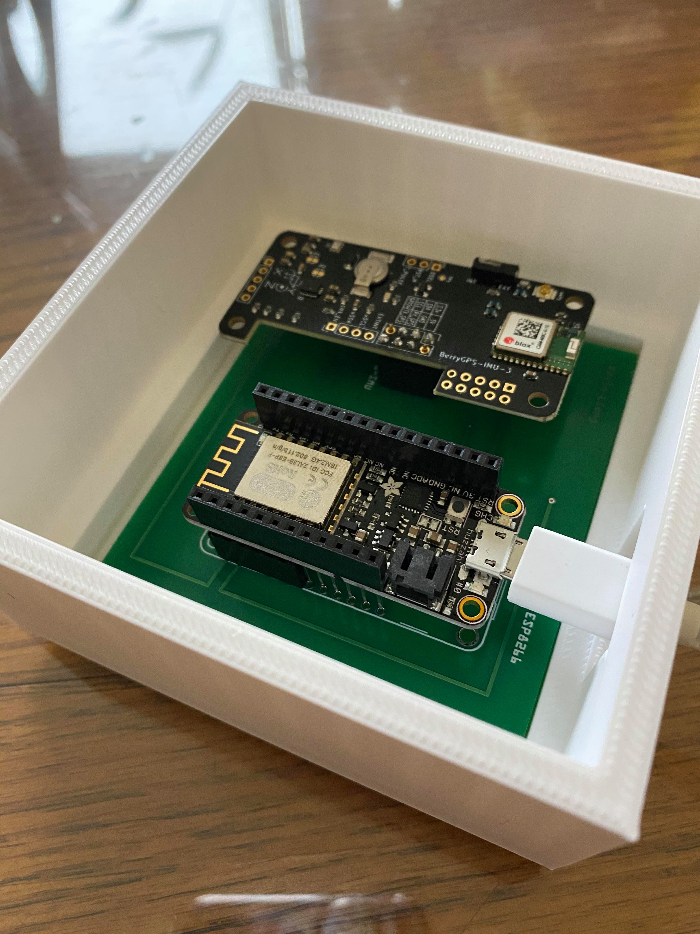
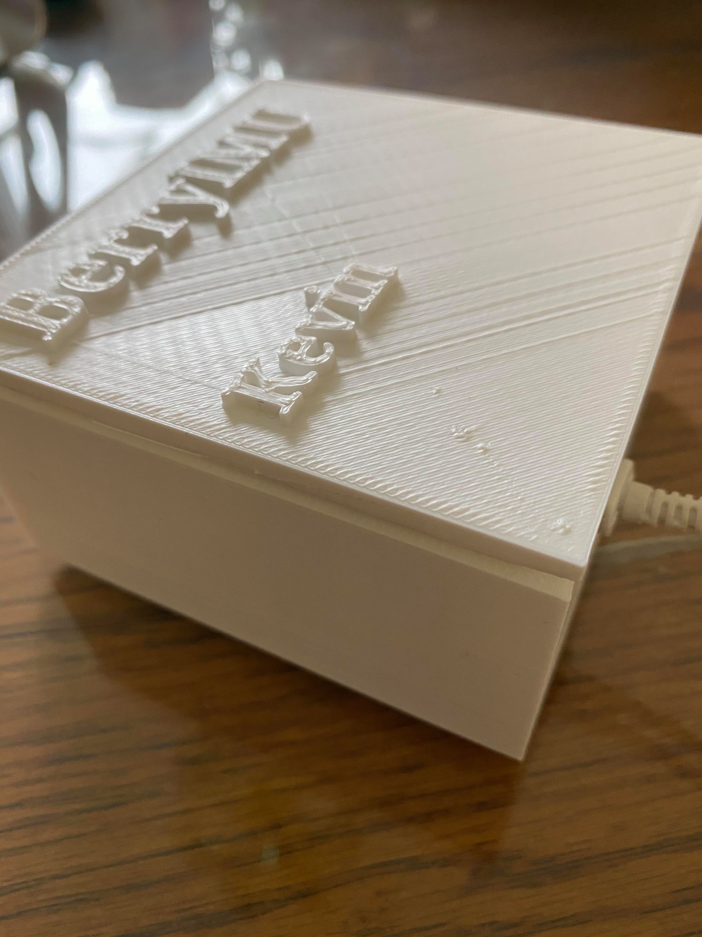
Images

Slide 6
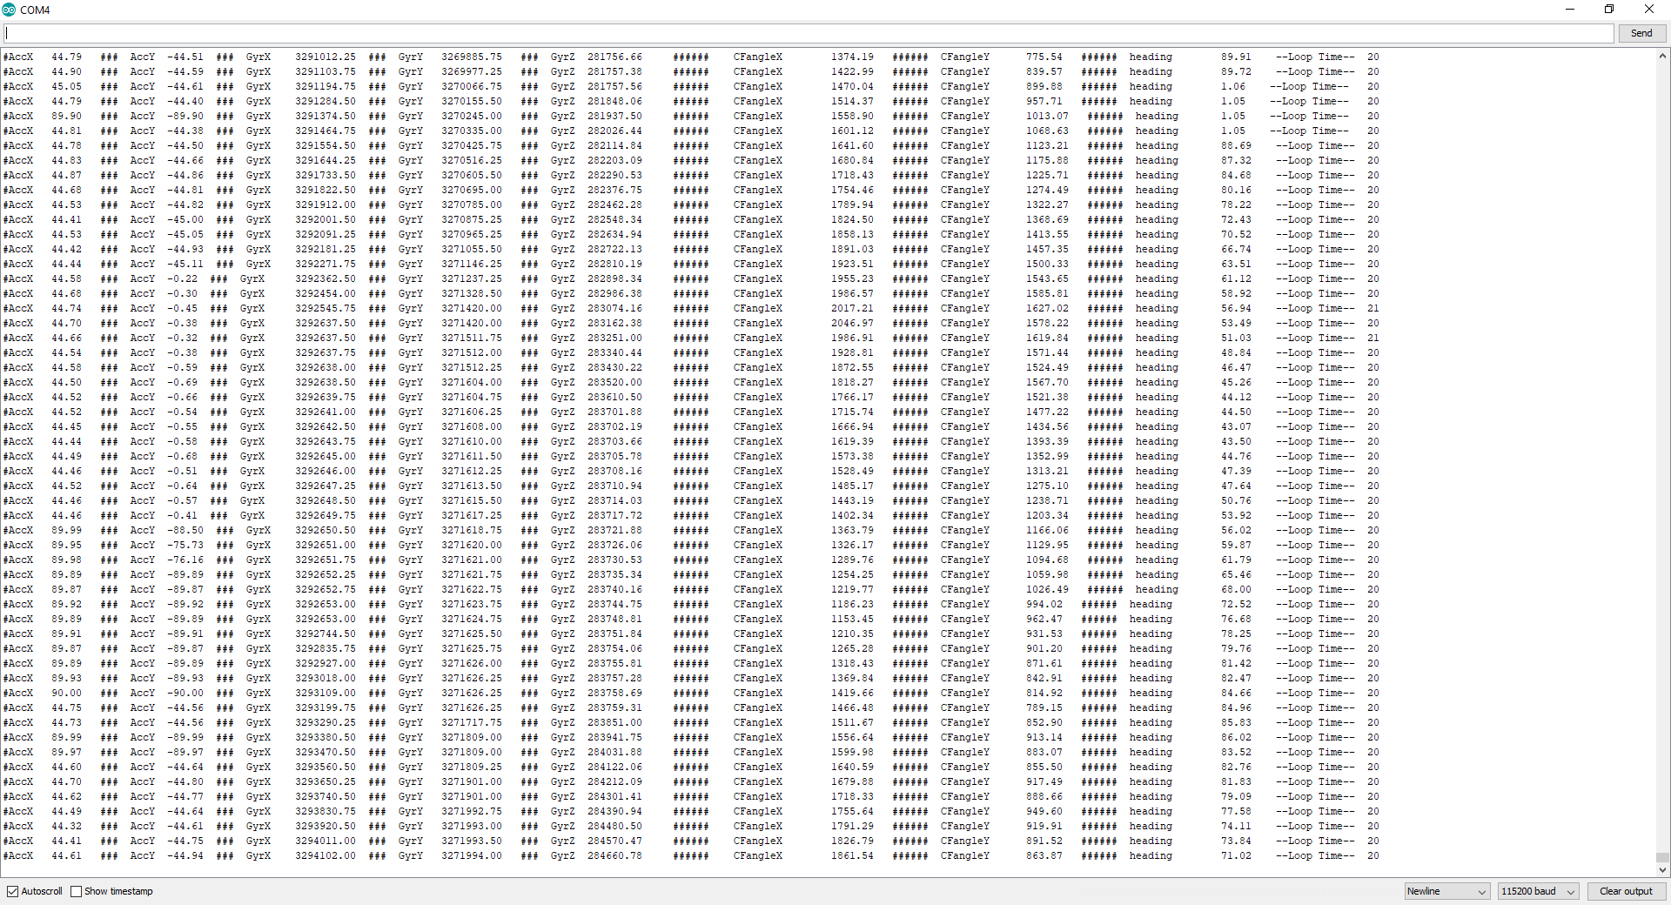
Images (cont’d)

Slide 7
Course Knowledge
TECH101(Electric Circuits) & TECH103 (Digital Fundamentals):
Learning to create different circuits and to take measurements
TECH150 (Electronic Devices & Circuits):
Learning to solder through power supply project
CENG216 (Intro to Software Engineering):
Learning how to create schedules and the understanding of Gantt charts
QUICK DEMO

Slide 8
References
OzzMaker. (2014). [Ozzmaker Logo]. Retrieved from https://i1.wp.com/ozzmaker.com/wp-content/uploads/2014/06/OzzMaker-Skull-250-side-bar-negative.png?w=250

