Slide 1
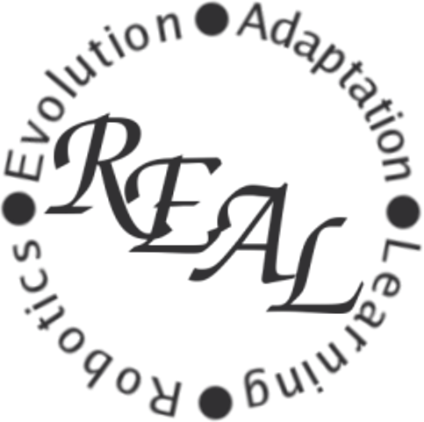
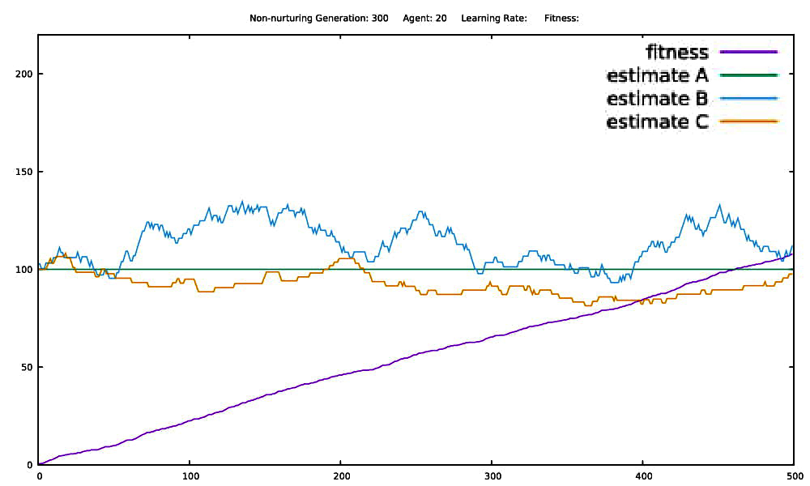
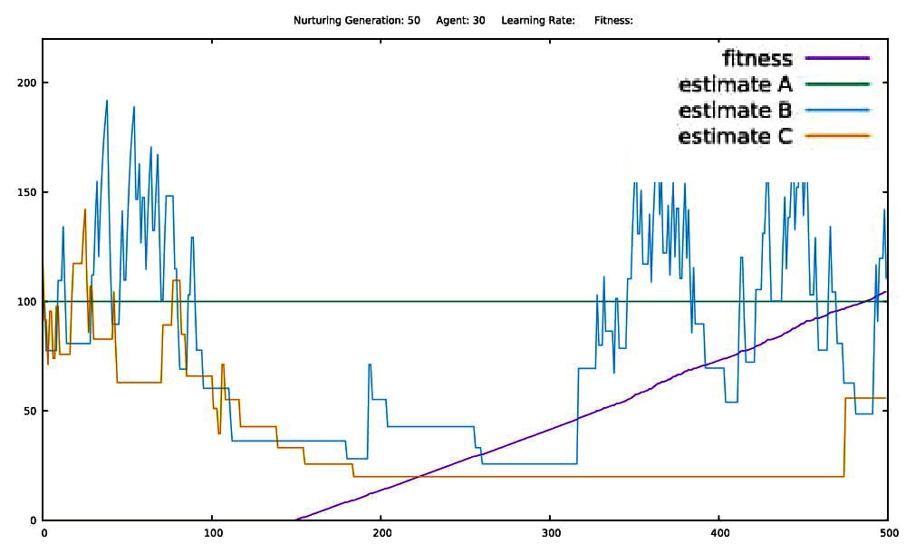
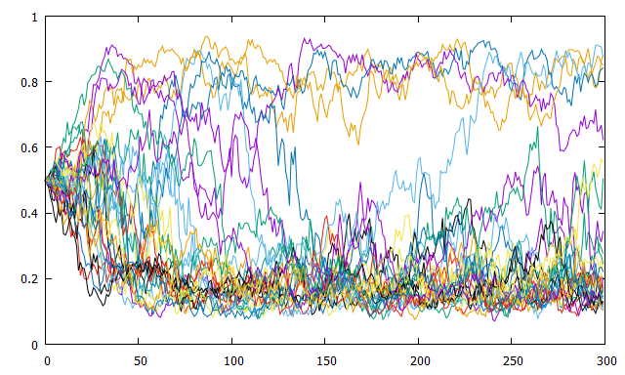
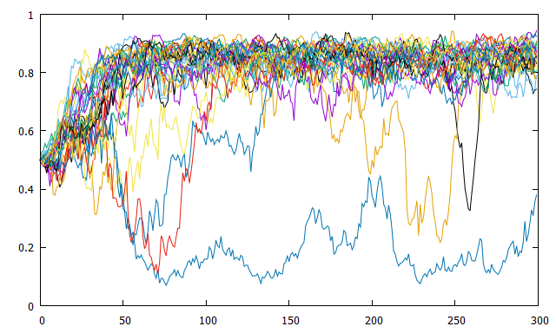
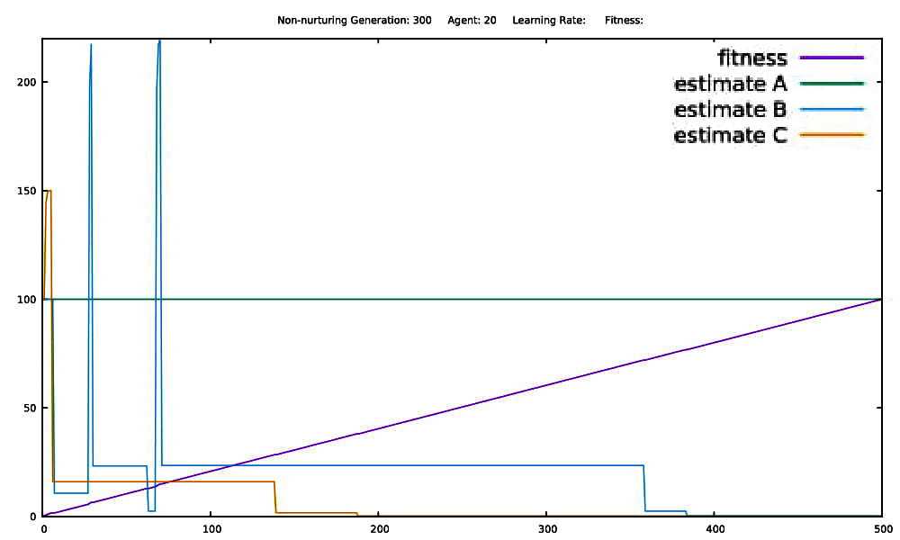
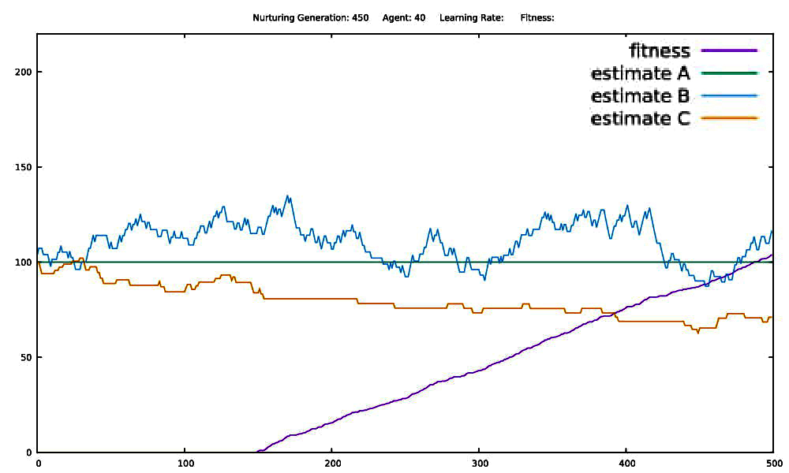
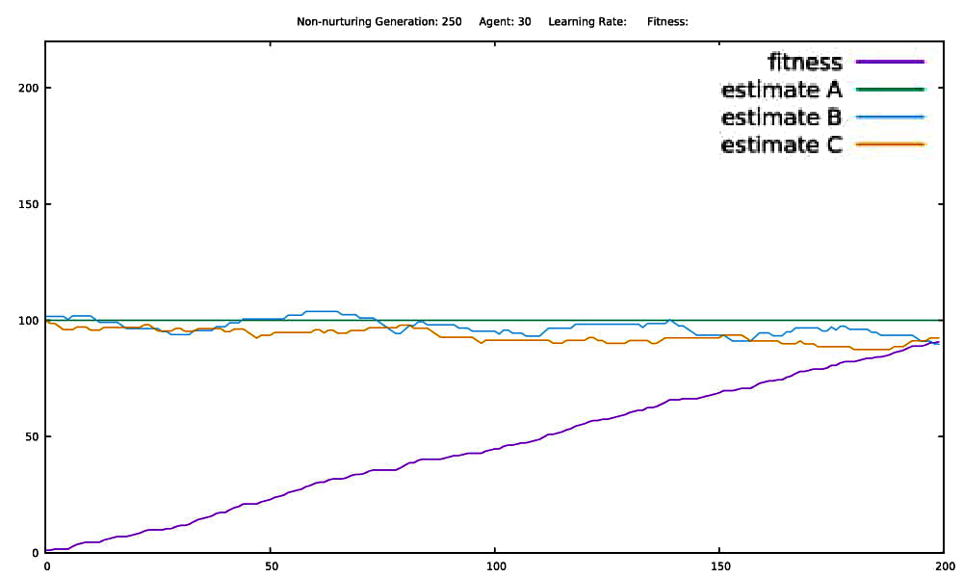
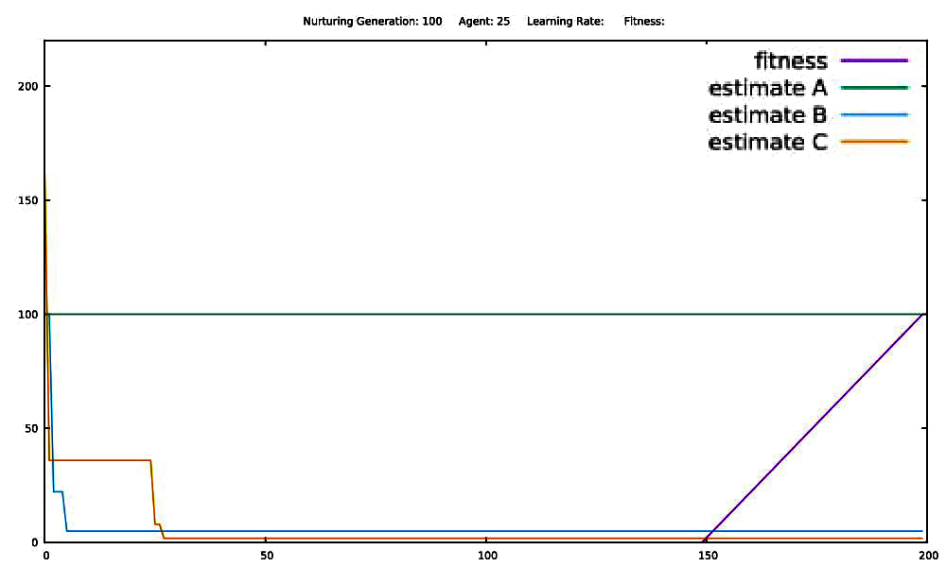
Reinforcement Learning, Nurturing, and Evolving Risk Neutrality in a Simulated Population.
Kevin Robb and Dr. Dean Hougen; Robotics, Evolution, Adaptation, and Learning Laboratory (REAL Lab); School of Computer Science, Gallogly College of Engineering, University of Oklahoma; Summer 2018
Goals:
Discover under what conditions a reinforcement learning population will evolve greater risk aversion or greater risk neutrality.
Understand the role of nurturing.
Determine trends in the data that reflect a broader insight to machine learning theory.
Apply to physical world to describe environments where a population will diverge into two distinct groups based on minor differences.
Contribute to evolution of machine learning by demonstrating ways to guide evolution of risk evaluation.
Experimental Setup:
Nurturing and non-nurturing simulations are run completely separately, with the same parameters, and analyzed afterwards. There is no interaction between the populations.
500 Generations
500 Trials each. First 150 trials are the nurturing period.
Each agent makes a choice, recalculates estimations, and increments aggregate fitness.
Data written at end, and next generation formed.
2 random agents chosen for tournament. Agent with higher fitness is selected.
Higher fitness agents are more likely to “produce offspring,” but low fitness agents are not excluded.
In the long run, bad genes are removed from the gene pool.
A higher tournament size allows risk-seeking agents to take over the population. (avoided)
Occurs 50 times to form a new population. Agents can be selected more than once.
Selected agents undergo mutation to their L values.
Mutations are chosen from a Gaussian distribution of mean 0.
A mutation (positive or negative) is added to each L value.
New agents are formed with these L values, and all estimations reset to 100.
Allowing estimations to carry over would constitute the evolution of instincts, rather than learning, and is not part of this study.
Continued Progression:
In the physical world, nurtured organisms (e.g., humans) live well beyond their nurturing period. Increased number of trials to 500, but left 150 nurturing trials, so now an agent is nurtured for 30% of their life, rather than 75%. This change caused nurtured agents to also evolve risk neutrality, and both became more successful.
Non-Nurturing Nurturing
Definitions with Context:
Reinforcement Learning (RL): machine learning method in which an agent learns an action policy by acting then receiving a numerical reward value based on its action. This reward tells the agent whether it has done a good job or a bad job, and the agent will use this to improve its policy.
State: a shorthand for a certain choice and its possible reward values. Denoting a state as B[0-220] means option B will return either 0 or 220, chosen at random. A[100] has only one possible reward.
Risk Aversion (RA): a preference for safe alternatives, even when a risky option may have a higher expected turnout. RA agents ignore minor statistical benefits and prefer a guaranteed reward, so they will choose A>(B=C).
Risk Neutrality (RN): a lack of preference for a certain option based on its riskiness. RN agents put main priority on expected value rather than relative safety. Ideally, a RN agent in this three-choice environment will be able to recognize that B>A>C.
Learning Parameter (L): measurement of “riskiness,” in the range 0 to 1. Each agent has its own L, constant during its life; L is only changed between generations. This L value is used to recalculate estimations after each trial: newEstimate = reward * L + currentEstimate * (1 - L)
A high value of L puts more weight on recency, representing risk aversion. Reward 0 drops an estimated value very low, making it unlikely to be chosen again for a while.
A low value of L puts more weight on previous experiences, and represents risk neutrality. Reward 0 preserves current estimations, and allows gradual progression towards the true mean.
Nurturing Period: a time to freely explore and learn the true mean values of all options before fitness matters. Choices during this time do not affect fitness. This gives nurtured agents an advantage.
Fitness and Estimations
Fitness and Estimations
Trial Number Trial Number
Progression:
Two-state environment, with results opposite of expected. Non-nurturing is risk neutral, and nurturing is risk averse.
Graphed: average L as a function of generation number. 30 complete runs of the simulation. 300 generations, 200 trials each.
Asymmetry introduced: Using B[0-220] and C[0-150], the average of B’s and C’s expected values no longer equals A’s, but is lower.
If this was higher, both cases would of course become RN.
Because it is lower, being risky is bad unless an agent can tell the difference between B and C.
Nurturing allows agents to learn to choose B and avoid C (evolving RN)
Without nurturing, agents avoid both B and C, sticking with safe A (evolving RA).
This behavior meets our initial query, but the type of environment that cause this behavior was unexpected.
Non-Nurturing Nurturing
Results:
When negatively-skewed asymmetry is introduced, non-nurtured agents are only able to tell that riskiness is bad on average (Figure 1), while nurtured agents are able to distinguish between the two uncertain options and choose the better (Figure 2).
The non-nurtured population evolves risk aversion and is closely gathered around a mean fitness of 100.
The nurtured population evolves risk neutrality and is very spread out around a mean fitness greater than 100.
The fitness landscape has two optima; which one is settled depends on mutation rate (MR).
Low L: global optimum, but small basin of attraction (hard to find; high MR or nurturing)
High L: local optimum, but large basin of attraction (easy to find, low MR)
Average Learning Parameter
Average Learning Parameter
Generation Number Generation Number
Table 1: Default Configuration Parameters for Environment
(values not mentioned in analysis are assumed to be the defaults from this table)
Issues: inconsistent, random, contradicts RL theory
Three-state environment implemented at this point. Tracking specific data.
Graphed: fitness and estimations as functions of trial number. 200 trials. One graph represents a single agent during a single generation.
The flat segment of the fitness line (purple) is the nurturing period. Ideally the estimations will each converge to approximate their real mean values. This does not happen very successfully yet.
Significant spikes and drops mean the agent has a high L and is very risk averse. If the lines experience minimal change, the agent has a low L and is very risk neutral. Non-nurturing (left) is still risk neutral, and nurturing (right) is risk averse.
Figure 1: Non-Nurturing Figure 2: Nurturing
Parameter | Value
Initial Learning Parameter | 0.5
Mutation Standard Deviation | 0.05
Number of Agents | 50
Number of Trials | 500
Number of Nurturing Trials | 150
Number of Generations | 500
Tournament Size | 2
Certain State | A[100]
Uncertain States (Symmetric) | B[0-220] and C[0-180]
Uncertain States (Asymmetric) | B[0-220] and C[0-150]
Fitness and Estimations
Fitness and Estimations
Non-Nurturing Nurturing
Trial Number Trial Number
Fitness and Estimations
Fitness and Estimations
Footnotes:
This project was successful in demonstrating that the type of environment affects what type of risk evaluation will evolve in an artificially intelligent system. An interesting follow-up to this experiment would be evolving instincts, such as the estimations (to some extent), or changing the environment throughout the simulation to see how that affects the population’s reliance on learning.
The non-nurturing case evolving RA upholds the concepts proven in the 2002 paper written by Yael Niv et al., which defined the fundamentals of RL. In the future, I will continue working with risk evaluation and the evolution of learning in Dr. Hougen’s REAL Lab.
Trial Number Trial Number
Issues: still contradicts RL theory, cannot distinguish between risky options
Continued at top of next column.
I was able to undertake this research through the FYRE program at OU because of NSF grant #1726889.

