Slide 1
DSO599 Data Project 2 Predicting Retention_14 and Analyzing Feature Importance
Chaiyapuk Titinanapun, Inez Gunawan, Bosen Wan, Xinxin Yang

Slide 2
Introduction & Data Overview
Project Goal
Data Overview
Prepping Data
Feature Engineering
Introduction Choosing Variables Algorithm Selection Model Training & Evaluation Feature Importance Prediction with New Data Key Takeaways Recommendations
User retention is a crucial metric for mobile game success and monetization. By accurately modeling retention, game companies can target interventions and offers to improve sticky-ness. They can also better align business plans to expected player lifespans.
Build a model and accurately predict whether a player will retain after 14 days
The dataset provided includes usage telemetry and attributes for the first 14 days after install for recently acquired players. Features capture profile information like country and device type, as well as key engagement metrics like playtime, sessions, spend, and churn risk.
Handled missing values and ensuring a proper train-test split strategy with stratification based on retention columns.
This includes target encoding, creating new game-related features, introducing binary retention and conversion features, computing percentage changes and rate changes, and evaluating progress in game chapters.
Notes:
Hi everyone, today we’ll be talking about our findings in our final project. Our goal for this project is to explore different approaches to predict this 14-day retention label.
And why are we doing this? We are hoping to find a model that can tell us how to improve sticky-ness with new players so that we can better align the business plans to improve user experience and retention strategies.
The data provided had a bunch of attributes of players recently acquired. While prepping the data we did some feature engineering. We target encoded and made new game related features which you can see more of in our code later.
Our goal is to explore different machine learning approaches to predict this 14-day retention label. In addition to maximizing accuracy, we want to balance model interpretability to extract player insights. The models can advise what types of users have highest long-term value. Findings will guide user acquisition strategy and onboarding optimizations to improve retention going forward. With enhanced retention, the mobile gaming company can better scale its platform and business.

Slide 3
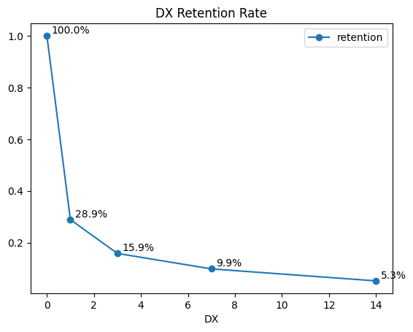
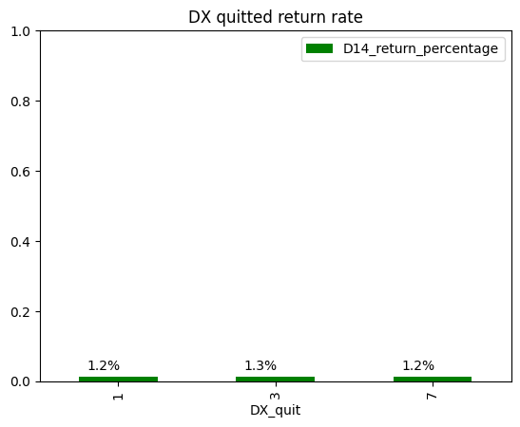
Retention Rate
Introduction Choosing Variables Algorithm Selection Model Training & Evaluation Feature Importance Prediction with New Data Key Takeaways Recommendations
Although model accuracy improves with time, the trade off is missing the opportunity to retain more players who have already dropped off. There is more value in taking earlier action, even if based on less data.
DX Retention Rate
DX Quitted Players Return Rate
Waiting longer means having more data points so can predict 14 day retention more accurately However, there are fewer players still active later on. Less players to impact by taking action closer to day 14.
Very few players (about 2%) who quit before day 14 eventually come back on day 14. This indicates it may not be efficient to focus retention efforts on re-engaging quitters. Retaining existing players is likely a better use of resources than trying to win back players who already quit
Notes:
So when looking at the retention rate, as we probably have predicted the retention rate graph on the left shows that there is a steep decline in people retained the longer we wait. But the longer we wait, the more data we have on players and hence the more accurate. So there is a tradeoff between accuracy and finding the sweet spot to have enough players to place impact on. And for funsies we also saw that less than 2% of people who left returns on day 14, so focusing on retention is better than focusing on re-engagement.
They quit and return back in day 14, there is not a lot of people who come back.
optimize more for ability to act sooner rather than chasing marginal accuracy gains later.

Slide 4
Algorithm Selection
Logistic Regression
Random Forest
Gradient Boosting
Introduction Choosing Variables Algorithm Selection Model Training & Evaluation Feature Importance Prediction with New Data Key Takeaways Recommendations
Testing different complex and simple models helps determine the best approach for this dataset and business problem. We have chosen Logistic Regression, Random Forest, and XGBoost as the algorithms
A good baseline model for binary classification problems like this. It is interpretable and fast to train.
Useful benchmark.
An ensemble method suited for tabular data that can capture nonlinear relationships and handle many input variables. Helps avoid overfitting.
A powerful gradient boosted decision tree algorithm known for high predictive accuracy. Handles imbalanced data well.
Notes:
We selected 3 different algorithms to help us model for day 14 retention. First, we did the logistic regression which is a very useful benchmark. Then we did random forest because it automatically handles feature interactions and is also robust to outliers. Finally, we did gradient boosting because it usually performs really well for their predictive accuracy.

Slide 5
Predicting which players will play our game
Training Data
D0, D1, D3, D7 Example: - Win Rate - Total Playtime - In-game Chapter - Location
Models
Logistic Regression
Random Forest
Gradient Boosting
Retained
Churn
Churn
Validation & Testing Data
Evaluation (F1 Score)
Introduction Choosing Variables Algorithm Selection Model Training & Evaluation Feature Importance Prediction with New Data Key Takeaways Recommendations
Player Data
Day-14 Retention: Individual Players
Input
Predict

Slide 6
How classifying works in detail
Algorithm was used to predict retention_14 for each player
42 % likely to retain
14 % likely to retain
3 % likely to retain
Top 6% of training population was used to determine the retained players
Predicted Retention Cutoff >= 22.6%
Introduction Choosing Variables Algorithm Selection Model Training & Evaluation Feature Importance Prediction with New Data Key Takeaways Recommendations

Slide 7
+
Precision: % of correct retention predicted
Recall: % of all retention covered
Introduction Choosing Variables Algorithm Selection Model Training & Evaluation Feature Importance Prediction with New Data Key Takeaways Recommendations
The model is measured by Precision & Recall

Slide 8
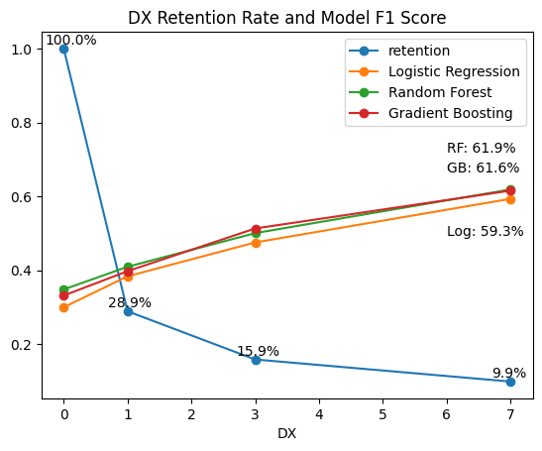
The model will perform better as we collect more player’s data. However, most players will leave after the first day of installation.
Introduction Choosing Variables Algorithm Selection Model Training & Evaluation Feature Importance Prediction with New Data Key Takeaways Recommendations
Using day-7 player data might be too late
Model Performance (F1) - D7 data | Evaluation - D7 data
Logistic Regression | 59.3%
Random Forest | 61.9%
Gradient Boosting | 61.6%

Slide 9
Feature Importance
DX_END_ISIN_CHAPTER_7
DX_TOTAL_PLAYTIME_7
DX_TOTAL_SESSION_CT_7
CITY
Introduction Choosing Variables Algorithm Selection Model Training & Evaluation Feature Importance Prediction with New Data Key Takeaways Recommendations
0.33
0.31
0.24
0.08
Notes:
Out of all the variables, we have listed the four most important feature that influences day 14 retention. It is surprising that city is the fourth most important feature that influences day 14 retention. However, as we examine more into the data we find out that the cities and countries that are more likely to retain until day 14 are European countries and cities. The rest of the three features make sense. And we find this pattern that the day 7 indicator in any feature is always more important than the day 3 indicator, then the day 1 indicator, which to us make sense because a player is more likely to retain if they are still going into the game in day 7.

Slide 10
Prediction with New Data
Day 14 Retention Likelihood
Testing Data F1_Score
Introduction Choosing Variables Algorithm Selection Model Training & Evaluation Feature Importance Prediction with New Data Key Takeaways Recommendations
5.9 %
0.62
Notes:
As we predict day 14 retention again using the best model and the different data set, we get the likelihood that players retain until day 14 is 5.9%. And the F1 Score to be 0.62.

Slide 11
Key Takeaways & Findings
Introduction Choosing Variables Algorithm Selection Model Training & Evaluation Feature Importance Prediction with New Data Key Takeaways Recommendations
For the industry as a whole (or a game of this genre), European is not a market to be neglected.
Making players retain until day 7 is more important than trying to retain them for day 1, as day 1 total playtime is even less important than most of the other features
Side Mission Game Percentage seems to be more important than PVP and Campaign. However, PVP win rate is the most important among all the game modes
Notes:
To summarize our key takeaways,
First: European market is important from our analysis, and should not be neglected
Secondly, making players retain until day 7 is more important than trying to retain them for day 1, as day 1 total playtime is even less important than most of the other features
Lastly, side mission seems to be more important than PVP and Campaign from our analysis. However, PVP win rate is the most important among all the game modes.

Slide 12
Recommendations
01
Marketing
02
Day 7 retention
03
Side Mission
04
Game Balance
Introduction Choosing Variables Algorithm Selection Model Training & Evaluation Feature Importance Prediction with New Data Key Takeaways Recommendations
Marketing in the European Region for games of this kind
Develop continuous operation strategy and make the early game experience abundant. Avoid click baiting
Focusing on the development of side missions to attract players to retain until day 14
Focus on the balance of the PVP mode so players don’t get discouraged because of their upset win rates
Notes:
With all our findings, we have the following recommendations to make:
As european market is important from our analysis, we recommend more marketing budget in European market for games of this kind.
Since day 7 retention is important, develop a continuous operation strategy and make the early game experience abundant
Invest in side mission development since they are attracting players to retain
Since PVP mode is the most important game mode, focus on the balance of PVP mode to encourage players to keep playing and spending.

Slide 13

Thanks!
Do you have any questions?

Slide 14
Appendix - All Algorithm Results
Larger F1 score indicates better precision and recall of a model, meaning the prediction of a model is better when F1 score is higher. Below are the F1 score
 | Day 0 | Day 1 | Day 3 | Day 7
Logistic Regression | 30.0% | 38.4% | 47.5% | 59.3%
Random Forest | 34.8% | 41.0% | 50.1% | 61.9%
Gradient Boosting | 33.2% | 39.8% | 51.3% | 61.6%
* The number shows how day 7 is always better because people have already been retained for 7 days and less noise or uncertainty (a.k.a more data).

Slide 15
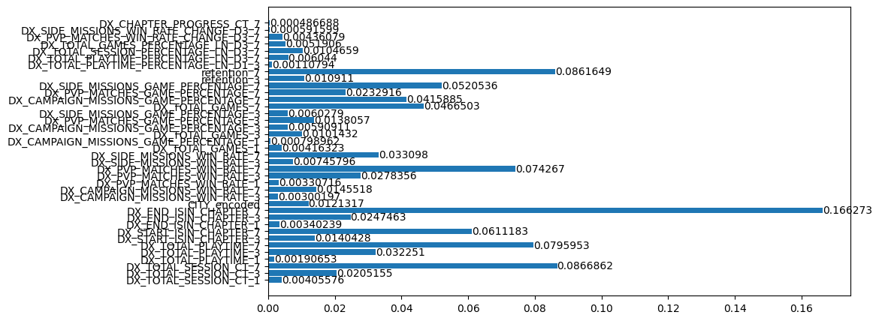
Appendix - Random Forest Feature Importance

Slide 16
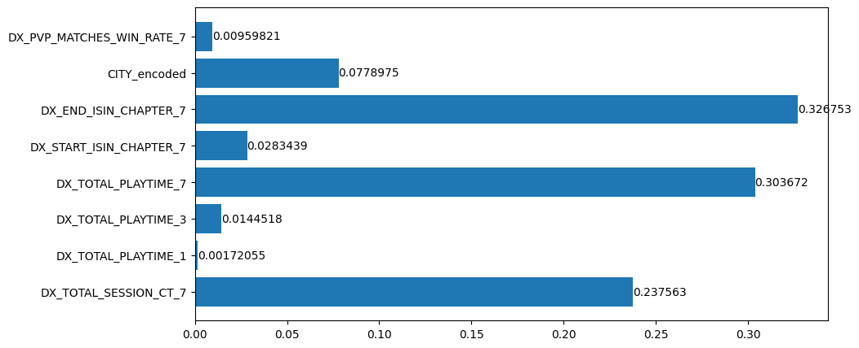
Appendix - Gradient Boosting Feature Importance

Slide 17
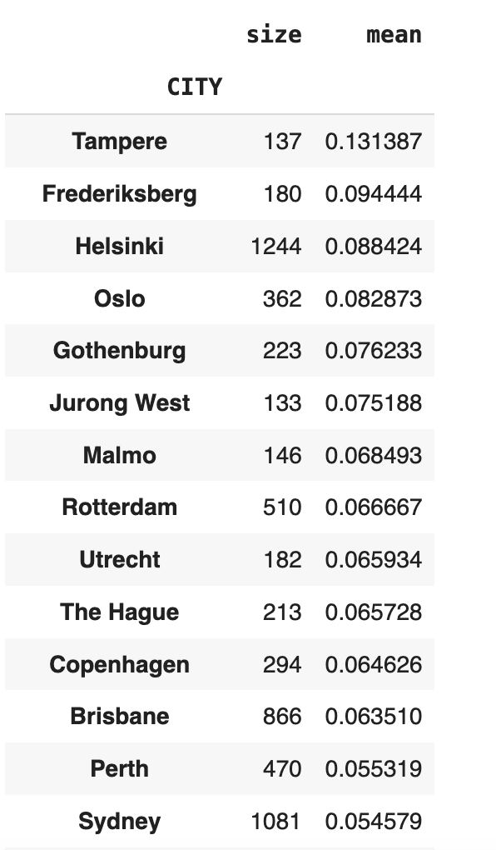
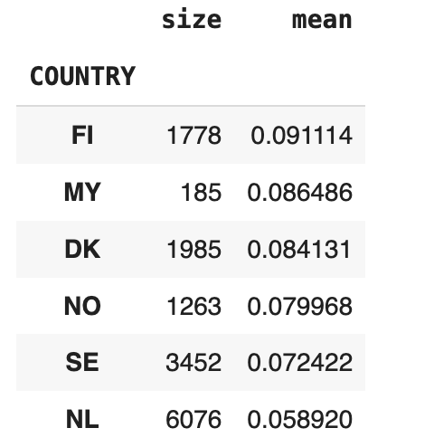
Appendix - City & Country Feature Importance

