Slide 1
Kevin Winter Data Anonymization / Replication using Generative Models (Master’s Project)

Slide 2
Motivation

Slide 3
Goal

Slide 4
Data Replication Framework
Data Input
MNIST
Data Preprocessing
Encoding
Modelling & Sampling
BOSTON
ADULT
BINARY
Scaling
GMM
VAE
GAN
RBM
Evaluation
Accuracy
Cramers V
Pearsons r
IVA
DT Model

Slide 5
Data Input

Slide 6
Data Preprocessing

Slide 7
Modelling & Sampling

Slide 8
Evaluation
asadas

Slide 9
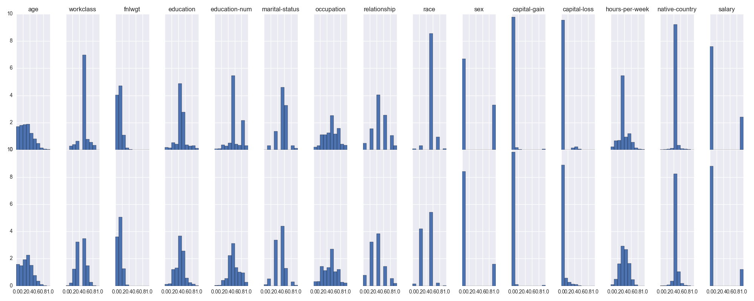
Results
GMM (reordered)

Slide 10
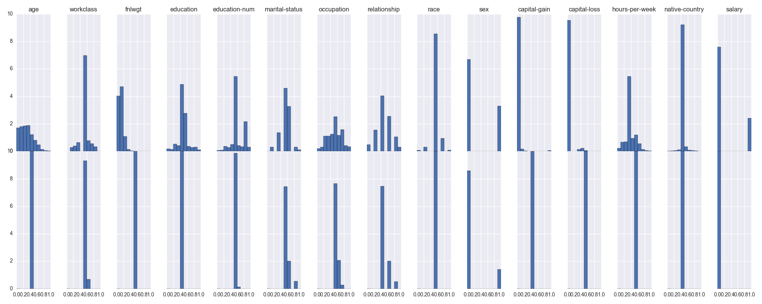
Results
VAE (reordered)

Slide 11
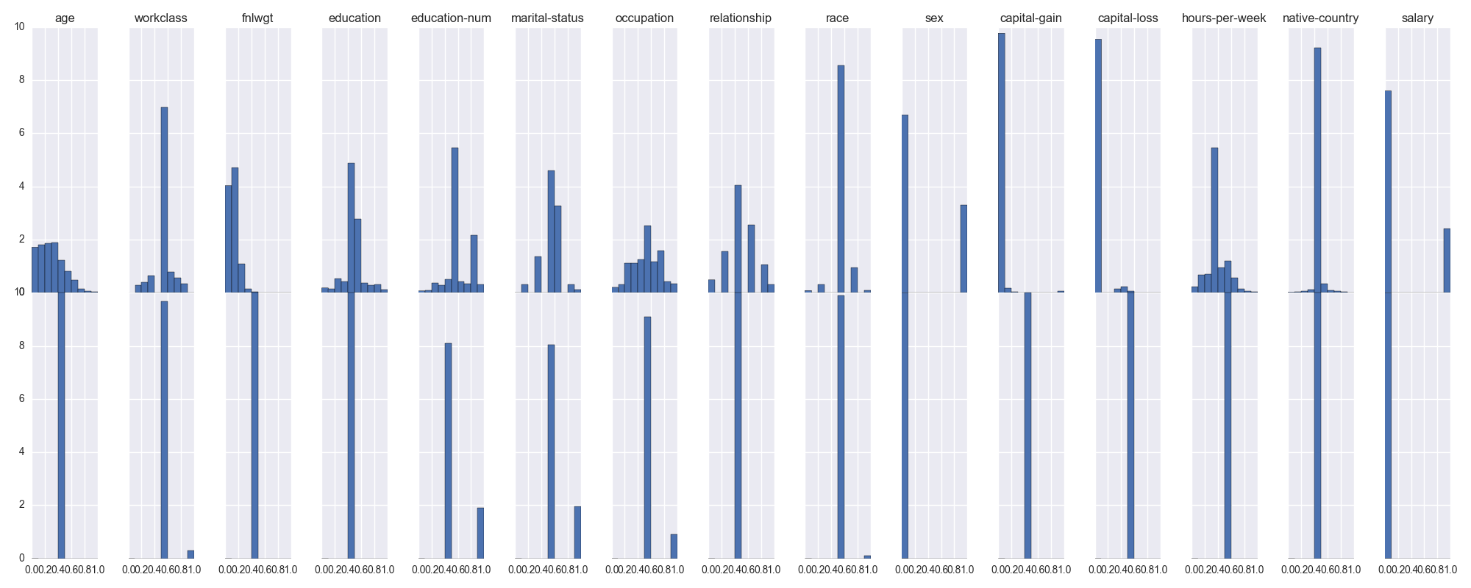
Results
RBM (reordered)

Slide 12
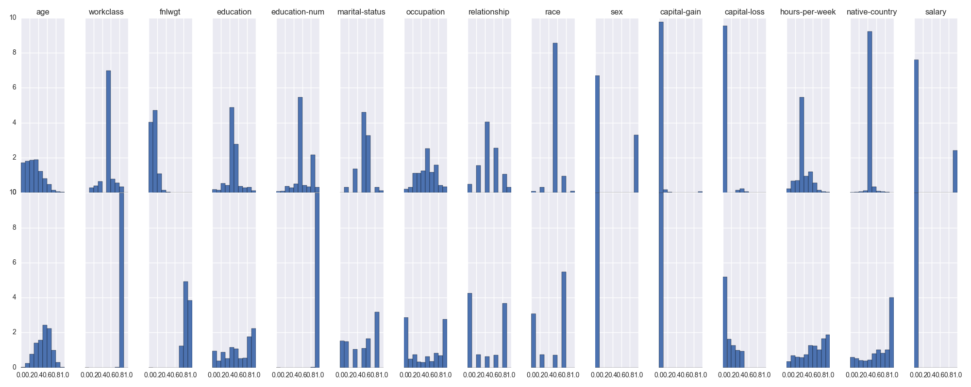
Results
GAN (reordered)

Slide 13
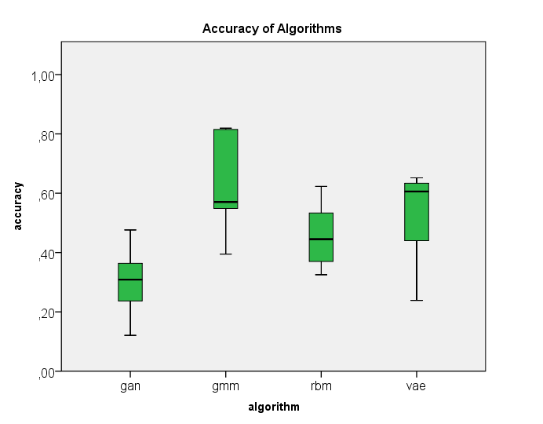

Slide 14
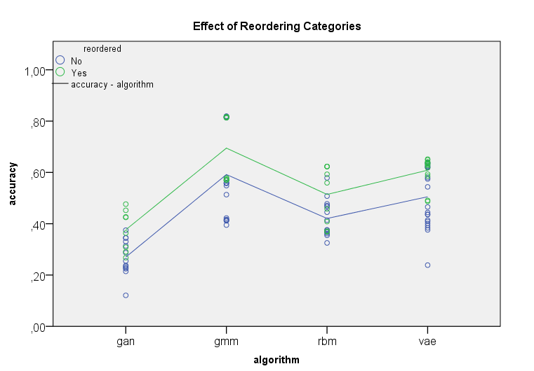

Slide 15
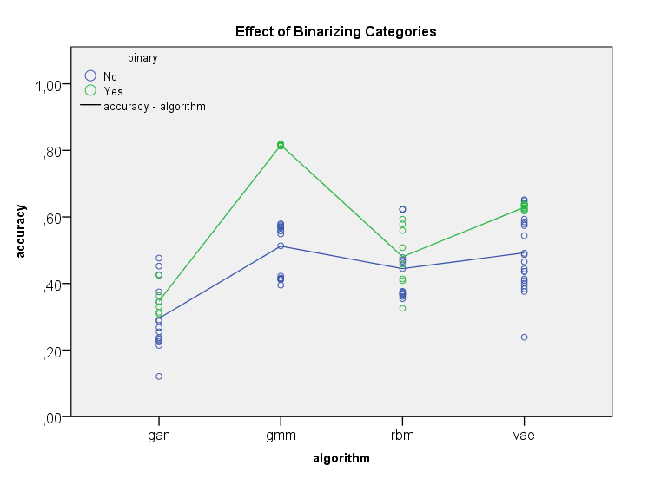

Slide 16
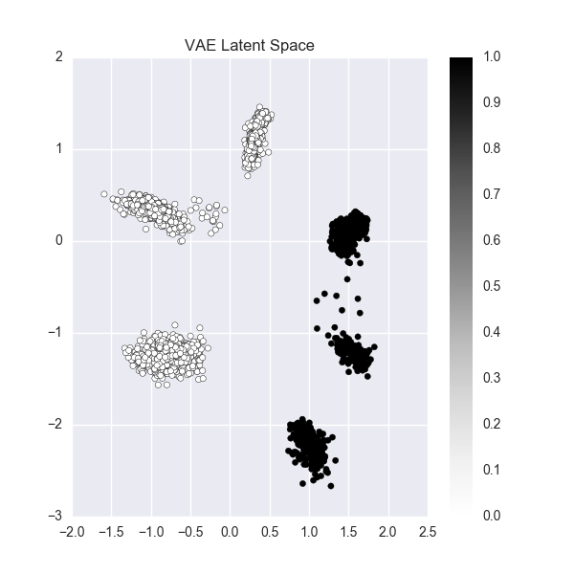
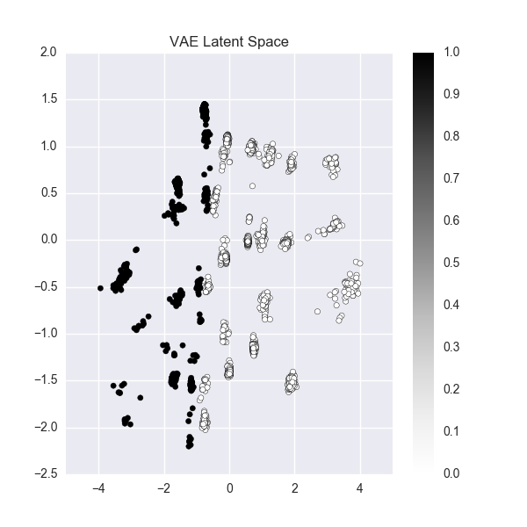
Latent Space

Slide 17
Conclusion

