Slide 1
Bank Marketing Prediction with ML
Kevin Zhou, Shao Jin
Prof. Linda M. Sellie
11:00 A.M Section
CS-UY 4563
12/20/2022

Slide 2


Introduction
P A R T 0 1
Age
Job
Marital
Education
Balance
…
Will the client subscribe
the product (bank term deposit) ?
7000 training samples and 3000 testing samples out of 45211 instances
logistic regression, support vector machines, and neural networks
different regularization, feature transformation

Slide 3
Data Preprocessing
P A R T 0 2
Import Dataset & Dataset Cleaning
Categorical Encoding
Data Scaling (Normalize): age, balance, contact duration
Data Splitting (7000 training, 3000 testing) & Data Transformation
[1.037371 1 1 2 2 -0.309556 1 2 3 7.0 5 -0.687574 1.0 -1.0 0.0 1]
[1.076139 1 1 4 4 0.095825 1 4 9 49.0 25 0.472758 1.0 1.0 0.0 1]

Slide 4
Logistic Regression
P A R T 0 3
X
Best W
No Regularization
X^2
Best W
X
Different C
Best W
L1 Regularization
X^2
Different C
Best W
X
Different C
Best W
L2 Regularization
X^2
Different C
Best W
X
Different C
Best W
Elasticnet Regularization
X^2
Different C
Best W
Best best W

Slide 5
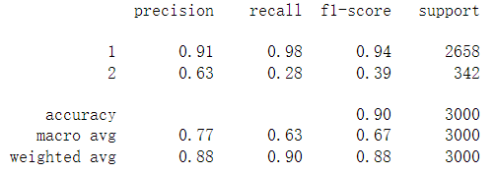
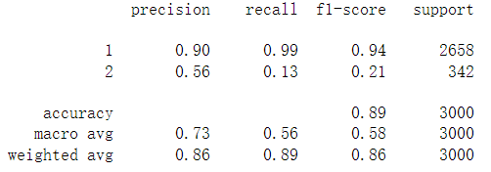
P A R T 0 3
Logistic Regression - No regularization - 1
Logistic Regression - No regularization - 2

Slide 6
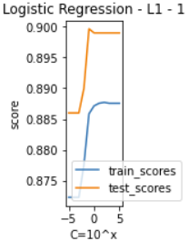
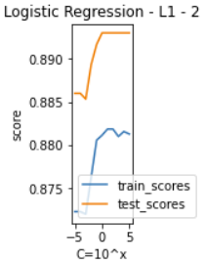
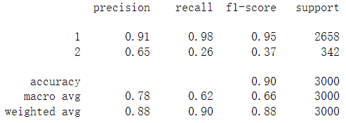
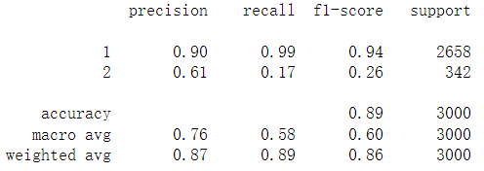
P A R T 0 3

Slide 7
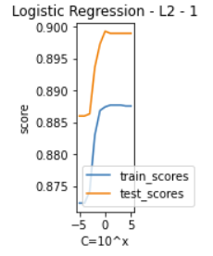
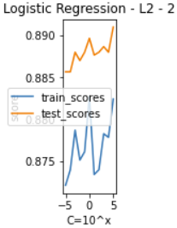
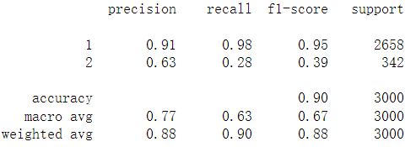
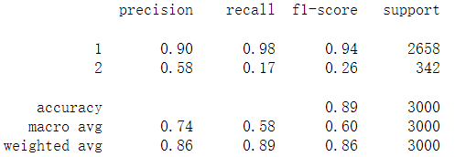
P A R T 0 3

Slide 8
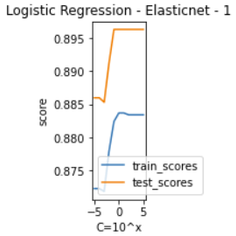
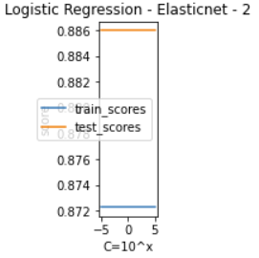
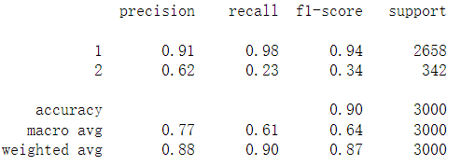
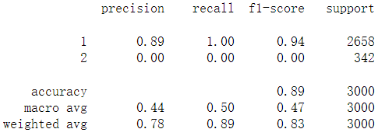
P A R T 0 3

Slide 9
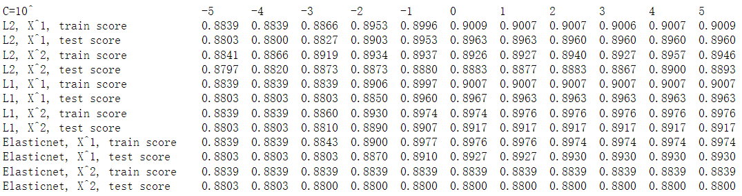
Logistic Regression
P A R T 0 3

Slide 10

Logistic Regression
P A R T 0 3
Best Logistic Regression Model for our Dataset:
No data transformation (Use X rather than X^2)
L2 Regularization
C = 1
=> Default Setting of sklearn LogisticRegression

Slide 11
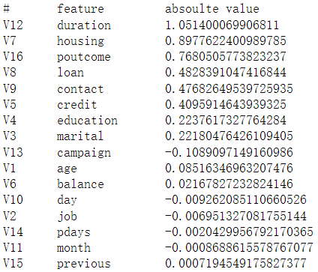

Logistic Regression
P A R T 0 3

Slide 12
SVM
P A R T 0 4
Linear Kernel
Different C
Best W
Polynomial Kernel
Different C
Best W
RBF Kernel
Different C
Best W
Sigmoid Kernel
Different C
Best W
Another Best best W

Slide 13
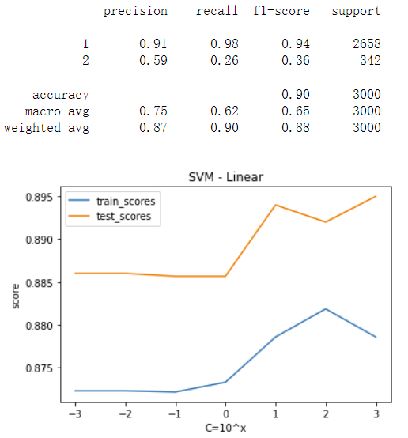
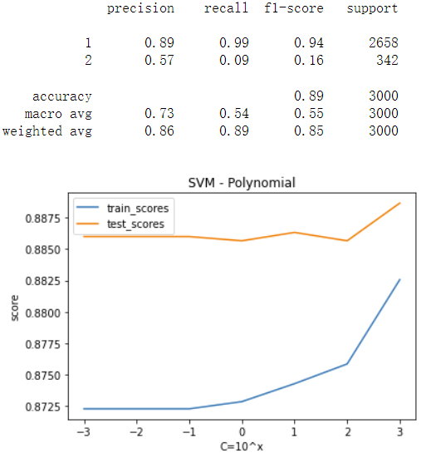
P A R T 0 4

Slide 14
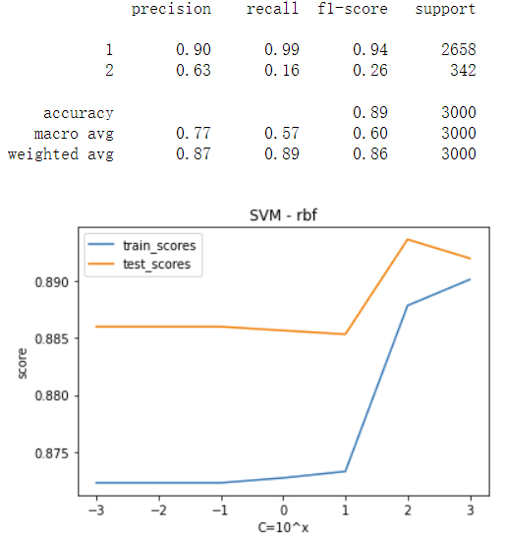
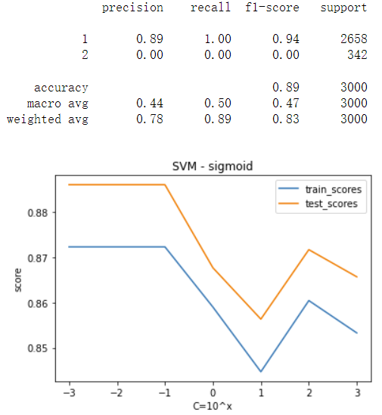
P A R T 0 4

Slide 15
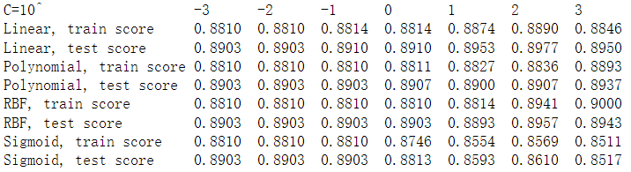
SVM
P A R T 0 4

Slide 16
SVM
P A R T 0 4
Best SVM Model for our Dataset:
Linear Kernel
Best C-value is different every time

Slide 17
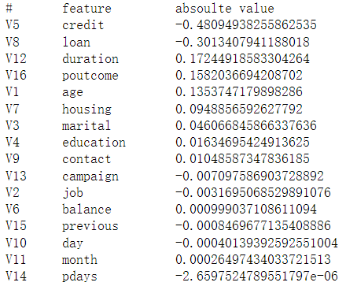

SVM
P A R T 0 4

Slide 18
Neural Network
P A R T 0 5
tanh
Best W
No hidden layer
logistic
Best W
relu
Best W
No Regularization
1 hidden layer(10)
3 Activations
Best W
2 hidden layer(10,5)
3 Activations
Best W
0-2 hidden layer
3 Activations
Different C
X
Best W
L2 Regularization
X^2
0-2 hidden layer
3 Activations
Different C
Best W
Another Best best W

Slide 19
Neural Network
P A R T 0 5
No regularization
 | Tanh | Logistic | Relu
No hidden layer | Train:0.949 Test:0.886 | Train:0.936 Test:0.885 | Train:0.914 Test:0.882
One hidden layer | Train:0.902 Test:0.886 | Train:0.898 Test:0.888 | Train:0.889 Test:0.889
Two hidden layer | Train:0.9 Test:0.879 | Train:0.896 Test:0.886 | Train:0.902 Test:0.886

Slide 20
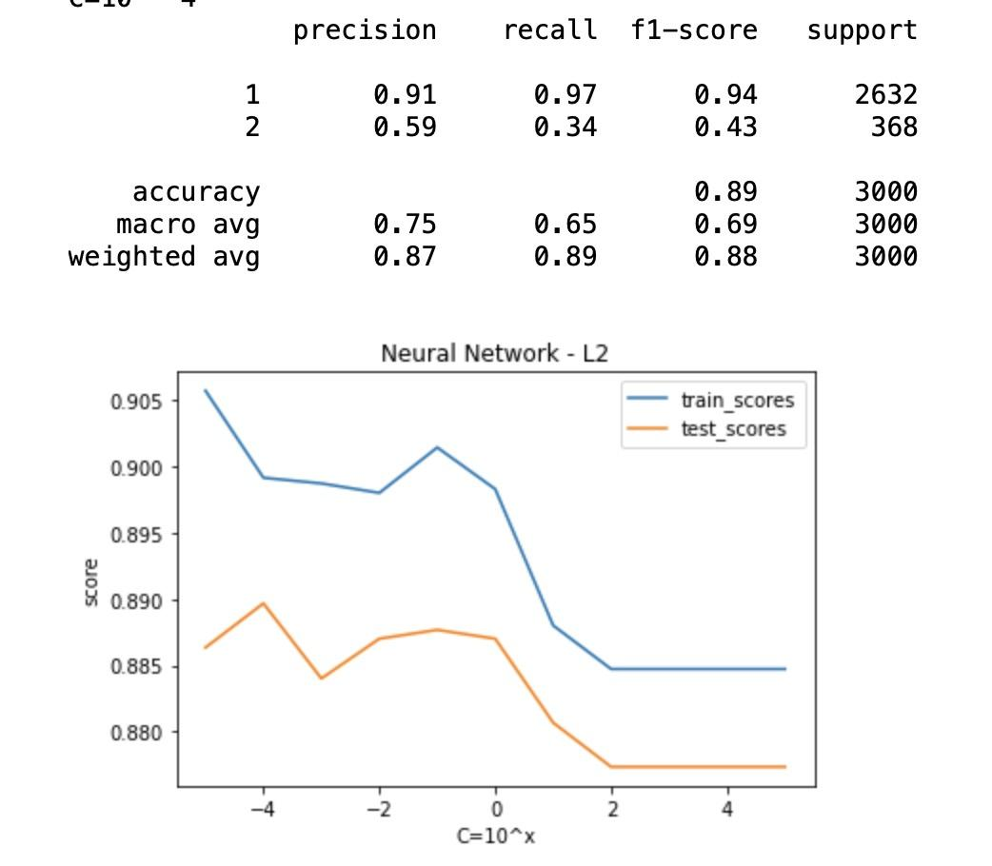
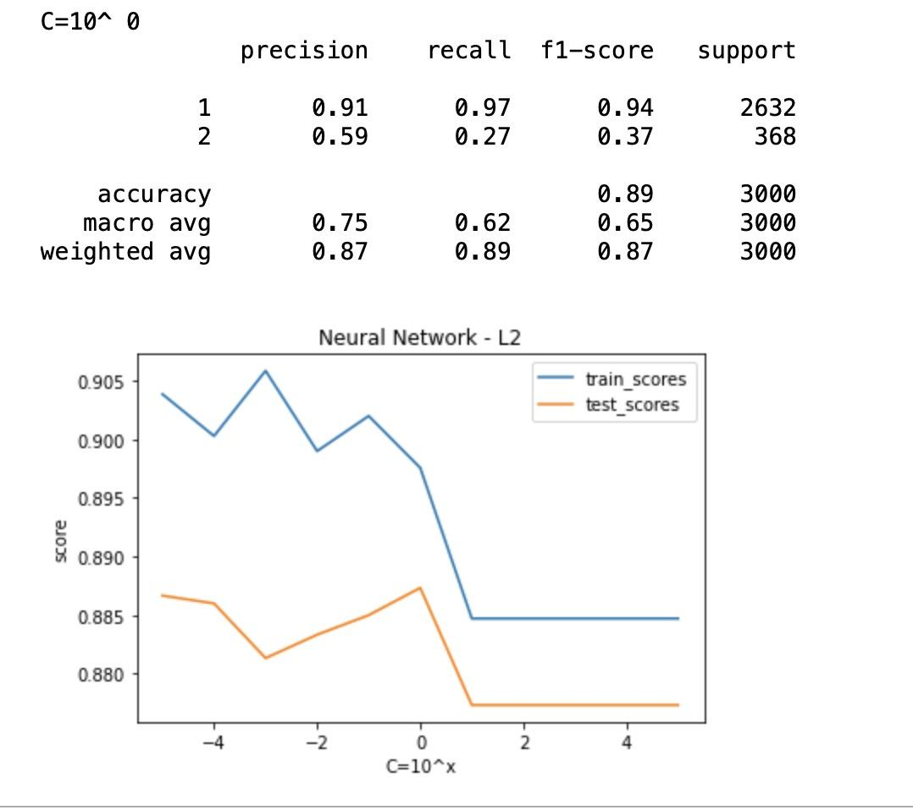
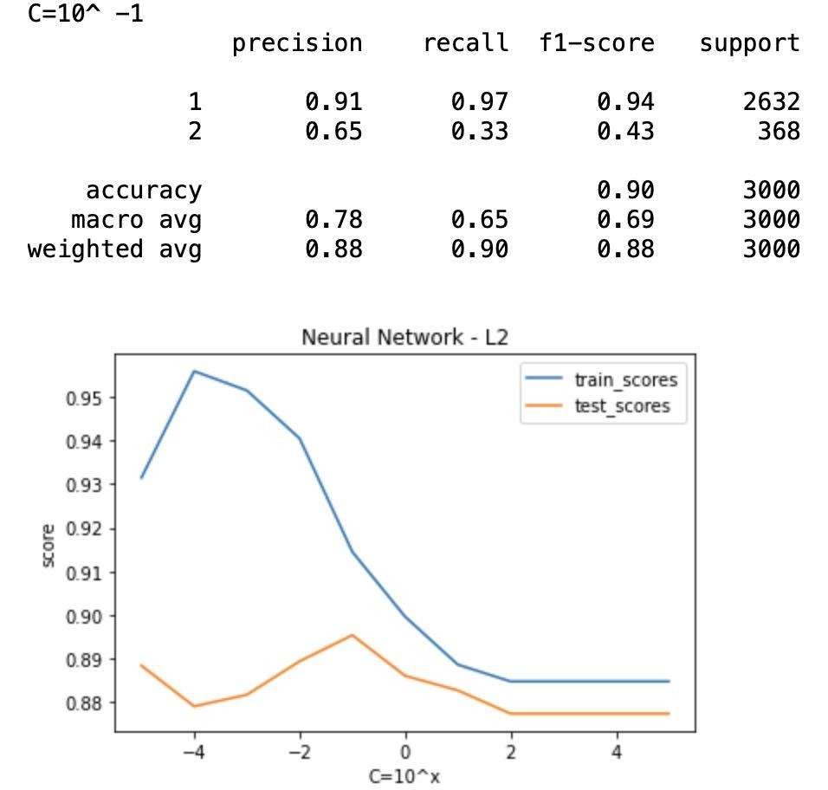
Neural Network
P A R T 0 5
L2 regularization
tanh
1 hidden layer
L2 regularization
tanh
2 hidden layer
L2 regularization
tanh
No hidden layer

Slide 21
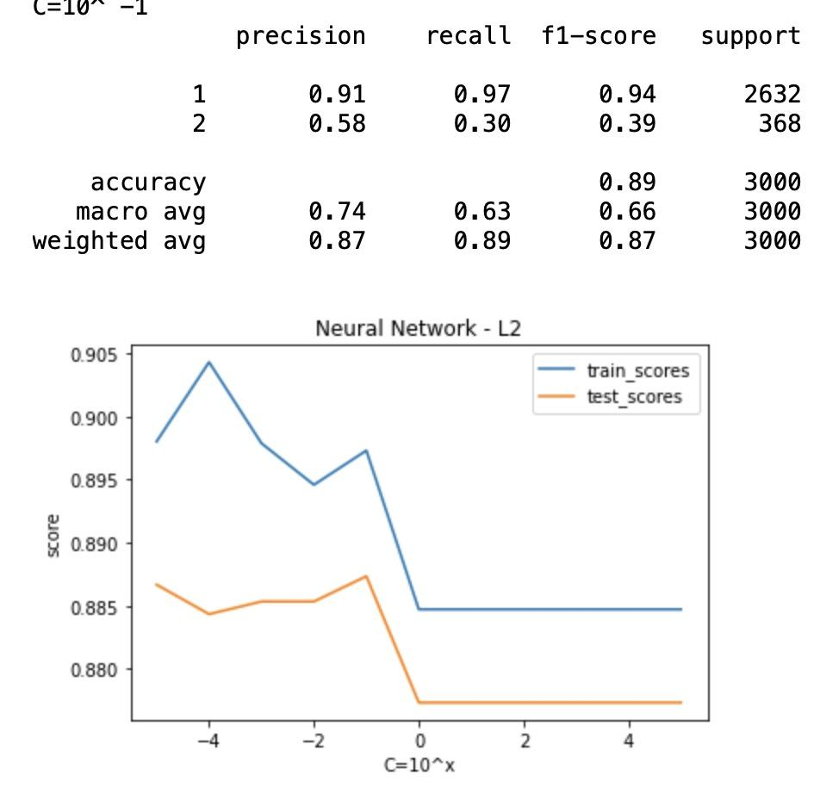
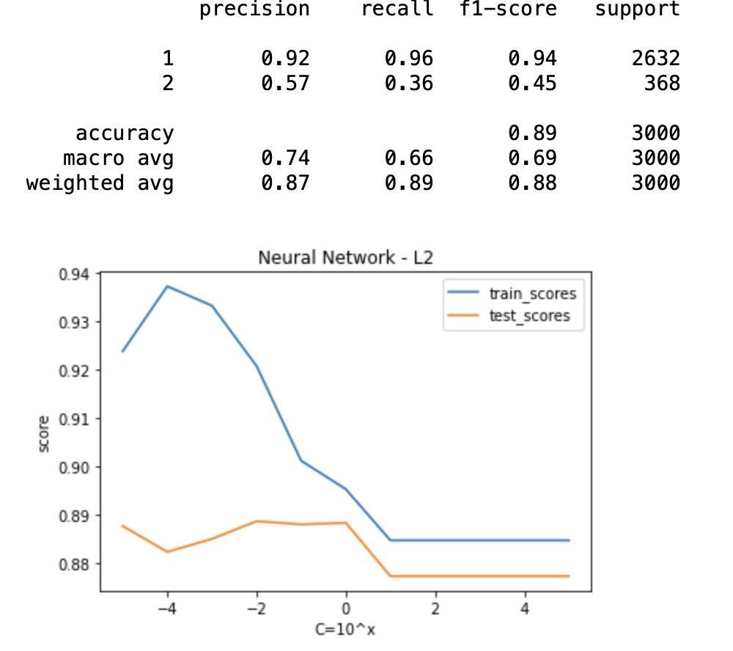
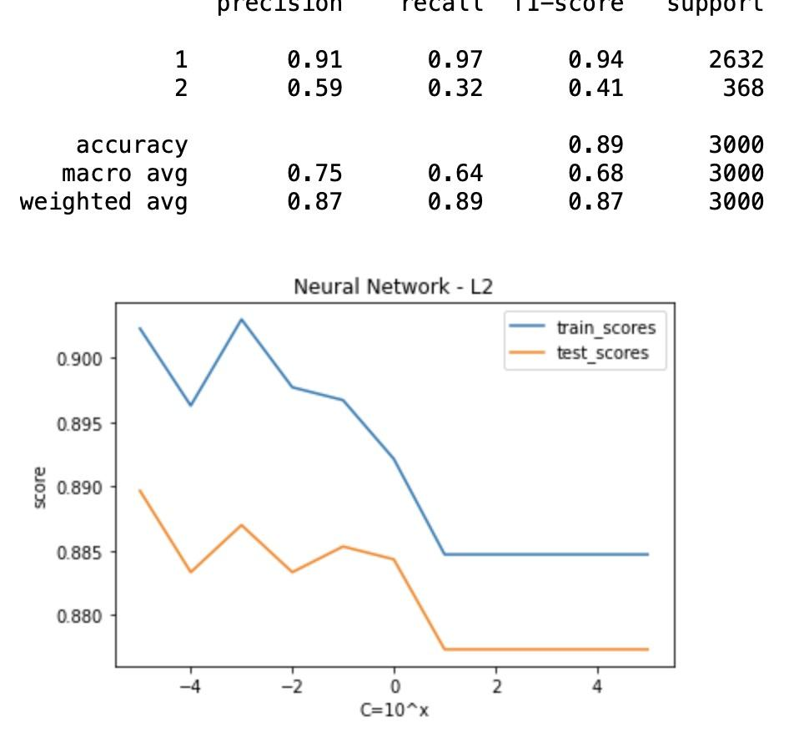
Neural Network
P A R T 0 5
L2 regularization
logistic
1 hidden layer
L2 regularization
logistic
2 hidden layer
L2 regularization
logistic
No hidden layer

Slide 22
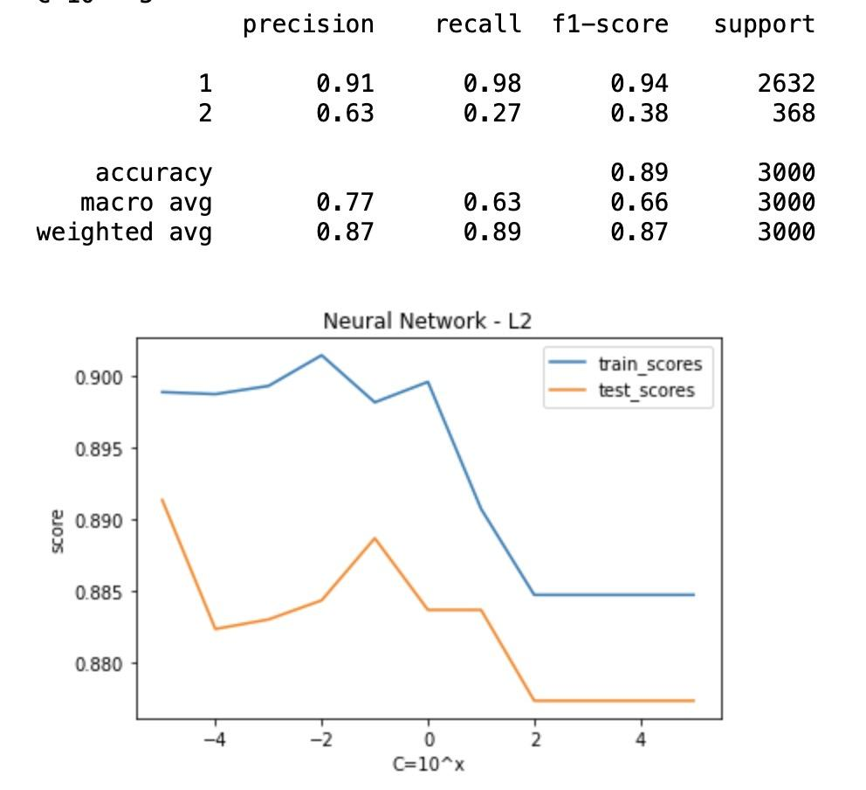
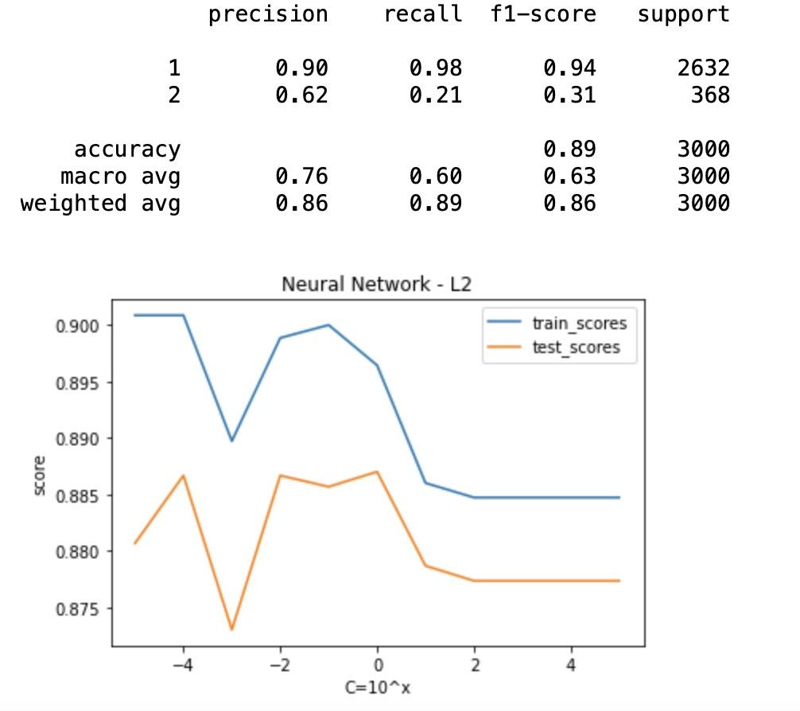
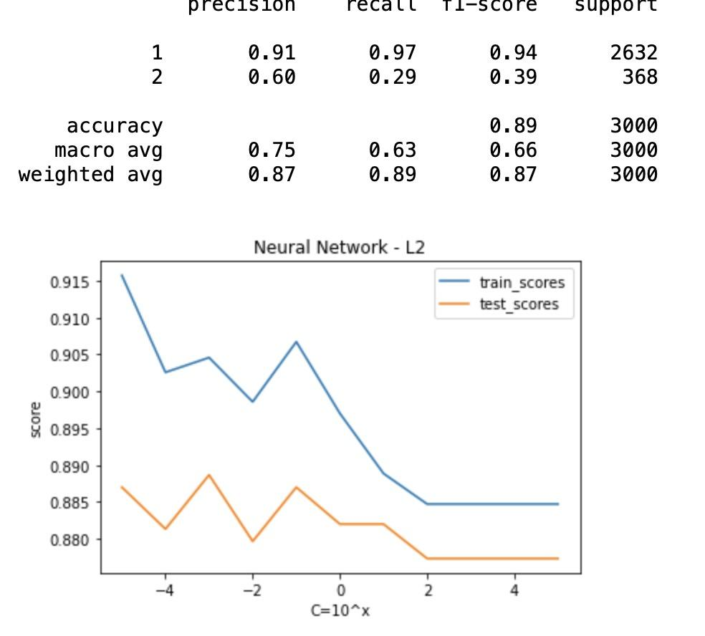
Neural Network
P A R T 0 5
L2 regularization
relu
1 hidden layer
L2 regularization
relu
2 hidden layer
L2 regularization
relu
No hidden layer

Slide 23
Neural Network
P A R T 0 5
Best Neural Network Model for our Dataset:
No hidden layer
L2 Regularization
Tanh activation function
C = 0.1

Slide 24
Conclusion
Logistic Regression
90.09%
89.63%
Neural Network
91.74%
89.03%
SVM
88.90%
89.77%
P A R T 0 4

Slide 25

Only 12% of clients
Bought the product
P A R T 0 6
Possible solution:
Train all the 54,211 samples

Slide 26

Works Cited
P A R T 0 1
Bank Marketing Dataset:
S. Moro, R. Laureano and P. Cortez. Using Data Mining for Bank Direct Marketing: An Application of the CRISP-DM Methodology. In P. Novais et al. (Eds.), Proceedings of the European Simulation and Modelling Conference - ESM'2011, pp. 117-121, Guimarães, Portugal, October, 2011. EUROSIS.
https://www.openml.org/search?type=data&status=active&sort=runs&id=1461
Sklearn Logistic Regression:
https://scikit-learn.org/stable/modules/generated/sklearn.linear_model.LogisticRegression.html
Logistic Regression in Python:
https://realpython.com/logistic-regression-python/
Sklearn SVM:
https://scikit-learn.org/stable/modules/generated/sklearn.svm.SVC.html
Neuron Networks in Python:
https://www.pluralsight.com/guides/machine-learning-neural-networks-scikit-learn

