Slide 1
Authentication
Azure AD
Passport JS,
OAuth
React JS UI
REST API
Server side / API
Cognito
Application need to authenticate to Azure AD and Cognito. There should be a login page with two options to login – Azure AD and Cognito. After login application should display user details with logout option(Refer screen layout in the next page)
We should use passport js OAuth2 http://www.passportjs.org/docs/oauth2-api/ (Do not use any passport js built in provider as we need generic OAuth2)
Start react project from scratch – do not use any unnecessary js import, need clean project with plain react js, no other external libraries
Use OAuth2 authentication code flow mentioned here https://docs.microsoft.com/en-us/azure/active-directory/develop/v2-oauth2-auth-code-flow (do not use MS authentication library - msal.js)
After short period of time token refresh, so should be able to handle that (it is explained in Protocol diagram in Azure AD authentication flow diagram on the link above)
For Cognito refer here - https://docs.aws.amazon.com/cognito/latest/developerguide/authorization-endpoint.html
** Arun will give the details of Azure AD and Cognito details (I think Cognito you already have as it is used for training APP, use the same credentials)

Slide 2
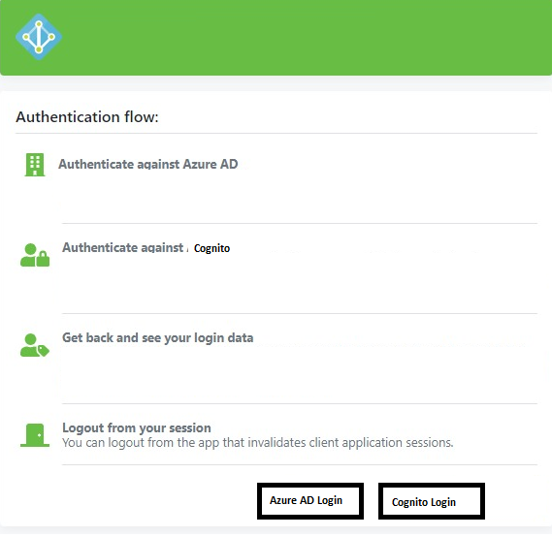
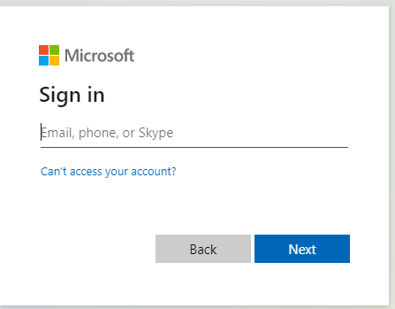
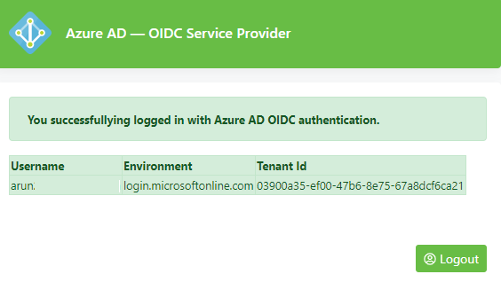
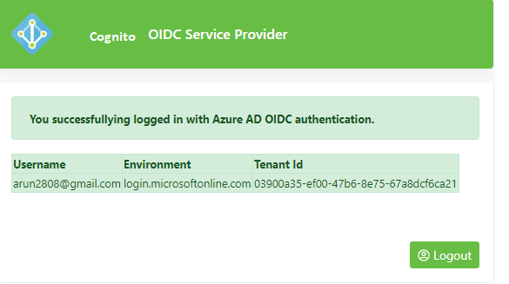
SGD 250
Milestone1 $ 50 : Agree design of the application - (agree on framework, how flow is designed, identify requirements)
Milestone2 $ 75 : Azure AD integration
Milestone3 $ 75 : Cognito integration
Milestone4 $ 50 : Documentation

