Slide 1
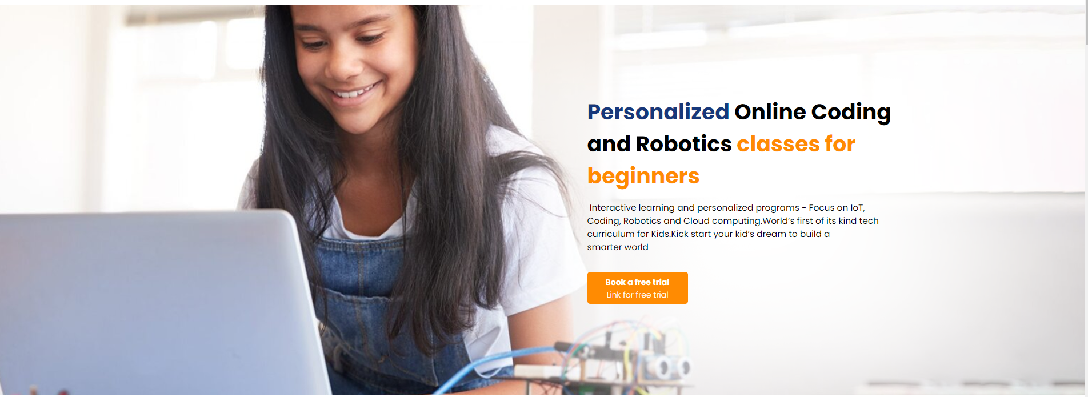
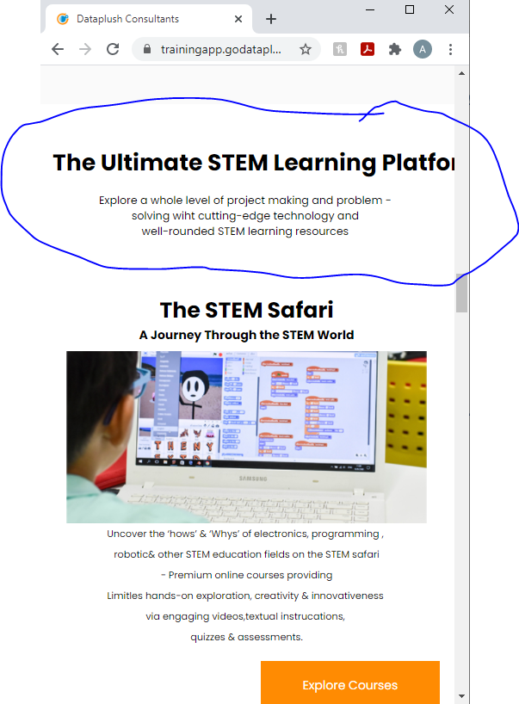
1) Add the image of the girl back and make mobile layout to make consistent with web layout
2) Section not displaying properly

Slide 2
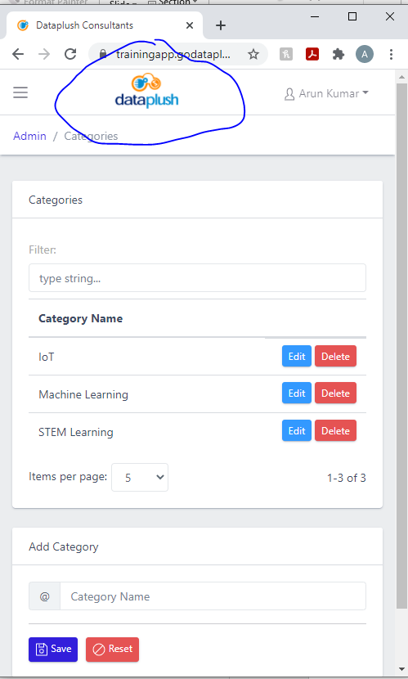

3) Show Home button to navigate to home page for mobile display, currently dataplush image overlaps home icon for mobile display
4) There is a bug in file upload for courses if we upload file in any other format other than pdf, while downloading it doesn't work, it is renamed to pdf. Uploaded files with other formats than PDF should be downloadable in the same format, for example uploaded word document
5) Labs links not working, it is pointing to localhost

Slide 3






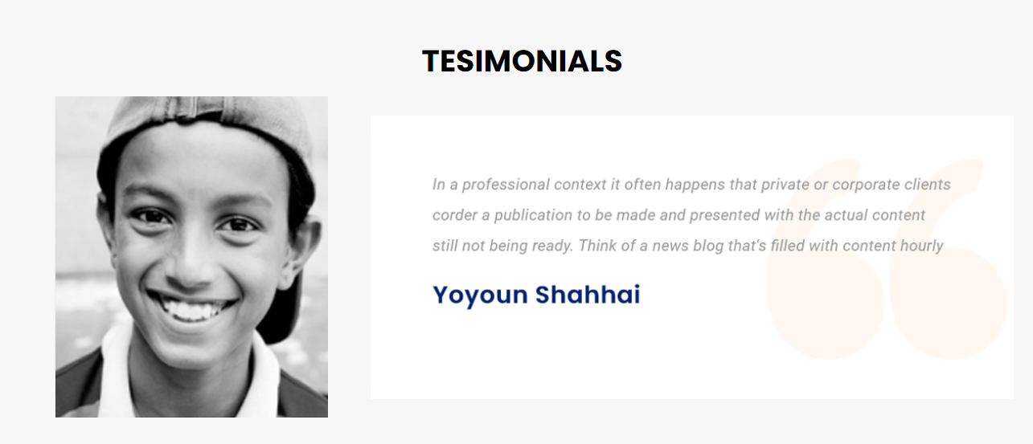
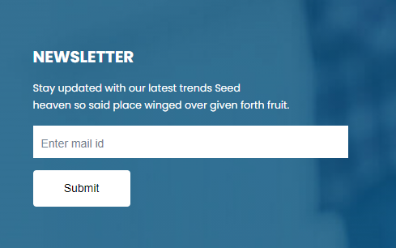
6) Contents are overlapping with links for some sections in web layout. Remove below links from homepage for both web/mobile layouts
7) Remove the sections from home page

