Slide 1
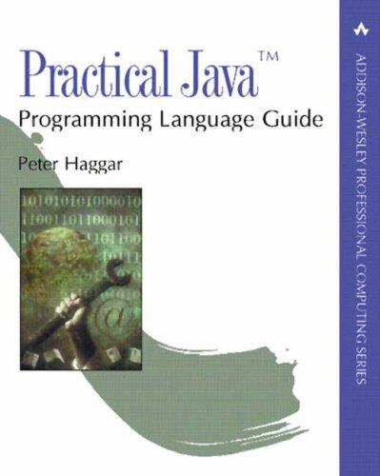

Practical Java
主題式的編排方式
General Techniques
Objects and Equality
Exception Handling
Multithreading
..…
目標產出更正確、高效率且穩定的Java程式
適合我們中高階的Programmer(至少沒有hello world)

Slide 2
Employee
doEmployee
18
0x5678
0x5678
e
0x1234
Red
+name: String
+empId: String
v
100
54321
main
0x1234
17
kevin
0x1234
kevin
KevinFang
+toString(): String
12345
v
10
Stack
Heap

