Slide 1
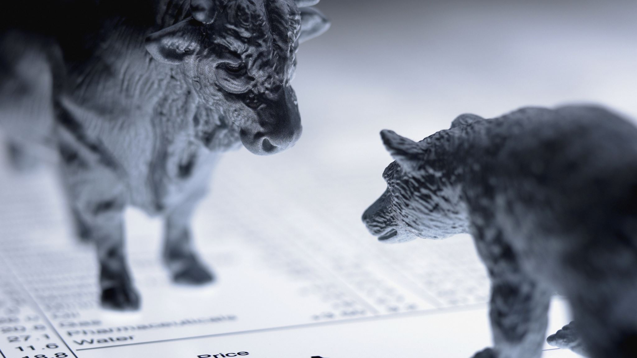
Vide Q&A
By Felix and Kevin

Slide 2
Contents
Motivation
Data
Acquisition
Pre-processing
Models
Retrievers
Program-generator
Website
Technical Details
Interface and UX
Outlook

Slide 3
Motivation
What problem are we solving?
Annual reports are filled with information, but long and tedious to retrieve them
Market is flooded with wrong and subjective information
high entry barrier for potential investors
What do we offer?
A comprehensive tool to ask questions and receive answers
minimize the effort and maximize the amount of information gained
Target group is defined as
stock market investors
potential stock market investors
other stakeholders (interested parties, other companies, beginners)

Slide 4
Data - Acquisition
API-request from official SEC-website
A report consists of >50 tables and around 100 pages
Data is retrieved in a html-format
Goal
Transform the tables into raw text
Extract the normal text
Combine both contents
Annual reports for Coca Cola, Amazon and Ebay are stored in the system

Slide 5
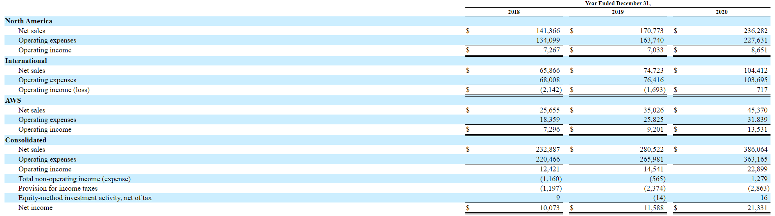
Data - Pre-processing
(Amazon, 2021)

Slide 6
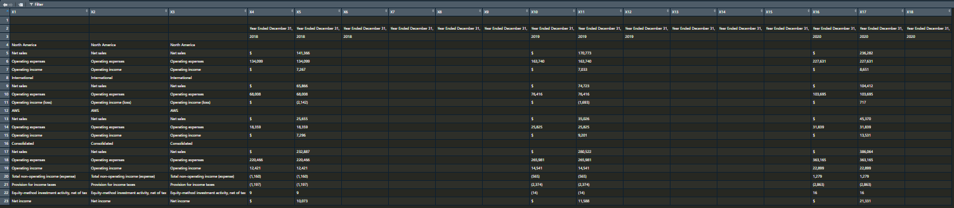
Data - Pre-processing

Slide 7
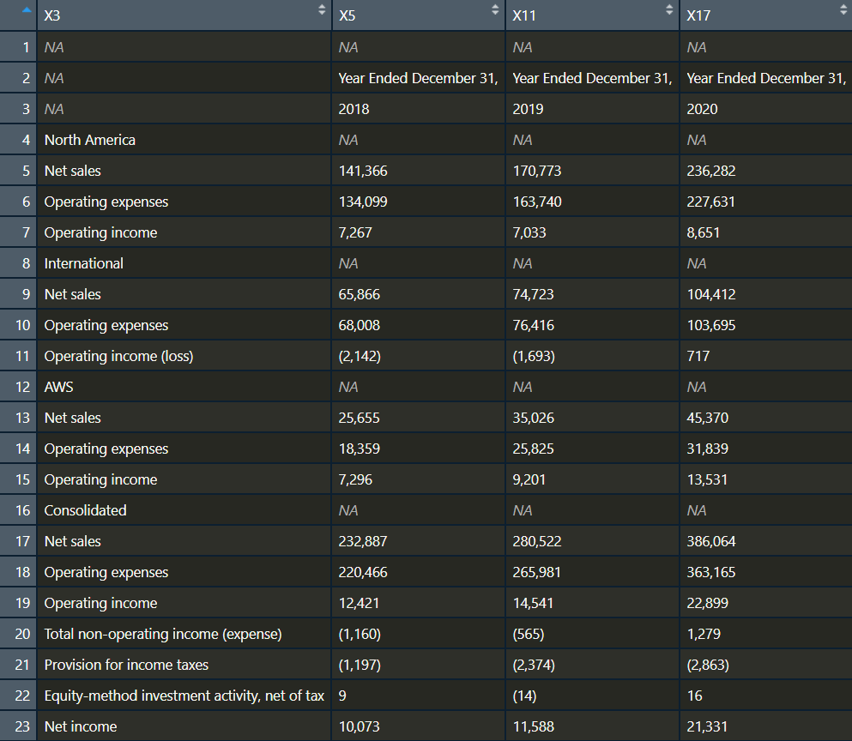
Data - Pre-processing
Each cell value is transformed into one sentence
Each sentence contains informations from the header-row, the sub-header and first value in each row
“In North America the Net sales of 2018 is 141,366 .”

Slide 8
Data - Pre-processing
Problem
not standardized table design
the data is not organised in a tidy way
some information gets lost
“in million”
side notes beneath the table (and some more)
The normal text data is then combined with the retrieved table data

Slide 9
Models - Retrievers
Pre-retriever:
Small model
All-MiniLM-L6-v2
Rough selection of relevant information
Computes cosine-similarities between question and each sentence

Slide 10
Models - Retrievers
Retriever:
Bigger model
BERT-base uncased
Slower, but more precise
Classifies sentences (relevant or not for the question)

Slide 11
Models - Generator
BERT-Base uncased
Trained to predict probabilities for tokens and generates a program-sequence
Predicts computation to get result
Conversion to result

Slide 12
Models
Retriever and Generator trained on FinQA-dataset
Financial Question and Answering Dataset
Cherry-picked examples in small setting
Large-scale implementation monumental task
Specific question for training

Slide 13
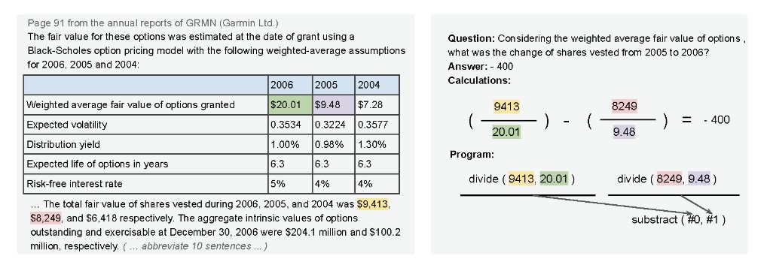
Models
Chen et al. (2022)

Slide 14
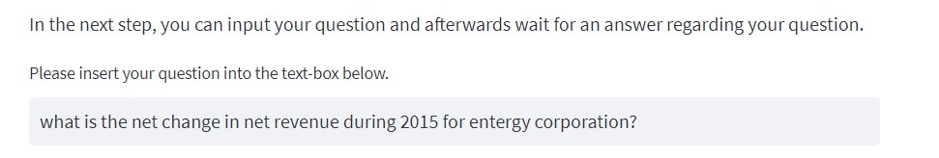
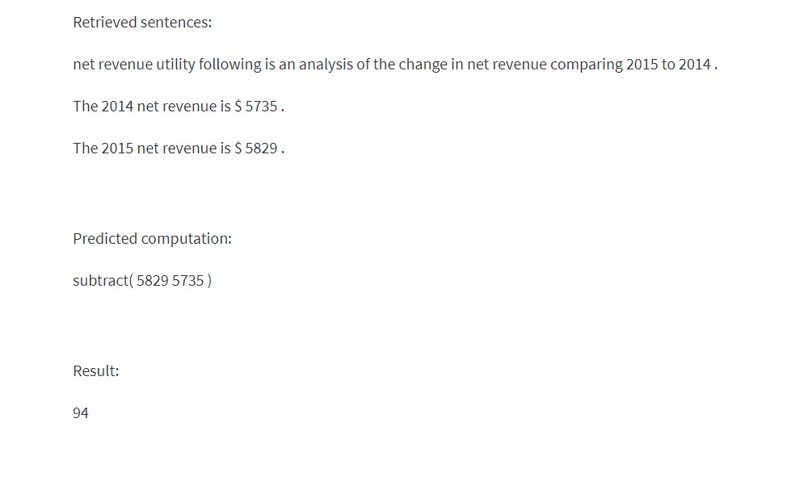
Models

Slide 15
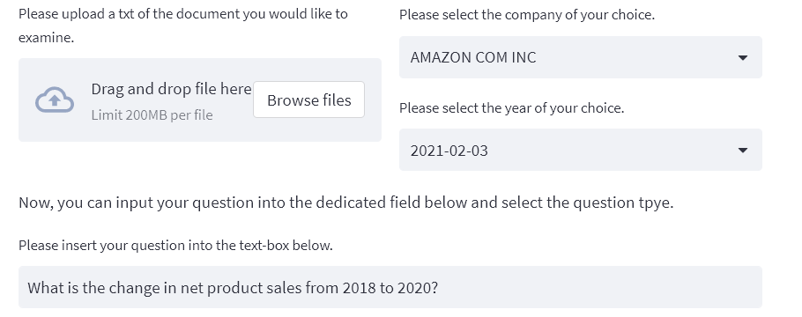
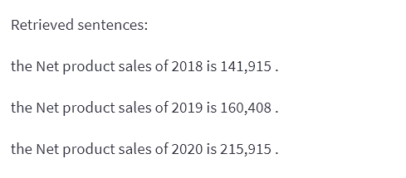
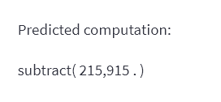
Models

Slide 16
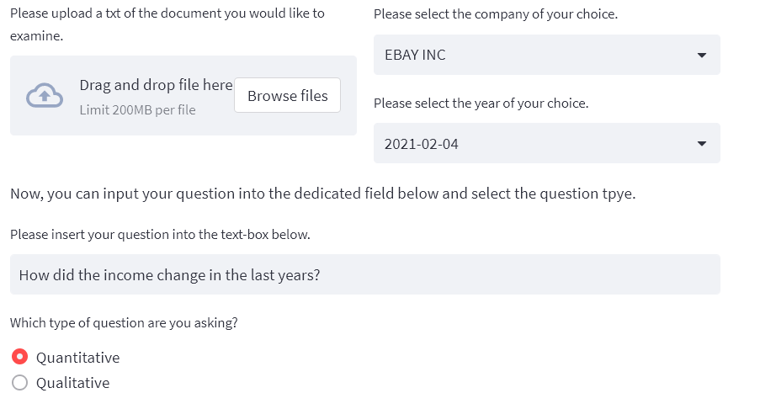
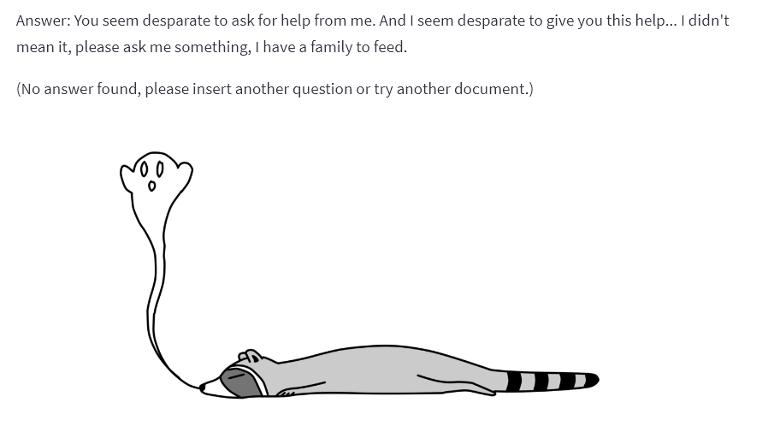
Models

Slide 17
Models

Slide 18
Website – Technical Details
hosted on bwCloud
web application is build with the service “Streamlit”
8 GB of RAM and 4 virtual CPU’s allocated to the server
website accessible here: 193.196.55.25:8501 or http://www.vide-qa.de/
computation time is around 2.5 minutes
during the model computation, the peek RAM usage is around 3.5 GB

Slide 19
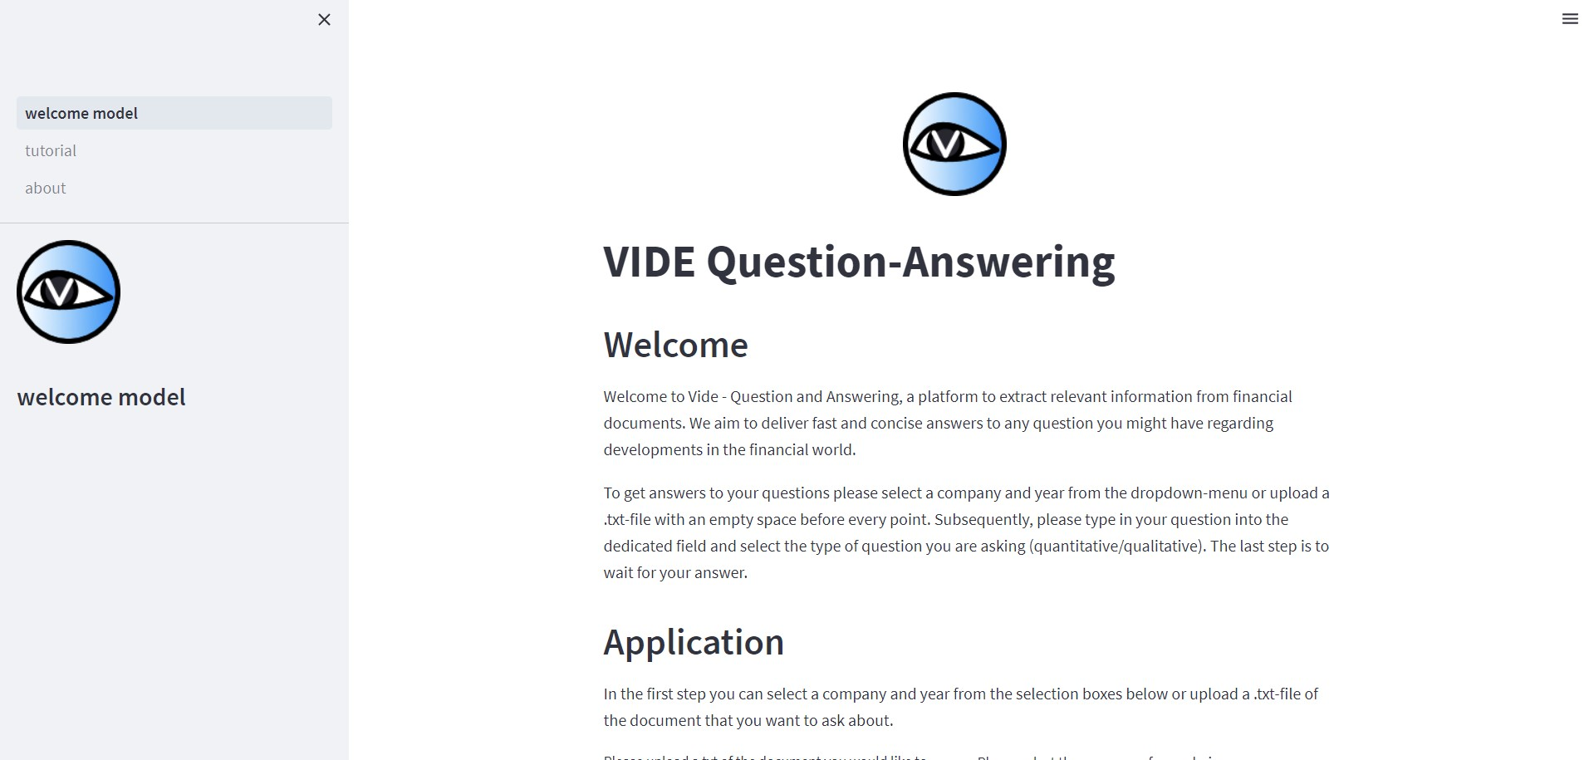
Website – Interface and UX
Main-page with the model
Explanations of how to use the app within the input-steps

Slide 20
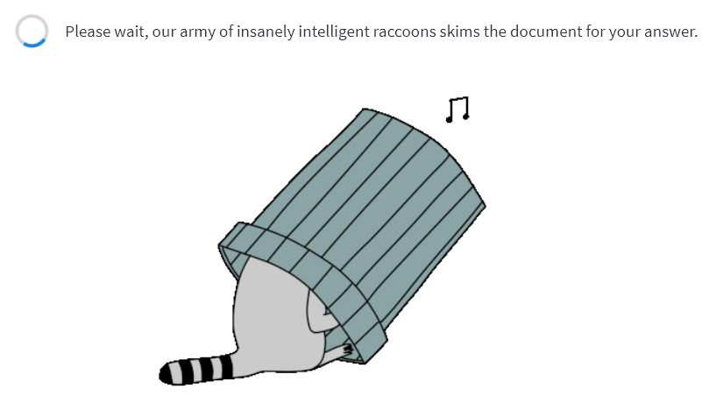

Website – Interface and UX
Waiting-animation and notification sound

Slide 21
Website – Interface and UX
If question does not match document

Slide 22
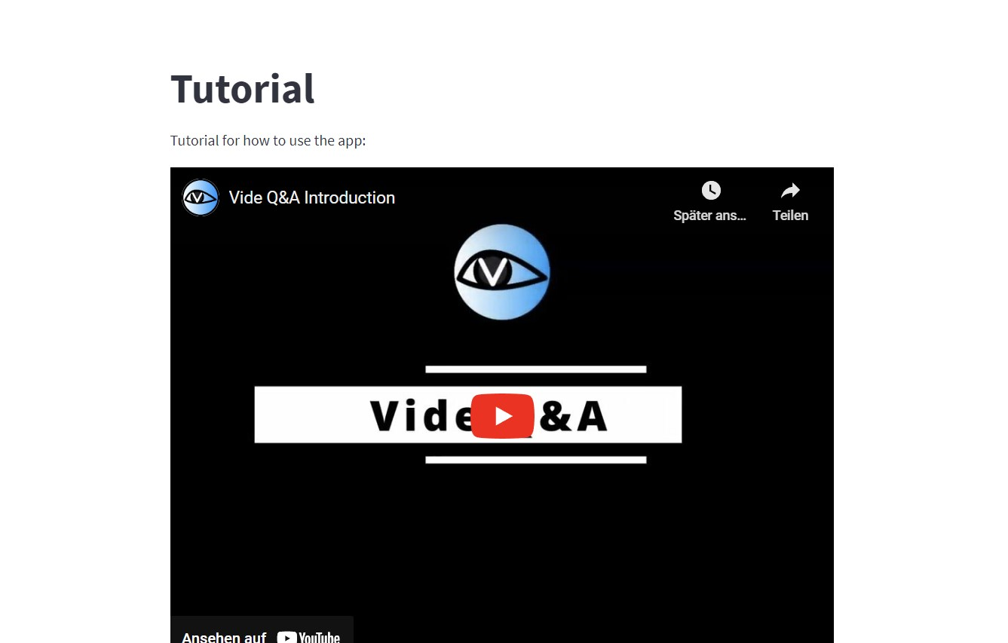
Website – Interface and UX
Tutorial-page with our explanatory video and sample questions

Slide 23
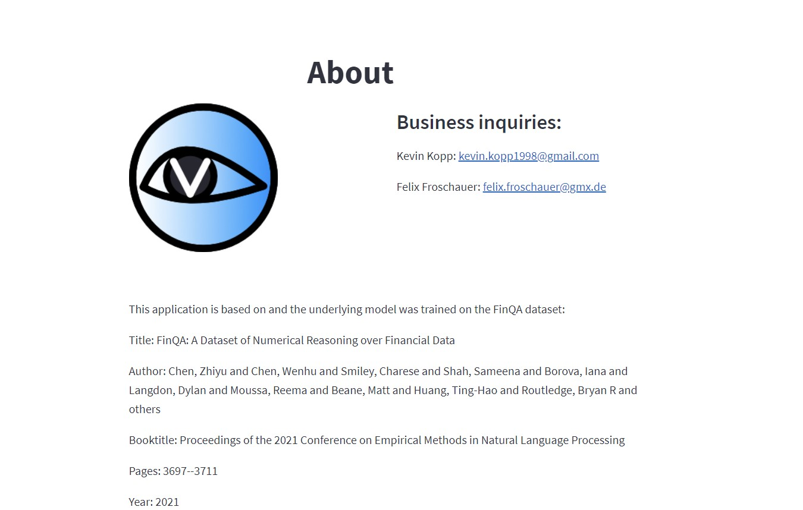
Website – Interface and UX
About page with contacts and credits

Slide 24
Website – Interface and UX
Main-page with the model
Explanations of how to use the app within the input-steps
Waiting-animation and notification sound
Tutorial-page with our explanatory video and sample questions
About page with contacts and credits

Slide 25
Outlook
Combining the quantitative and qualitative model to one
Maybe train retriever on outputs of pre-retriever
Maybe increase model size for better results
Recording- and translation-function
Multiple languages

Slide 26
Sources
FinQA
Title: FinQA: A Dataset of Numerical Reasoning over Financial Data
Author: Chen, Zhiyu and Chen, Wenhu and Smiley, Charese and Shah, Sameena and Borova, Iana and Langdon, Dylan and Moussa, Reema and Beane, Matt and Huang, Ting-Hao and Routledge, Bryan R and others
Booktitle: Proceedings of the 2021 Conference on Empirical Methods in Natural Language Processing
Pages: 3697--3711
Year: 2021
All-MiniLM-L6-v2
https://huggingface.co/sentence-transformers/all-MiniLM-L6-v2

