Slide 1


Lecturer: Prof. Zainab Usman
Business Intelligence Presentation
LEO RISK ETL Project
Cheng-Yi Lin 林正翌
2026

Slide 2




ETL & BI Architecture
U.S. Space-Track API
(7-day Orbital Snapshots)
https://www.space-track.org/auth/login
One-Time Cold History Bootstrap
PostgreSQL
Data Warehouse
Power BI Dashboard
German GFZ Api
(30-Day Space Weather)
https://www.gfz.de/
Automated Daily Workflow
(Apache Airflow)
Star Schema Design

Slide 3
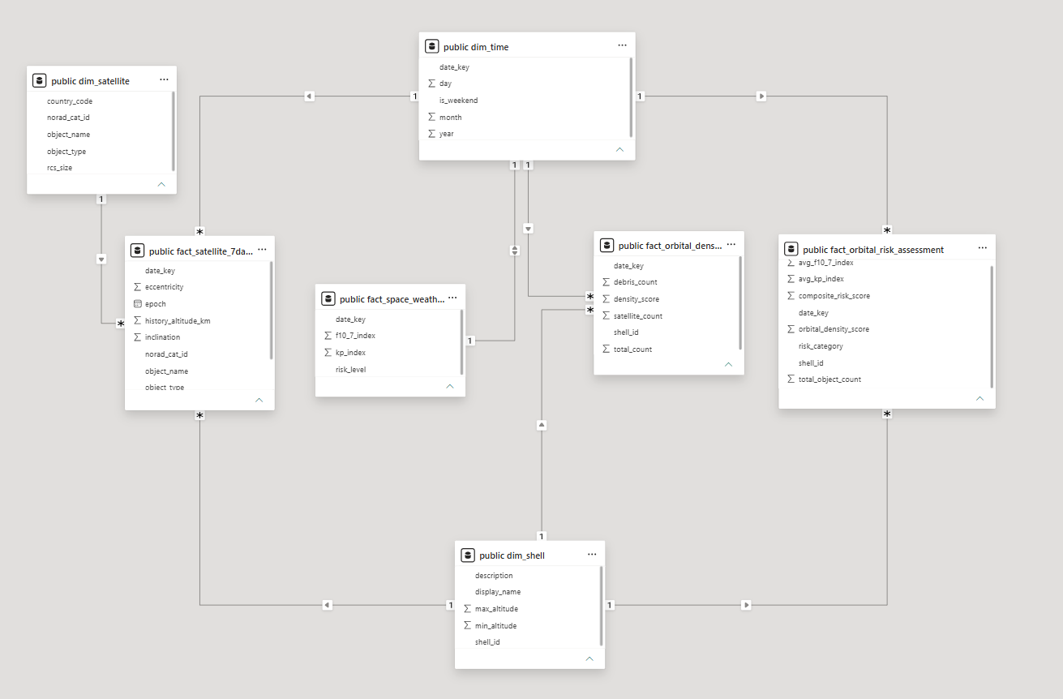
Database Structure
Dimension Tabel:
dim_time
dim_satellite
dim_shell
Fact Tabel:
fact_space_weather
fact_orbital_density
fact_satellite_7days_history
fact_orbital_risk_assessment

Slide 4
Challenges & Solutions
Production Obstacles (Challenges) | Engineering Remedies (Solutions)
Docker Network Isolation: Containers failing to communicate via localhost (DNS resolution breakdown). | Docker Internal Routing: Hardcoded strict network aliasing (postgres) to utilize Docker’s native DNS mesh network.
Upstream API Rate Limiting: Multi-day historical backfills getting blocked or throttled by Space-Track.org servers. | Time-Window Pooling & Retry: Implemented a 1-second interval cooldown buffer and Airflow retries=2 delay loops.
API Key/Schema Mismatch: Pandas crashing with KeyError due to inconsistent uppercase/lowercase API field updates. | Defensive Column Normalization: Programmed an upstream structural sanitization line (df.columns.str.upper()) upon raw load.

Slide 5


Github link:
https://github.com/kevin19cool/BI_project_leo_risk_analysis
Links
API Page:
Space-Track: https://www.space-track.org/documentation#/api
GFZ (Helmholtz-Zentrum für Geoforschung): https://kp.gfz.de/en/data

