Slide 1
NLP Project 1
Team 10 | Hotel? Trivago!
B03902101 楊力權 b03902101@ntu.edu.tw
R05922038 黃郁庭 r05922038@ntu.edu.tw
B03902086 李鈺昇 b03902086@ntu.edu.tw

Slide 2
Outline
Our best method on Kaggle
Other methods

Slide 3
Outline
Our best method on Kaggle
Other methods

Slide 4
Aspect Extraction
Why aspect extraction?

Slide 5
Train word2vector model
polarity_review.txt
aspect_review.txt
test_review.txt

Slide 6
Similarity threshold
5 aspects need their own unique threshold, here are two ways below:
Every threshold can be decided by calculate the average similarity of a whole sentence which contains the aspect in aspect_review.txt
Every threshold can be decided by calculate the best aspect accuracy of aspect in aspect_review.txt

Slide 7
Test
Cut a sentence in phrases
Use the word2vec model to check the word’s similarity with 5 aspects [服務、環境、價格、交通、餐廳]
If a word’s (or the whole sentence’s average) similarity is bigger than the aspect’s threshold, we can assume that the sentence contains the aspect.

Slide 8
Convolutional Neural Networks
一個model預測一種aspect的positive or negative (共5個model )
label：
1 : positive
-1 : negative
0 : unknown/none
data：
將review中的每個word的vector串接起來 (斷詞、remove stop words)
限定每個review最多只能串接300個word (不足補0、超過不計)
EX.假設每個word的vector大小為1*150，則data的大小為300*150

Slide 9
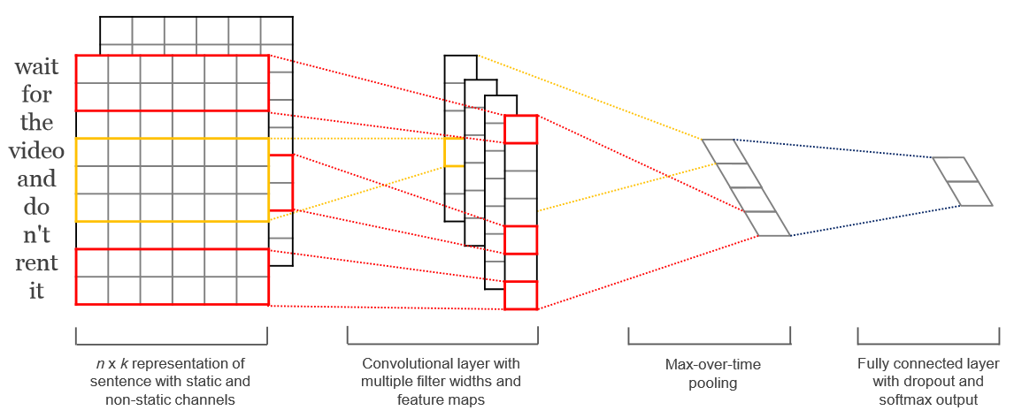
Convolutional Neural Networks (cont.)
Convolutional Neural Networks for Sentence Classiﬁcation, Yoon Kim
https://arxiv.org/abs/1408.5882

Slide 10
Convolutional Neural Networks (cont.)
training set：需要先預測polarity_review.txt的aspect (258,003)
validation set：Aspect_review.txt (200)
val_acc與Kaggle的public/private score差不多
通常val_acc表現較好的model會出現在前5個epoch中

Slide 11
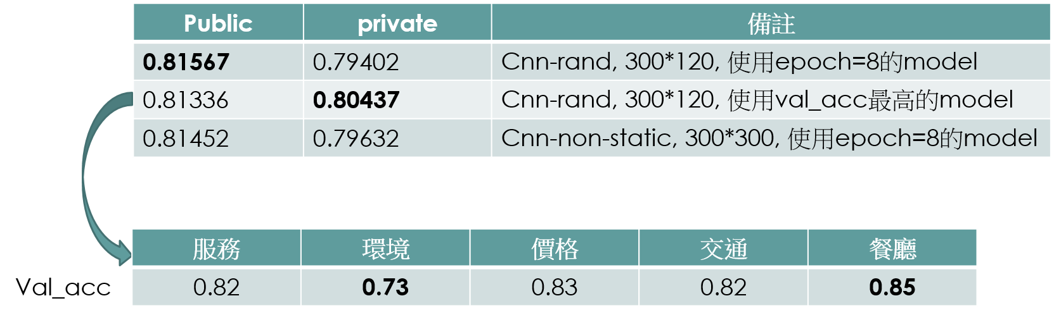
Convolutional Neural Networks (cont.)

Slide 12
Outline
Our best method on Kaggle
Other methods

Slide 13
Other methods - 1
前處理
斷詞：jieba
Remove stop words：移除掉部分詞性(coreNLP)
SP、BA、DER、DEV、DEC、DEG、MSP、ETC、DT、SB、 LB、LC、PU、URL、PN、CC、M、CD、P、AS、X、NT
找test_aspect.txt的aspect
Word2vec：每個review選出與5個aspect最相似的word，再自訂threshold篩選
預測test_aspect.txt的polarity
Linear Support Vector Classification：用polarity_review.txt訓練出來的模型去預測
Public：0.73848/ Private：0.70081

Slide 14
Other methods - 2
For each review R in polarity_review.txt, find the most similar review R’ in aspect_review.txt, and assign some of the aspects of R’ to R.
Similarity: cosine similarity between the averages of word vectors in the reviews
The most likely aspect by aspect term, or all the aspects with the same polarity
Use classifiers to make predictions given a review R and aspect A:
Input: [averages of word vectors in R] concatenated with [one hot encoding of A]
Output: {-1, 0, +1}
KNeighborsClassifier (0.724) and RandomForestClassifier (0.71) perform the best on polarity_review.txt as validation set, but both perform poorly on Kaggle public leaderboard.

