Slide 1
Firmalice - Automatic Detection of Authentication Bypass Vulnerabilities in Binary Firmware,
NDSS’15

Slide 2
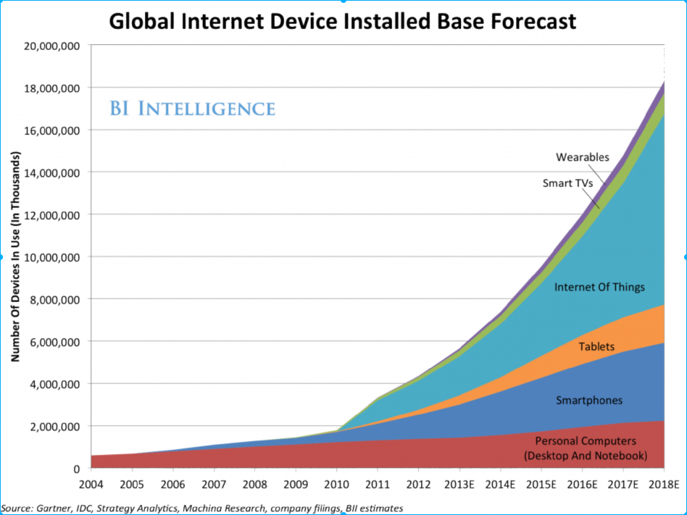
Background: The “Internet of Things”

Slide 3
Background: Emergence of Backdoors
Santamarta, Ruben. "HERE BE BACKDOORS: A Journey Into The
Secrets Of Industrial Firmware." Black Hat USA (2012).Heffner, Craig. "Reverse Engineering a D-Link Backdoor" /dev/ttys0 (2013).
Vanderbeken, Eloi. "TCP/32764 backdoor, or how linksys saved Christmas!" GitHub (2013).
Heffner, Craig. "Finding and Reversing Backdoors in Consumer Firmware." EELive! (2014).

Slide 4
DEMO: fauxware
int authenticate(char *username, char *password)
{
char stored_pw[9];
stored_pw[8] = 0;
int pwfile;
// evil back d00r
if (strcmp(password, sneaky) == 0) return 1;
pwfile = open(username, O_RDONLY);
read(pwfile, stored_pw, 8);
if (strcmp(password, stored_pw) == 0) return 1;
return 0;
}

Slide 5
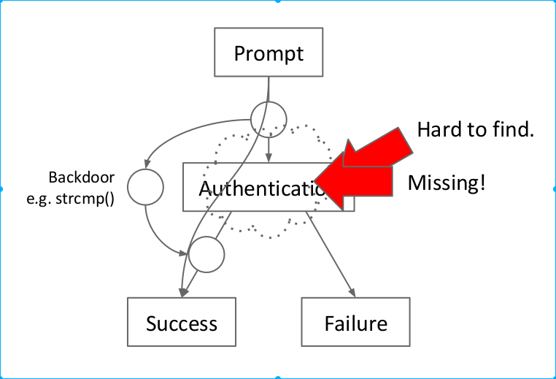

Slide 6
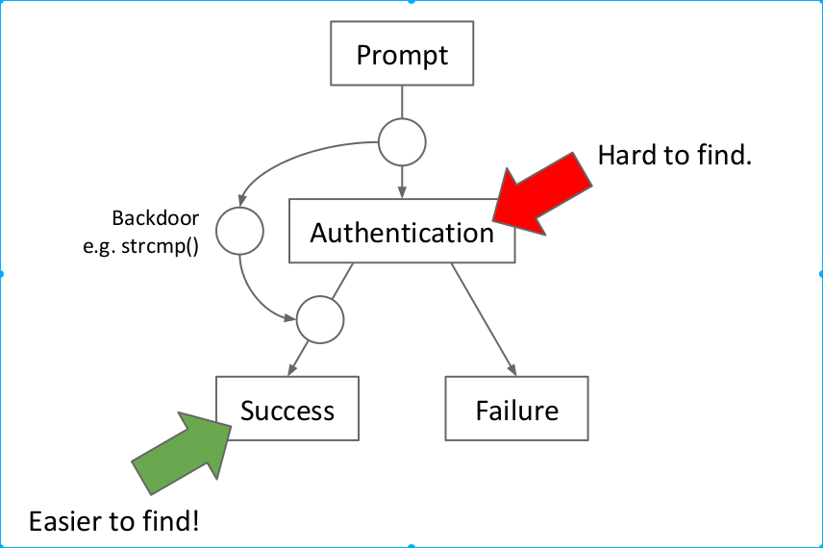
Solution: Input Determinism

Slide 7
“
Input Determinism

Slide 8
Solution: Input Determinism

Slide 9
“
Symbolic Execution

Slide 10
Symbolic Execution
"How do I trigger path X or condition Y?"
Interpret the application.
read(0, x, 4)
Track "constraints" on variables.
if (x < 100 && x >= 10)
When the required condition is triggered, "concretize" to obtain a possible input.

Slide 11
x = int(input())
if x >= 10:
if x < 100:
print "Two!"
else:
print "Lots!"
else:
print "One!"
State A
Variables x = ???
Constraints ------

Slide 12
x = int(input())
if x >= 10:
if x < 100:
print "Two!"
else:
print "Lots!"
else:
print "One!"
State A
Variables x = ???
Constraints ------
State AA
Variables x = ???
Constraints x < 10
State AB
Variables x = ???
Constraints x >= 10

Slide 13
x = int(input())
if x >= 10:
if x < 100:
print "Two!"
else:
print "Lots!"
else:
print "One!"
State AA
Variables x = ???
Constraints x < 10
State AB
Variables x = ???
Constraints x >= 10

Slide 14
x = int(input())
if x >= 10:
if x < 100:
print "Two!"
else:
print "Lots!"
else:
print "One!"
State AA
Variables x = ???
Constraints x < 10
State AB
Variables x = ???
Constraints x >= 10
State ABA
Variables x = ???
Constraints x >= 10 x < 100
State ABB
Variables x = ???
Constraints x >= 10 x >= 100

Slide 15
x = int(input())
if x >= 10:
if x < 100:
print "Two!"
else:
print "Lots!"
else:
print "One!"
State ABA
Variables x = ???
Constraints x >= 10 x < 100
Concretized ABA
Variables x = 99

Slide 16
Symbolic Execution
Constraint solving:
Conversion from set of constraints to set of concrete values that satisfy them.
NP-complete, in general.
Constraints
x >= 10 x < 100
x = 42

Slide 17
Firmalice: Input and Chanllenge
Input:
Firmware sample
Challenge:
Large binary programs
Unrelated user input

Slide 18
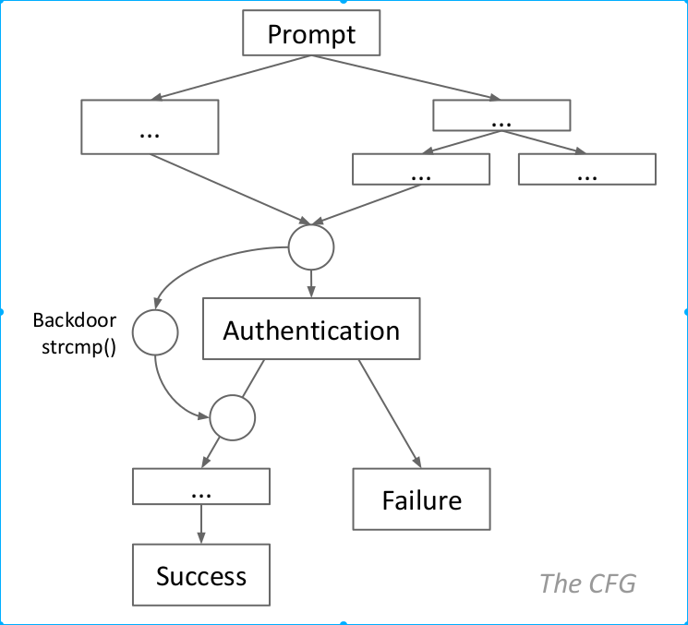

Slide 19
Firmalice: Analysis Steps
Static Analysis (backwards program slicing)
Dynamic Symbolic Execution
Authentication Bypass Check

Slide 20
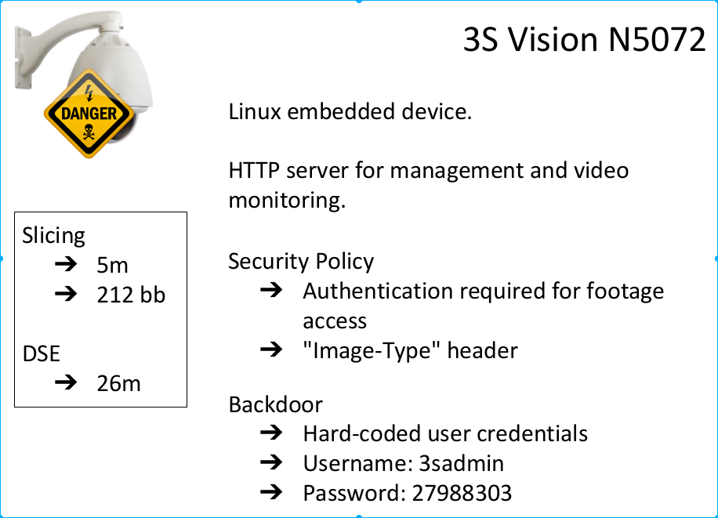
real-world firmware samples

Slide 21
Firmalice: Summary
New backdoor model: input determinism
Implemented analysis system
Found backdoors in real firmware!

