Slide 1
SoK: (State of) The Art of War: Offensive Techniques in Binary Analysis
IEEE Symposium on Security and Privacy’15

Slide 2
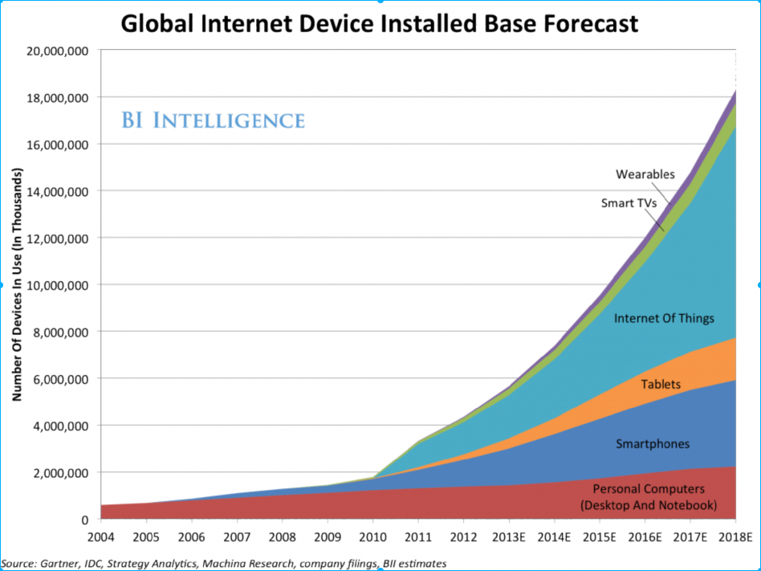
Background: The “Internet of Things”

Slide 3
What is on embedded devices?
Embedded Linux and user-space programs
Custom OS and custom programs combined together in a binary blob
  typically, the binary is all that you get
  and, sometimes, it is not easy to get this off the device

Slide 4
SStatic Binary Analysis
reason over multiple (all) execution paths
can achieve excellent coverage
precision versus scalability trade-off
  very precise analysis can be slow and not scalable
  too much approximation leads to wrong results (false positives)
often works on abstract program model
  for example, binary code is lifted to an intermediate representation

Slide 5
Dynamic Binary Analysis
examine individual program paths
very precise
coverage is (very) limited
sometimes hard to properly run program
  hard to attach debugger to embedded system
  when code is extracted and emulated, what happens with calls to peripherals?

Slide 6
Challenges of Static Binary Analysis
Get the binary code
Binaries lack significant information present in source
Often no clear library or operating system abstractions
  where to start the analysis from?
  hard to handle environment interactions

Slide 7
angr: Design Goals
Cross-architecture support
Cross-platform support
Support for different analysis paradigms
Usability

Slide 8
angr: Framework
Binary Loading CLE
Intermediate Representation VEX/pyVEX
Program State Representation/Modification simuVEX
Data Model claripy
Full-Program Analysis(Symbolic Execuction Analysis) angr

Slide 9
Binary Loading: CLE
backend key | description
elf | Static loader for ELF files based on PyELFTools
pe | Static loader for PE files based on PEFile
cgc | Static loader for Cyber Grand Challenge binaries
backedcgc | Static loader for CGC binaries that allows specifying memory and register backersaa
elfcore | Static loader for ELF core dumps
ida | Launches an instance of IDA to parse the file
blob | Loads the file into memory as a flat image

Slide 10
Binary Loading: CLE
>>> import angr
>>> b = angr.Project("/bin/true")
# this is the entry point of the binary
>>> print b.entry
# these are the minimum and maximum addresses of the binary's memory contents
>>> print b.loader.min_addr(), b.loader.max_addr()
# this is the full name of the binary
>>> print b.filename

Slide 11


Intermediate Representation: VEX/pyVEX
libVEX
x86
AMD64
ARM
ARM64
MIPS
MIPS64
PPC
PPC64

Slide 12



SimuVEX
registers
memory
files
OS state

Slide 13
Solver Engine: claripy
Claripy ASTs provide a unified way to interact with concrete and symbolic expressions
Claripy frontends provide a unified interface to expression resolution (including constraint solving) over different backends (Z3, VSA)

Slide 14
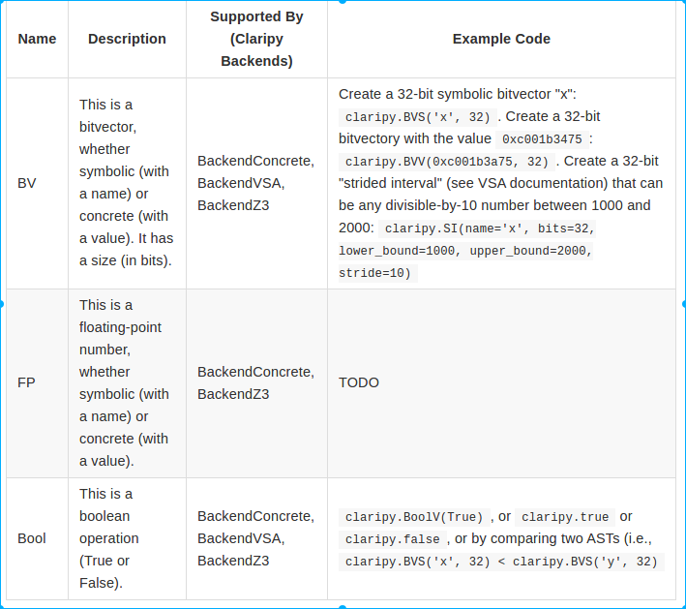
Solver Engine: claripy

Slide 15



angr
Binary Loader
angr
Symbolic Execution Engine
Control-Flow Graph
Static Analysis Routines
Data-Flow Analysis
Value-Set Analysis

Slide 16
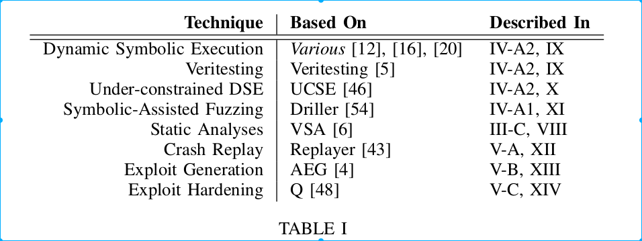
angr

Slide 17
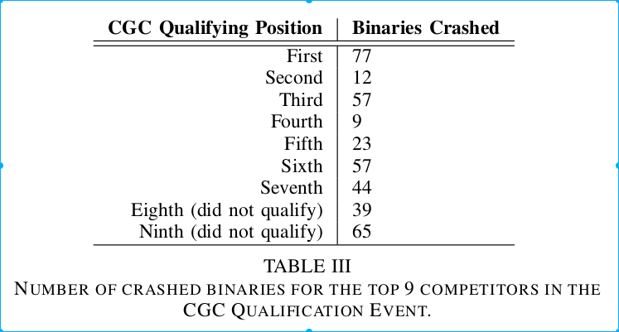
angr: Comparative Evaluation

Slide 18
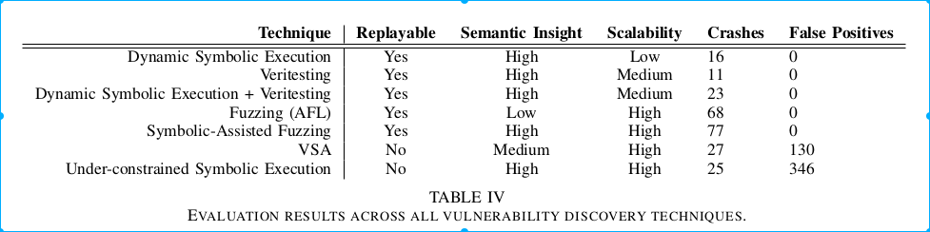
angr: Comparative Evaluation

Slide 19
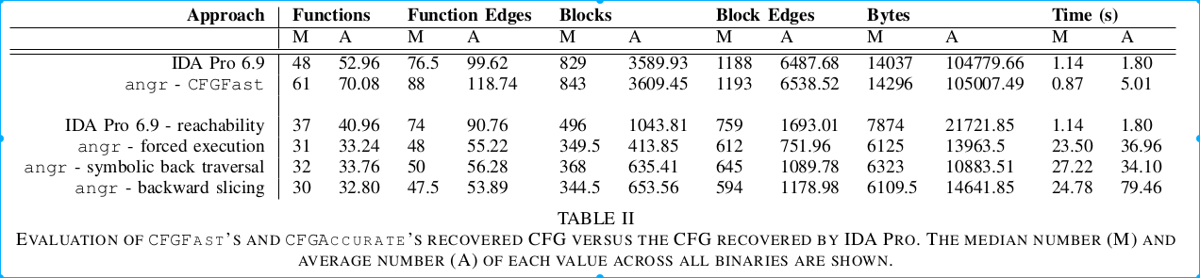
angr: Comparative Evaluation

