Slide 1
Driller: Augmenting Fuzzing Through Selective Symbolic Execution,
NDSS’16

Slide 2
Fuzzing
Fuzzing is a technique that executes an application with a wide set of inputs, checking if these inputs cause the application to crash.
quickly discover different paths that process “general” input
“specific” input?

Slide 3
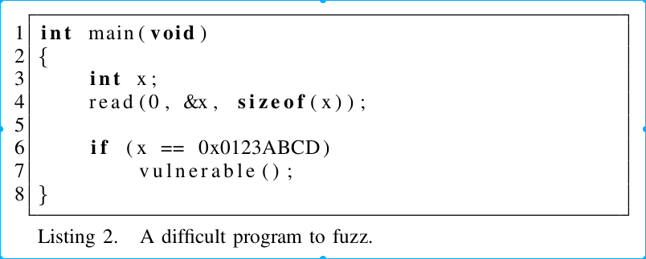
Fuzzer Limitations

Slide 4
Selective Concolic Execution
“stuck”: fuzzing component has gone through
a predetermined amount (proportional to the input length) of mutations without identifying new state transitions

Slide 5
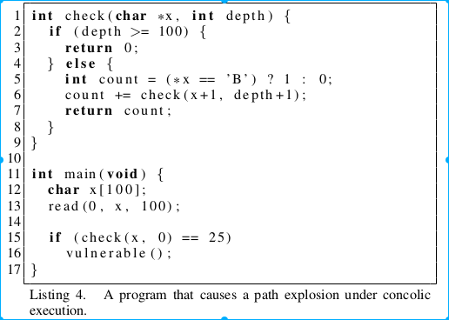
Limitations
Slow
State explosion

Slide 6
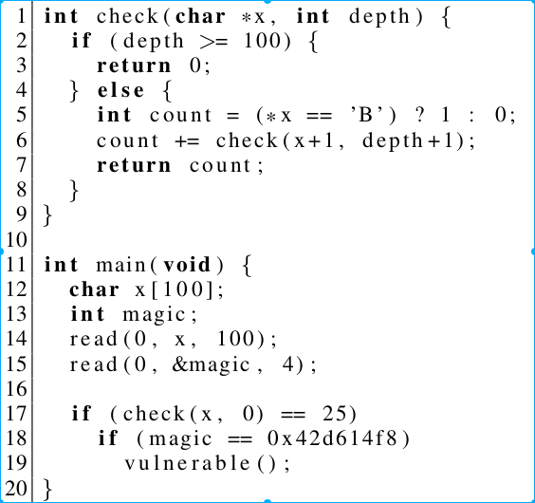
Concolic Execution in Driller
Pre-constrained Tracing
Input Preconstraining
Limited Symbolic Exploration

Slide 7
Evaluation
Dataset
  126 Applications from the qualifying event of the CGC
Experiment Setup
  A computer cluster of modern AMD64 processors
  Each binary had four dedicated fuzzer nodes
  A pool of 64 concolic execution nodes (maximum 4GB mem for a job)
  24 hours

Slide 8
Evaluation: Experiments
Basic fuzzing
Symbolic execution
Driller

Slide 9
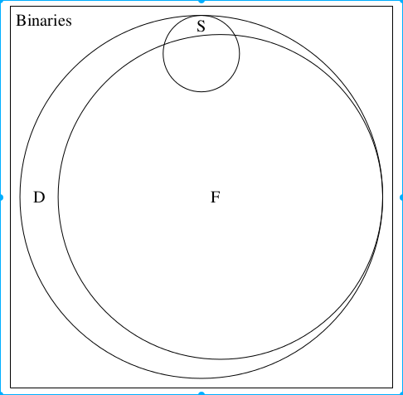
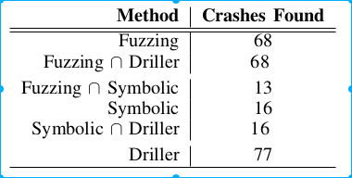
Evaluation: Experiments

Slide 10
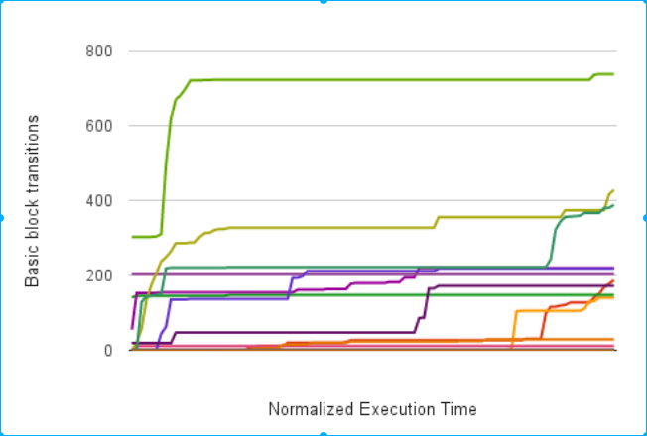
Evaluation: Experiments

Slide 11
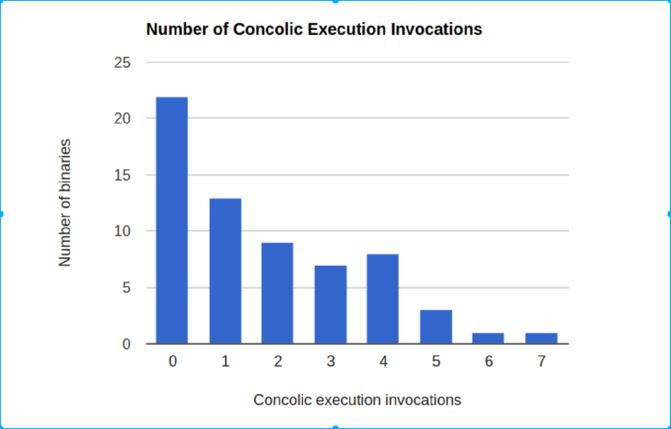
Evaluation: Experiments

Slide 12
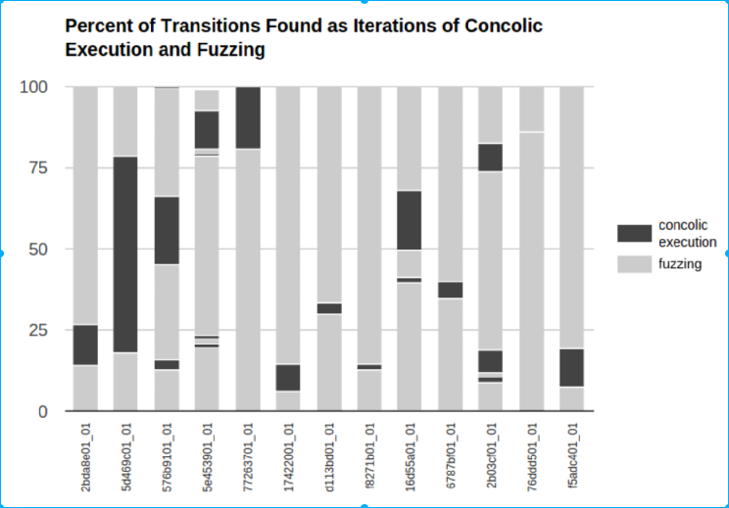
Evaluation: Experiments

Slide 13
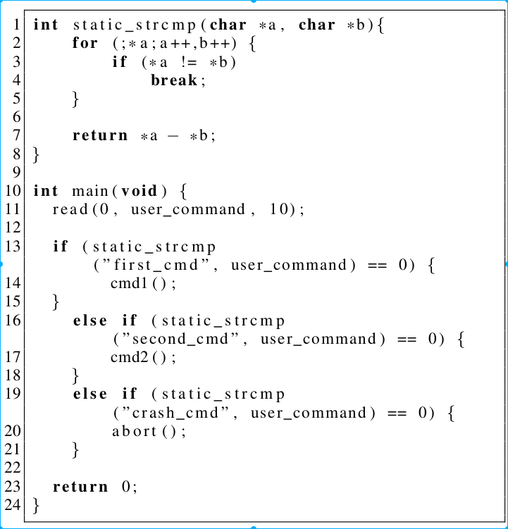
Limitation

Slide 14
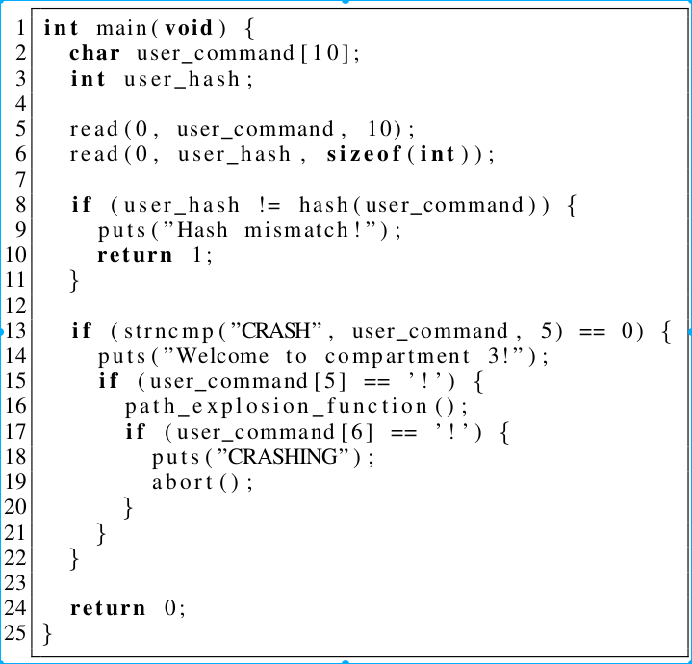
Limitation

