Slide 1
KLEE: Unassisted and Automatic Generation of High-Coverage Tests for Complex Systems Programs
Cristian Cadar, Daniel Dunbar, Dawson Engler Stanford University

Slide 2
Problem
Functional correctness bugs, are difficult to find without executing a piece of code
The difficulty and poor performance of random and manual approaches

Slide 3
Symbolic execution
Whether the approach has any hope of consistently achieving high coverage on real applications?
Two common concerns
(1) the exponential number of paths through code
(2) the challenges in handling code that interacts with its surrounding environment

Slide 4
How KLEE works
Two problems common to the programs we check:
Complexity
Environmental Dependencies

Slide 5
The KLEE Architecture
Basic architecture
Compact state representation
Query optimization
State scheduling

Slide 6
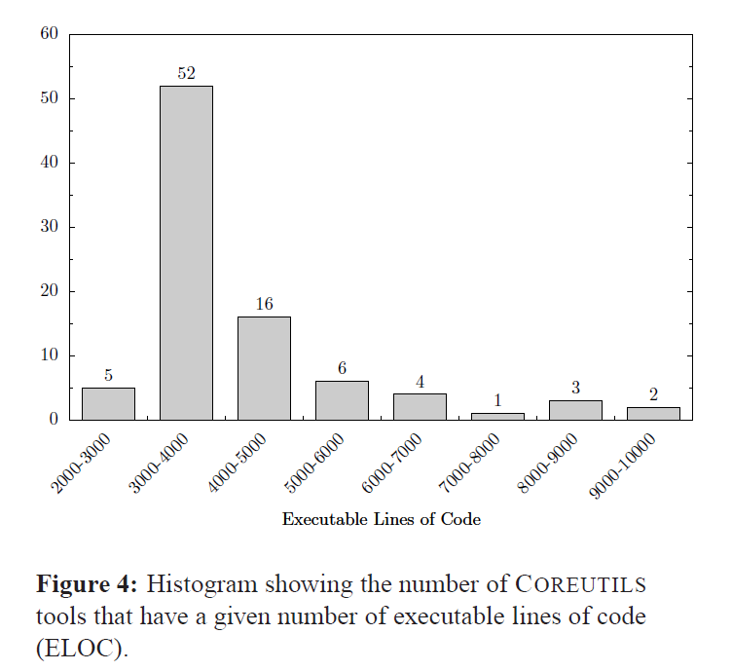

Slide 7
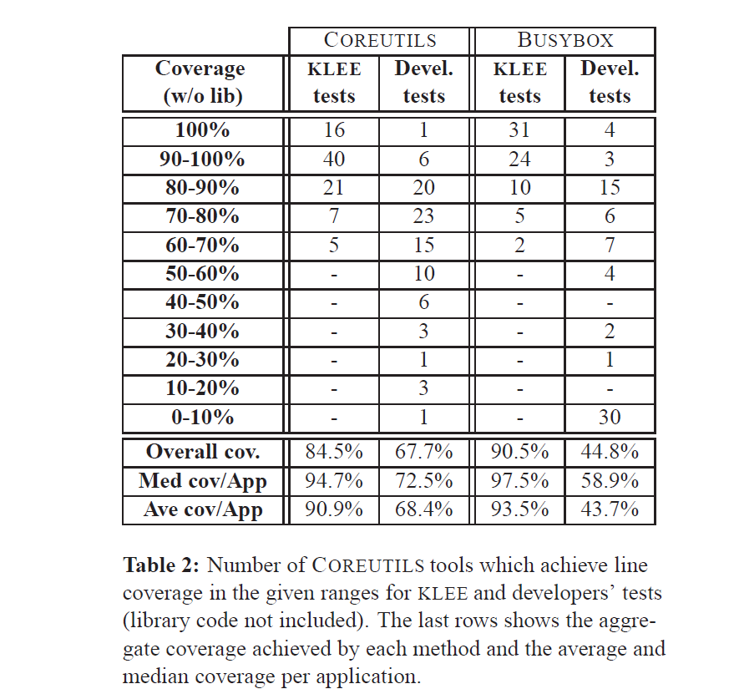
Evaluation

Slide 8
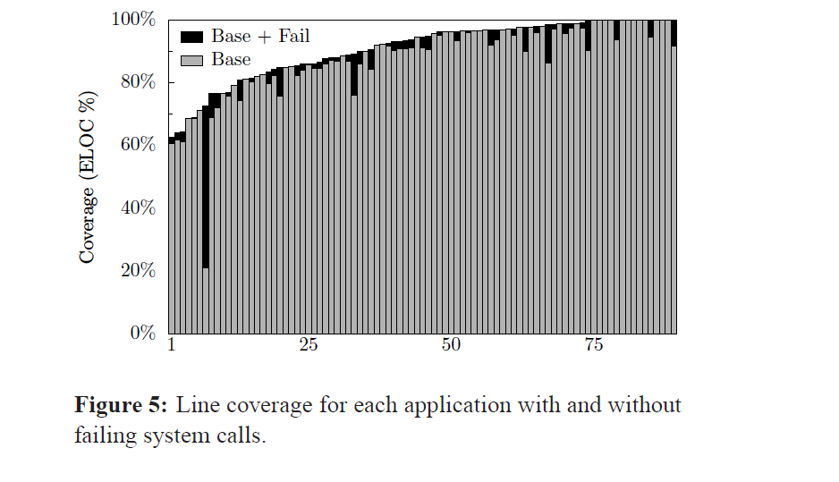

Slide 9
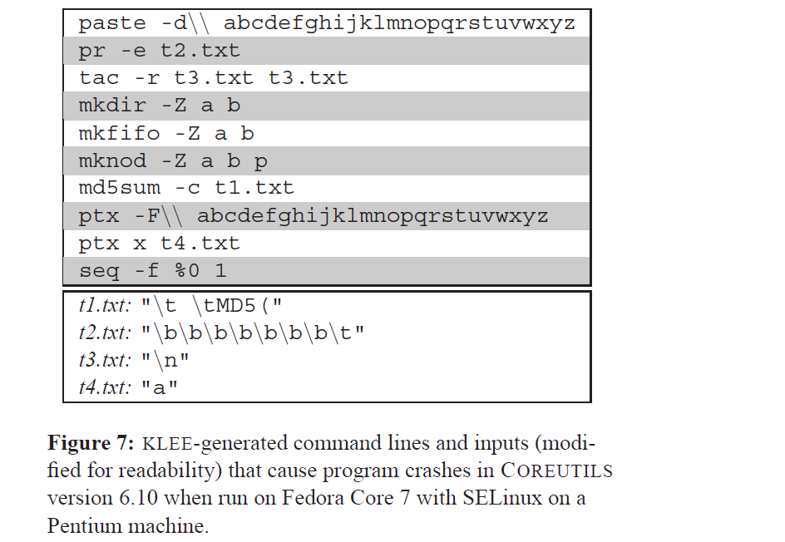

Slide 10
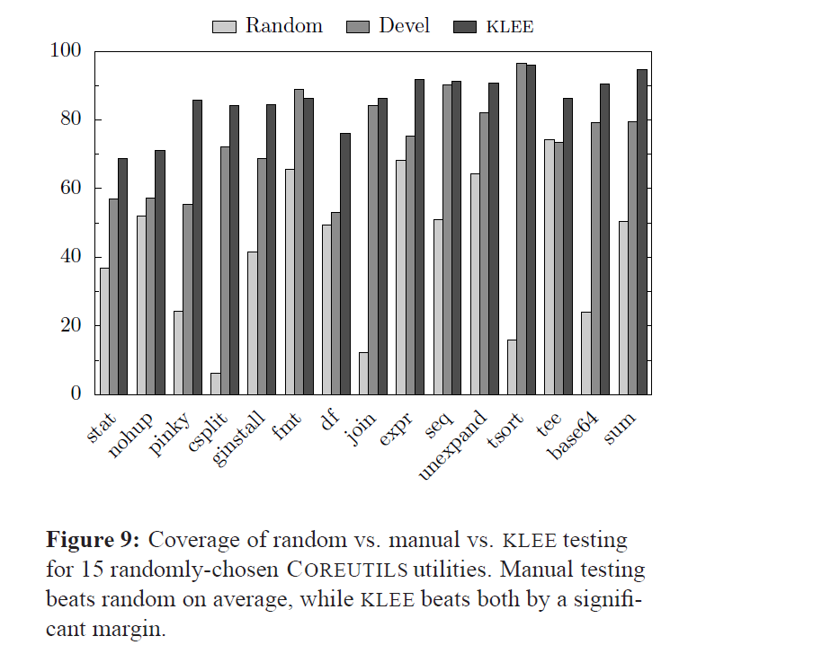

Slide 11
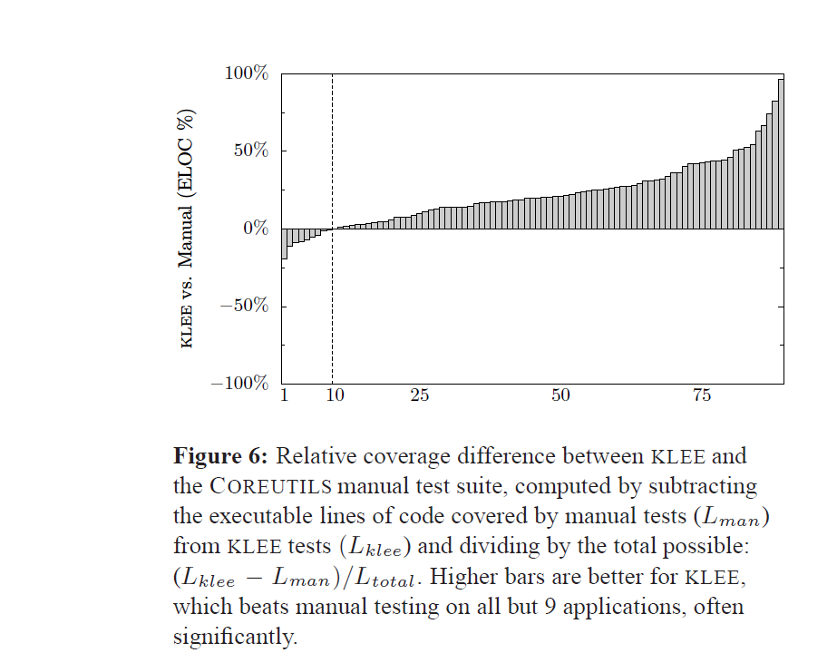

Slide 12
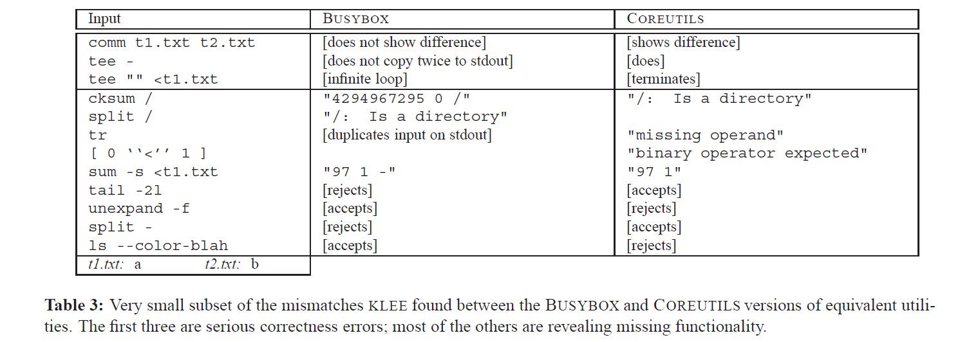

Slide 13
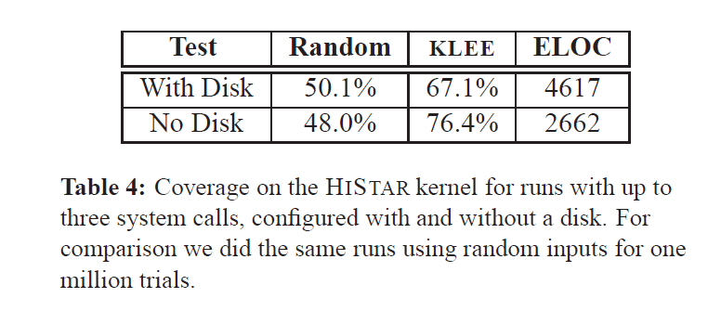

Slide 14
Contributions
Present a new symbolic execution tool, KLEE
KLEE’s automatically-generated tests get high coverage on a diverse set of real, complicated,and environmentally-intensive programs

Slide 15
End

