Slide 1
Efficient implementation of movie recommendation System by using Genetic Algorithm
E2
0456145 顧凱云
0456134楊于進

Slide 2
Outline
Motivation
System environment
Procedure
System Architecture
Result

Slide 3

Motivation
Using the genetic algorithm to implement the movie recommendation system requires a large amount of computation.

Slide 4
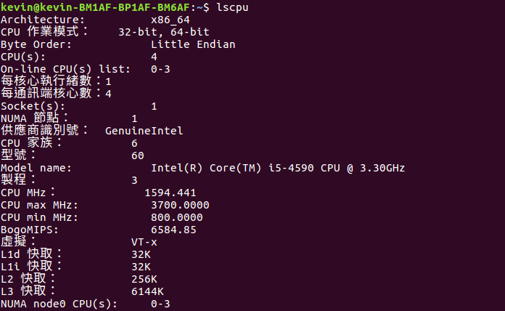
System environment

Slide 5
Genetic Algorithm
Elitist genetic Algorithm:
Populationsize:100
Select randomly out of the top 40% of the whole population
Tournament selection
Crossover probability 1
Mutation probability 0.01

Slide 6
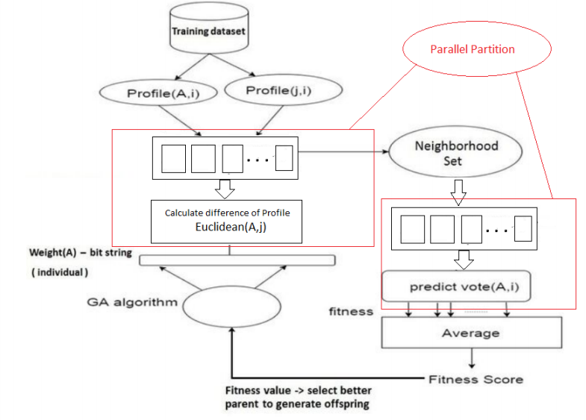
Training stage architecture 1/3
Database collect from movie Lens

Slide 7
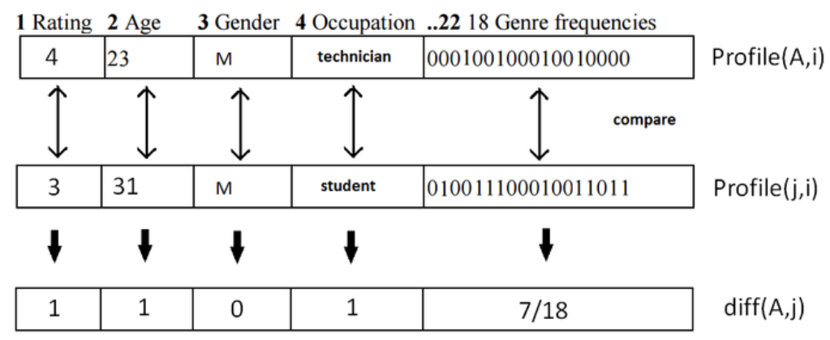
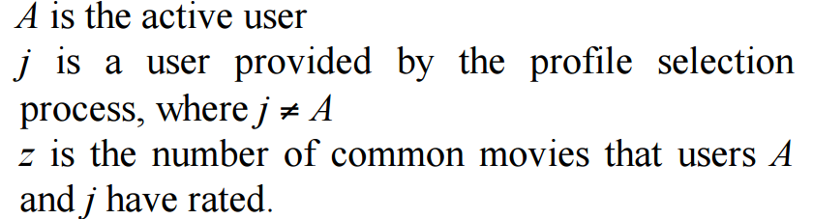
Training stage architecture 2/3

Slide 8
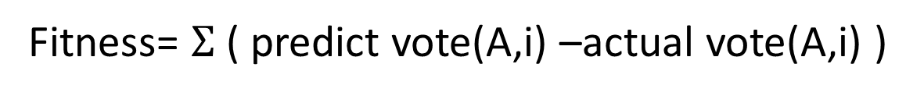
Training stage architecture 3/3
Similar(A,j)=1/Euclidean(A,j)
totalSimilar = sum of similar(A,j) , j: neighbors who had seen movie i
Predict vote(A,i)=$meanVoteA+\frac{1}{totalSimilar}∗Σ(similar\left(A,j\right)∗\left(vote\left(j,i\right)−meanVotej\right))$
Fitness= $Σ$( predict vote(A,i) –actual vote(A,i) )
i
i:common movie

Slide 9
Procedure
1/3 whole data -> training data -> compute weight & Euclidean of all other users
Set Euclidean threshold to find neighborhood( high similar users )
Calculate predict vote & fitness value of those neighborhood using GA -> select good weight help us get better neighborhood for next generation
After finish GA we can get optimal weight -> get final similar neighborhood
Movies those similar neighborhood like , we assume active user may like

Slide 10
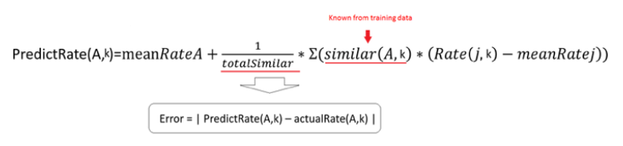
Testing stage flow chart

Slide 11
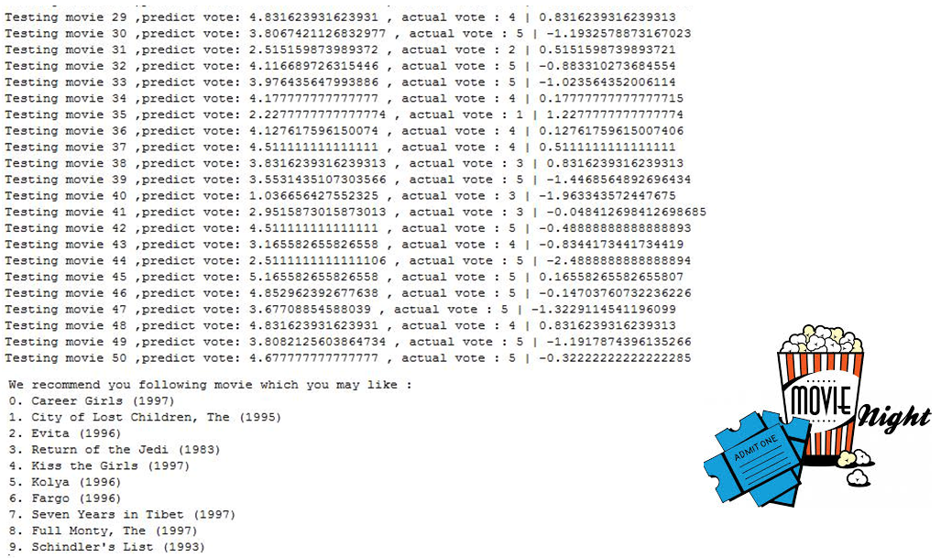
Result

Slide 12
Result
OpenMP
2 Threads | 4 Threads | 8 Thread
1.915 | 3.304 | 3.127
Speed up

Slide 13
Result

Slide 14
Q&A

Slide 15
Motivation for GA
無須猜測各feature對於不同user的重要程度及feature間的關聯性
藉由genetic algorithm 來決定每個feature weight 大小
找出feature weight 進而找出其他與使用者相似用戶並推薦電影給使用者

