Slide 1
COMPUTER ARCHITECTURE
PIPELINED MIPS
Grouop 8: 電機四 趙祐毅、電機四 羅志軒、電機三 許凱傑

Slide 2
OUTLINE
Baseline
special design
Result
Extension
Branch prediction
Multiplication/ division
Notes:
Baseline (4min)
special design
Result
Extension
Branch prediction (2min)
Multiplication/ division (3 min)
Cache (3min)

Slide 3
OUTLINE
Baseline
special design
Result
Extension
Branch prediction
Multiplication/ division
Notes:
Baseline (4min)
special design
Result
Extension
Branch prediction (2min)
Multiplication/ division (3 min)
Cache (3min)

Slide 4
BASELINE -- SPECIAL DESIGN
J/ Jal
Jump in IF
Jr/ Jalr
Jump in EX
Branch
Branch prediction in IF
Branch result in EX
Critical path

Slide 5
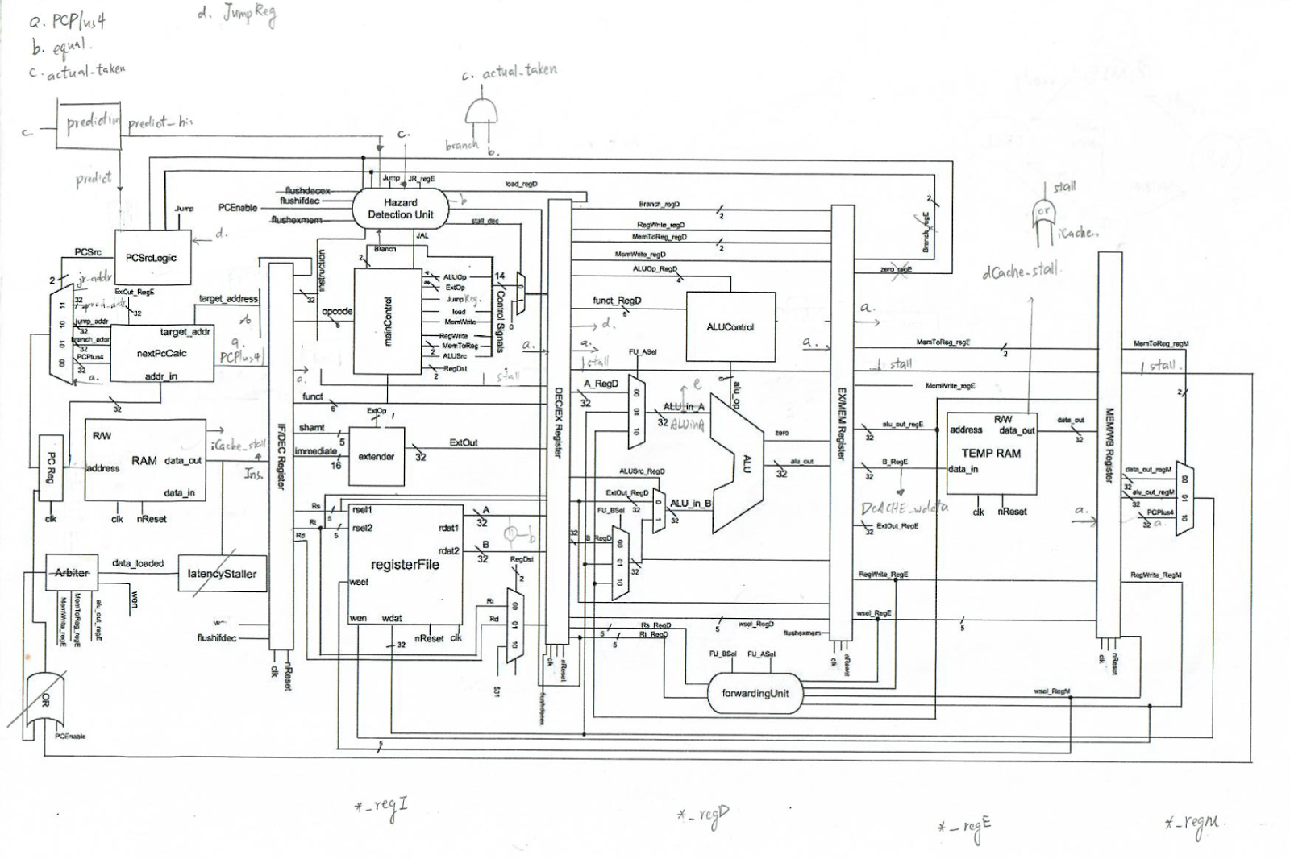
Pre-control Unit

Slide 7
BASELINE -- SPECIAL DESIGN
Flush
Flush in IF/DEC
Flush in mainControl signal (only those will affect performance)
Notes:
Flush
Flush in IF/DEC
Flush in mainControl signal (only those will affect performance) -- save mux
PCsrc
Priority: Stall → Jump(EX) → Branch (EX) → J/ BR (IF)
PCplus4 + mux
Use register read signal to pass PCplus4

Slide 9
BASELINE -- SPECIAL DESIGN
Stall?
PCsrc
Priority: Stall → Jump(EX) →Branch(EX) → J/ BR (IF)
Yes
No
Current PC
Jr/Jalr or Branch (EX)?
Not Jr/Jalr/ Br
Jr/Jalr
Branch
Jr and Flush
Predict right?
Right
Wrong
J/Jal or Branch (IF)?
J/Jal
Branch
Correct and Flush
No
Jump
Predict?
Normal PC+4
0
1
Not Taken
Taken
Notes:
Flush
Flush in IF/DEC
Flush in mainControl signal (only those will affect performance) -- save mux
PCsrc
Priority: Stall → Jump(EX) → Branch (EX) → J/ BR (IF)
PCplus4 + mux
Use register read signal to pass PCplus4

Slide 10
BASELINE -- SPECIAL DESIGN
Jal/ Jalr: PCplus4 passing
Use register read signal to pass PCplus4
Add mux to A, B
Notes:
Flush
Flush in IF/DEC
Flush in mainControl signal (only those will affect performance) -- save mux
PCsrc
Priority: Stall → Jump(EX) → Branch (EX) → J/ BR (IF)
PCplus4 + mux
Use register read signal to pass PCplus4

Slide 12
OUTLINE
Baseline
special design
Result
Extension
Branch prediction
Multiplication/ division
Notes:
Baseline (4min)
special design
Result
Extension
Branch prediction (2min)
Multiplication/ division (3 min)
Cache (3min)

Slide 13
BASELINE -- RESULT
Direct-mapped I-cache/ D-cache
Total Area: 2,153,628.0 (μm^2)
Cell Area: 265,427.5 (μm^2)
Timing: 5.6 ns
Area(Total)*T: 12,060,316.8 (μm^2 * ns)
Area(Cell)*T: 1,486,394 (μm^2 * ns)
Notes:
252674.962598
10012500

Slide 14
OUTLINE
Baseline
special design
Result
Extension
Branch prediction
Multiplication/ division
Notes:
Baseline (4min)
special design
Result
Extension
Branch prediction (2min)
Multiplication/ division (3 min)
Cache (3min)

Slide 15
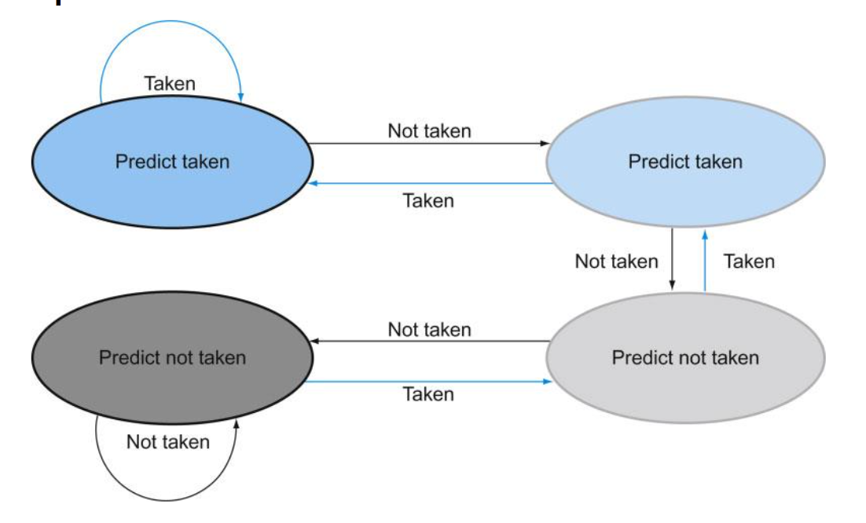
EXTENSION – BRANCH PREDICTION
Design
No BPU(taken): Always do taken
No BPU(not taken): Always do untaken
1-bit BPU
2-bit BPU

Slide 16
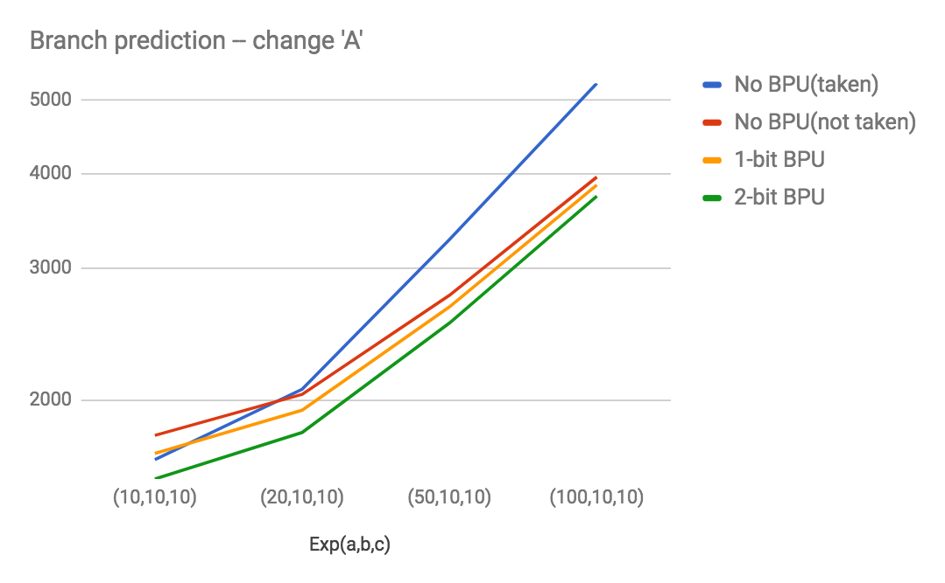
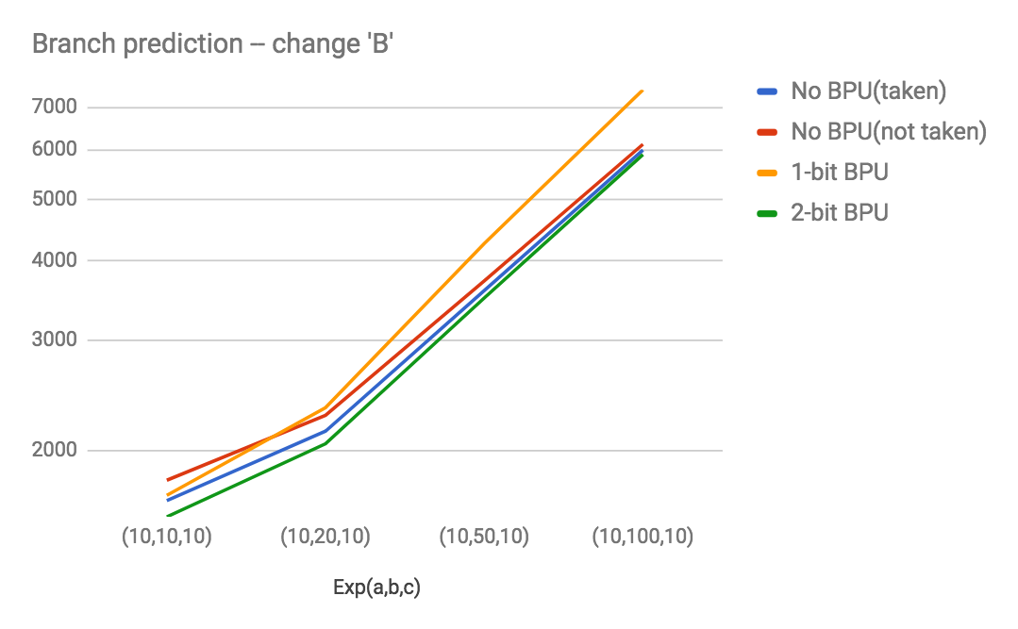
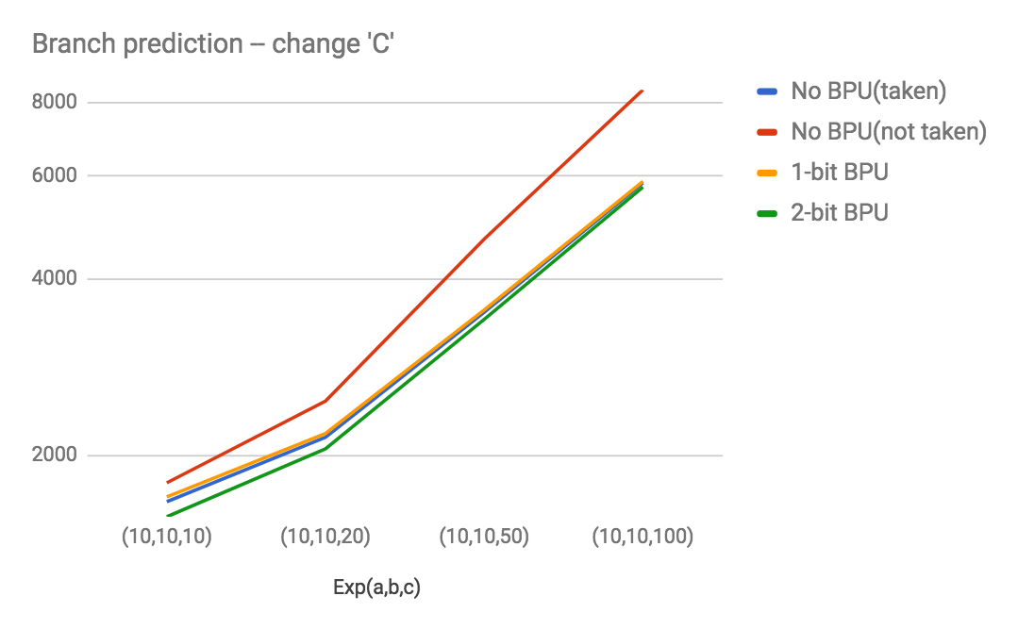
EXTENSION – BRANCH PREDICTION
Experiment result
a: branch not taken/ b: branch not taken, taken interleaved/ c: branch taken

Slide 17
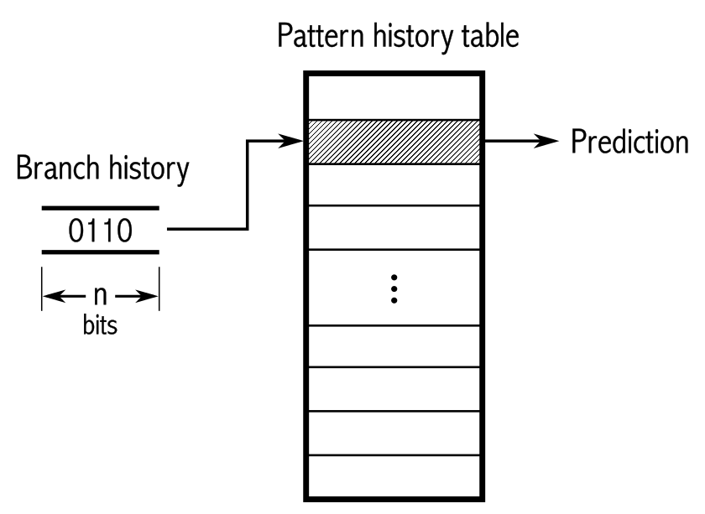
EXTENSION – BRANCH PREDICTION
Problem and improvement
2-bit not perform good when ‘b’: branch not taken, taken interleaved
Successively read
Predict based on its history

Slide 18
OUTLINE
Baseline
special design
Result
Extension
Branch prediction
Multiplication/ division
Notes:
Baseline (4min)
special design
Result
Extension
Branch prediction (2min)
Multiplication/ division (3 min)
Cache (3min)

Slide 19
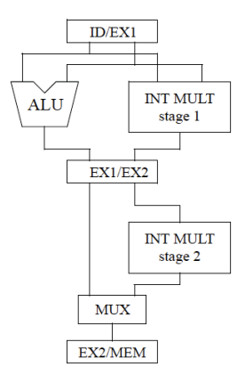
MULT / DIV -- Iterative approach
Less area: 2 EX stage will probably double ALU module area, i.e. more registers, adders, subtracters
Can use less total execution time: if Mult/Div instructions are only 1/16 of all instructions, it can be quicker
Maybe Less cycle time: due to simpler control

Slide 20
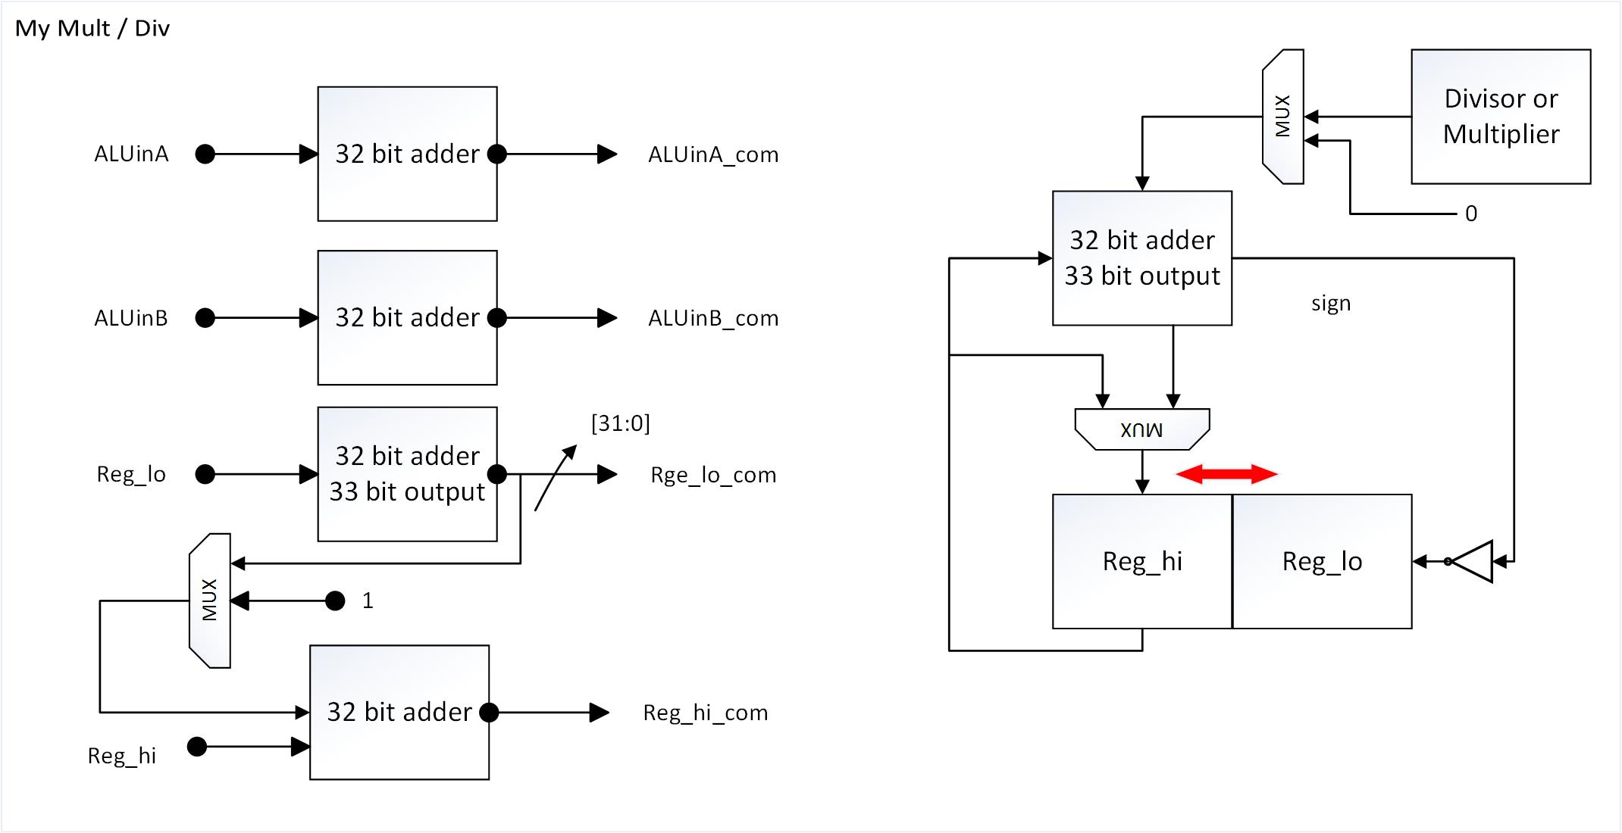
MULT / DIV -- Architecture
1 32-bit adder for mult/div
4 32-bit adders for implementing 2’s complement
Special design:
convert divisor to negative number. Thus, we don’t need subtracter and control circuit.
convert multiplicand, multiplier and dividend into positive numbers → will need 1 extra cycle for converting results to correct negative numbers
stall_multdiv

Slide 21
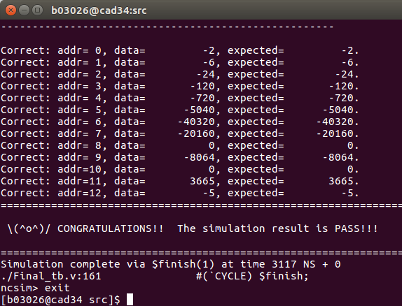

MULT / DIV -- Post-Synthesis Simulation Result

Slide 22
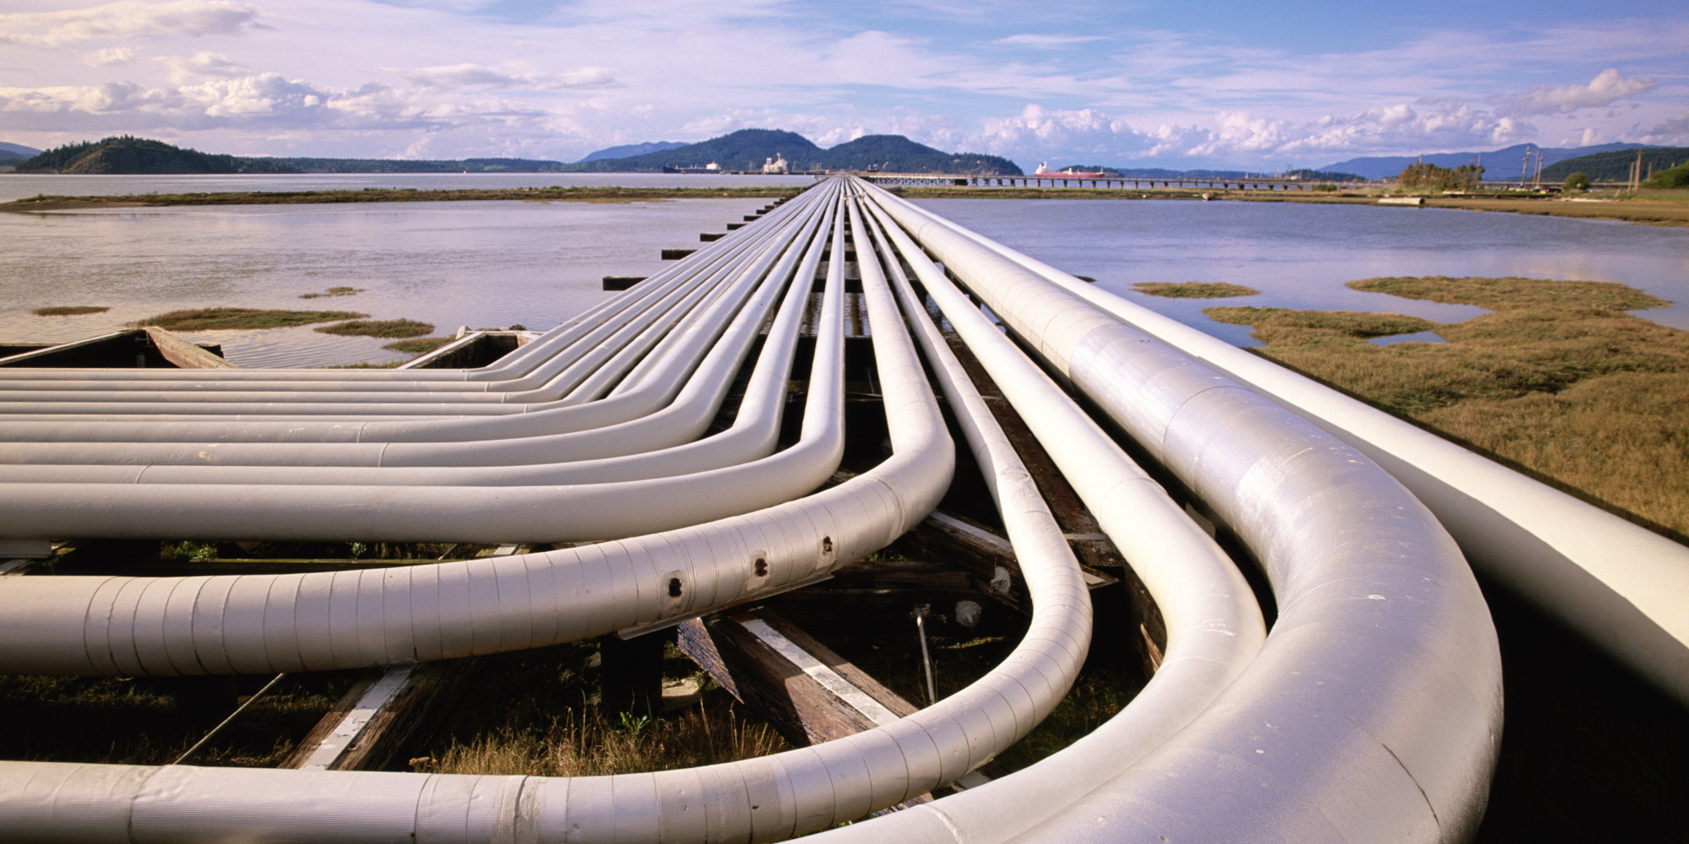
We PIPELINED!!!

