Slide 1

COVID-19 Mobility Impact and the S&P500
Kevin Wang

Slide 2
Agenda
Goals for this Project
Defining Mobility Impact
Snapshot of the US Economy during COVID-19
US Regions Mobility Impact
Data Manipulation
Model Building
Results
Potential Further Analysis

Slide 3
Goals for this Project
To build a model that can predict the effect on the US Economy (using the S&P500 as a proxy) given the Mobility Impact caused by COVID-19
*The baseline is the median value, for the corresponding day of the week, during the 5-week period Jan 3–Feb 6, 2020

Slide 4

What is Mobility Impact?
This term is defined as the changes to the Frequency and Length of Stay to different locations compared to a baseline value*.
Covid-19 has had a drastic impact in our Mobility and the Google Community Covid-19 Reports have quantified the impact.
*The baseline is the median value, for the corresponding day of the week, during the 5-week period Jan 3–Feb 6, 2020

Slide 5






The Mobility Categories Include
Residential
Parks
Work Office
Transit Station
Grocery
Retail & Entertainment

Slide 6
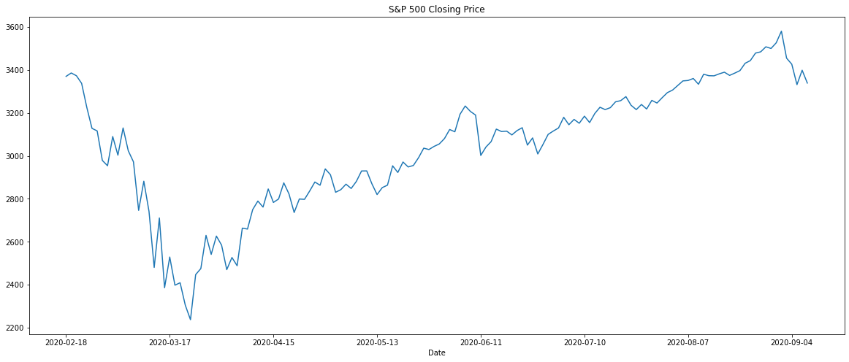
COVID-19 Impact on the US Economy
Historical Data from Yahoo Finance

Slide 7
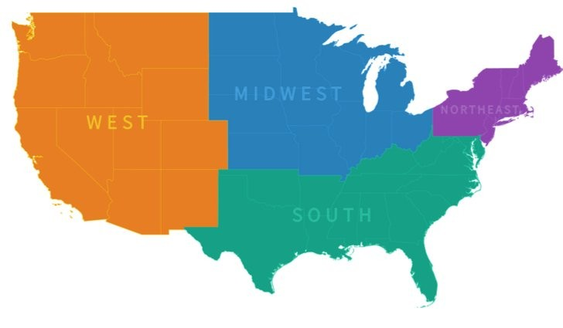
US Regions Mobility Impact
Using 1 representative state per region

Slide 8
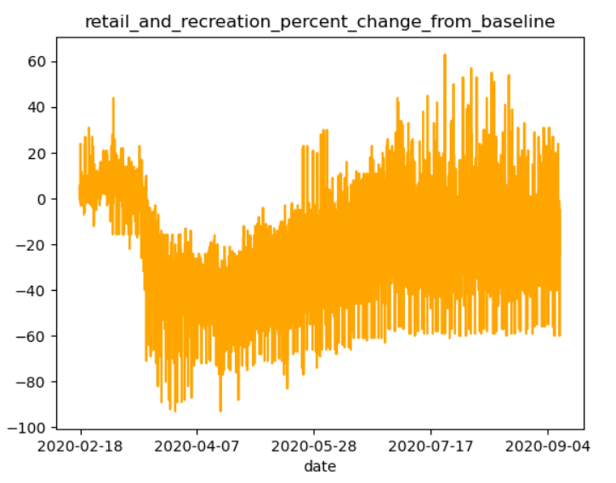
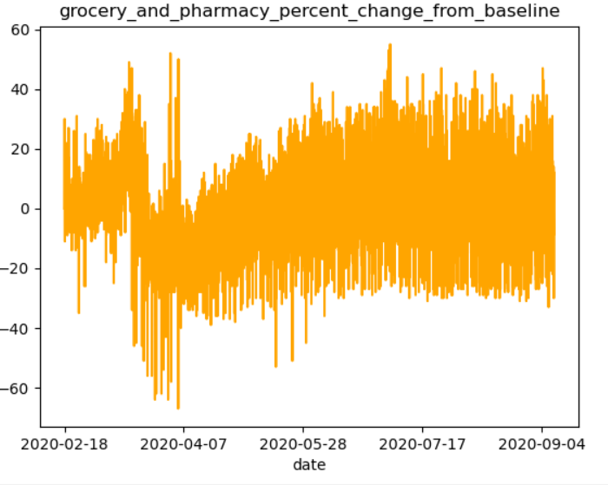
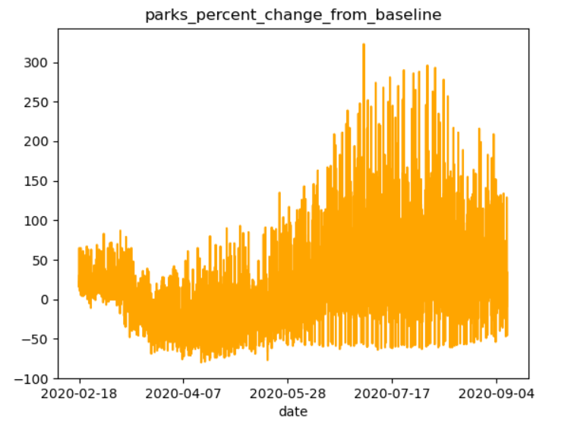
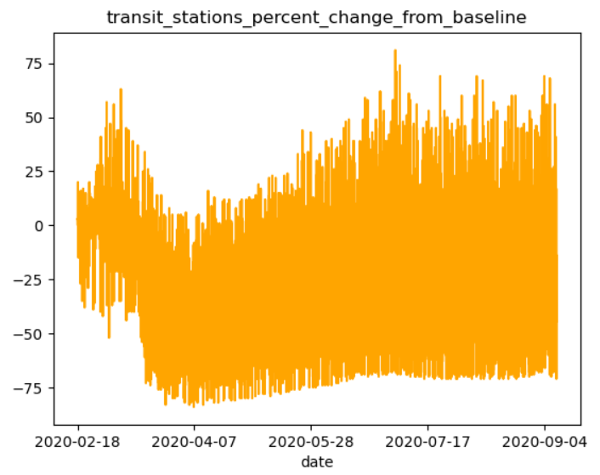
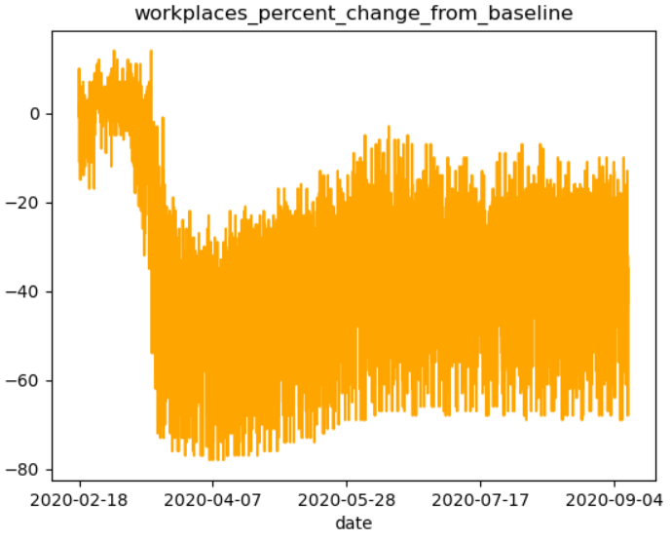
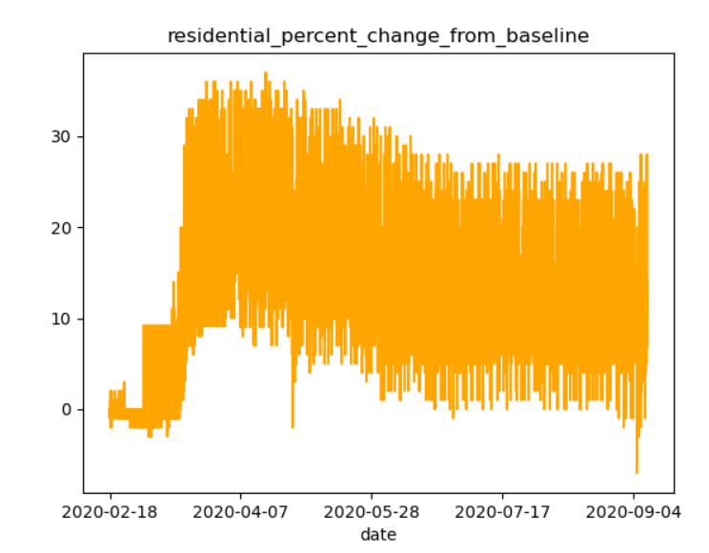
West (California)

Slide 9
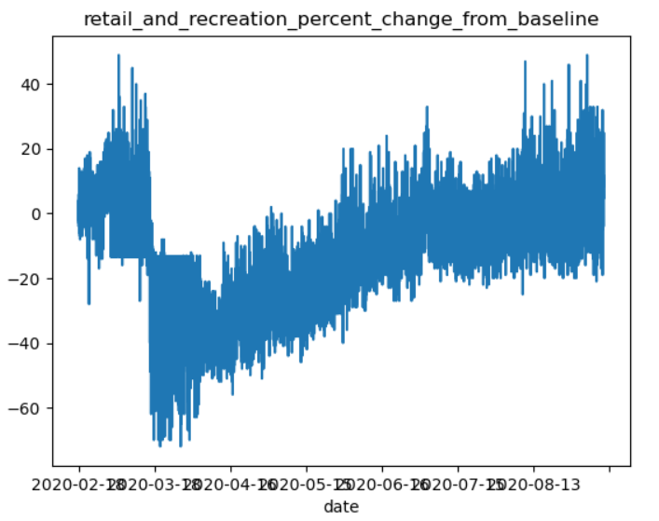
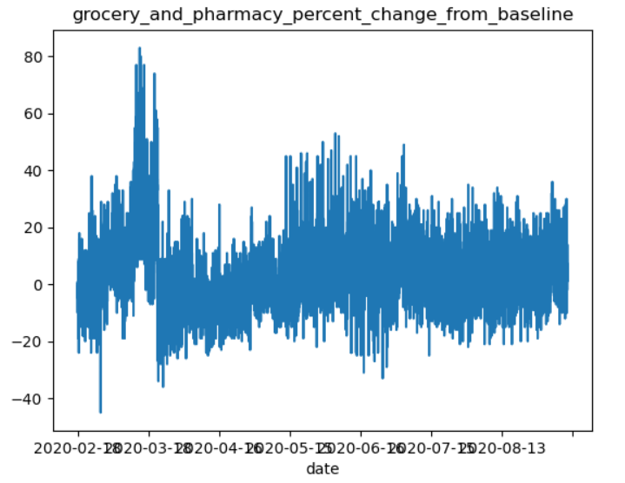
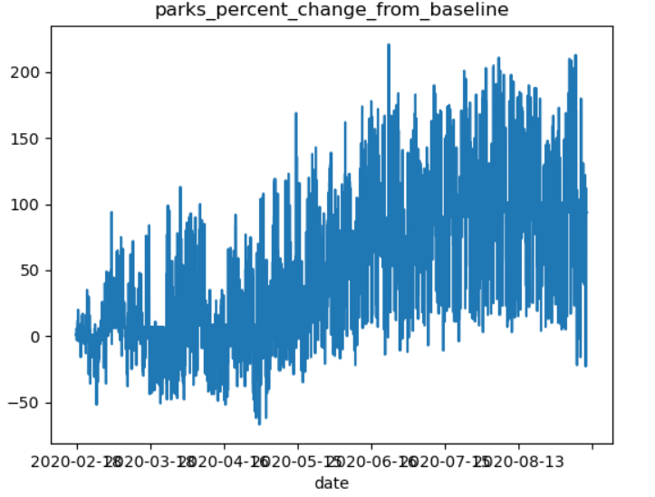
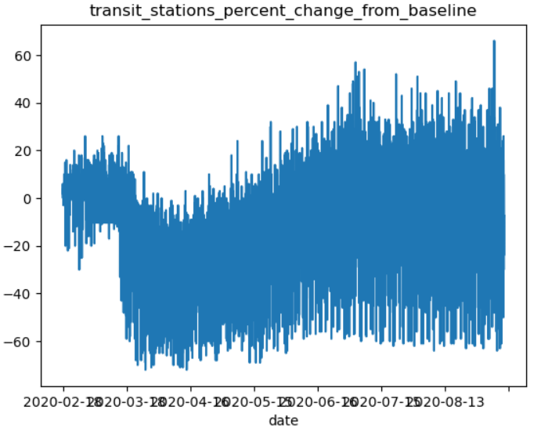
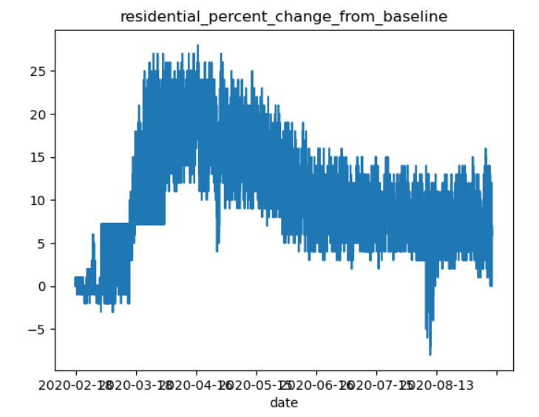
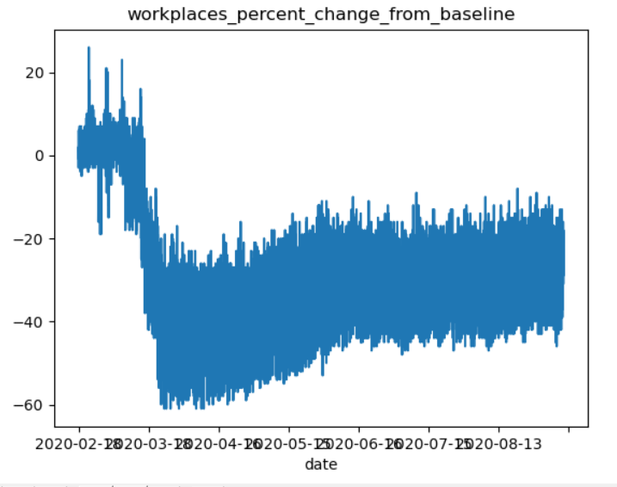
Midwest (Illinois)

Slide 10
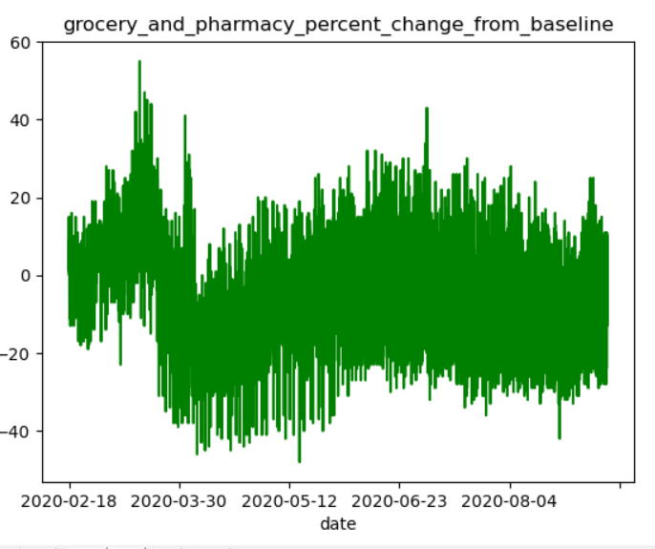
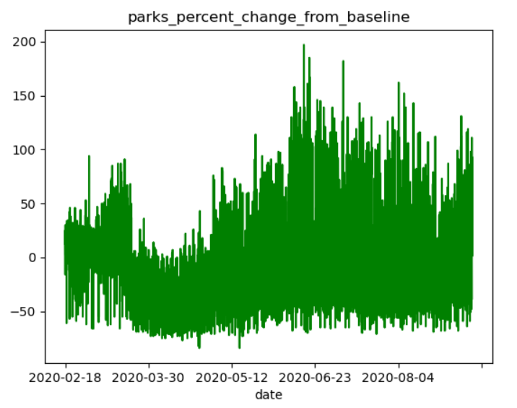
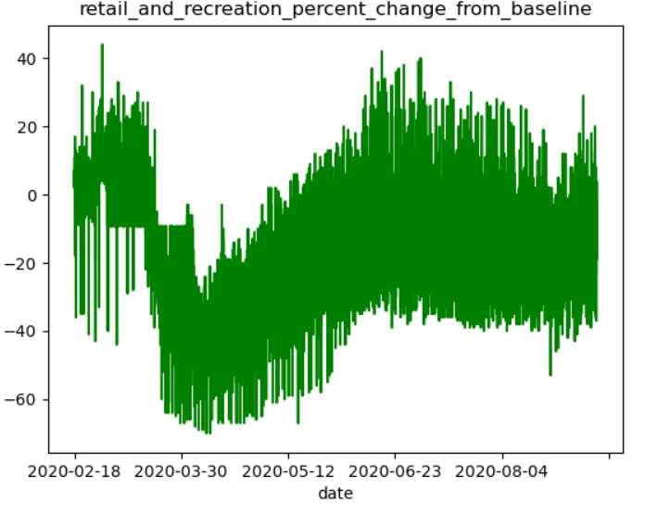
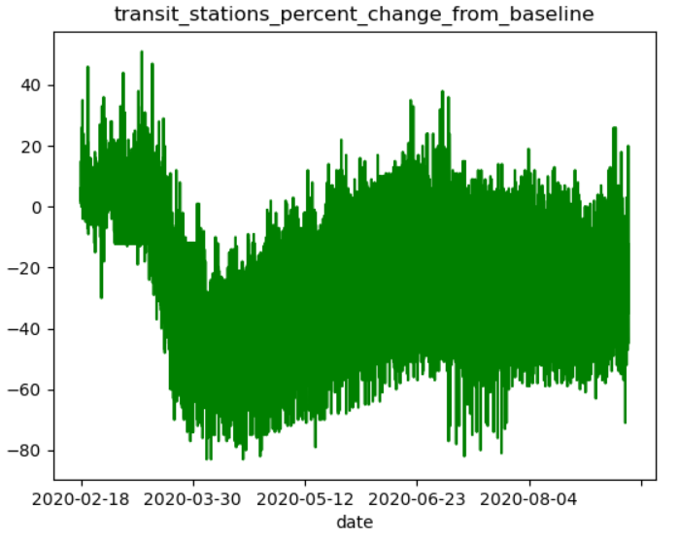
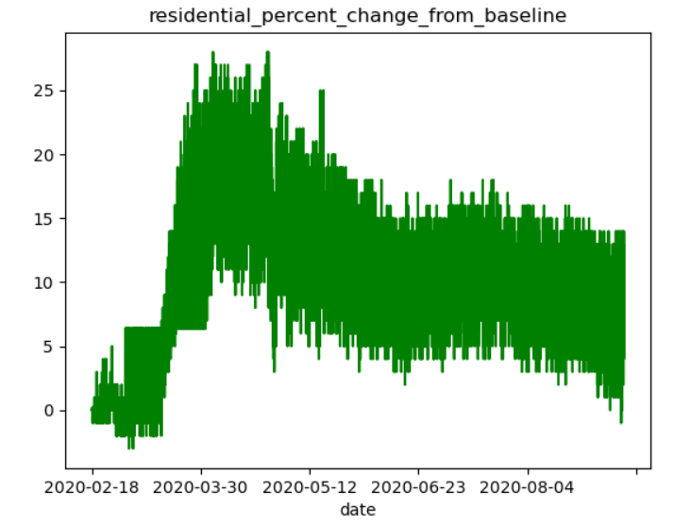
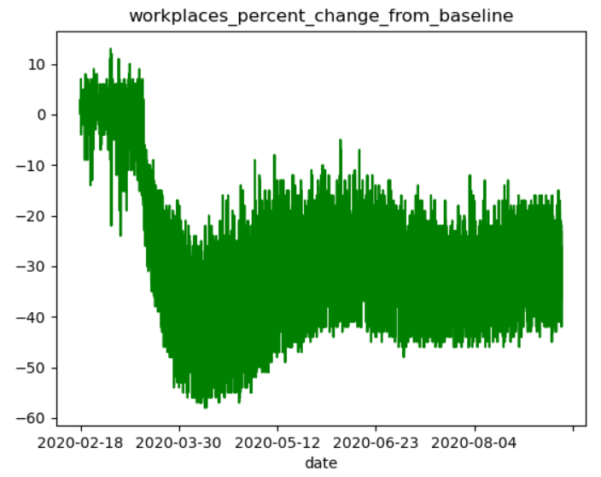
South (Florida)

Slide 11
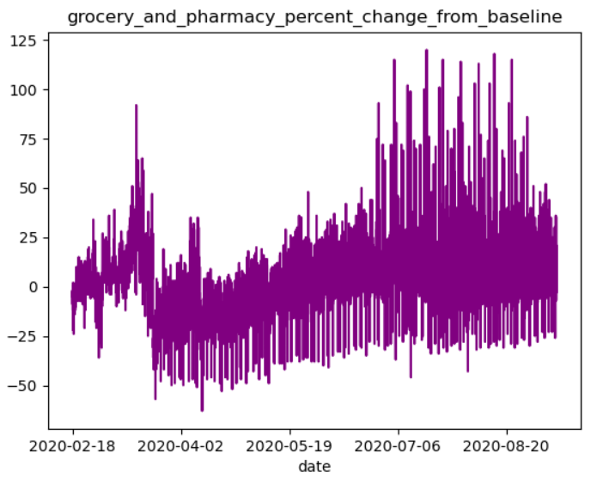
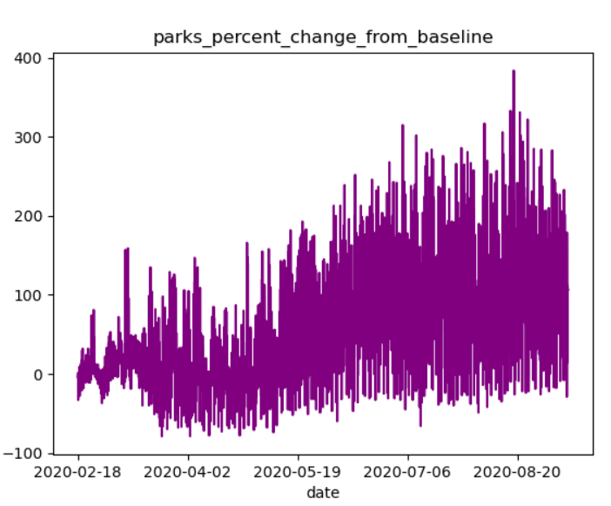
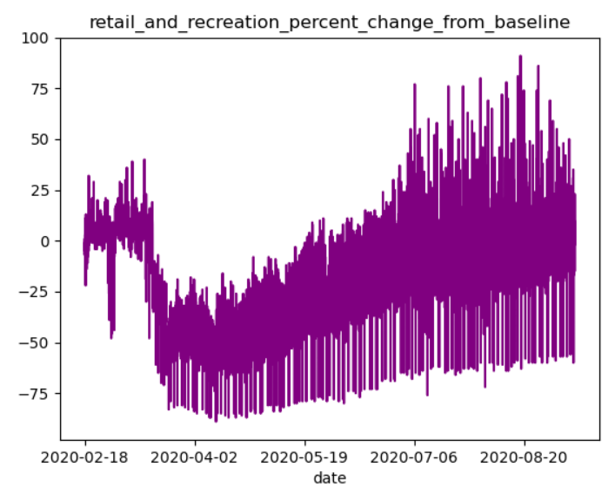
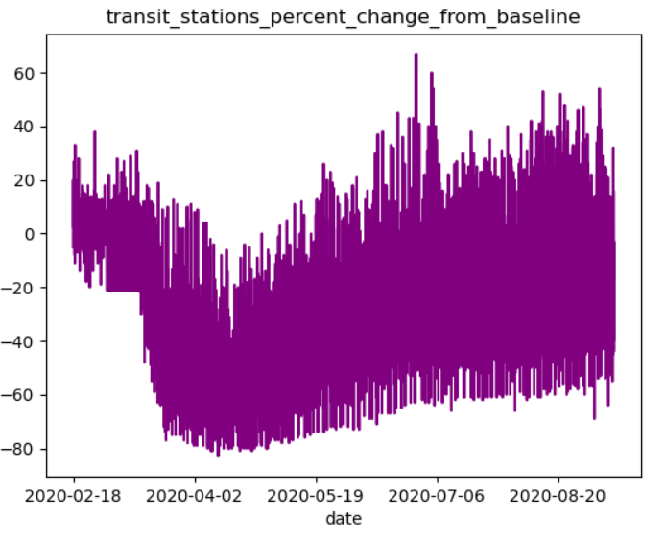
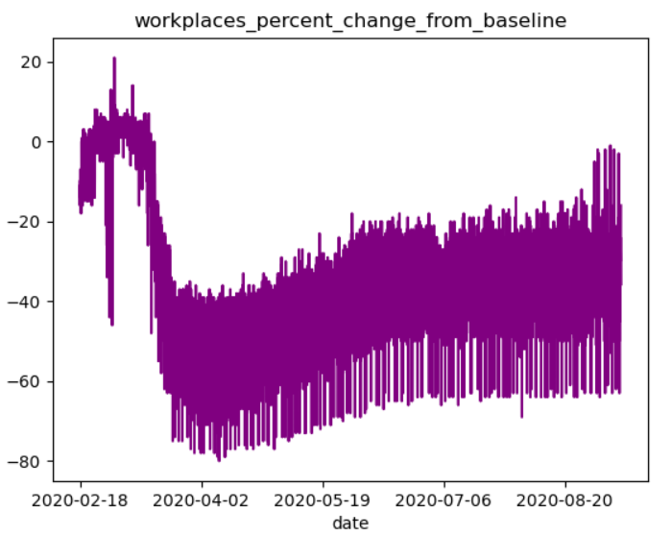
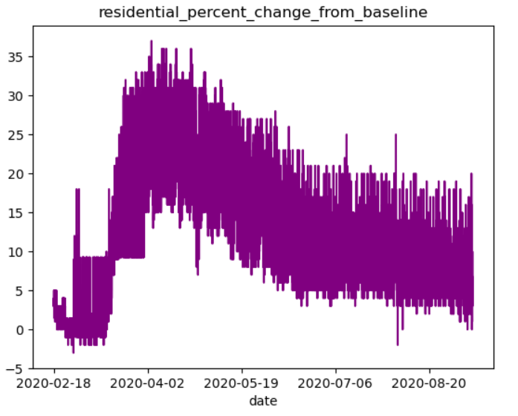
East (New York)

Slide 12
Data Manipulation: Steps Taken
Subsetting the United States Geography and Isolating Relevant Mobility Features
Merging Mobility Impact Data with Economy Data
Data Imputation by Sub Region and Month

Slide 13
Model Building
Data Preprocessing
One hot Encoding for Sub Region Data
Model Selection
Gradient Boosting Regressor
Hyper Parameter Tuning
Randomized Search
Train Test Split

Slide 14
Results (Gradient Boosting Regressor)
Estimators: 100
Learning Rate = 0.05
Max Depth = 10
RMSE = 116.455

Slide 15
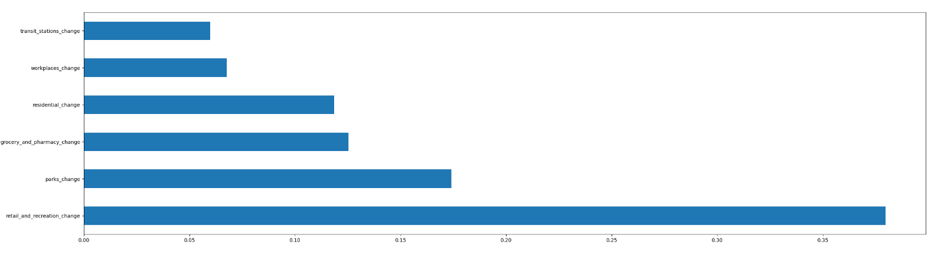
Feature Importance

Slide 16

Potential Further Analysis
Utilizing similar model structure for specific market sectors
Quantify the effect of Mobility Impact on different industries
Develop a quantitative feature for Financial Market Predictions

Slide 17
Thank You

