Slide 1
Database Management System
by Jean Baptiste MINANI
Email:baptisteauca@gmail.com
Eric NGABO
Email: ngaboericngabo2@gmail.com
Matthew 19:26 “With men this is impossible; but with God all things are possible”
Notes:
This template can be used as a starter file for presenting training materials in a group setting.
Sections
Right-click on a slide to add sections. Sections can help to organize your slides or facilitate collaboration between multiple authors.
Notes
Use the Notes section for delivery notes or to provide additional details for the audience. View these notes in Presentation View during your presentation.
Keep in mind the font size (important for accessibility, visibility, videotaping, and online production)
Coordinated colors
Pay particular attention to the graphs, charts, and text boxes.
Consider that attendees will print in black and white or grayscale. Run a test print to make sure your colors work when printed in pure black and white and grayscale.
Graphics, tables, and graphs
Keep it simple: If possible, use consistent, non-distracting styles and colors.
Label all graphs and tables.

Slide 2
Course Content
UNIT-I | Introduction to Databases
 | Introduction, data, information, database, database management system, what is database system, purpose of database system, view of data, traditional database systems, Relational databases, database architecture.
UNIT-II | Database system concepts and architecture
 | Data Models, Schemas, and instances; three-schema architecture and data independence; database languages; centralized and client/server architectures for DBMS; three-tier client/server Architecture for web applications; classification of Database Management Systems.
UNIT-III | Data Modeling Using ERD
 | Conceptual Data Models for Database Design; entity types, entity sets, attributes, and keys; Relationship types, Relationship Sets; Weak Entity Types; ER Diagram, Naming Conventions and Design Issues; Enhanced Entity Relationship and UML Modeling(i.e. Subclasses, super classes, inheritance, specialization and generalization); Relational data model and Relational database constraints; Relational Algebra Operations from set theory; Additional Relational Operations; Examples of Queries in Relational Algebra; Relational Database Design using ER-to- Relational Mapping
UNIT-IV | Schema Definition, Basic Constraints, and Queries
 | SQL Data Definition and Data Types(The CREATE TABLE command in SQL, Specifying Basic Constraints in SQL, Specifying Key and Referential Integrity Constraints, NOT NULL, CHECK and UNIQUE constraints), Schema change statements in SQL(The Drop Command, The Alter Command, The Update Command);The SELECT-FROM-WHERE Structure of Basic SQL Queries; Unspecified WHERE Clause and Use of the Asterisk; Tables as Sets in SQL; Substring Pattern Matching and Arithmetic Operators; Ordering of Query Results; More Complex SQL Queries; Comparisons Involving NULL and Three Valued Logic; Nested Queries, Tuples, and Set/Multiset Comparisons; Correlated Nested Queries; The EXISTs and UNIQUE Functions in SQL; Renaming of Attributes in SQL; Joined Tables in SQL; aggregate Functions in SQL; Grouping(the GROUP BY and HAVING Clauses), INSERT, DELETE, and UPDATE Statements in SQL; VIEWS(Virtual Tables) in SQL,
UNIT-V | Functional Dependencies and Normalization
 | Functional Dependencies, Normal Forms Based on Primary Keys, General Definitions of 1NF, 2NF, and 3NF, Boyce-Codd Normal Form
UNIT-VI | Transaction Processing Concepts and Concurrency control Techniques
 | Introduction to Transaction Processing Concepts, Concurrency control Techniques and Database Recovery Techniques.

Slide 3
Delivery Methods
Lectures(Attendance is very important and late comer might not get it)
Reading assignments(Beggs, Elmasri and Navathe)
Lab assignments
Reference books

Slide 4
Agenda
Some common uses of database systems.
Characteristics of file-based systems.
Problems with file-based approach.
Meaning of the term database.
Meaning of the term Database Management System (DBMS).

Slide 5
Examples of Database Applications
Purchases from the supermarket
Purchases using your credit card
Booking a holiday at the travel agents
Using the local library
Taking out insurance
Renting a video
Using the Internet
Studying at university

Slide 6
File-Based Systems
Collection of application programs that perform services for the end users (e.g. reports).
Each program defines and manages its own data.
Traditional file based system is basically a file based system, in which we manually or through computer handle the database such as updating, insertion ,deletion adding new files to database etc.

Slide 7
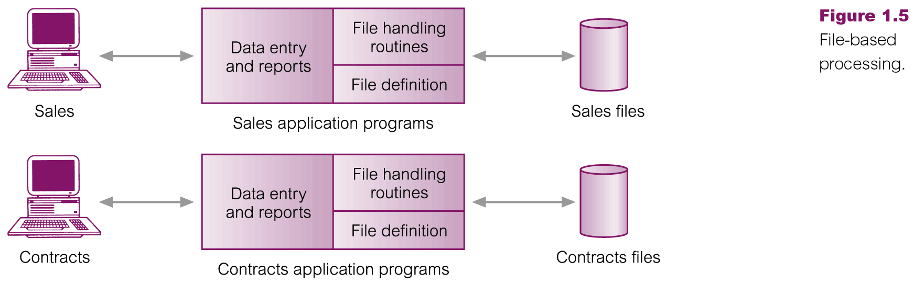
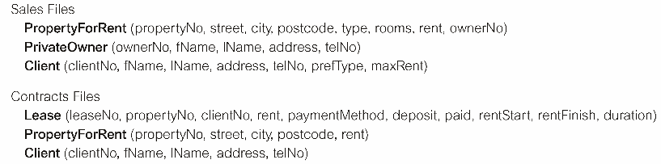
File-Based Processing

Slide 8
Limitations of File-Based Approach
Separation and isolation of data
Each program maintains its own set of data.
Users of one program may be unaware of potentially useful data held by other programs.
Duplication of data
Same data is held by different programs.
Wasted space and potentially different values and/or different formats for the same item.

Slide 9
Limitations of File-Based Approach
Data dependence
File structure is defined in the program code
Program-Data Dependence. File descriptions are stored within each application program that accesses it
Duplication of data
Data integrity problem(ability to force records to be consistent)
Limited data sharing

Slide 10
Database Approach
Came because:
Definition of data was embedded in application programs, rather than being stored separately and independently.
No control over access and manipulation of data beyond that imposed by application programs.
Result:
the database and Database Management System (DBMS).

Slide 11
Database
Shared collection of logically related data (and a description of this data), designed to meet the information needs of an organization.
System catalog (metadata) provides description of data to enable program–data independence.
Logically related data comprises entities, attributes, and relationships of an organization’s information.

Slide 12
Database Management System (DBMS)
A software system that enables users to define, create, maintain, and control access to the database.
(Database) application program: a computer program that interacts with database by issuing an appropriate request (SQL statement) to the DBMS.

Slide 13
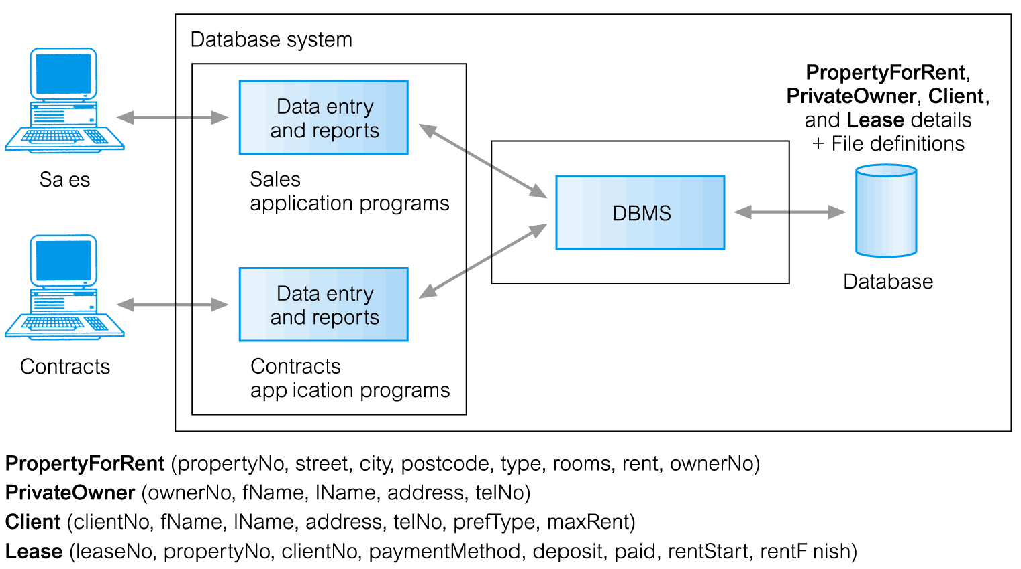
Database Management System (DBMS)

Slide 14
Database Approach
Data definition language (DDL).
Permits specification of data types, structures and any data constraints.
All specifications are stored in the database.
Data manipulation language (DML).
General enquiry facility (query language) of the data.

Slide 15
Database Approach
Controlled access to database may include:
a security system
an integrity system
a concurrency control system
a recovery control system

Slide 16
Views
Allows each user to have his or her own view of the database.
A view is essentially some subset of the database.

Slide 17
Views - Benefits
Reduce complexity
Provide a level of security
Provide a mechanism to customize the appearance of the database
Present a consistent, unchanging picture of the structure of the database, even if the underlying database is changed

Slide 18
Some Advantages of DBMSs
Control of data redundancy
Data consistency
Sharing of data
Improved data integrity
Improved security

Slide 19
Advantages of DBMSs(cont…)
Improved data accessibility and responsiveness
Increased productivity
Improved maintenance through data independence
Increased concurrency
Improved backup and recovery services

Slide 20
Some Disadvantages of DBMSs
Complexity
Size
Cost of DBMS
Additional hardware costs
Higher impact of a failure

