Slide 1
Gesture-Recognition
Instruction
kevin8299

Slide 2
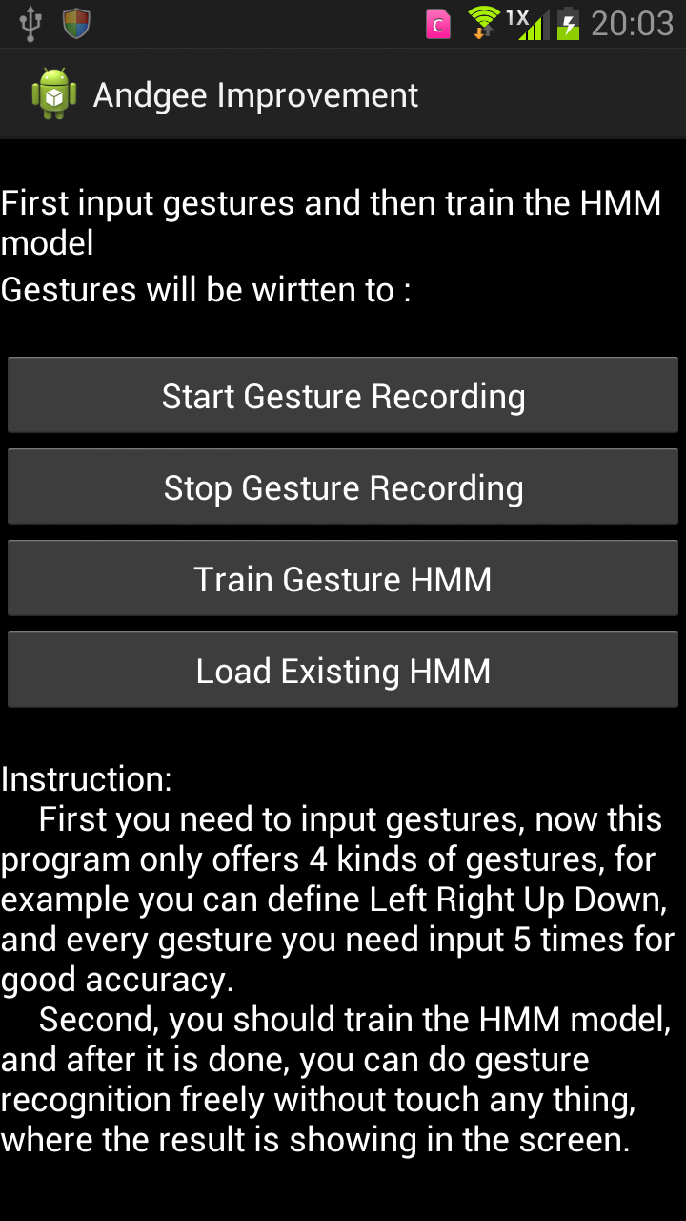
User Interface
This UI mainly contains 4 parts:
Recognized Result
Operation Status
Control Buttons
Instructions

Slide 3
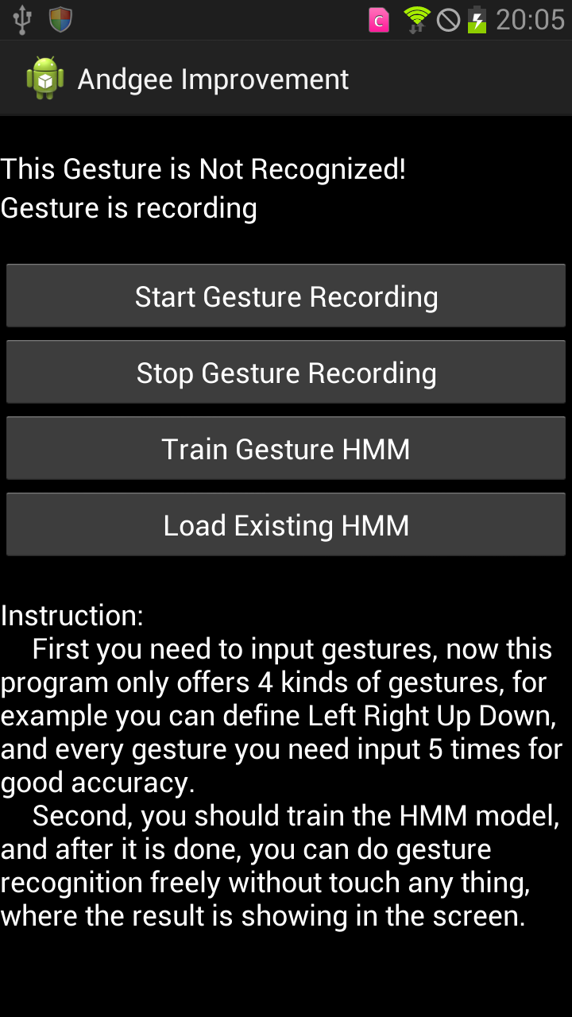
Start Gesture Recording
The “Status” line would indicate “Gesture is recording”

Slide 4
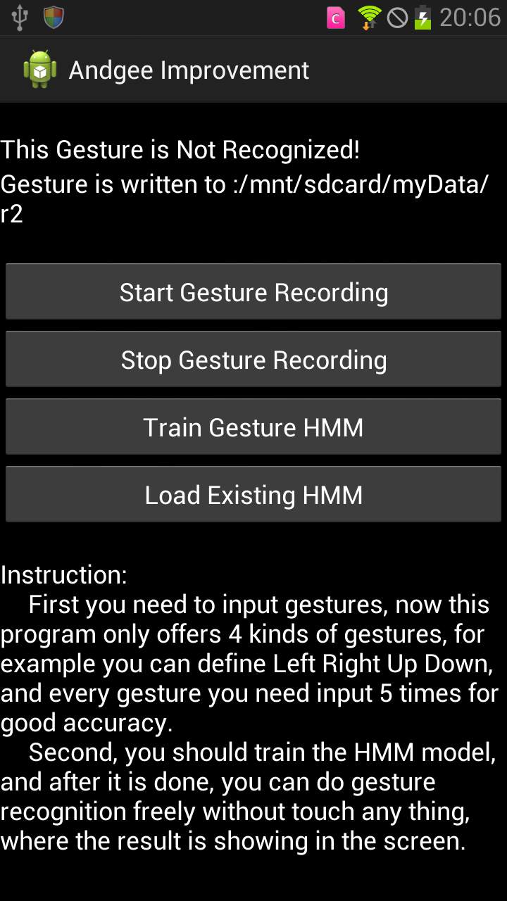

Input Gesture for Model Training
After clicked start button, you can make gestures with the phone, which means you can input 4 kinds of gestures, and every gesture needs 5 repeated input

Slide 5
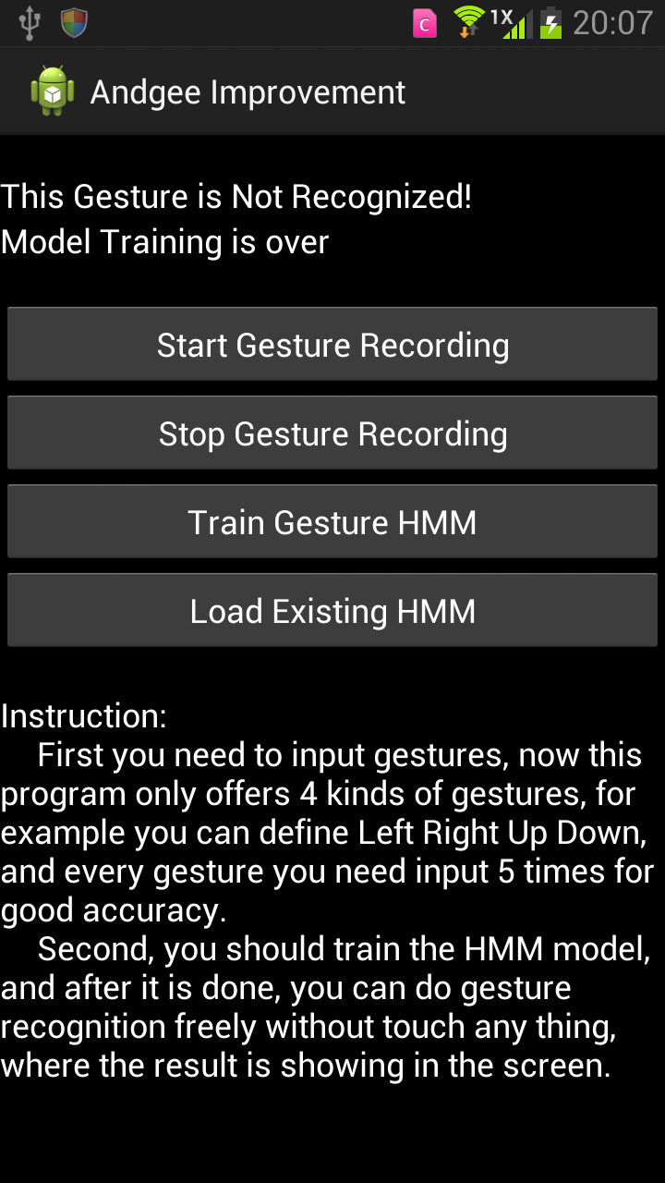
Train Gesture Model
After gesture inputting is over, you can click “Train Gesture HMM” to train models, and “Model Training is over” would show when the training is over.

Slide 6
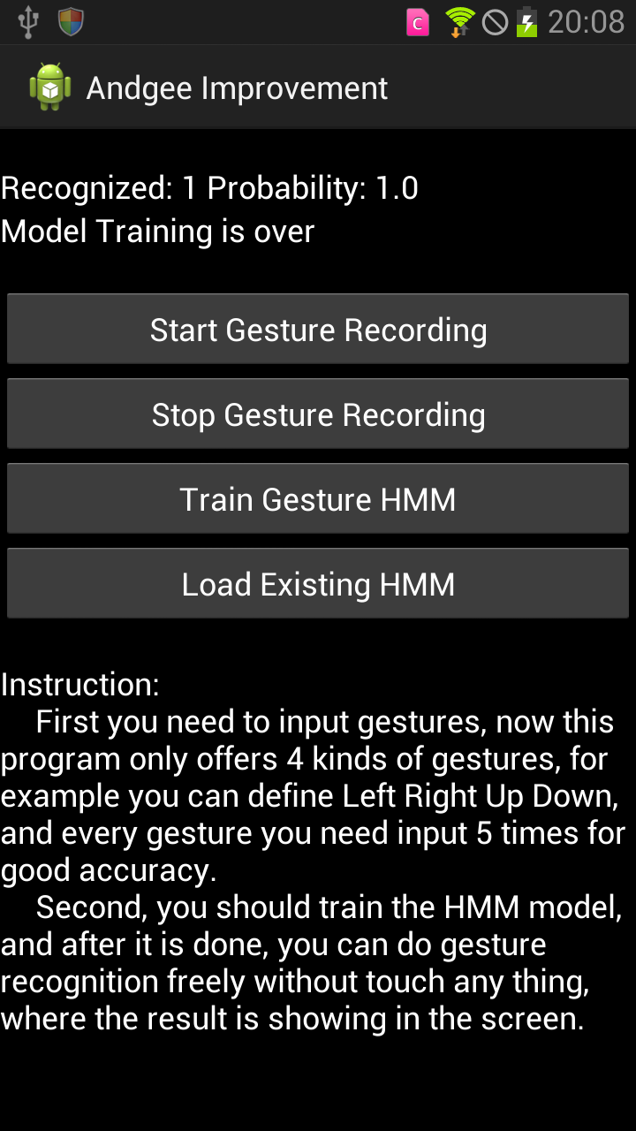
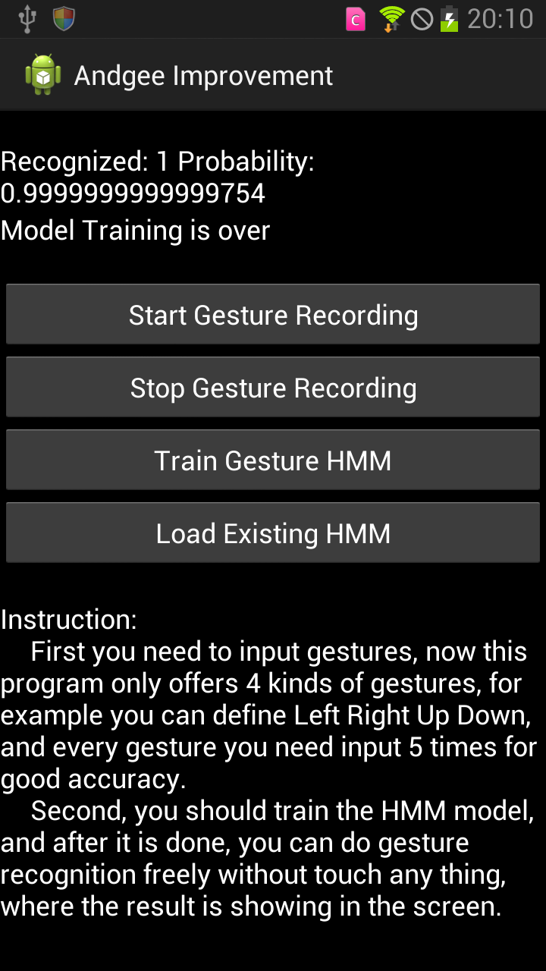
Input Gesture to Do Recognition
When model training is over, you can input gesture for recognition, and the recognized result is shown with the gesture id and its probability. Moreover, if the gesture is not recognized, it would tell you “This gesture is NOT recognized!”

