Slide 1
Temporal-Spatial-Data-Mining
Demo Programs Explanation
kevin8299

Slide 2
In “demo.debug.java” directory, there are 3 demo programs:
Clastering2PolygonDemo
Used to demo clustering algorithm based on density, and finding the polygon and circle that encircles the points cluster
(2) MeaningfulLocationDemo
Used to demo how a meaningful location is generated, based on 2 dimensions: time and distance
(3) PathRelatedDemo
Used to generate path point for different person, which can be used in algorithm debug.

Slide 3
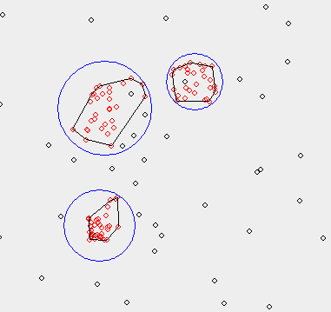
Clastering2PolygonDemo

Slide 4
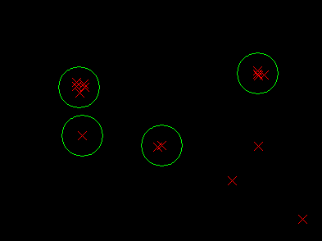
MeaningfulLocationDemo

Slide 5
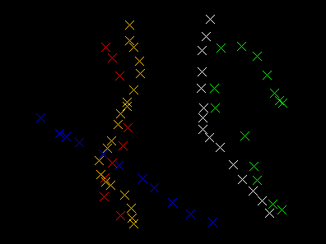
PathRelatedDemo
Here different color means different person

