Slide 1
Instacart Market Basket Analysis
Presenter: 陳彥彣

Slide 2
Data Description
aisles.csv 134 unique id
departments.csv 21 unique id
products.csv 49688 unique id
orders.csv 3421083 orders, 206209 users
order_products__prior.csv 3214874 orders, 49677 products
order_products__train.csv 131209 orders, 39123 products
sample_submission.csv
Sets | Number of orders
prior order | 3214874
train order | 131209
test order | 75000

Slide 3
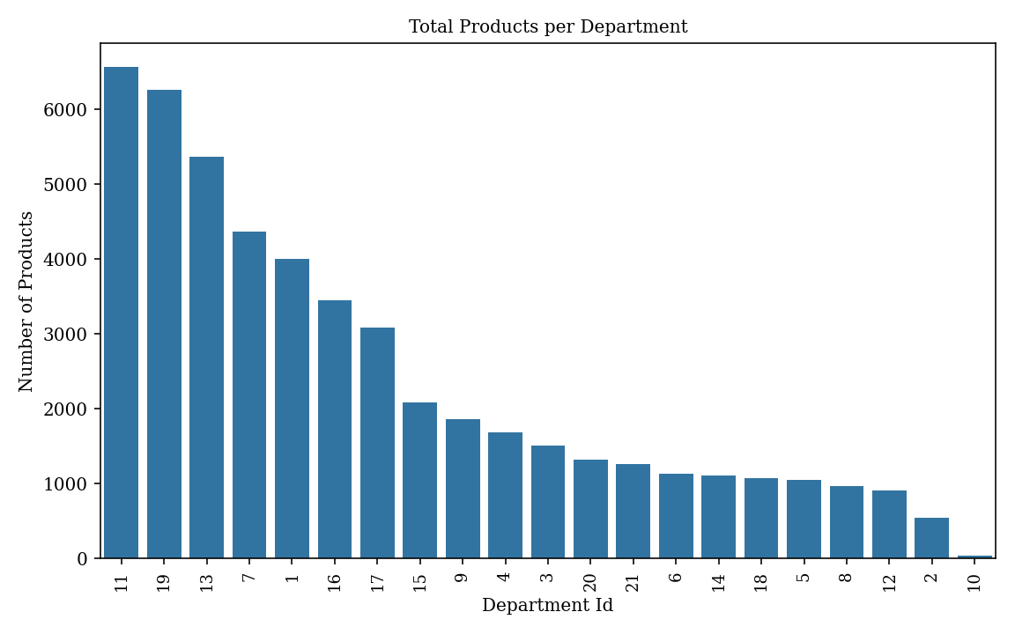
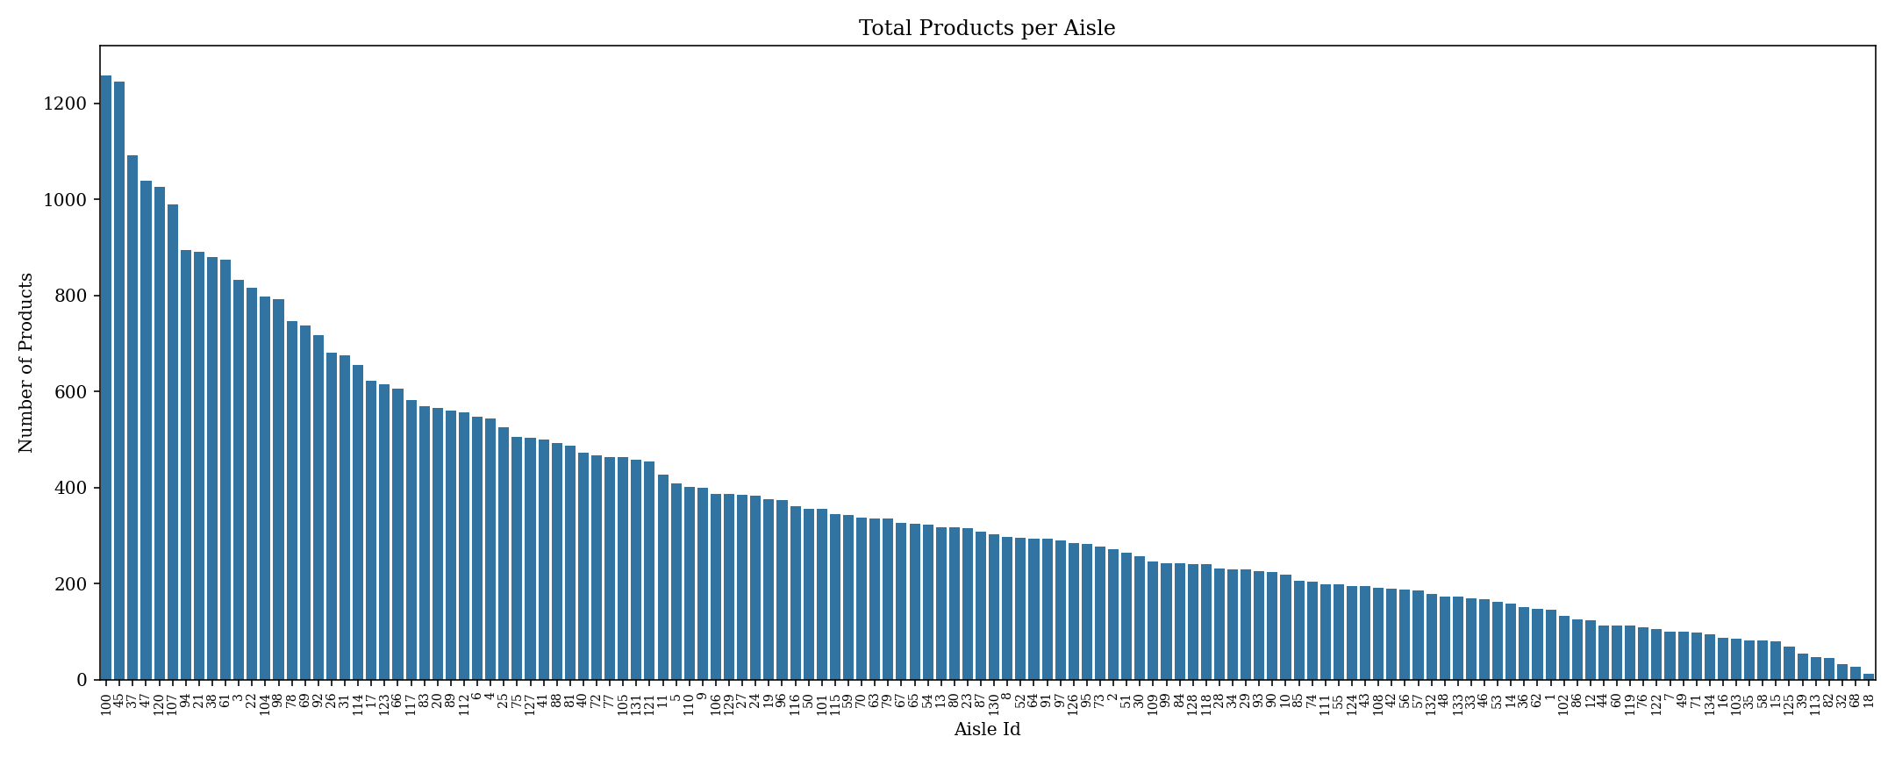
Data Description
aisles.csv
departments.csv
products.csv
orders.csv
order_products__prior.csv
order_products__train.csv
sample_submission.csv

Slide 4
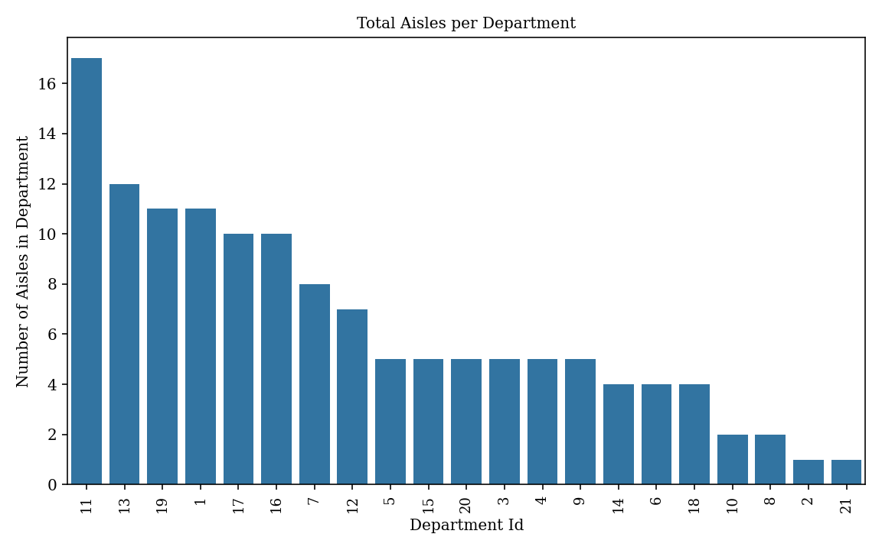
Data Description
aisles.csv
departments.csv
products.csv
orders.csv
order_products__prior.csv
order_products__train.csv
sample_submission.csv

Slide 5
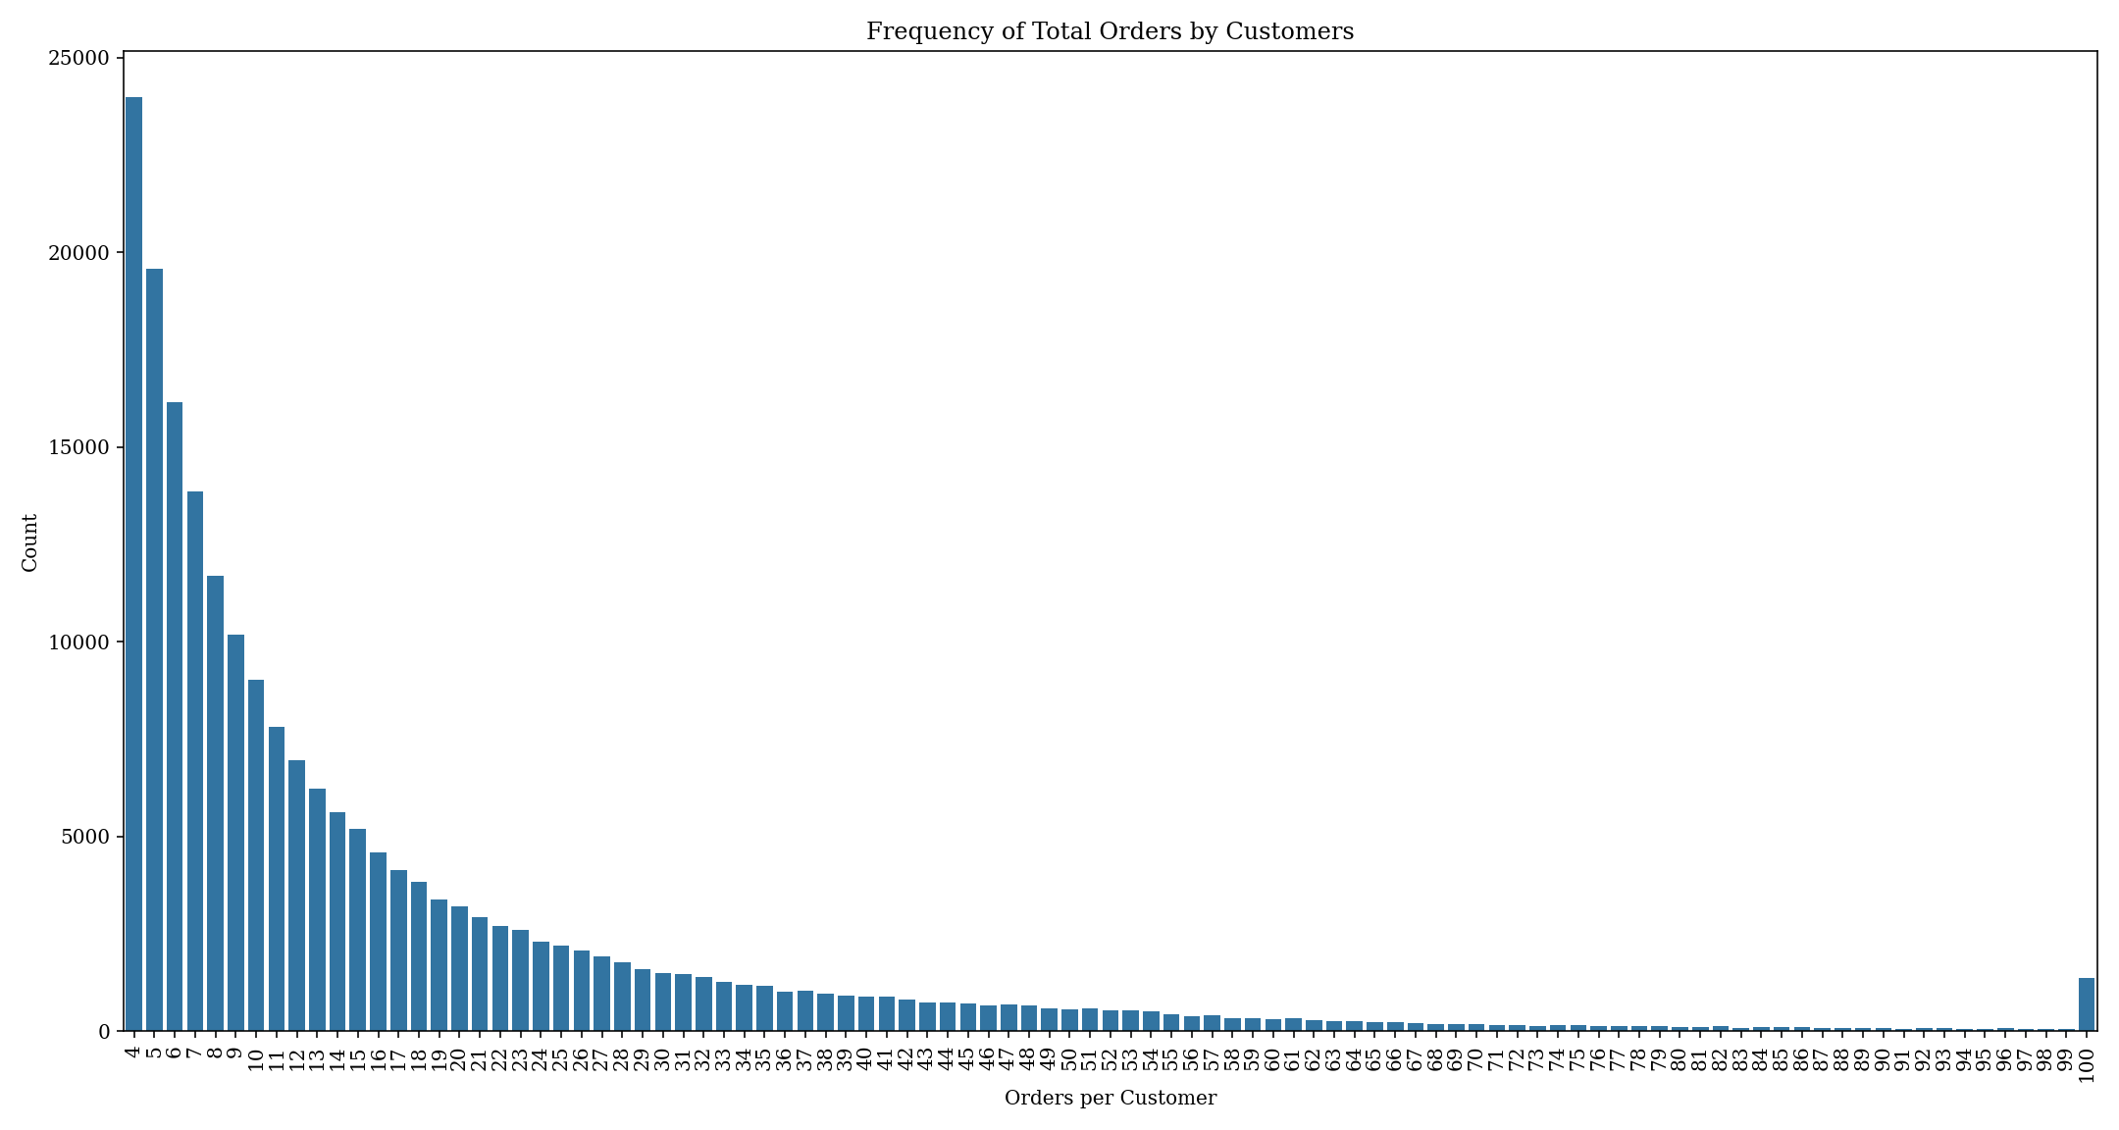
Data Description
aisles.csv
departments.csv
products.csv
orders.csv
order_products__prior.csv
order_products__train.csv
sample_submission.csv

Slide 6
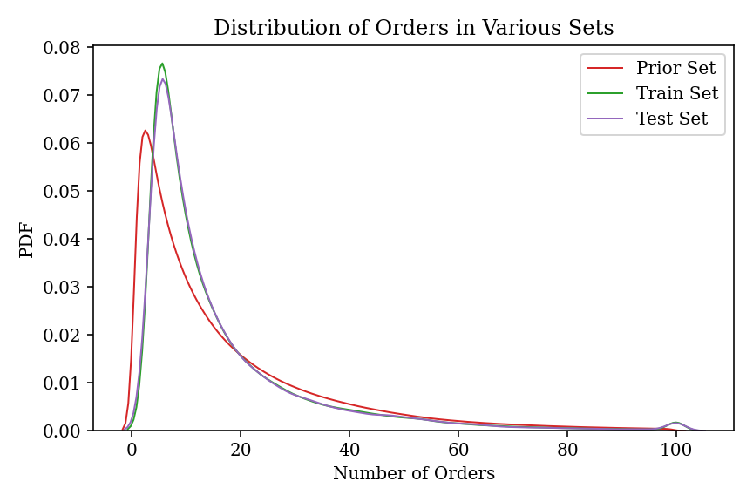
Data Description
aisles.csv
departments.csv
products.csv
orders.csv
order_products__prior.csv
order_products__train.csv
sample_submission.csv

Slide 7
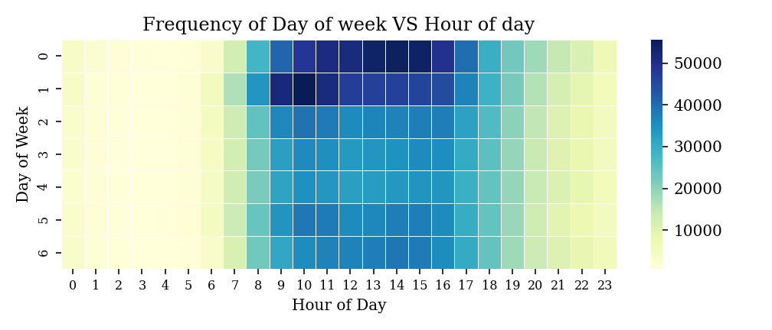
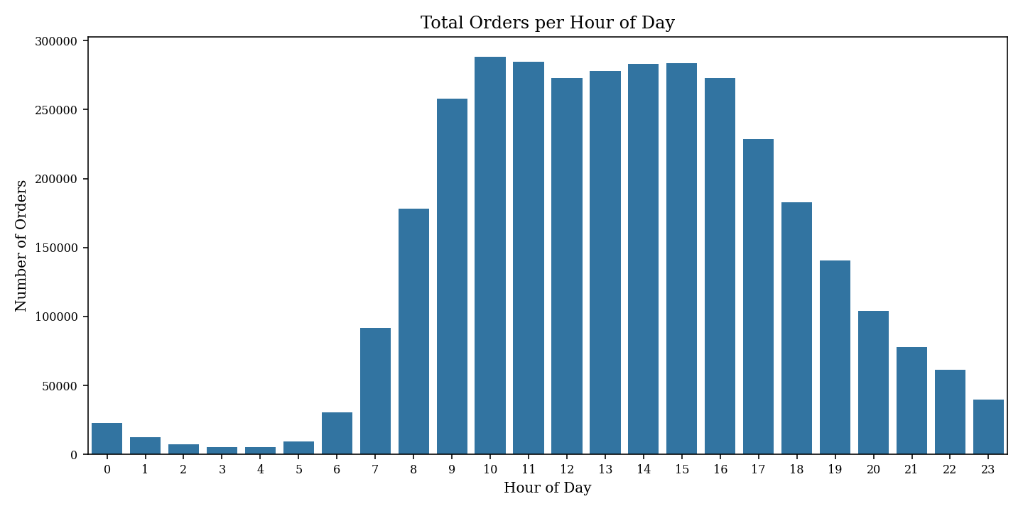
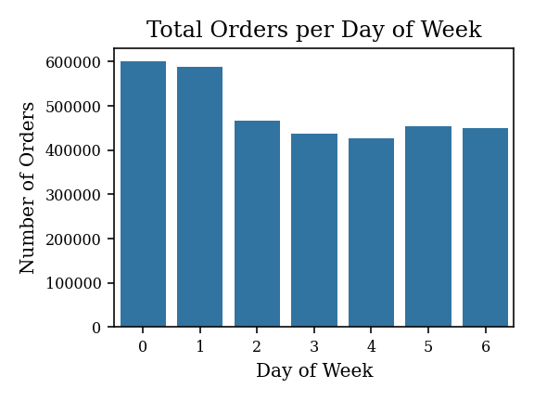
Data Description
aisles.csv
departments.csv
products.csv
orders.csv
order_products__prior.csv
order_products__train.csv
sample_submission.csv

Slide 8
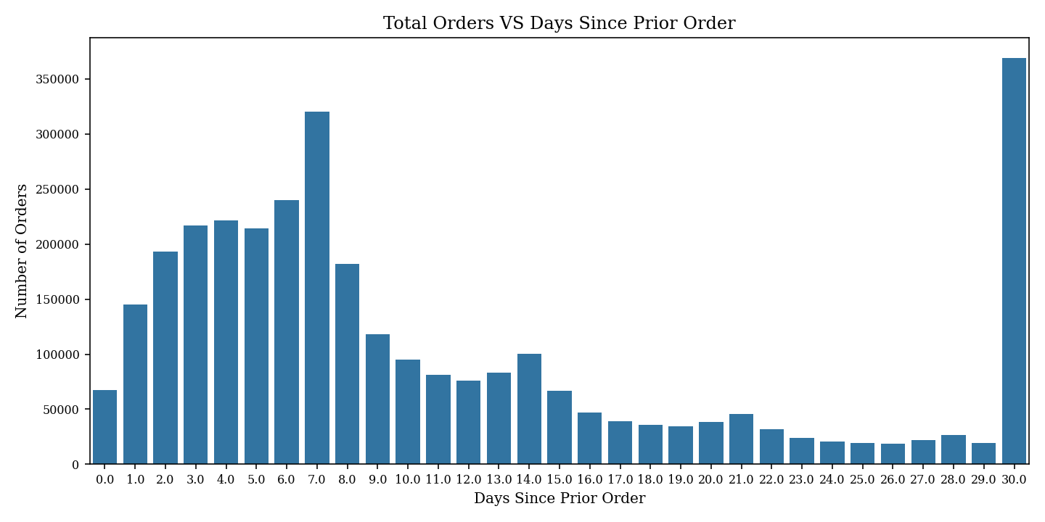
Data Description
aisles.csv
departments.csv
products.csv
orders.csv
order_products__prior.csv
order_products__train.csv
sample_submission.csv

Slide 9
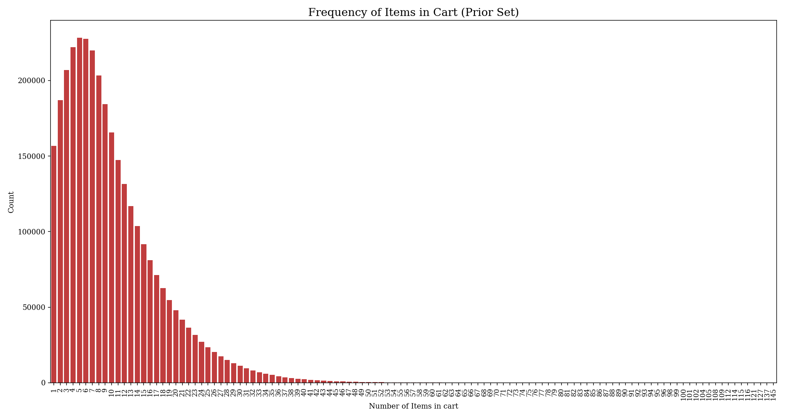
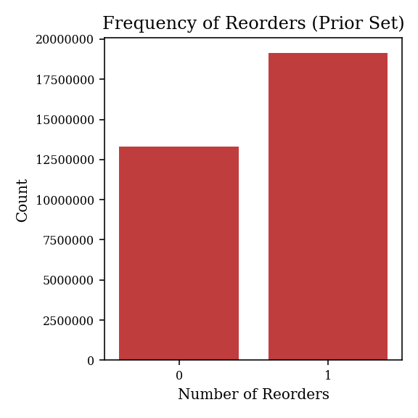
Data Description
aisles.csv
departments.csv
products.csv
orders.csv
order_products__prior.csv
order_products__train.csv
sample_submission.csv

Slide 10
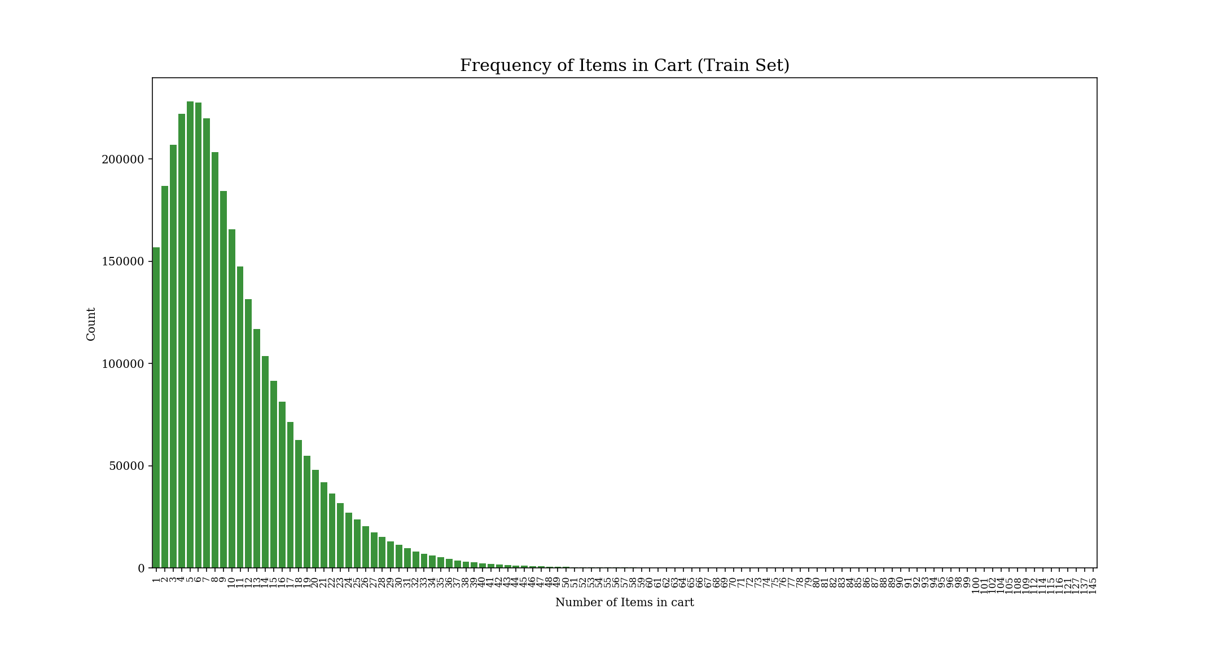
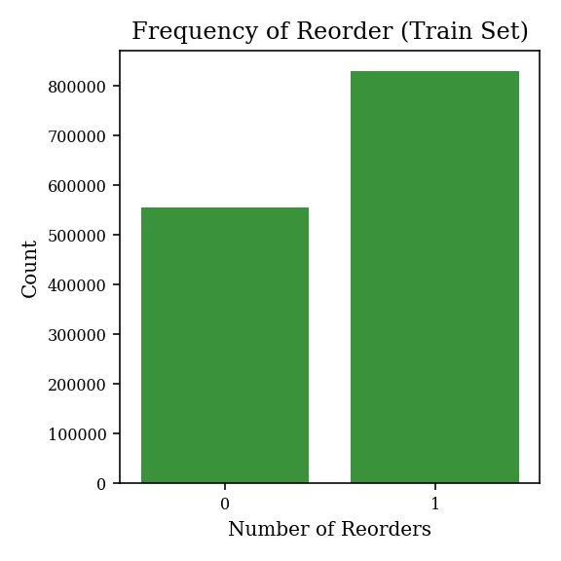
Data Description
aisles.csv
departments.csv
products.csv
orders.csv
order_products__prior.csv
order_products__train.csv
sample_submission.csv

Slide 11
Features
Aisle
Department
Product
User
Binary encoding

Slide 12
Features
Aisle
Department
Product
User
Average and std of add-to-cart order
Ordered frequency
Reordered frequency
Percentage of reordering
Total unique users
Percentage of repeat customers

Slide 13
Features
Aisle
Department
Product
User
Average and of std day-of-week of order
Average and of std hour-of-day of order
Average and of std days-since-prior-order
Total orders
Total products ordered
Total unique products ordered
Total products reordered
Percentage of overall reordered products
Average order size
Mean of reordered items of all orders

Slide 14
Instacart Market Basket Analysis
Presenter: 陳彥彣

