Slide 1
Big Data Analytics
e
GPU Cloud/Spark/Scikit-Learn

Slide 2
Agenda
GPU Cloud
Login
Create Container
Jupyter Lab
SSH
SFTP
Spark
Introduction
MLib
Demo
Scikit-Learn

Slide 3
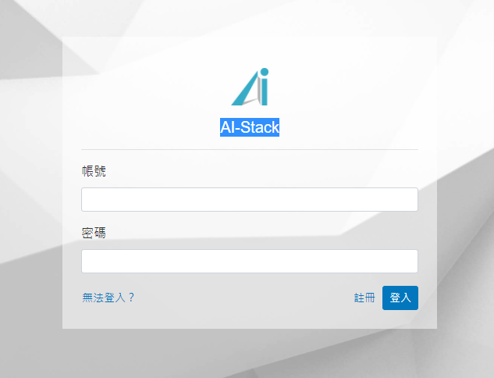
GPU Cloud
Login
校外需登入VPN (https://net.nccu.edu.tw/sslvpn/)
Login (http://140.119.24.115:8080/)
帳號:
Team1: ai-sec10
Team2: ai-sec2
Team3: ai-sec3
….
Team9:ai-sec9
密碼 nccu@0708(預設)

Slide 4
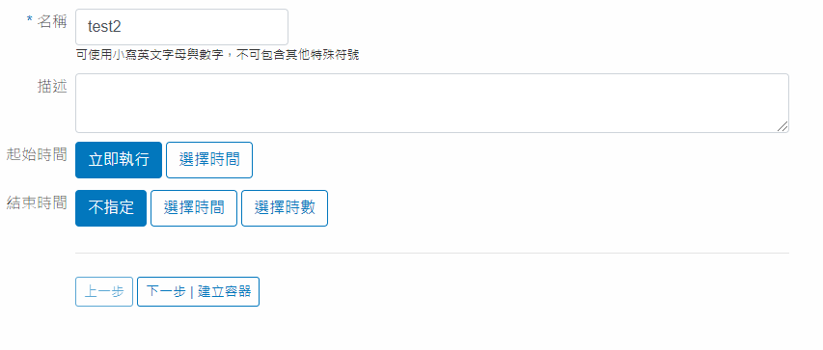
GPU Cloud
Create Container
機器學習服務->建立容器 (同時僅能建立一組容器)
輸入名稱
下一步

Slide 5
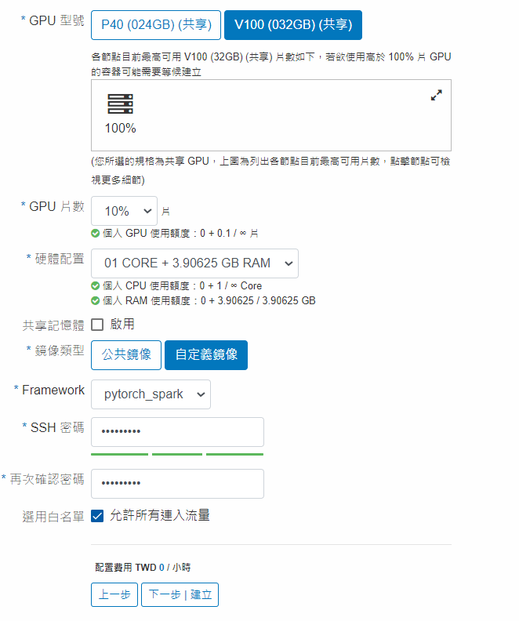
GPU Cloud
Create Container cont.
選擇GPU (V100有較多記憶體)
選擇鏡像類型 (自定義鏡像)
Frame: (擇一) 自定義：pytorch_spark (Pytorch+Spark) 公共鏡像: pytorch/tensorflow
輸入SSH 密碼
下一步

Slide 6
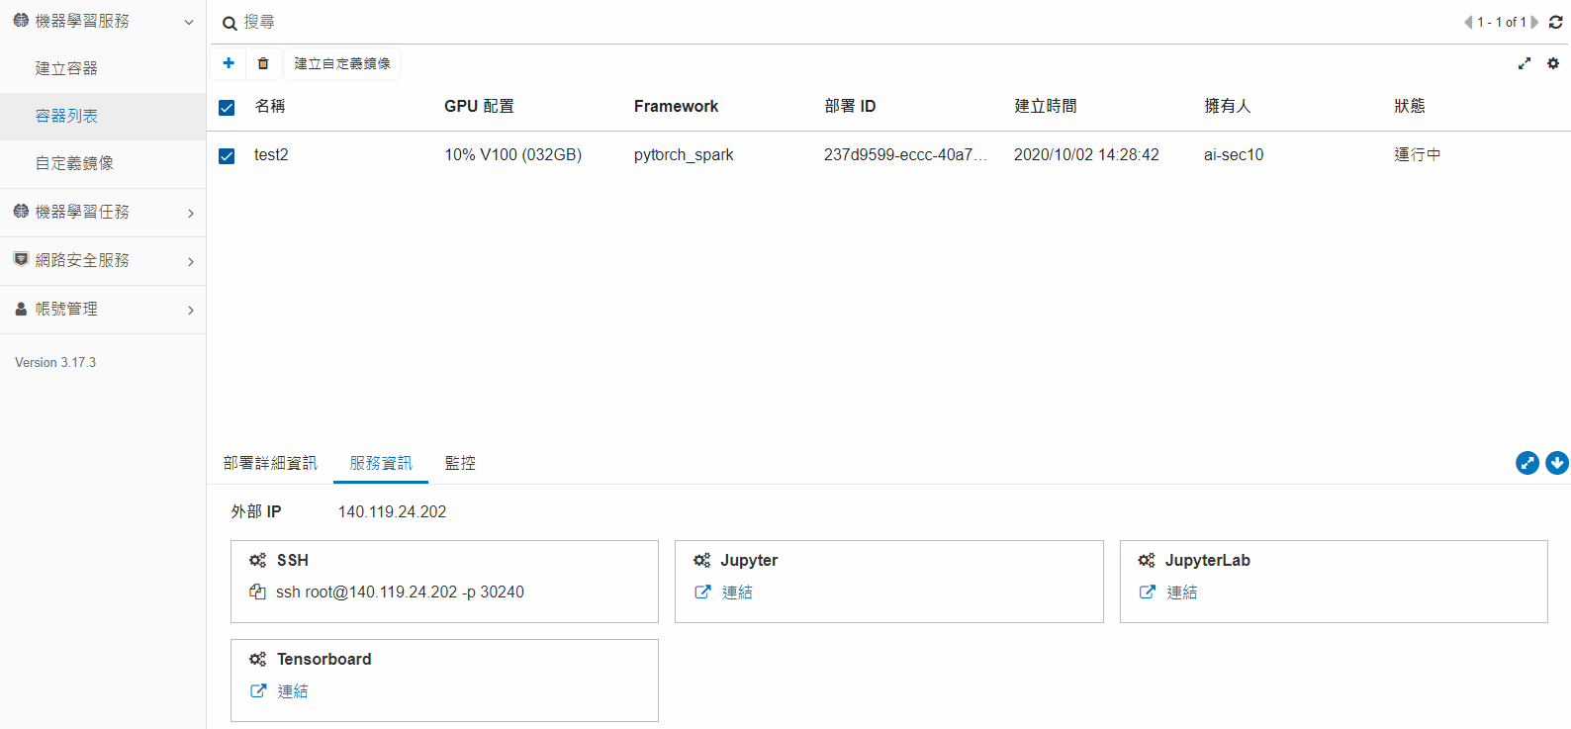
GPU Cloud
List Service Information
機器學習服務->容器列表->服務資訊

Slide 7
GPU Cloud
Jupyter Lab
Open Service Information
Click JupyterLab

Slide 8
GPU Cloud
SSH (Secure Shell)
Tool: Putty (https://www.putty.org/)
Open Service Information
Use IP and Port based on SSH setting in Service Information 140.119.24.202 –p 30240 means IP:140.119.24.202 Port:30240
User: root
Password: The password used during Create Container

Slide 9
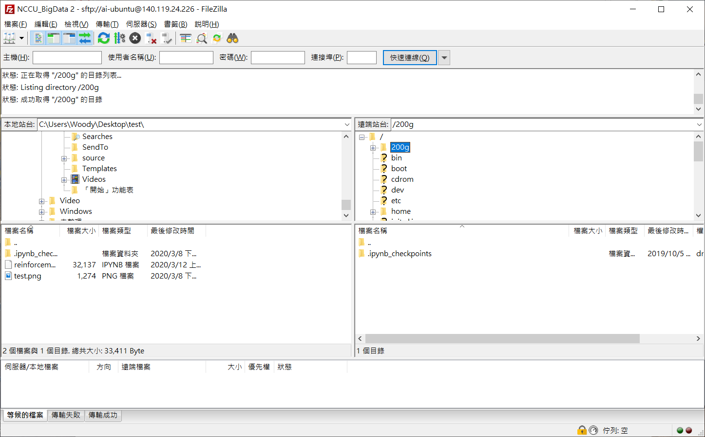
GPU Cloud
SFTP
Tool: FileZilla (https://filezilla-project.org/)
Protocol: SFTP – SSH File Transfer Protocol
Use IP and Port based on SSH setting in Service Information 140.119.24.202 –p 30240 means IP:140.119.24.202 Port:30240
User: root
Password: The password used during Create Container
JupyterLab workspace located under /nfs/Workspace

Slide 10
Spark
Introduction
Apache Spark is a lightning-fast cluster computing technology, designed for fast computation.
The main feature of Spark is its in-memory cluster computing that increases the processing speed of an application.
Spark SQL
Spark Streaming
Mlib
(machine learning)
GraphX
(graph)
Apache Spark Core

Slide 11
Spark
MLib
MLib is Spark’s machine learning (ML) library. Its goal is to make practical machine learning scalable and easy.
ML Algorithms: common learning algorithms such as classification, regression, clustering, and collaborative filtering
Featurization: feature extraction, transformation, dimensionality reduction, and selection
Pipelines: tools for constructing, evaluating, and tuning ML Pipelines
Persistence: saving and load algorithms, models, and Pipelines
Utilities: linear algebra, statistics, data handling, etc.
DataFrame-based API is primary API
RDD-based APIs in the spark.mllib package have entered maintenance mode
https://spark.apache.org/mllib/
https://spark.apache.org/docs/latest/ml-guide.html

Slide 12
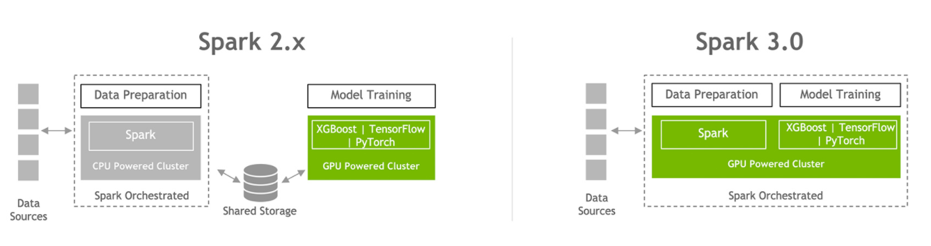
Spark
GPU-Accelerated Apache Spark
https://www.nvidia.com/en-us/deep-learning-ai/solutions/data-science/apache-spark-3/

Slide 13
Spark
Installation (Not needed if using pytorch_spark container)
#install Java and Scala
apt-get -qq install openjdk-8-jdk
apt-get -qq install scala
#install Spark
wget https://downloads.apache.org/spark/spark-3.0.1/spark-3.0.1-bin-hadoop2.7.tgz -nc
mkdir /opt/apache-spark
tar xvf spark-3.0.1-bin-hadoop2.7.tgz -C /opt/apache-spark
#update .bashrc
echo '#Spark' >> ~/.bashrc
echo 'export SPARK_HOME=/opt/apache-spark/spark-3.0.1-bin-hadoop2.7' >> ~/.bashrc
echo 'export PATH=$PATH:$SPARK_HOME/bin' >> ~/.bashrc
source ~/.bashrc
#install findspark
python -m pip install findspark

Slide 14
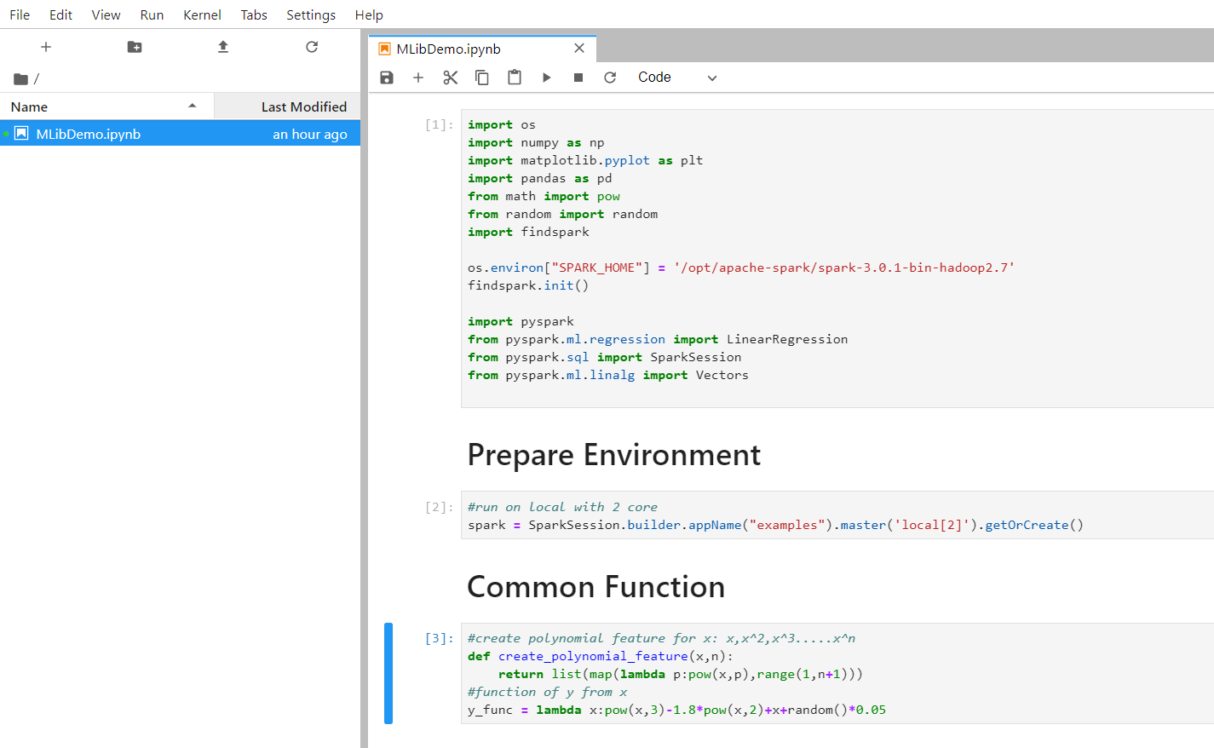
Spark
Demo (LinearRegression)
Download MLibDemo.ipynb (https://1drv.ms/u/s!Arc322XQP_SVh6Ng8FgFP10Hz5UkFQ?e=3v67Ne)
Open JupyterLab
Drag or upload MLibDemo.ipynb to JupyterLab
Open MLibDemo.ipynb

Slide 15
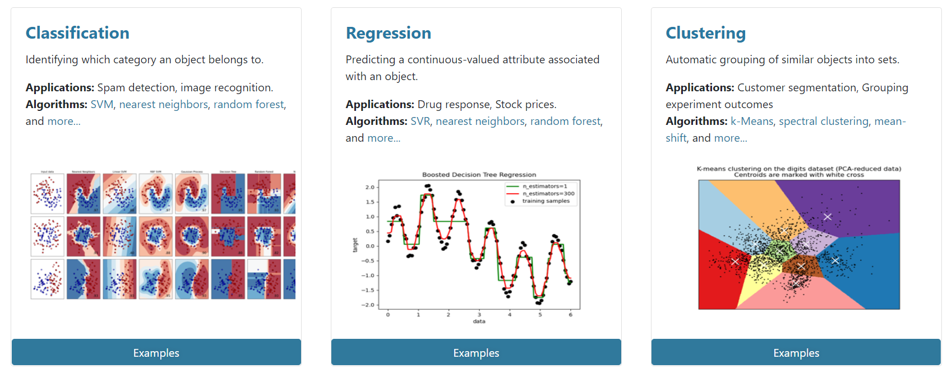
Scikit-Learn
Machine Learning in Python
https://scikit-learn.org/stable/

