Slide 1
Real-time video object tracking
Computer Vision Prototype for Aircraft Localization
Medina García, Kevin
09 February 2026

Slide 2
Context
Problem Statement and Project Objectives

Slide 3
Context
01
Current Situation
02
Problem Statement
03
Project Objectives
Offline post-processing of flight test video sequences
Operators manually select critical aircraft points: nose, antennas, etc.
Used to calculate the closure rate (Cv) during air-to-air refueling maneuvers
This process is time-consuming, operator-dependent and not scalable.
Tracking 2D points under variable lightning, perspective changes and partial occlusions
Not compatible with real-time operation workflows
Automatically detect and localize critical aircraft keypoints
Replace manual post-processing with an automated workflow
Develop a real-time object tracking prototype

Slide 4
Object Detection
Evaluating Modern Techniques in Aircraft Recognition

Slide 5
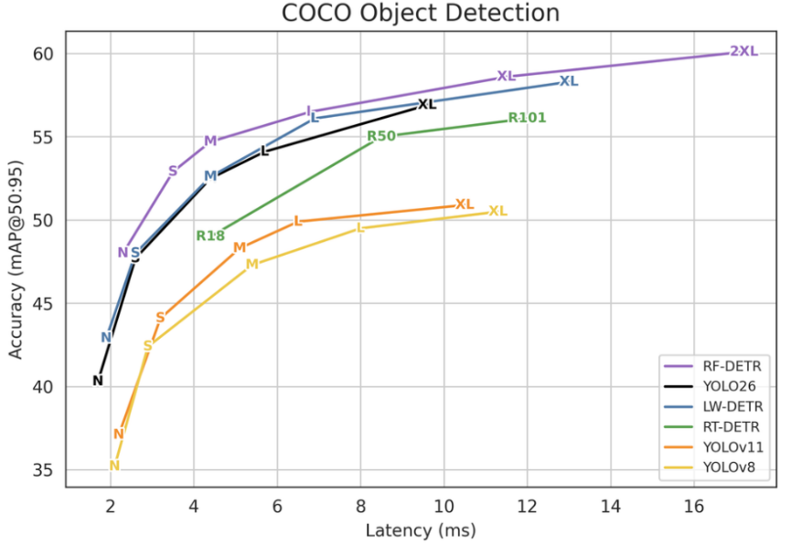
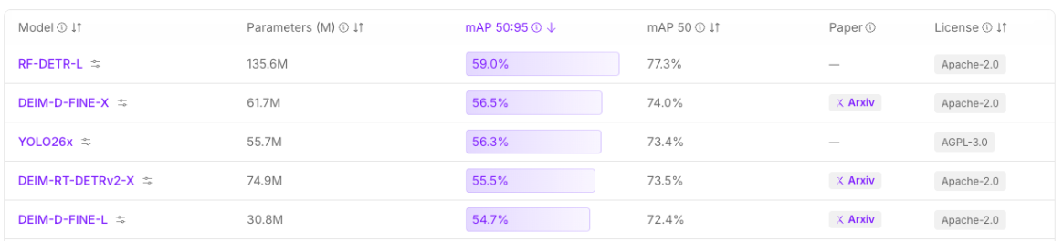
Architectural Overview & Benchmarking
YOLO (CNN/Hybrid)
D-FINE (Transformer-based)
RF-DETR (Re-frame DETR)
Treats detection as a single regression problem
Knows for being extremely fast and efficient
Uses transformers to understand the whole image
Better at cutting the exact edges of an object
State-of-art, one of the most advanced models available
Specialized in small object detection

Slide 6
Video Analysis
YOLO26x
D-FINE-X-large
RF-DETR-large (2026)

Slide 7
Object Segmentation
Precise Mask Generation for Aircraft Identification

Slide 8
Architectural Overview & Benchmarking
DeepLab (CNN-Based)
YOLO (CNN/Hybrid)
SAM (Transformer-based)
Uses a CNN backbone to capture context
It’s a solid baseline that focuses on semantic segmentation
Uses CNN for speed and a specialized head for instance segmentation
With fine-tunning, learns the exact geometry of the aircraft
A foundational model built entirely on Vision Transformers (ViT)
It has Zero-Shot capabilities, meaning it can segment anything
Metric | DeepLab v3 | YOLO26x | SAM3
Precision (Map 50-95) | ~66-68% (uses mIoU) | 57.5% | ~42-45%
Latency (Inference) | ~50–300 ms | 11.8 ms | 2500 ms
Parameters | ~24 M | 55.7 M | 310 M
Architecture | Encoder + ASPP + Decoder | NMS-Free / End-to-End | Prompt-based Decoder

Slide 9
Video Analysis
DeepLab v3
YOLO11x-seg
SAM3

Slide 10
Keypoints Detection
High-Precision Localization of Critical Components (Nose & Antennas)

Slide 11
Architectural Overview & Benchmarking
SIFT (Gradient-based)
FAST (Heuristics/Decision Tree)
ORB (CNN-based)
Superpoint (Fully CNN)
Uses local gradient histograms to ensure points are uniquely identifiable
High accurate but computationally expensive for real-time applications
Identifies keypoints by comparing a central pixel against a circular neighbourhood
Keypoints identification is quickly but requires an external descriptor
Combines FAST detection with a modified BRIEF descriptor
Allows reliable tracking even as the aircraft changes perspective
State of art that uses a deep convolutional network to detect keypoints and descriptors
Learns high-level features that are more stable for complex structures
 | SIFT | FAST | ORB | Superpoint
Robustness/Accuracy | Excellent (Classic Standart) | Low (Sensitive to noise) | Balanced (Real-time) | High (State of art)
Speed (ms) | ~100-200+ ms | ~1-5ms | ~17ms | ~13ms on GPU
Typical Use | Photogrammetry and Offline processing | Simple Sensors | SLAM and Mobile Devices | Modern SLAM and Vision Transformers

Slide 12
Video Analysis
SIFT
FAST
ORB
Superpoint

Slide 13
Pipeline
<insertar pipeline>

